Slide 1
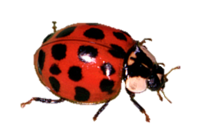
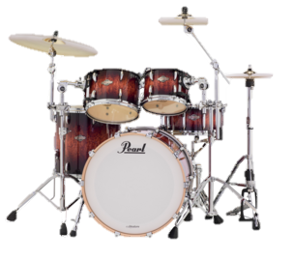
PROJECT 4: Percussion Pal drum machine
John McCain, Audrey Evans, Alan Wang, Hari Ramanan

Slide 2
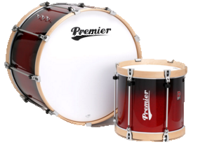
Project Demo

Slide 3
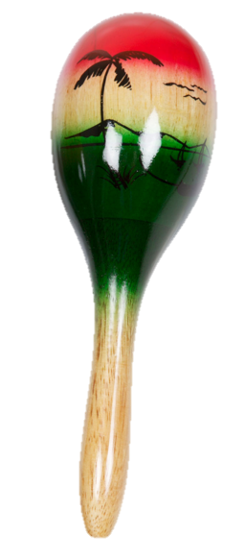
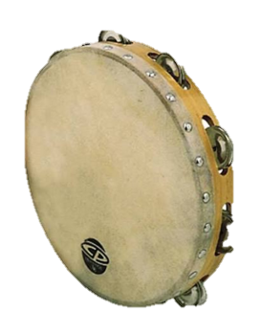
Known and Current Bugs

Slide 4
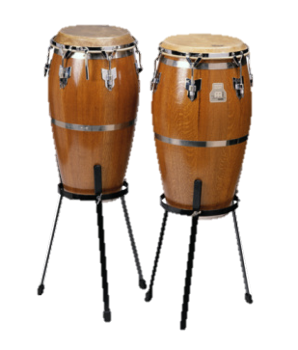
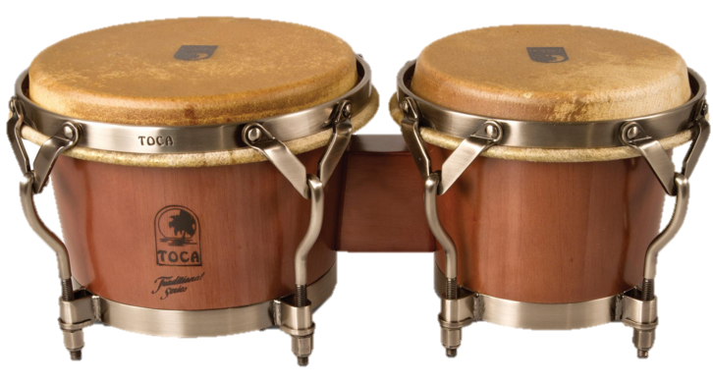
Deployment Plan
Initial development
Advertisements
Facebook
demographic
Copyright/legal issues
Instrument recording
Hosting servers and website url

Slide 5

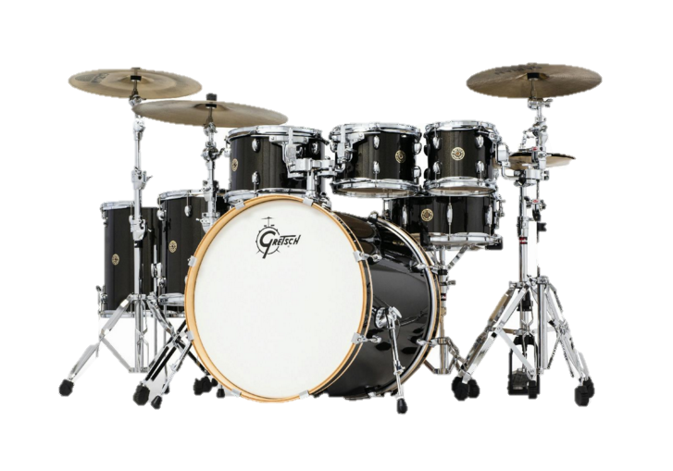
Maintenance Plan
People/staff
John, Hari, Audrey, Alan
Secretary
accountant
Advertising
Servers, domain names
Patron/benefactor option

Slide 6
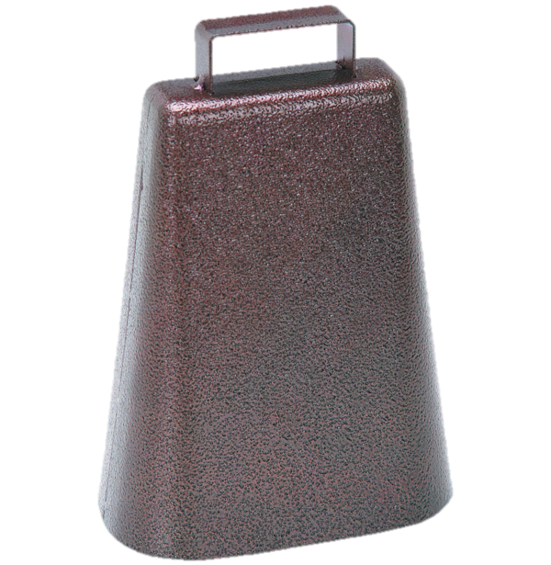
Work Allocation

