Slide 1
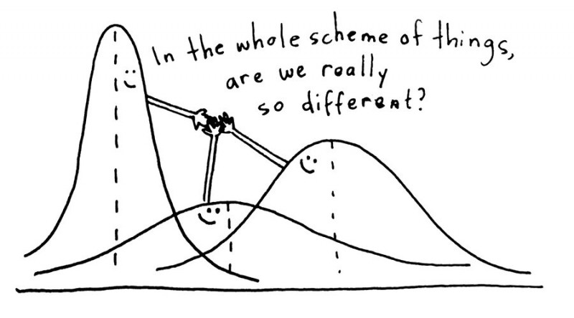
Analysis of Variance
Credit: https://www.questionpro.com/blog/anova-testing/

Slide 2
Analysis of Variance
Standard hypothesis testing is great for comparing two statistics, θ₁ and θ₂.
What is we have more than two statistics to compare?
Use “one-way” analysis of variance (ANOVA)
Note that the statistics to be compares must all be of the same type
Usually the statistics we want to “compare” in the sciences are averages between different treatments

Slide 3
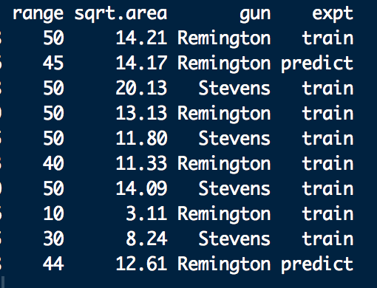
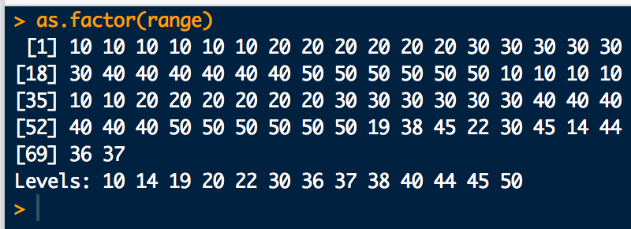
Analysis of Variance
Experiment: understand how inputs (explanatory variables) affect outputs (responses)
Treatments: the input variables.
Typically, discrete factors with a finite number of levels
dafs shotgun.df
“gun” is a factor with levels: Remington
Stevens
“range” is a factor with levels:

Slide 4
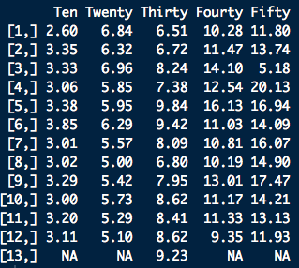

Analysis of Variance
“range” is the treatment
Index is i, column number in this case
# replicates per treatment is 12 or 13
Index is j, row number in this case
we’ll want to see if these are “statistically” the same or if there is evidence that they are different

Slide 5
Analysis of Variance
Population mean
Difference between the population mean and the mean for each treatment

Slide 6
Analysis of Variance
Assume:
Also assumes variance is constant across treatments
ANOVA
x_{ij}=0 or 1
X is the
“model matrix”
Linear Regression
Equivalence:

Slide 7
Analysis of Variance
H₀ for “means” ANOVA
The treatment means being compared are not statistically different at the (1-α)×100% level of confidence
H_{a} for “means” ANOVA
At least one of the treatment means being compared is statically distinct from the others.
ANOVA computes an F-statistic from the data and compares to a critical F_{c} value for
Level of confidence
D.O.F. 1 = # of treatments -1
D.O.F. 2 = # of obs. - # of treatments

Slide 8
Analysis of Variance: Intuition
For each treatment i, differences from the overall average are indicators of differences among the μ_{i}!^{Vardeman,Jobe}
The F-statistic compares the (weighted) average of squared treatment deviations to the average of overall squared deviations
More precisely, the F-statistic is the ratio of the mean squared treatment deviations (mean “variation” between treatments, MSB) to the mean squared deviation within treatments (mean “variation” between treatments, MSW)
Sometimes MSB is called mean treatment “variation”, MST
Sometimes MSW is called mean “variation” error within treatments, MSE

Slide 9
Analysis of Variance: Calculation
MSB can be computed as:
#treatments
total sample average
treatment sample
average
#treatments
#samples
per treatments
Sum Squared Deviations Between Treatments, SSB
MSW can be computed as:
#treatments
#samples
per treatments
treatment sample
average
#samples
data
Sum Squared Deviations Within Treatments, SSW

Slide 10
Analysis of Variance: Calculation
A nice way to organize the calculations is with an ANOVA table:
Sources | Degrees of Freedom | Sum Squares | Mean Sum Squares | F-statistic | p-value
Treatments | k-1 | SSB | MSB = SSB/(k-1) | F = MSB/MSW | 1 - pf(F, k-1, n-k)
Error | n-k | SSW | MSW = SSW/(n-k)
Total | n-1 | SST

Slide 11
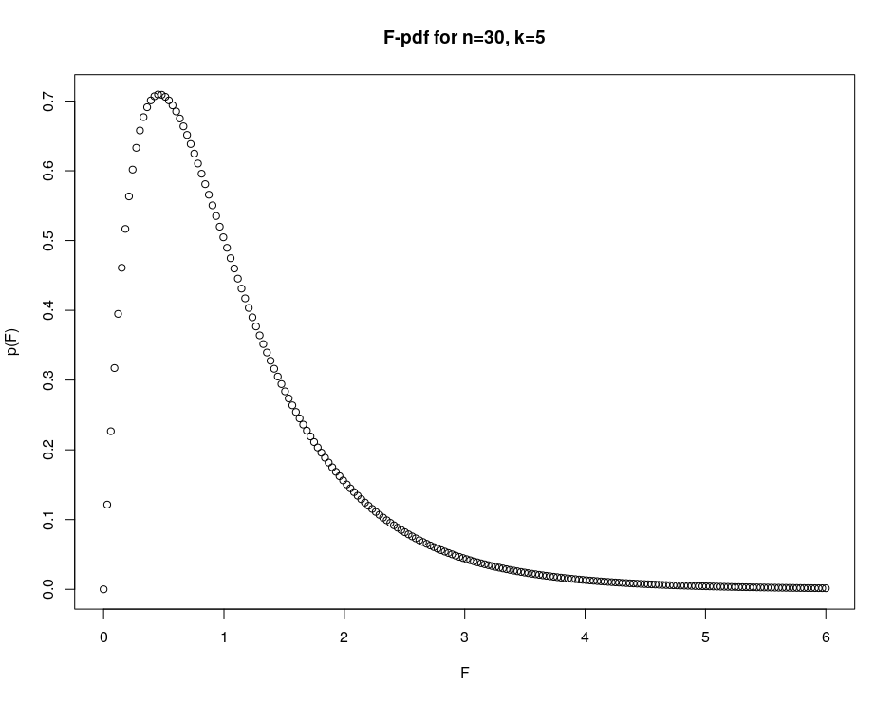
What an could F-pdf look like
n <- 30 # Number of samples
k <- 5 # Number of treatments
x <- seq(0,6,length.out = 200)
y <- df(x, df1 = k-1, df2 = n-k)
plot(x,y, xlab="F", ylab = "p(F)", main="F-pdf for n=30, k=5")

Slide 12
Example
Consider the GSR (square-root) area as a function of range below:
10 feet
20 feet
30 feet
40 feet
50 feet
2.60, 3.35, 3.33, 3.06, 3.38, 3.85, 3.01, 3.02, 3.29, 3.00, 3.20, 3.11
6.84, 6.32, 6.96, 5.85, 5.95, 6.29, 5.57, 5.00, 5.42, 5.73, 5.29, 5.10
6.51, 6.72, 8.24, 7.38, 9.84, 9.42, 8.09, 6.80, 7.95, 8.62, 8.41, 8.62, 9.23
10.28, 11.47, 14.10, 12.54, 16.13, 11.03, 10.81, 10.19, 13.01, 11.17, 11.33, 9.35
11.80, 13.74, 5.18, 20.13, 16.94, 14.09, 16.07, 14.90, 17.47, 14.21, 13.13, 11.93
Use ANOVA to test for evidence of a significant difference between at least one of the treatment means

Slide 13
Example
# Data (responses)
y10 <- c(2.60,3.35,3.33,3.06,3.38,3.85,3.01,3.02,3.29,3.00,3.20,3.11)
y20 <- c(6.84,6.32,6.96,5.85,5.95,6.29,5.57,5.00,5.42,5.73,5.29,5.10)
y30 <-c(6.51,6.72,8.24,7.38,9.84,9.42,8.09,6.80,7.95,8.62,8.41,8.62,9.23)
y40 <- c(10.28,11.47,14.10,12.54,16.13,11.03,10.81,10.19,13.01,11.17,11.33,9.35)
y50 <- c(11.80,13.74, 5.18,20.13,16.94,14.09,16.07,14.90,17.47,14.21,13.13,11.93)
y <- c(y10, y20, y30, y40, y50)
# Treatment labels for each data point
lbl.treat <- factor(c(
rep(10,length(y10)),
rep(20,length(y20)),
rep(30,length(y30)),
rep(40,length(y40)),
rep(50,length(y50))
))
lbl.treat

Slide 14
Example
# Take a look at the data first:
m <- mean(y) # Grand average
m.treat <- c( # Treatment averages
mean(y10),
mean(y20),
mean(y30),
mean(y40),
mean(y50)
)
m
m.treat
boxplot(y ~ lbl.treat, range=0 ) # Box plots
points(1:5, m.treat, pch=16, col="red") # Put in treatment avgs
abline(a = m, b = 0) # Grand avg
# R can handle all the ANOVA calculations automatically:
fit <- lm(y ~ lbl.treat)
anova(fit)

Slide 15
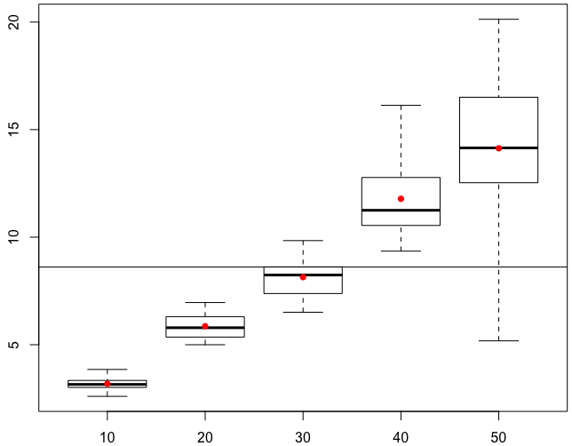
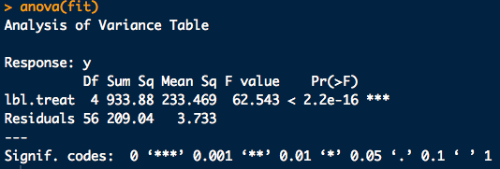
Example

Slide 16
Post Hoc Testing
If ANOVA returns a significant result, it makes sense to ask which means may be statistically different than the rest.
A way to accomplish this is to do pair-wise hypothesis tests on all pairs of treatment averages to see if the Null (μ_{A}-μ_{B} = 0) may be rejected.
The problem is, using regular t-tests the probability of falsely rejecting the Null is α.
For n-treatments there are _{n}C₂ pair-wise t-tests to perform, so the our level of confidence in _{n}C₂ simultaneous t-tests is at-least:
For 5-treatments, our overall confidence in all 10, 95% confidence t-tests would only be (at-least):

Slide 17
Post Hoc Testing
We could compensate for the problem by performing each t-test at the 1-α/_{n}C₂ confidence level. (the Bonferroni correction)
This typically leads to unreasonable false negative reject rate
Something else we could do is use a test statistic which compensates well for the fact that we are doing simultaneous hypothesis tests (Tukey HSD)
p-values can be obtained with ptukey(q^{Tukey}, k, n-k), but TukeyHSD packages up the whole calculation in an easy to use function.

Slide 18
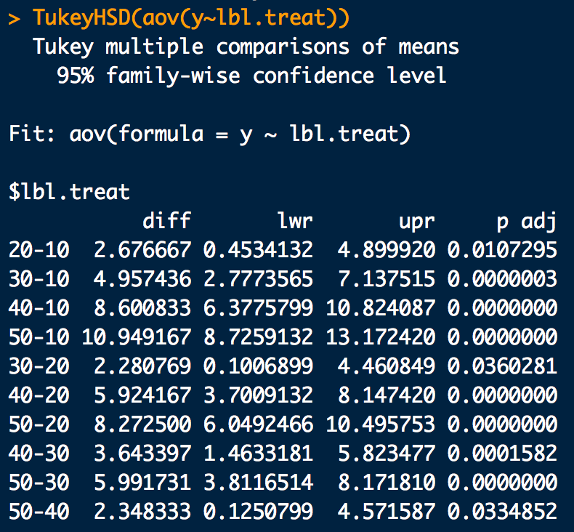
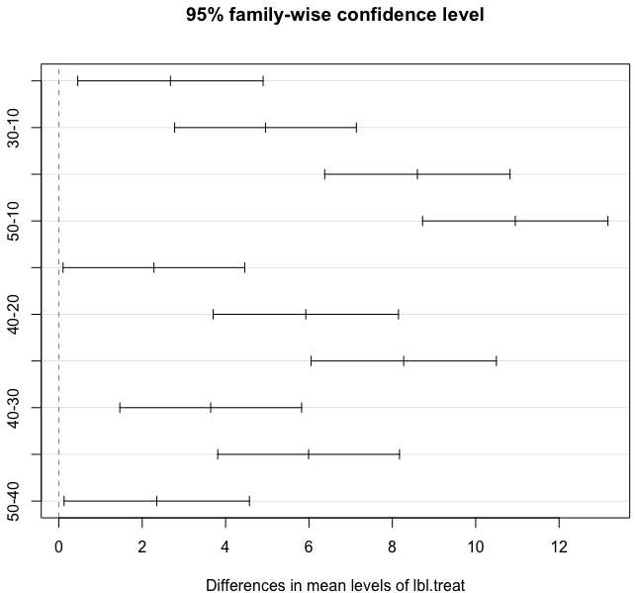
Example: Tukey HSD
# Find a significant result from ANOVA? Do a Tukey HSD:
fit.tukey <- TukeyHSD(aov(y~lbl.treat))
fit.tukey # Tukey test outputs
plot(fit.tukey) # Graphical version

