Slide 1
Tornado Warning Verification and its Relationship to Storm Type
Eric Guillot
July 12, 2007 REU Interim Presentation
Mentors:
Travis Smith
Valliappa “Lak” Lakshmanan
Greg Stumpf
Don Burgess

Slide 2
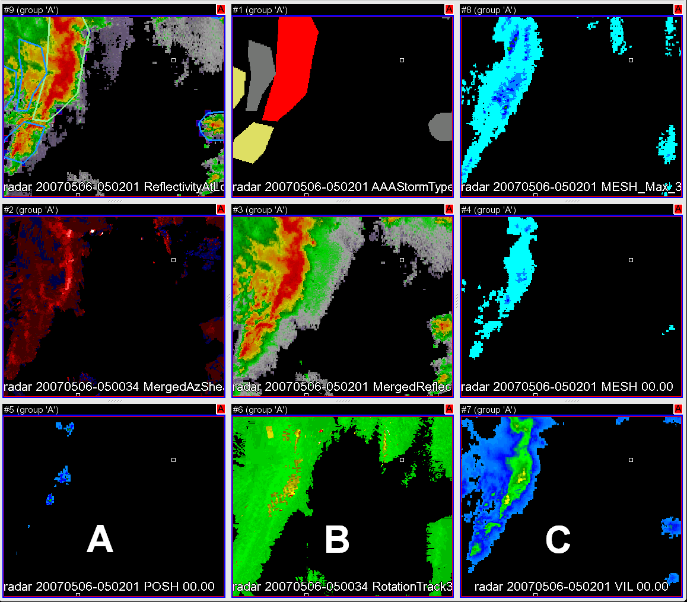
Manual Storm Classification
Manually classified over 1,000 storms over three days worth of data (March 28th, May 5th, and May 28th of 2007).
Turned polygons into grids, overlaid with clustering program to decide which level of clustering performed the best

Slide 3
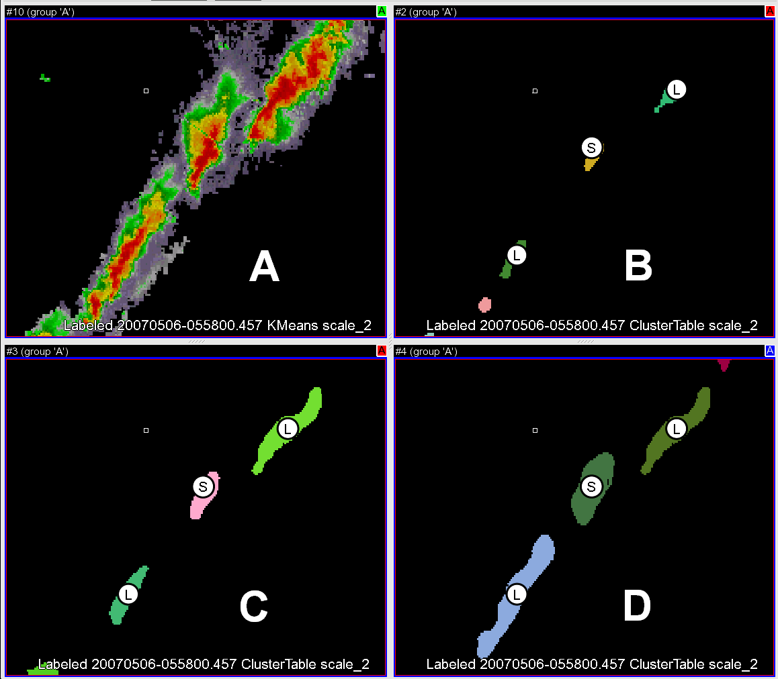
Cluster Identification Using Kmeans
Radar base reflectivity analyzed by computer program to identify areas of concentrated reflectivity (clusters)
  Lakshmanan, V., R. Rabin, and V. DeBrunner, 2003: Multiscale storm identification and forecast. J. Atm. Res., 67, 367-380
Kmeans yields 3 different scales of clustering…we chose either C or D to train the decision tree
    Mostly, cluster attributes at 420 km^2 (scale D) used for our study

Slide 4
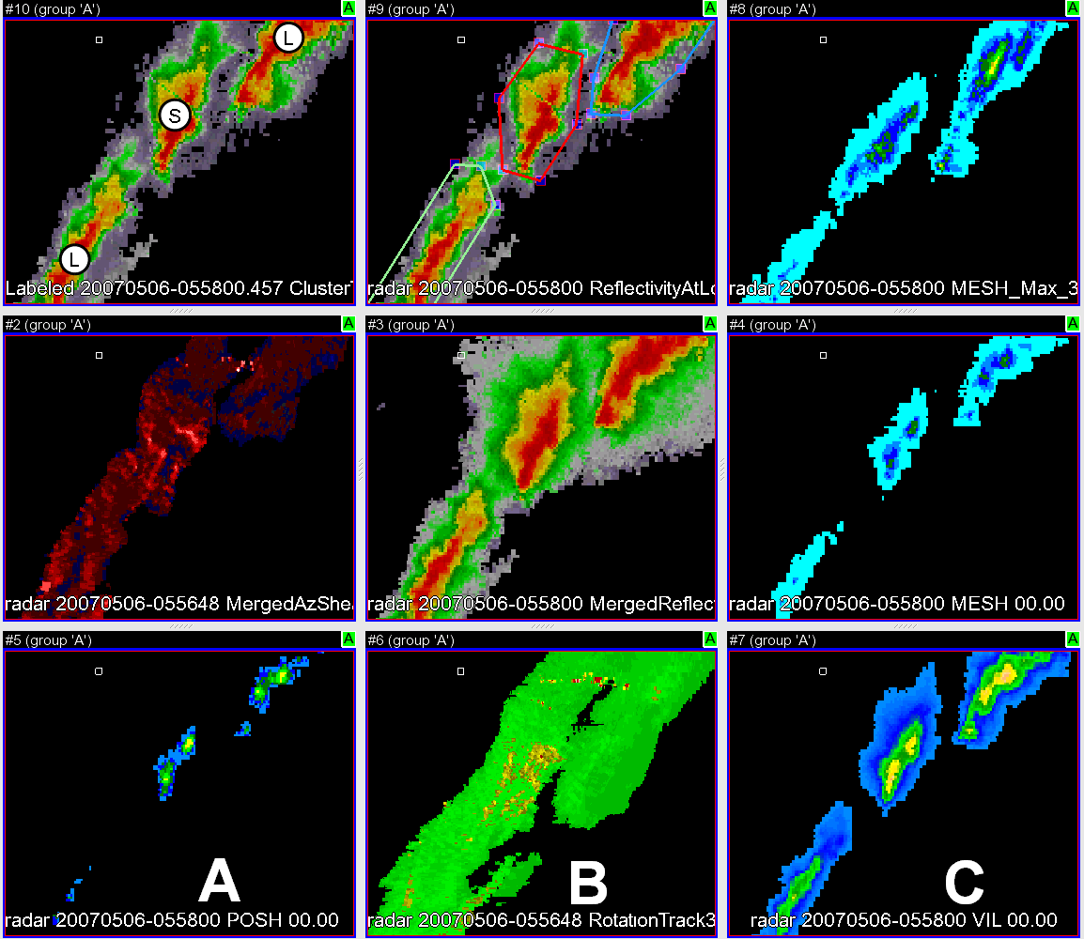
Decision Tree Training
Trained decision tree using manually classified storms in order to develop a logical process for automatically classifying them
Tested this decision tree on three additional cases (April 21st of 2007, and May 10th and 14th of 2006)
  TSS=0.58; good enough for our study to continue

Slide 5
Tornado Warning Verification
Tornado warnings from 45 different WFO’s overlaid with LSRs from SPC, coupled with closest storm at time of warning
Considered “hit” if warning matches up spatially and temporally with tornado report
Considered “miss” if no warning issued, but tornado reported
Considered “false alarm” if warning issued, but no tornado reported

Slide 6
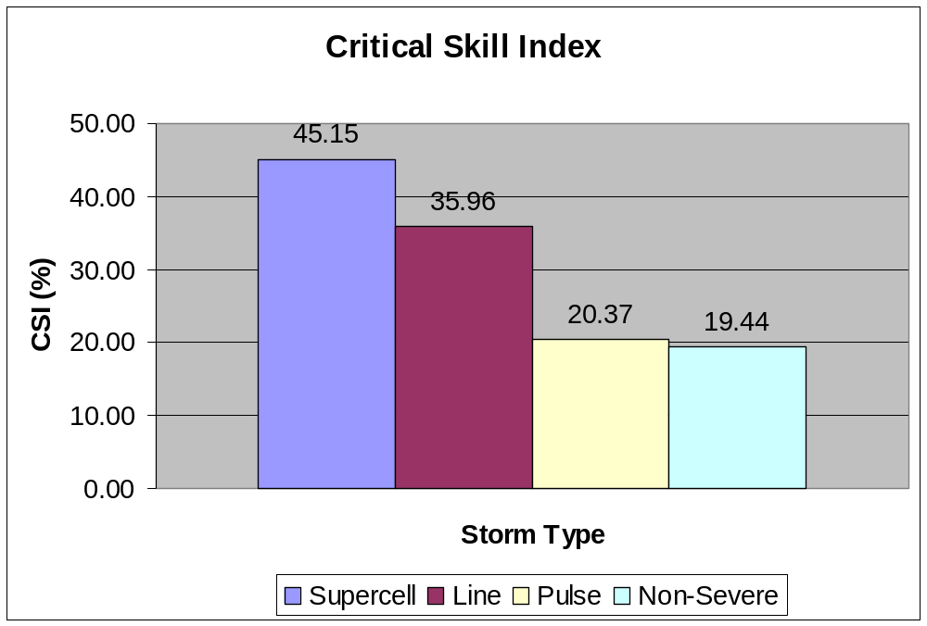
Preliminary Results
Breaking down forecast skill parameters by storm type yields insightful results
Seems to be most skill among forecasters for torndos spawned by isolated supercells
Forecasters seem to have most difficult time forecasting “landspouts” spawned in pulse storms and non-severe storms
Statistically prove that different storms spawn tornados that are easier/more difficult to forecast for

