Slide 1
203CR
Designing for Usability 2
User Evaluation of Prototypes

Slide 2
What we’ll cover today
Designing prototypes for evaluation
Different kinds of evaluation
Evaluations of lo-, mid-, and hi-fidelity prototypes

Slide 3
Designing Prototypes for Evaluation
User-centred design (UCD) assumes that good design must be user-evaluated design
So we have to design prototypes so they can be evaluated
Raises the question of what we want evaluating
203CR Spring Term: User Evaluation of Prototypes
2/23

Slide 4
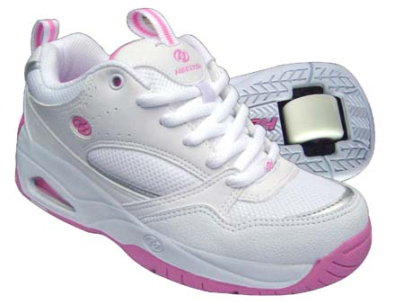
The Hugeness of Heelys
http://www.youtube.com/watch?v=NnJgtA-U6fg

Slide 5
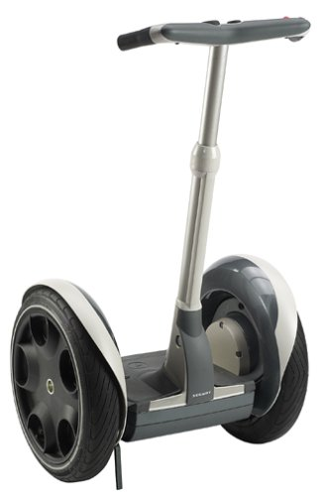
The Sublimeness of Segway
http://www.youtube.com/watch?v=ioNctElzaas

Slide 6
Hazard!!
You can’t evaluate everything
For each, write down
everything you can
think of that could be
evaluated by users
Heelys (RIP?)
Segway
(Ditto)

Slide 7
‘Total evaluation’
Unlikely to happen
ALL the functionality
ALL the interfaces and interface features
User Experience
Aesthetics
‘Usability-In-Life’ (multiple contexts)
Even for simple stuff like Heelys, all this would be a major, major job…

Slide 8
Scoping Evaluation
Given that we can’t evaluate everything, what are we going to evaluate?
Key functions…
Key interface features (if applicable)
User Experience (what sort?)
Aesthetics

Slide 9
Segue to Segway
Imagine you have 5 hours and around £200 to evaluate something about the Segway
Decide who your users will be
Decide what you are going to evaluate
(If you get as far as how,
that is good too)

Slide 10
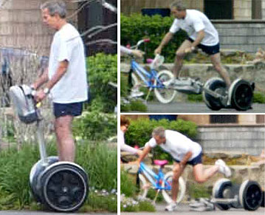
But the Segway is a product…
The Segway is fully developed – it is not a prototype
This means that we can evaluate it ‘out there’
We can get at ‘usability in life’
President Bush wipes out…

Slide 11
The problem
Evaluating prototypes out there is very hard to do
How do you evaluate e.g. a paper prototype of an MP3 player, out there ‘in the wild’?
Realistically, we have to have a near-product-level prototype before we can do ‘ecological’ evaluation
For the moment, we need to stay lab-based

Slide 12
Running Evaluations of Prototypes
Whether the prototype is paper or digital…
Lo-, mid-, or hi-fi…
The issues are similar
You need to go for interaction
But you can also go for demonstration

Slide 13
Demonstration
A typical approach is to describe the concept using video
‘Video prototype’
E.g. https://www.youtube.com/watch?v=mq4jIP9iQ0E
These are not interactive prototypes
They can help define a concept, provoke discussion, and gauge attitudes

Slide 14
Interaction
Interactive prototypes can be made quite easily
Can be paper or digital and even physical
We’ve already seen examples on 203CR

Slide 15
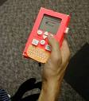
Physical prototypes
Most useful for devices and hardware interfaces
Here’s an example
Cheap plastic
components
This one has
controls connected
to GUI
Even this is not
straightforward

Slide 16
Interactivity with Paper
Think about the paper prototyping process again
The principle is that when the user touches something, there is state change
This is the principle for all interactive prototypes

Slide 17
Digital Interactivity
Can be done w/PowerPoint
Check this video – quite basic, and not too exciting, but good for getting started
http://www.youtube.com/watch?v=JjbeCkn0bJg (lecturer will run you through parts of it but not the whole thing)
A good option for the mid-fi part of your assignment...
... but things can get more complex…

Slide 18
‘Situated’ PowerPoint example (very very simple)

Slide 19
‘Situated’ PowerPoint example (very very simple)
Black Betty
Ram Jam Band

Slide 20
Situated example: much more complex…
eSPACE (see URL on Moodle)
  Mainly done in Flash

Slide 21
So what do you actually do with users?
Get as many as you need
HAZARD: think carefully about numbers; is 5 enough?
Do the same evaluation with each – not together!
Clear scenario of use
Clear instructions
Consent form
Decide on e.g. metrics, questions etc.

Slide 22
What interactivity?
Make sure the interactivity is sufficiently implemented for your scenario, with multiple paths (‘solution path redundancy’)

Slide 23
Aesthetics
Not much point asking ‘Do you like the design’ – users always say Yes (why?)
Lots of ways into what people think
e.g. ‘5 adjectives to describe the design’
(and ask why)

Slide 24
User Experience
Operationalise body language, facial expression
E.g. smiles mean satisfaction
Or use a ratings scale for experience e.g. fun, satisfaction, etc.

Slide 25
Formative User Studies
Often, when prototyping, situated user studies are just not possible
So you have to go lab-based
But you can still do situated user studies of existing activity if your project is about improving something

Slide 26
For Example (1)
Project: Improvements to Moodle
Formative studies: observe students using Moodle / interview them / make a survey
Get requirements
Make a paper prototype
Do a lab based user study
Get requirements
Make a digital prototype
Do a lab based user study
Get requirements; talk about future prototyping without implementing it

Slide 27
For Example (2)
Project: Sat Nav improvements
Formative studies: observe drivers using sat nav / interview them
Get requirements
Make a paper prototype
Do a lab based user study
Get requirements
Make a digital prototype
Do a lab based user study
Get requirements; talk about future prototyping without implementing it

Slide 28
Summary
Evaluating prototypes depends on what the prototype is (e.g. controls, GUI)
And what you are going to evaluate
Think about key functions/interactions
But maybe also aesthetics/user experience
Again (as with so much in HCI) how it gets done in an informed judgment call
Before you make the prototypes, it’s often possible to do more situated user studies

