Slide 1
203CR
Designing for Usability 2
Prototyping (1) Part 1: What is prototyping Part 2: Paper prototyping
John Halloran
John.Halloran@coventry.ac.uk
<number>

Slide 2
Part 1: What is prototyping?
<number>

Slide 3
In Part 1
The assignment involves prototyping
Prototyping in general; and prototyping pervasive interfaces
Different kinds of prototype and how to create them
<number>

Slide 4
The Assignment
A UCD (User Centred Design) process with 2 iterations
Iteration 1:
Formative user study; requirements
Interactive paper prototype
User evaluation
Requirements development
Iteration 2:
Interactive digital prototype
User evaluation
Requirements development
<number>

Slide 5
Prototyping
Overview
What is a prototype
Why prototype
Different kinds of prototype
- low fidelity (lo-fi)
- mid fidelity (mid-fi)
- high fidelity (hi-fi) (Week 2: UCD)
Compromises in prototyping
- vertical
- horizontal
Construction
<number>

Slide 6
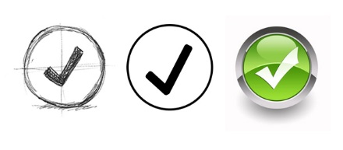
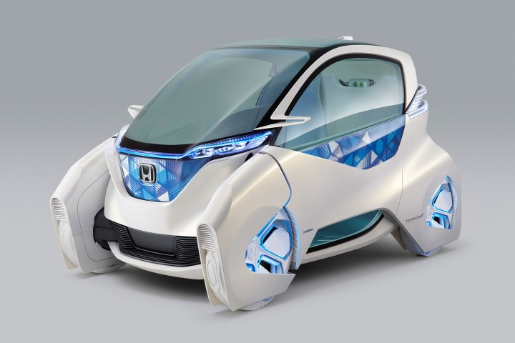
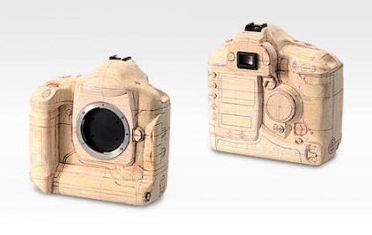
What is a prototype?
Can be a model (but not always)
Used in many design fields
different levels of fidelity
<number>

Slide 7
More types of prototype
Series of screen sketches
Storyboard, i.e. a cartoon like series of sketches
PowerPoint slideshow
Video simulating the use of the system
Cardboard mockup
Piece of software with limited functionality written in the target language (e.g. java, perl) or another language (e.g. director)
Physical model e.g. lump of wood for Palm Pilot
<number>

Slide 8
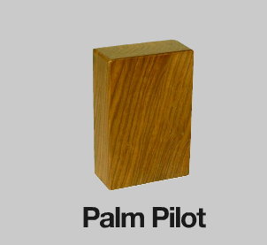
Palm Pilot prototype
Founder (Jeff Hawkins) carved a block of wood and carried it around with him...
<number>

Slide 9
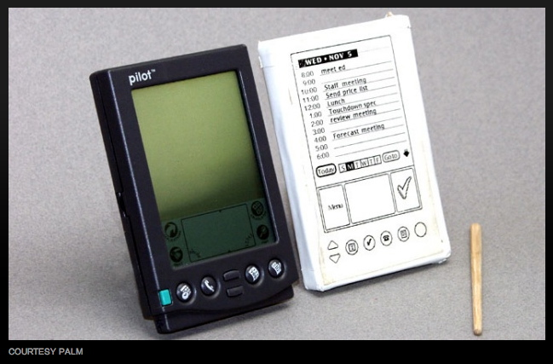
Palm Pilot prototype
Then developed concepts
<number>

Slide 10
What to prototype
Technical aspects
Workflow, task design
Screen layouts and information display
Graphic design, look-and-feel
Content and nomenclature
- e.g. taxonomy of objects/widgets, etc.
Controversial or critical areas
- e.g. security issues
<number>

Slide 11
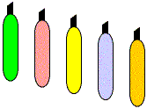
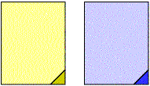
Lo-fi prototyping
Uses media which are unlike the final media e.g. paper, cardboard
Quick, cheap, easily changed
Examples
- sketches of screens, task sequences etc.
- Post-it notes
- storyboards
- ‘Wizard of Oz’
<number>

Slide 12
Storyboards
Used early in design
Often used with scenarios, bringing in more detail, and a chance to role play
Series of sketches/individual frames
- presenting a sequential storyline
- showing how a user might progress through activities
<number>

Slide 13
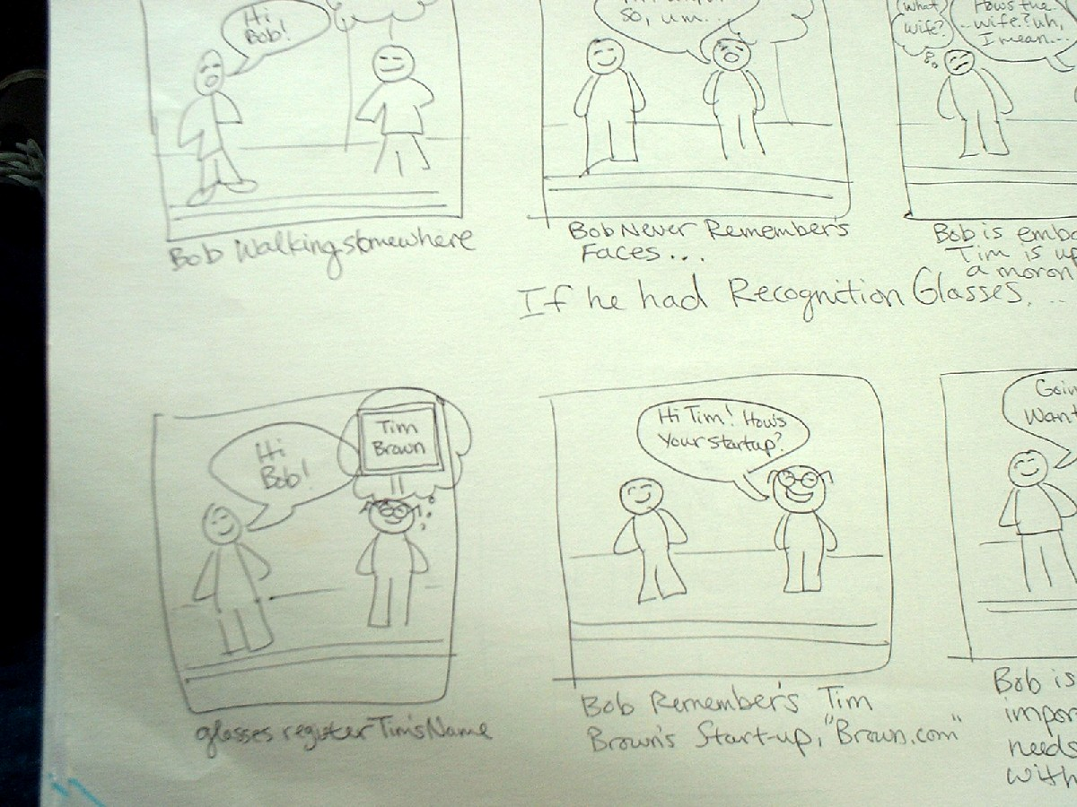
Storyboard Example (1): ‘recognition glasses’
<number>

Slide 14
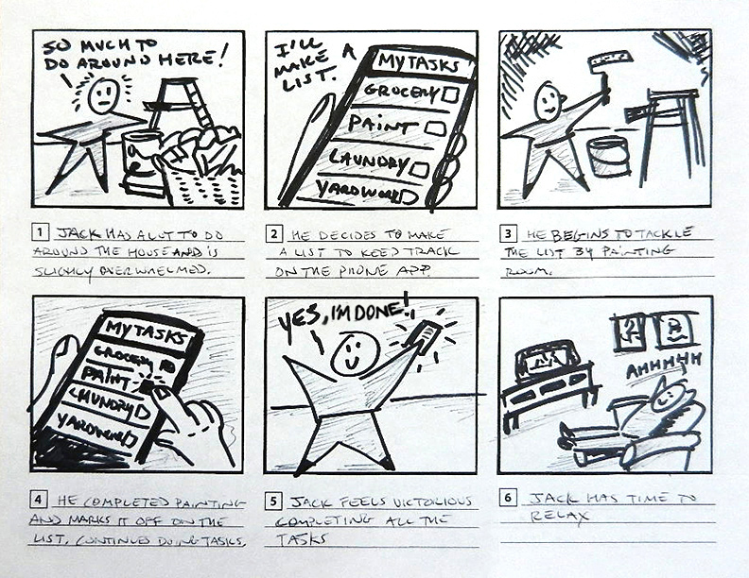
Storyboard Example (2): get stuff done!
<number>

Slide 15
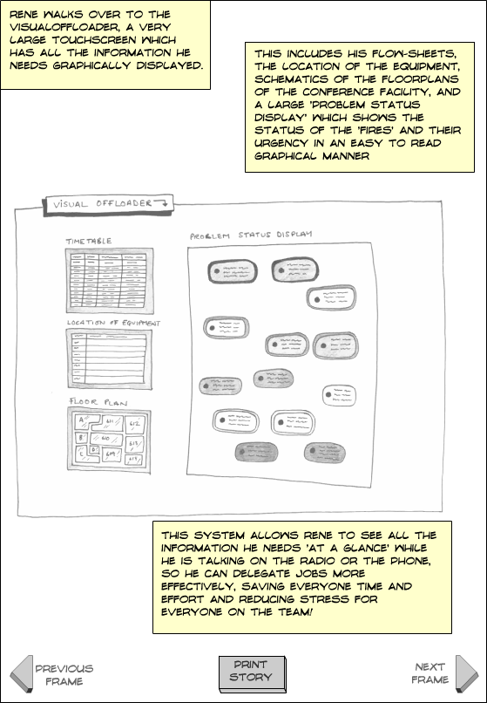
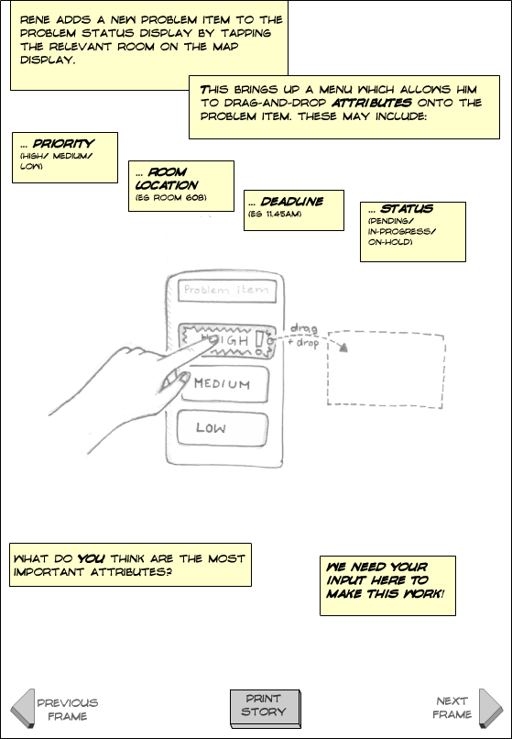
More storyboards
<number>

Slide 16

Sketching
Important for lo-fi prototyping
Anyone can do it
Provides quick and dirty look, design concepts, etc.
Get a quick idea of design message designers want to communicate
<number>

Slide 17
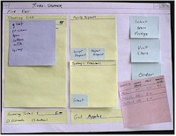
Using paper, post-its, index cards...
Here, to mock up interface menus
14 of 34
<number>

Slide 18
More tangible prototyping
Prototyping technology in physical spaces...
Prototyping tangible interaction devices for supporting learning about genetics...
<number>

Slide 19
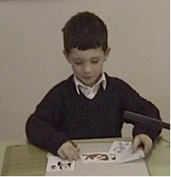
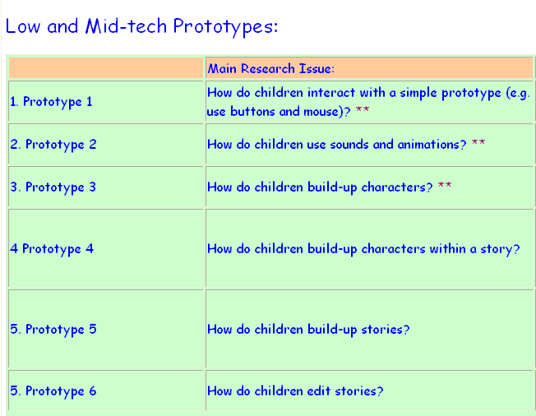
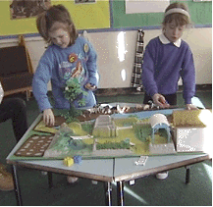
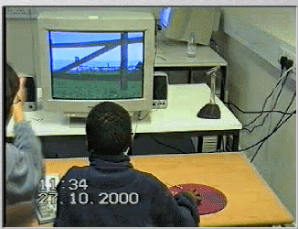
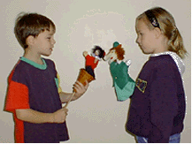
3D Virtual Puppet Theatre
<number>

Slide 20
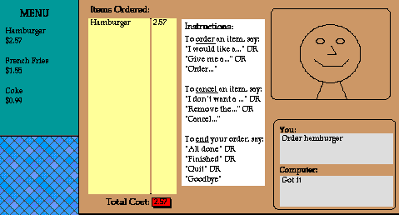
Wizard of Oz
Mock up interactivity
It’s not the system controlling the interaction, it’s you, the designer
User
>Blurb blurb
>Do this
>Why?
<number>

Slide 21
Mid-fi and hi-fi prototypes
Mid-fi prototype Schematic. A simple model of the final product Simulated functionality often based on screen mockups Uses materials that may differ from final product Example tools: Powerpoint, Director | Hi-fi prototype Detailed. A more complete model of the final product Actual functionality (but not everything) Uses materials you’d expect to find in the final product Example tools: Director, Flash, Visual Basic, etc.
<number>

Slide 22
Compromises in prototyping
All prototypes involve compromises
- e.g. software-based prototype: slow response; clunky feedback; sketchy icons; limited functionality
Two common types of compromise
- horizontal prototype: provide a wide range of functions but with little detail
- vertical prototype: provide a lot of detail for only a few functions
<number>

Slide 23
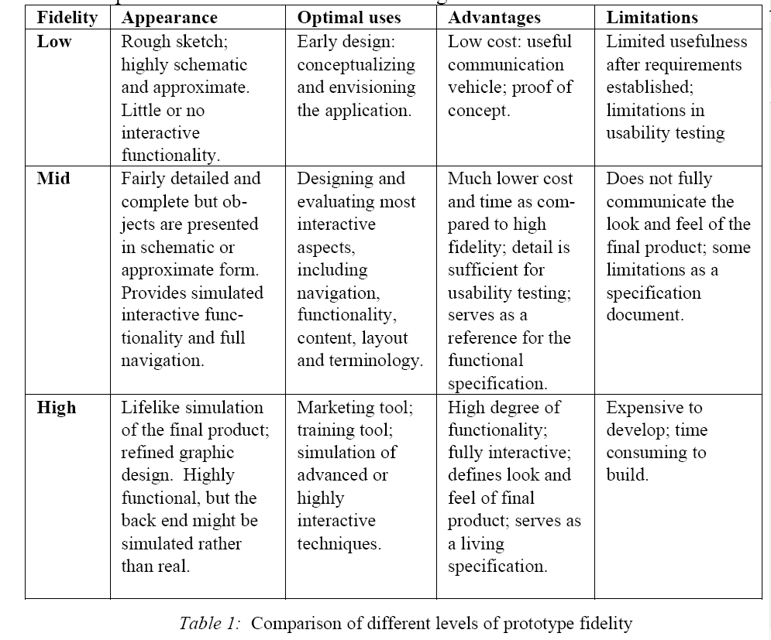
Prototype comparisons
http://www.ipo.tue.nl/homepages/mrauterb/lecturenotes/MFP-Prototypying.PDF
<number>

Slide 24
Part 2: Paper prototypes
<number>

Slide 25
In this Part
Paper prototyping basics
Interactive and non-interactive paper prototypes
The relationship of paper prototyping to the larger prototyping process
NB This lecture makes use of Snyder’s ‘Paper Prototyping’.
<number>

Slide 26
Paper prototypes
Different things qualify as paper prototypes
Rough concept sketches
Storyboards
Interactive paper prototypes
<number>

Slide 27
Why do them
You have a design problem
That may be something entirely new
It may be a revision or extension of something already existing
You need to try things out
<number>

Slide 28
Problem space
Before you do anything you need a problem space / opportunity space
What’s that? A design issue
It needs focus
It needs to be scoped
So for your work this means an interface and its functionality
<number>

Slide 29
Types of paper prototype
All paper prototypes are lo fi
But within paper prototypes there is a lot of variation
They can be interactive or non-interactive
They can be rough, or more ‘finished’
<number>

Slide 30
Check these out
Let’s check out some videos of lo-fi paper prototype usability test
http://www.youtube.com/watch?v=GrV2SZuRPv0 (email app)
http://www.youtube.com/watch?v=6TbyXq3XHSc (iPhone app)
http://www.youtube.com/watch?v=Bq1rkVTZLtU (visitor navigation)
A lot of excellent stuff on youtube – just google youtube ‘paper prototyping’
<number>

Slide 31
Solution paths
You have your task and you have implemented just the solution
E.g. it’s a mobile phone interface to choose the album ‘Hot Fuss’ by The Killers
But there is no other option BUT to choose that album because you have implemented only the route to this
So what do we do?
<number>

Slide 32
Realistic solution path redundancy
We make other solution paths
Including the NULL path
Somebody does something wrong
We have a new page that says ‘NOT IMPLEMENTED’
It has a BACK button
<number>

Slide 33
Going to mid-fi
We can stick to the same task
But we introduce a lot more solution path redundancy, i.e. people can go here there and everywhere in your design whether paper or digital
<number>

Slide 34
Going to ‘hi-fi’
Whether paper or digital we have more functionality
Better look and feel – comps as a minimum
So developing prototypes as part of UCD means adding detail, look-and-feel, and increasing the amount of things it can do, together with the paths a user can take
<number>

