Slide 1

A LOW-MEMORY SPECTRAL-CORRELATION ANALYZER FOR DIGITAL QAM-SRRC WAVEFORMS A THESIS DEFENSE MAY 7, 2021 © 2021 DYLAN JACOB GORMLEY
Notes:
Hello, my name is Dylan Jacob Gormley.
Today I am here to defend my thesis titled “...”
This work is “Submitted in partial fulfillment of the requirements for the degree MSEE at CSU.”
Before enrolling in this program, I received my BSCE from UMBC in 2017.
I currently work a civil servant at NASA GRC as a telecommunications engineer.
And after this I will begin my PhD at CWRU in EE with a focus on signal processing this fall.

Slide 2



COMMITTEE
Professor Chansu Yu - Committee Chairperson
Software-Defined Radios
Associate Professor Pong Chu - Committee Member
Field-Programmable Gate Arrays
Associate Professor Murad Hizlan - Committee Member
Robust Digital Communications
Notes:
Listed here are my thesis committee members.
I chose each member of the committee based on their expertise in the areas listed.
I would like to thank each of you for choosing to be in my thesis committee.

Slide 3
ABSTRACT
Cyclostationary signal processing (CSP) provides the ability to estimate received waveforms' statistical features blindly. Quadrature amplitude modulated (QAM) waveforms, when filtered by the square-root-raised cosine (SRRC) pulse shape function, have cyclic features that CSP can exploit to detect waveform parameters such as symbol rate (SR) and center frequency (CF). The estimation of these SR-CF pairs enables a cognitive radio (CR) to perform spectrum sensing techniques such as spectrum sharing and interference mitigation. Here, we investigate a field-programmable gate array (FPGA) application of a blind symbol rate-center frequency estimator. First, this study provides a background on the theory behind the cyclic spectral density function (CSD), spectral correlation analyzers (SCA), and spectrum sensing. Following this is a discussion on the motivation for CubeSat spectrum sensing. An SCA implementation for low-memory devices, such as FPGA-based CubeSat, is then describes. The paper concludes by reporting the performance characteristics of the newly developed streaming-based SCA.
Notes:
Prior to this defense, the graduate department posted my abstract for reading prior to this defense, so everyone here should have some familiarity with it.
I have highlighted the fundamental concept discussed in the thesis.
“Here, we investigate a field-programmable gate array (FPGA) application of a blind symbol rate-center frequency estimator.”

Slide 4
AGENDA
I.
IV.
II.
V.
Introduction
Performance Characterization
Background
Experiments
Results
Cyclostationary Signal Processing
Spectral Density
Spectral Correlation Analyzers
Spectrum Sensing
Conclusion
III.
Implementation
Motivation
The Streaming-SCA
Digital Design
Notes:
This defense will discuss the five chapters covered in my thesis, shown here.

Slide 5
I.
INTRODUCTION
‘Where shall I begin, please your Majesty?’ he asked. ‘Begin at the beginning,’ the King said, gravely, ‘and go on till you come to the end: then stop.’
–Lewis Carroll
Notes:
We begin with the intuition and motivation behind this thesis.

Slide 6
Cyclostationarity Intuition
The maximum daily temperature in New York City can be modeled as a cyclostationary process:
The maximum temperature on July 21 is statistically different from the temperature on December 20.
However, it is a reasonable approximation that the temperature on December 20 of different years has identical statistics.
Thus, we can view the random process composed of daily maximum temperatures as 365 interleaved stationary processes, each of which takes on a new value once per year.
Example taken from Cyclostationary process – Wikipedia. No citation listed.
Notes:
To develop the intuition behind a cyclostationary process, we begin with a simple example.
<read example>
Ignores climate change so is technically “almost cyclostationary” –however it is still a great example.

Slide 7
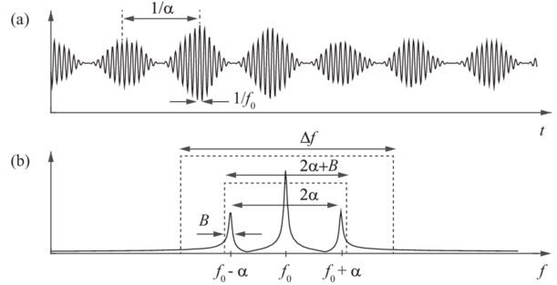
Relationship to Digital Communications
AM waveform exhibiting cyclostationary features
Its’ frequency spectrum.
Example taken from Fast computation of the spectral correlation — Research Gate.
Notes:
Digital communications also exhibit cyclostationarity.
In this example we observe cyclostationarity of period 1/alpha and 1/f0.

Slide 8
Motivation
Objective
Problem
Solution
Use cyclostationary signal processing (CSP) to extract the RF features of a waveform.
CSP realizations are very computationally complex.
Design a low complexity CSP realization by narrowing the scope of its use.
Notes:
Waveform in this context refers to any modulated signal.
CSP is of particular interest as a feature estimator due to its robustness.
It is very resilient against noise.
Additionally, it can differentiate between noise and interference.
For cognitive radio, RF features are defined as symbol rate and center frequency.
A well-known deterrent of cyclostationary feature estimation is the computational complexity.
The interest in small satellites will be discussed later in the presentation.
In my thesis, I investigate how to reduce the CSP complexity such that it can work on a small satellite.

Slide 9
Method
Literature review of existing CSP realization techniques
Modify existing techniques to reduce complexity
Implement on a small satellite grade FPGA
Characterize performance
Evaluate future optimization techniques
Notes:
Displayed is a summary of the overall methodology I used during the creation of my thesis.

Slide 10
II.
BACKGROUND
No, no! The adventures first, the explanations take such a dreadful time.
–Lewis Carroll
Notes:
Next, we discuss the mathematics, notation, and concepts needed to understand the approach I took to creating this novel CSP realization.

Slide 11
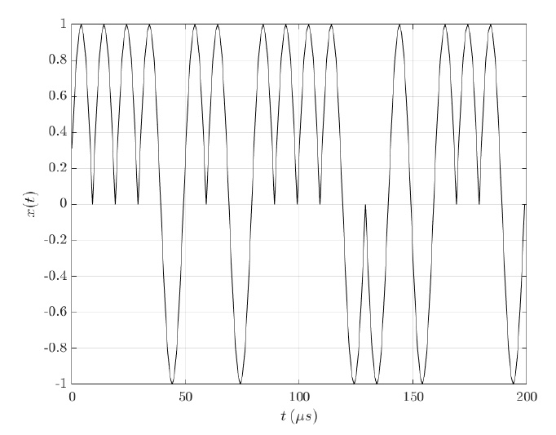
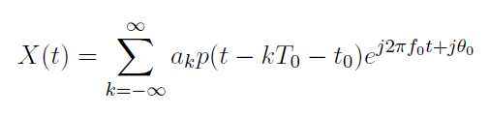
Cyclostationary Signal Processing (CSP): Quadrature Amplitude Modulation (QAM)
Notes:
We begin chapter 2 by defining X(t) as the general expression for QAM, where k is the symbol index, T0 is the symbol period, f0 is the carrier frequency, t0 is the symbol clock phase, phi is the carrier phase, p is the pulse shaping function.
This expression also includes the definition of PSK and PM waveforms.
The plot shown is an example time plot of a QAM waveform.

Slide 12
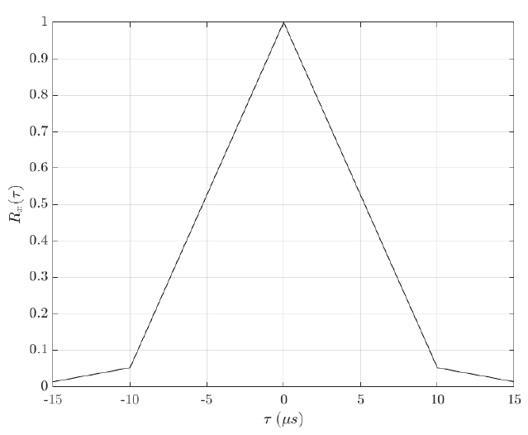
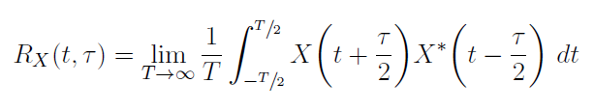
Cyclostationary Signal Processing (CSP): The Autocorrelation Function (AF)
Notes:
The autocorrelation function is the correlation of a signal with a delayed copy of itself.
In the equation shown tau is the lag parameter between the delayed copies.
By invoking ergocity, we define the AF as the function of a sample path, and can limit the AF by T.
The plot of an autocorrelation is referred to as the autocorrelogram.
Ergocity Definition: a random signal is said to be ergodic if its statistical properties can be deduced from a single, sufficiently long, random sample of the process.

Slide 13
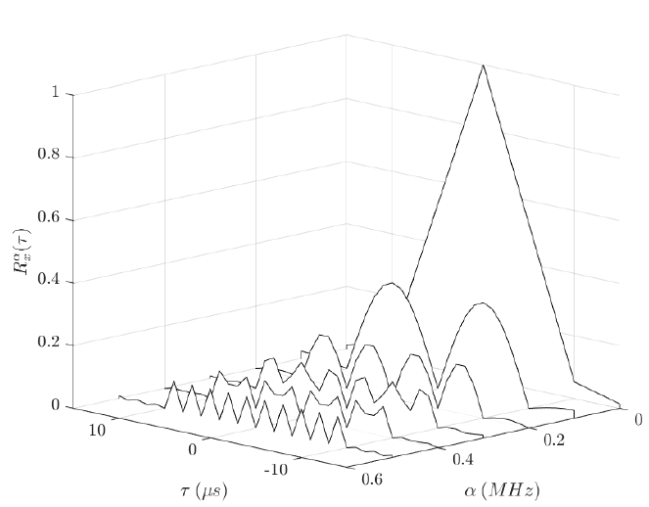
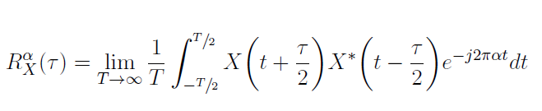
Cyclostationary Signal Processing (CSP): The Cyclic Autocorrelation Function (CAF)
Notes:
The CAF equation can be thought of as cross-correlation between the AF and a tone of frequency, alpha-- called a cycle frequency.
Notice the expression resembles DFT, however values of tau are retained.
The plot of the CAF is known as the cyclic autocorrelogram.
Peaks are caused by cyclic features such as modulation order, encoding, symbol rate, and center frequency…
We will detail on how to extract these features using CSP is given in upcoming slides.

Slide 14
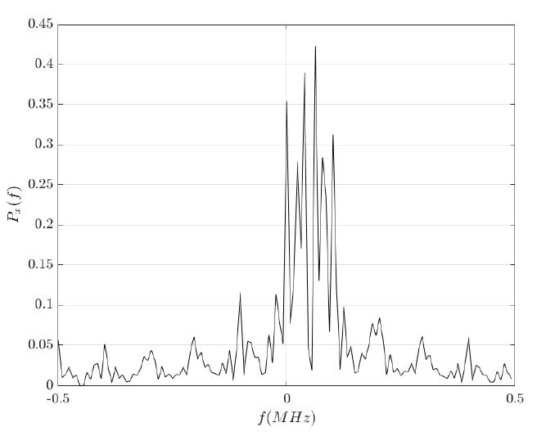

Spectral Density: The Periodogram
Notes:
For a random signal, such as QAM, the Fourier transform doesn’t exist, and therefore no ESD.
However, by time limiting X(t) with window size T, we can estimate the PSD with what is known as the periodogram (equation shown).
Here, hat indicates the DFT.
Plot shown is periodogram.
Notice that it is very challenging to determine RF characteristics such as center frequency and symbol rate.
It is a very poor estimate of the PSD due to the high variance of each frequency.
This is because the periodogram of a random signal is a random function.
To more accurately estimate, the periodogram is used a core component of more sophisticated methods.
Time-smoothing (averaging many short overlapping periodograms) and frequency-smoothing (use of an LPF) force convergence to closely approximate true PSD.

Slide 15
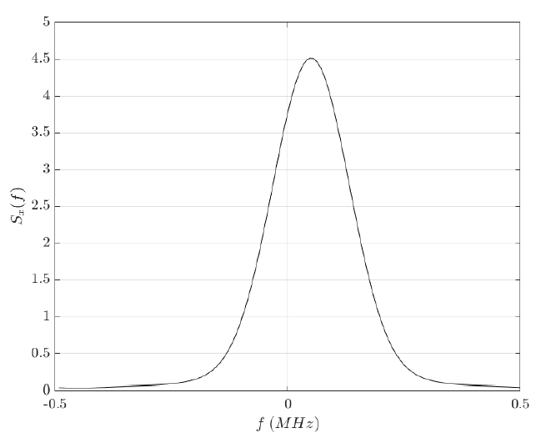

Spectral Density: The Power Spectral Density Function (PSD)
Notes:
Equation shown is PSD estimate using frequency-smoothing.
Much easier to determine RF characteristics such as center frequency and symbol rate.

Slide 16
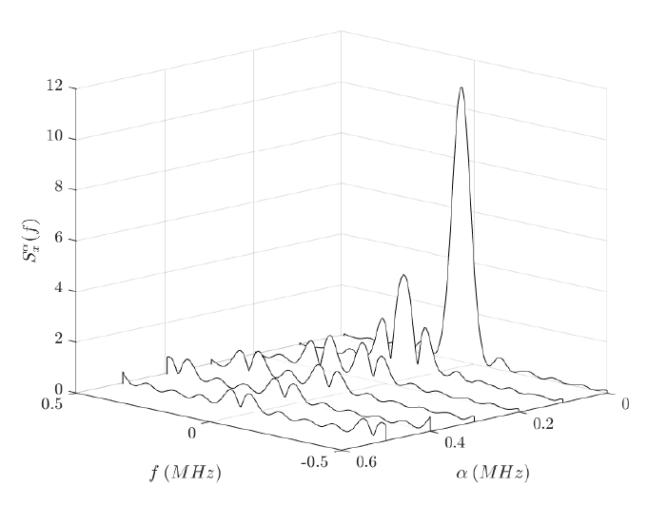
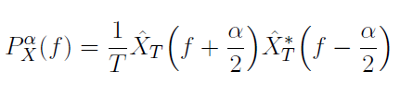

Spectral Density: Cyclic Spectral Density Function (CSD)
Notes:
Top equation is cyclic periodogram -> same idea as periodogram, but also need to evaluate at alpha.
Bottom equation frequency-smooths to estimate the true cyclic PSD -> that is, the CSD.
Plot is the CSD. Each alpha is a PSD. Alpha=0 is spectral density of AF.

Slide 17
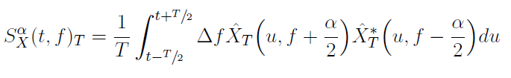
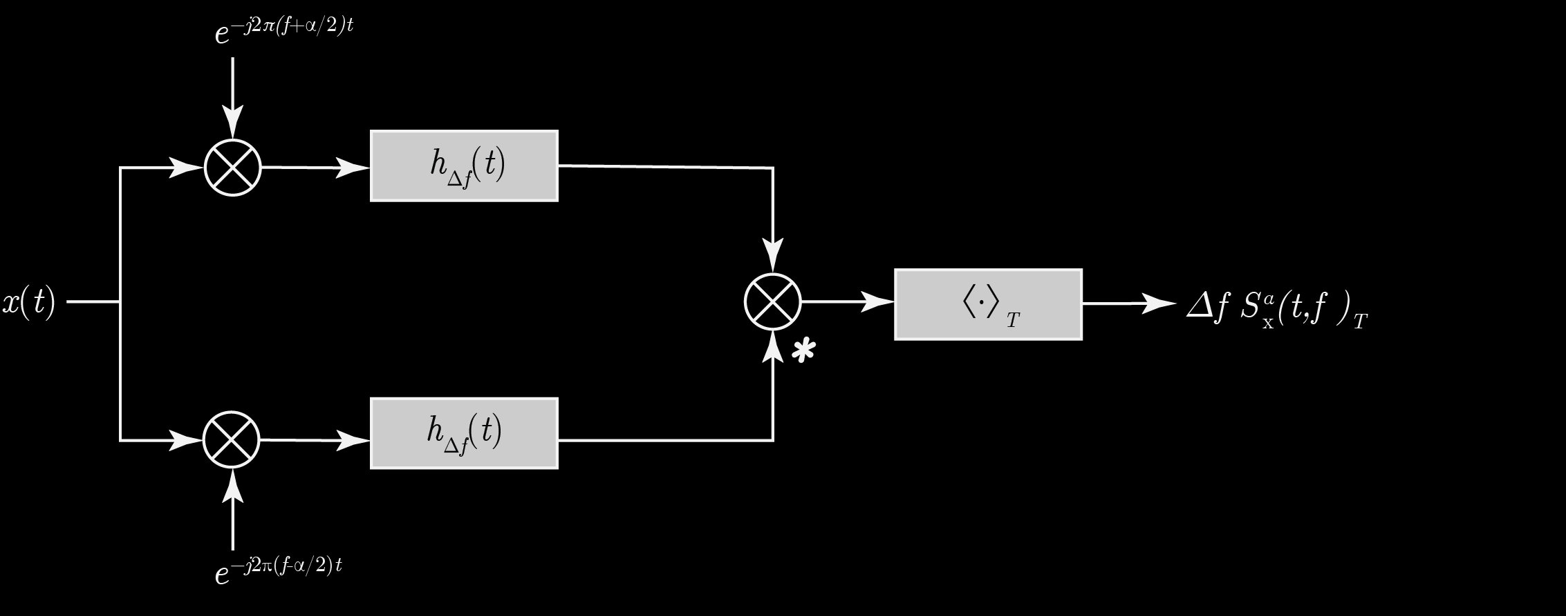
Spectral Correlation Analyzers (SCA): Blind Cycle Frequency-Frequency Estimation
Notes:
Top equation is CSD of M-QAM.
Middle equation is SRRC.
M-QAM-SRRC has the interesting property that the CSD only produces PSDs at alpha=(-Rs,0,Rs)
-Rs is a negative symbol rate and can be discarded.
0 is the PSD of the AF, which will always appear. It is, therefore, trivial, and can be discarded.
So, the only PSD of interest that is left is exactly at our symbol rate.
Further, the peak of PSD for alpha = Rs is located exactly at the center frequency.
In summary, the nontrivial CSD peak of a M-QAM-SRRC waveform produces features exactly at (Rs,fc).
We only need to produce the cyclic PSD at Rs and find its peak.

Slide 18
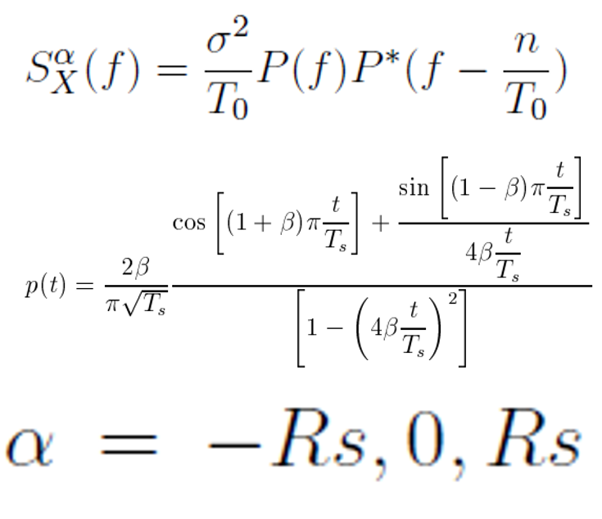
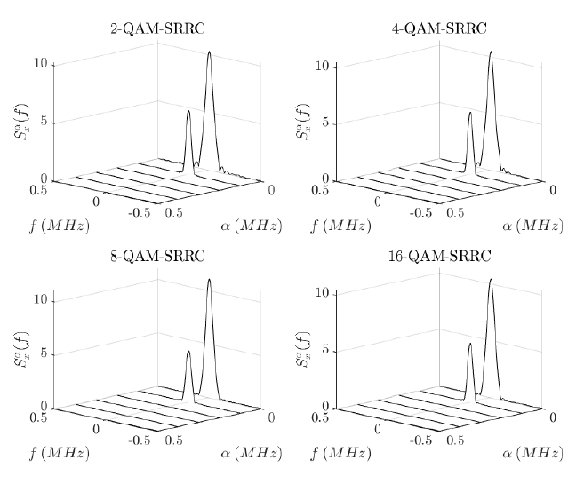
Spectral Correlation Analyzers (SCA): Blind Symbol Rate-Center Frequency Estimation
Notes:
Top equation is CSD of M-QAM.
Middle equation is SRRC.
M-QAM-SRRC has the interesting property that the CSD only produces PSDs at alpha=(-Rs,0,Rs)
-Rs is a negative symbol rate and can be discarded.
0 is the PSD of the AF, which will always appear. It is, therefore, trivial, and can be discarded.
So, the only PSD of interest that is left is exactly at our symbol rate.
Further, the peak of PSD for alpha = Rs is located exactly at the center frequency.
In summary, the nontrivial CSD peak of a M-QAM-SRRC waveform produces features exactly at (Rs,fc).
We only need to produce the cyclic PSD at Rs and find its peak.

Slide 19
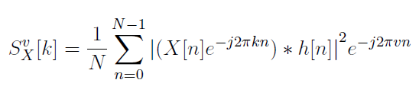
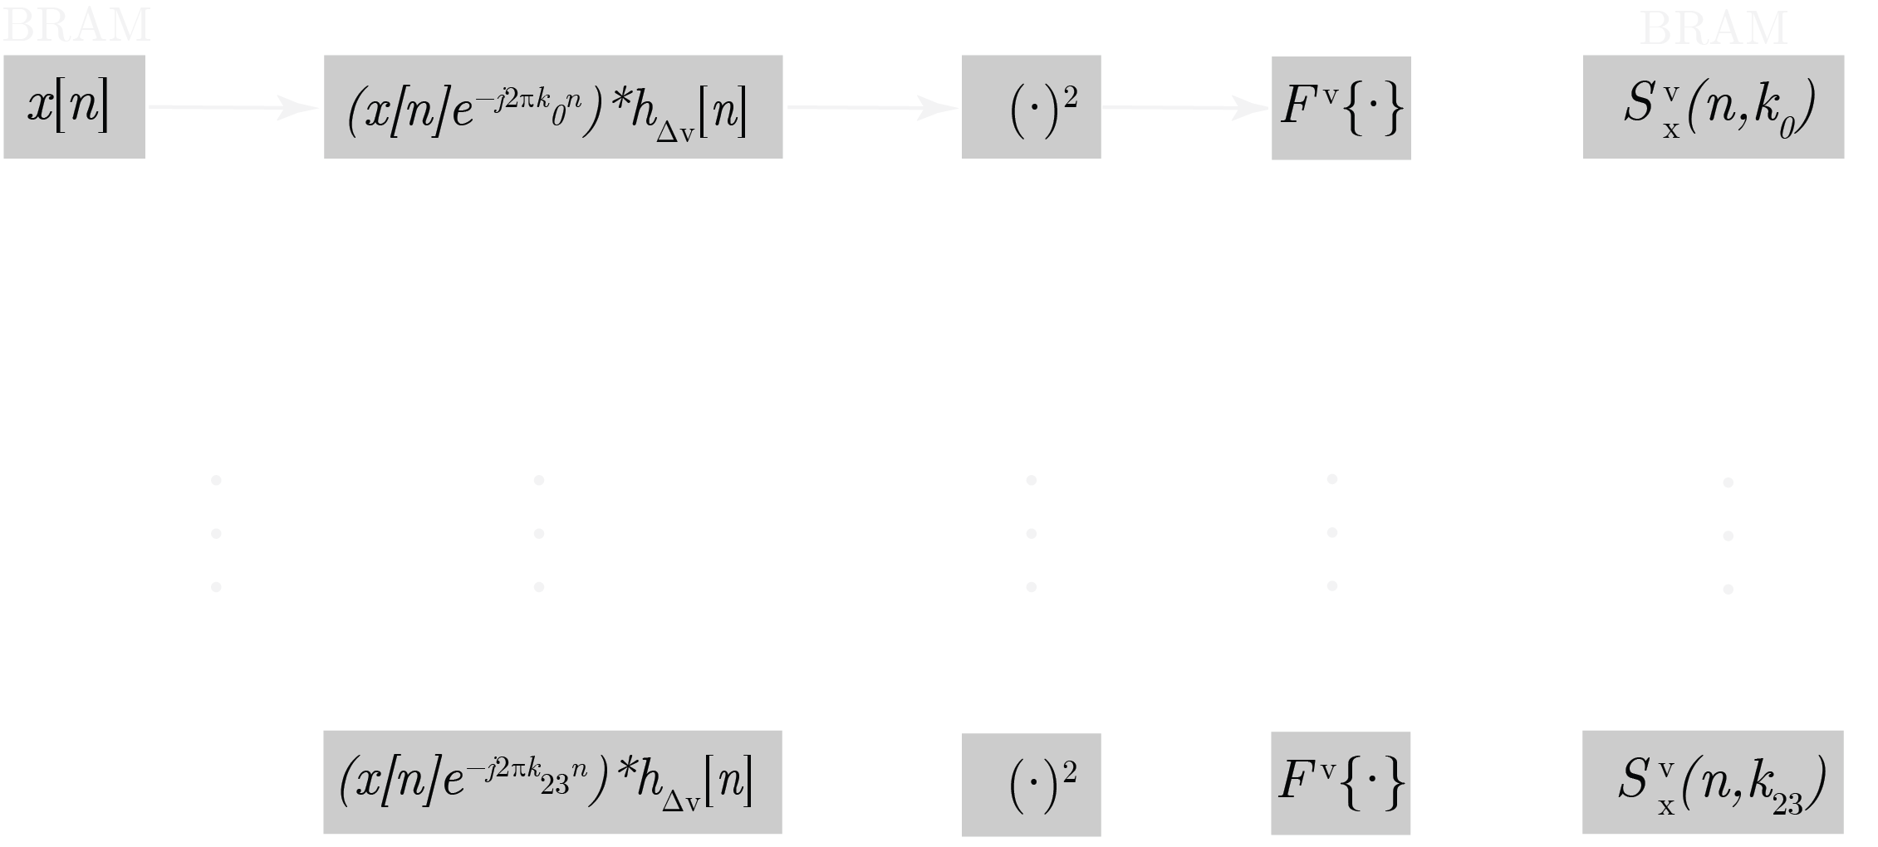
Spectral Correlation Analyzers (SCA): Blind Symbol Rate-Center Frequency Estimation
Notes:
By assuming we only wish to evaluate the CSD of M-QAM-SRRC waveforms, we can simplify Gardner’s equation to the discrete equation above (called CAC-DFT).
This works by assuming we only wish to evaluate only the current point.
Used to blindly estimate (Rs,fc) points.
Plot is the illustration of an SCA created by M. V. Koch. Works by evaluating multiple instances of CAC-DFT equation at once.

Slide 20
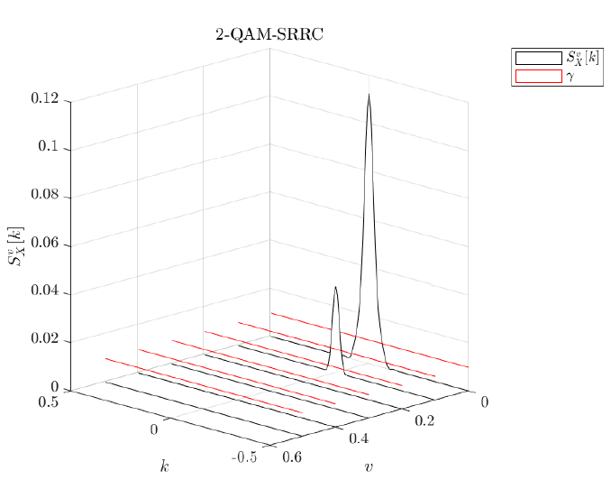
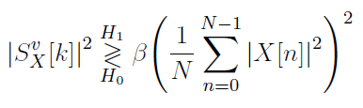
Spectral Sensing: Detection
Notes:
Left hand side is sufficient statistic of each CSD point (mag squared)
Right hand side is sufficient statistic of received noise power.
Beta is a scalar used to adjust the sensitivity of false alarm. Optimal beta can be found using receiver operating characters (ROC) curve.
Plot shows CSD and threshold. Anything above the threshold is an active waveform of (Rs,fc)=(v,k).

Slide 21
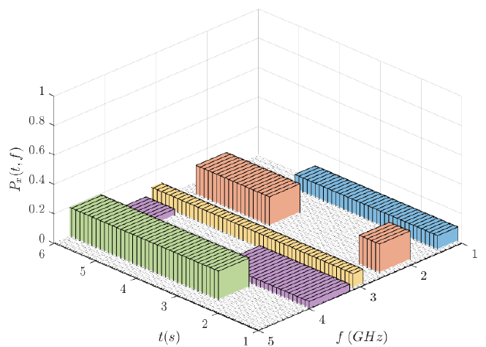
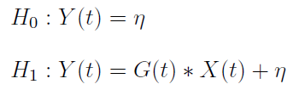
Spectral Sensing: The Binary Hypothesis
Notes:
This is where everything comes together.
The goal of spectrum sensing is to determine where users are, and where users are not.
Binary hypothesis: user is active or user is not active.
CSP not only tells us whether the user is active, but can tell us the features of the user.
The CSPs ability to differentiate between noise and an actual PU reduced the probability of false alarm.

Slide 22
III.
IMPLEMENTATION
If you don’t know where you’re going any road can take you there.
–Lewis Carroll
Notes:
Next, we shall focus on the application of spectrum sensing on a class of small satellites, known as cubesat.
Following this, we will step through the digital design.

Slide 23
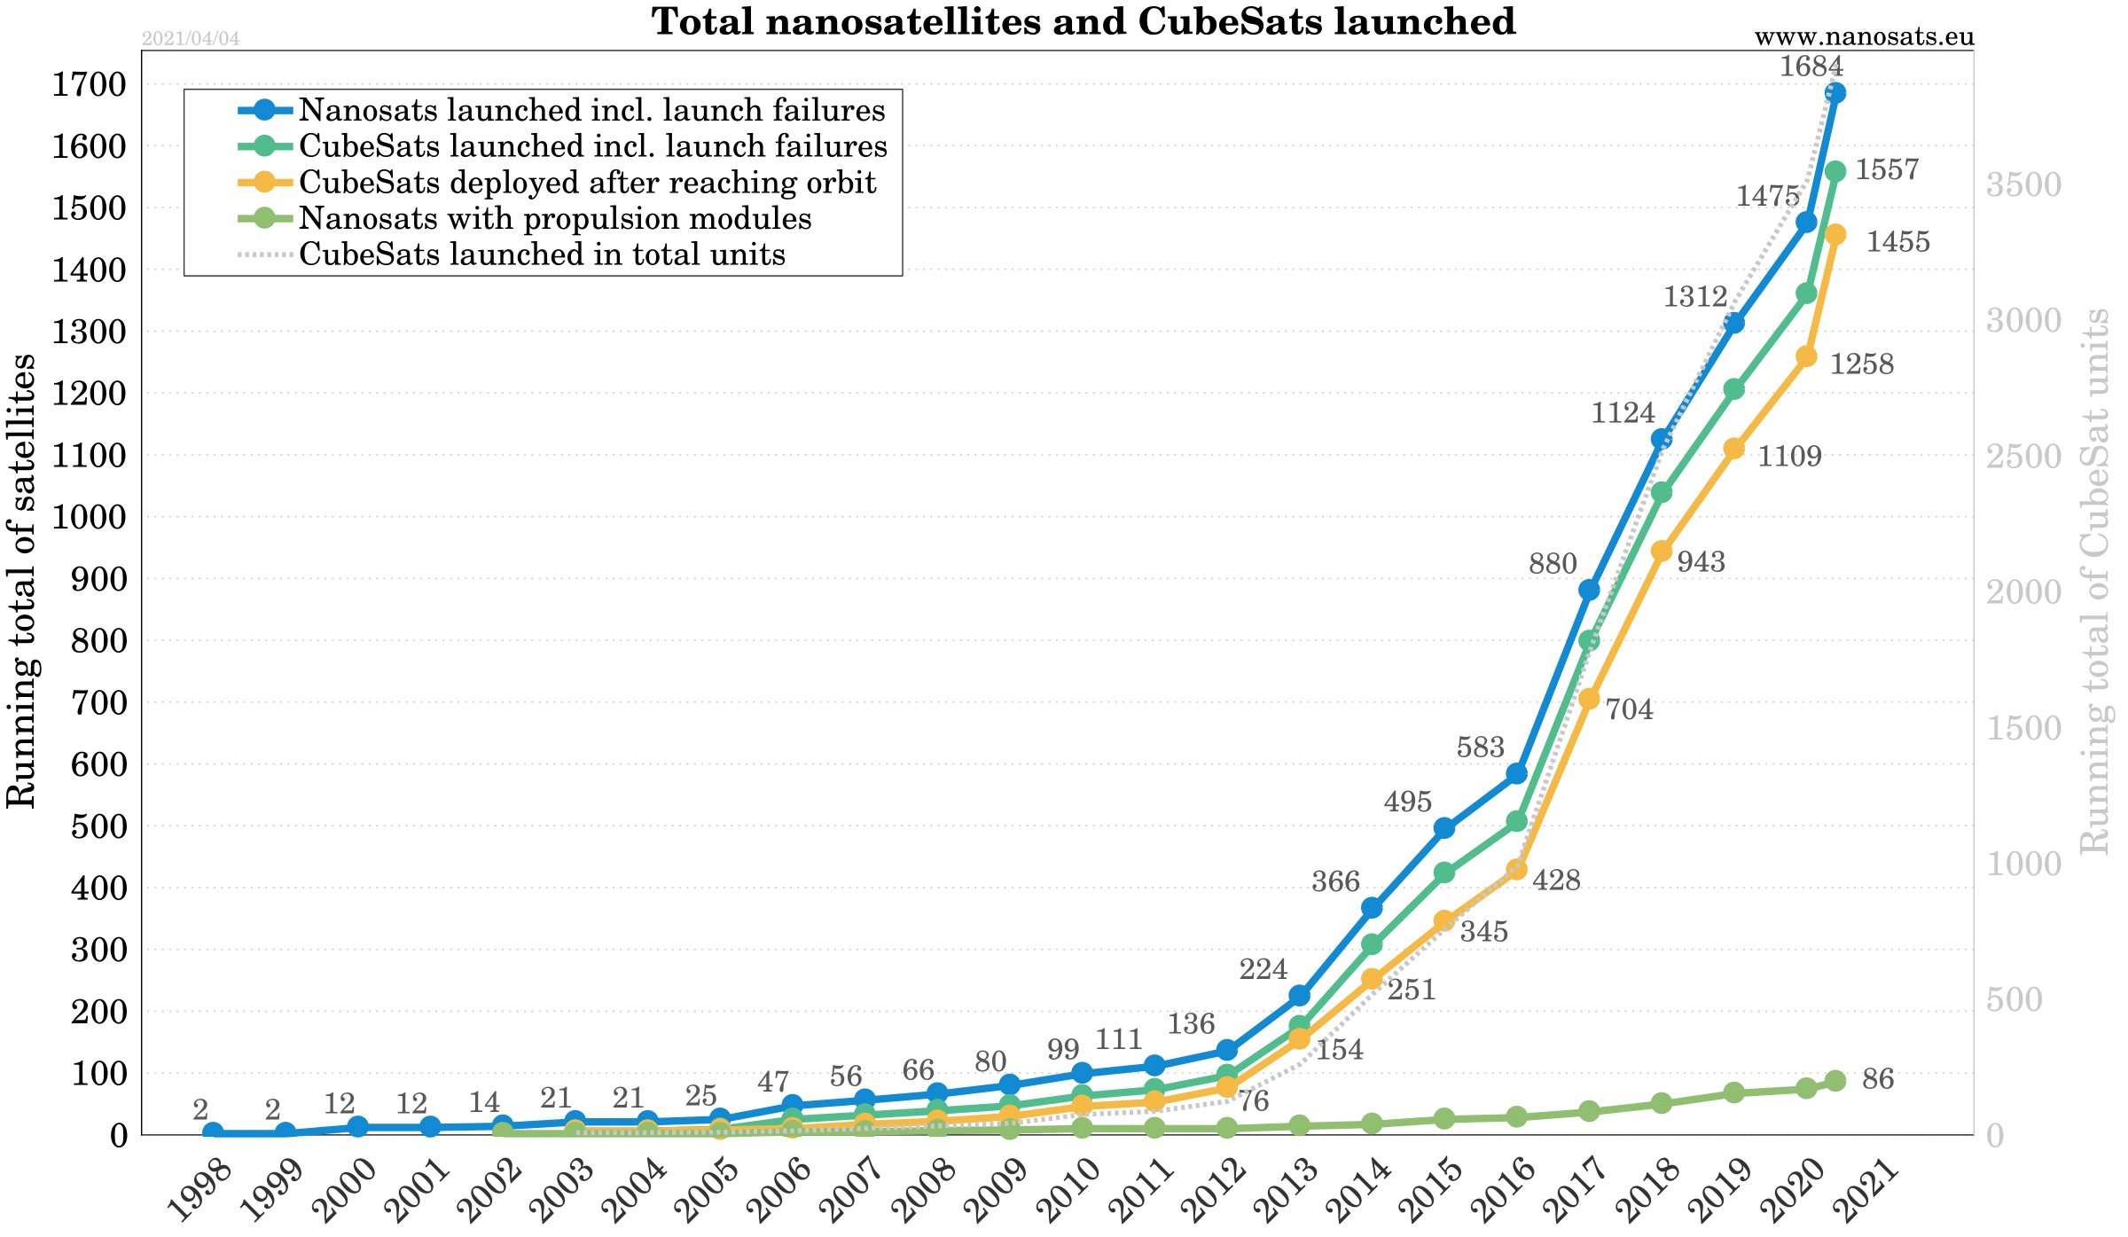
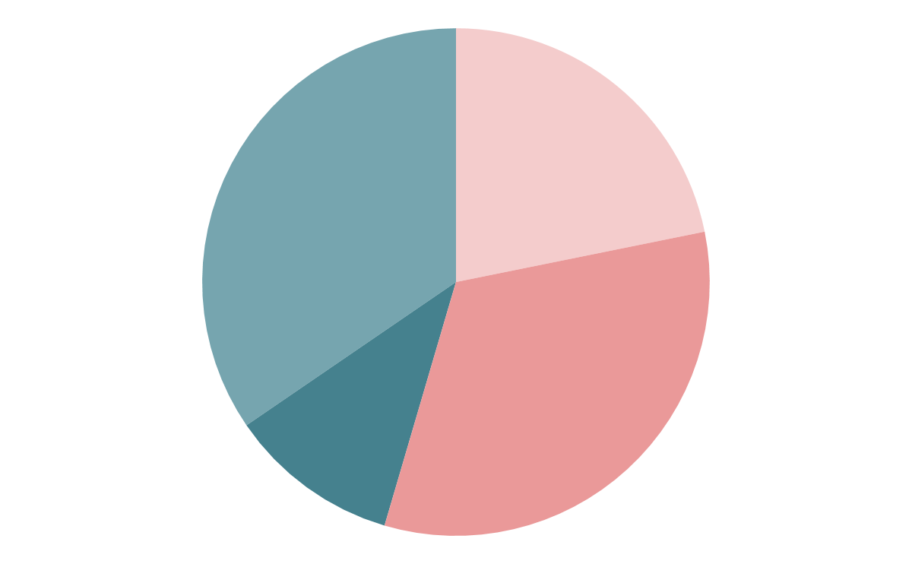
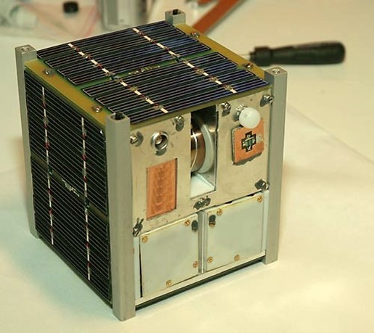
CubeSats: History
Left picture from CubeSat – Wikipedia. No citation.
Right figure from Nanosats Database
Notes:
What is a cubesat?
A CubeSat (U-class spacecraft) is a type of miniaturized satellite for space research that is made up of multiple cubic modules of 10 cm × 10 cm × 10 cm size. CubeSats have a mass of no more than 1.33 kilograms (2.9 lb) per unit, and often use commercial off-the-shelf (COTS) components for their electronics and structure.
Uses typically involve experiments that can be miniaturized or serve purposes such as Earth observation. CubeSats are employed to demonstrate spacecraft technologies intended for small satellites or that present questionable feasibility and are unlikely to justify the cost of a larger satellite. Scientific experiments with unproven underlying theory may also find themselves aboard CubeSats because their low cost can justify higher risks.
Over the last two decades, cube satellite (CubeSat) launches have increased exponentially.

Slide 24
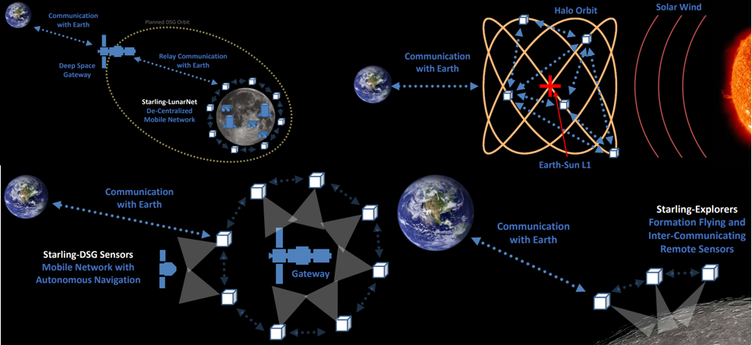
CubeSats: Formation Flying
Figures from NASA Technical Reports Server (NTRS)
Notes:
As a result of these CubeSats’ flexibility, formation-based satellite architectures are of increasing interest to the public and private sector alike.
Modern flight formations are designed to operate with tens hundreds, or thousands of CubeSats.
The pictures shown here show Ames Research Center (ARC) illustrates the usefulness of CubeSat swarm formations in a series of missions known as Starling 1.

Slide 25
CubeSats: Limitations
Common SCAs utilize many FFTs
Very fast, but large BRAM is needed to store all input/output samples of an FFT at once.
CSP algorithms require large sample sizes, regardless of implementation
Nominal CubeSat FPGA
xc7z045fbg676-1
19.2Mb of BRAM
Example
32b, 2¹⁶-point SSCA needs at a minimum of 67Mb per cycle frequency.
Typically has many cycle frequencies processing at once.
The required 67Mb is much higher than the BRAM of our CubeSat FPGAs.
Notes:
In this work, we envision a future where these formations are commonplace.
Subsequently, the inter-satellite links become vulnerable to problems experienced terrestrially, such as spectrum congestion and interference.
As discussed in Chapter II, Spectrum sensing algorithms used to detect these issues, but as are traditionally computationally expensive.
Moreover, the nature of a CubeSat is to operate on limited resources.
To overcome this, we will build a CubeSat-oriented feature estimator known as the streaming spectral correlation analyzer (streaming-SCA).

Slide 26
The Streaming-SCA: Assumptions
Evaluates only one pipelined (v; k) pair at a time, called a point.
Utilizes a minimum amount of BRAM.
Is designed for FPGA use.
Does not evaluate the trivial case of v = 0, which is the spectral density of the conventional AF.
Uses a fixed lowpass-filter (LPF) width of 2, corresponding to taps [0:5; 0:5].
Processes samples directly from ADC (“streaming”)
Notes:
Let us assume that we wish to sense the waveforms present in a channel.
As discussed in Chapter II, the CAF-DFT SCA is desirable because it does not rely on the FFT.
In order to create a design that will t onto a CubeSat CR, we will alter the CAF-DFT such that it:
Evaluates only one pipelined (v; k) pair at a time, called a point.
If our SCA is well designed, branches are reconfigurable such that if extra resources are available on the platform, many instances can be used in parallel.
Utilizes a minimum amount of BRAM.
The CAF-DFT stores samples from the analog to digital converter (ADC) into BRAM.
This is done to ensure every evaluation of a (v; k) pair is consistent when processed.
For this design, we continuously acquire data directly from the ADC.
Sample-by-sample acquisition risks inconsistency from one (v; k) to another, but if a signal is reasonably stable, this offers a massive savings of our CRs resources.
Is designed for FPGA use.
FPGAs offer greater SWaP efficiency, higher determinism and are more resilient in space environments.
Does not evaluate the trivial case of v = 0, which is the spectral density of the conventional AF.
Uses a fixed lowpass-filter (LPF) width of 2, corresponding to taps [0:5; 0:5].
The CAF-DFT utilizes a filter that dynamically changes with v.
On an FPGA, this overhead is expensive, and therefore only 2 taps are used for the streaming-SCA.

Slide 27
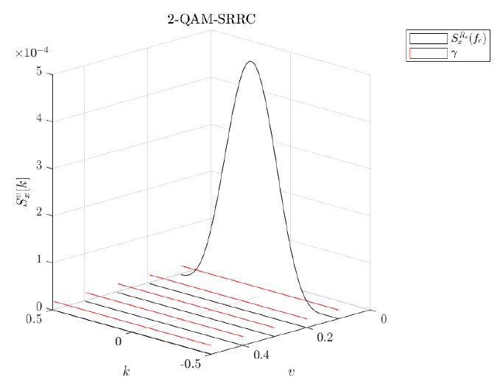

The Streaming-SCA: Trade-Offs
Notes:
In exchange for this low-memory utilization, the processing time is increased.
This amounts to a design trade-- parameters are determined depending on the SU's allotted time to move away from the PU.
Plot shown is the CSD produced by using a MATLAB simulation of our streaming-SCA
Next, we will describe the implement of the streaming-SCA as a digital circuit, by walking through each component and its subcomponents.
This design uses no third-party intellectual property, which improves platform portability, reconfigurability, transparency of operation, and troubleshooting.
There are minor references to VHDL functions, such as resize(), however, this chapter is intended to be language agnostic.

Slide 28
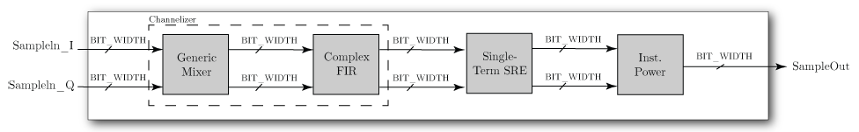
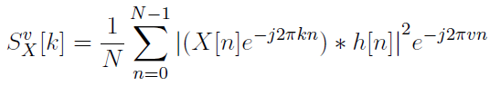
Digital Design: The Center Frequency Estimator (CFE)
Notes:
The purpose of the center frequency estimator (CFE) is to produce a CSD estimate for each SR, CF candidate.
This module produces the estimate of a (v; k) pair, which maps to some (Rs; fc).
Mathematically, this module corresponds to Equation (17), rewritten here, for some X; v; k; n;
The magnitude square can be taken to produce the sufficient statistic

Slide 29
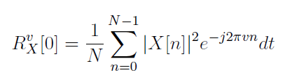
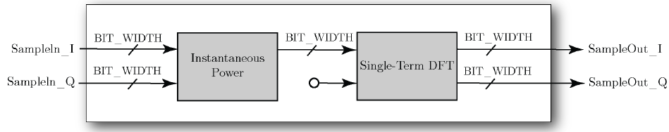
Digital Design: The Symbol Rate Estimator (SRE)
Notes:
This module is an implementation of the CAF, but for tau = 0;

Slide 30
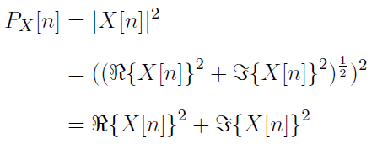
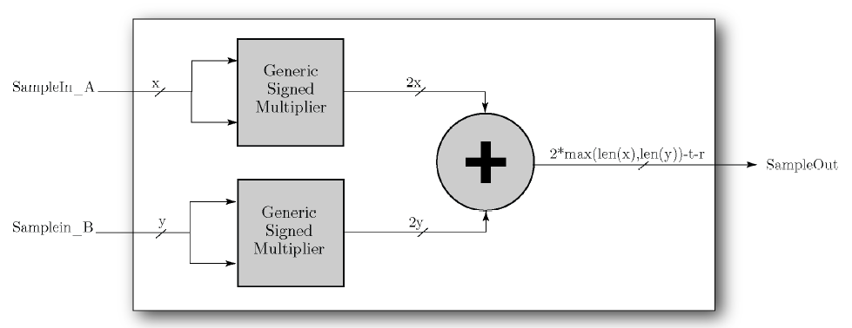
Digital Design: The Instantaneous Power
Notes:
This module serves as a special case of the AF for tau=0.
This special case is equivalent to one index of Parseval's theorem, which is expressed as the magnitude squared.
This is mathematically expressed as:

Slide 31
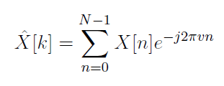
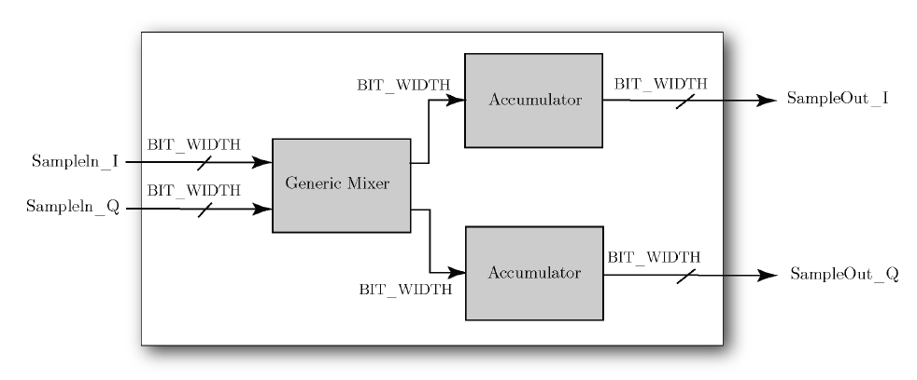
Digital Design: The Discrete Fourier Transform (DFT)
Notes:
The DFT is used to perform frequency-domain analysis of discrete-time signals.
For this implementation, the below expression is evaluated for one k at a time, as opposed to the FFT, which calculates all values of k simultaneously.
The DFT of X[n] is expressed mathematically as:

Slide 32

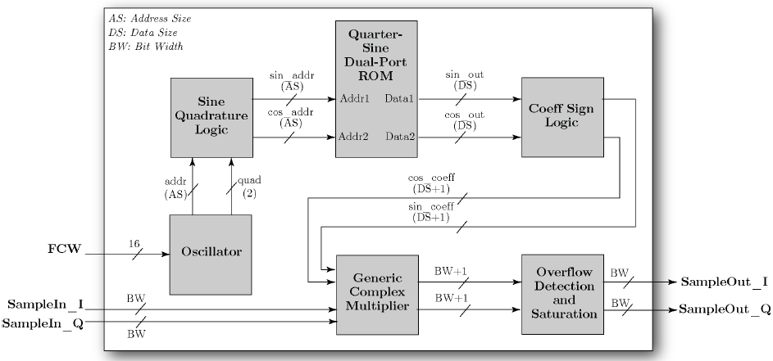
Digital Design: The Frequency Mixer
Notes:
A heterodyne is a signal frequency that is produced by mixing the frequencies of two signals.
In this context, frequency mixing is performed by element-wise multiplication of a signal with a digital numerically controlled local oscillator (NCO).
The frequency mixer is mathematically expressed as:

Slide 33
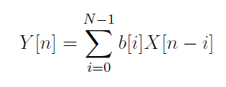
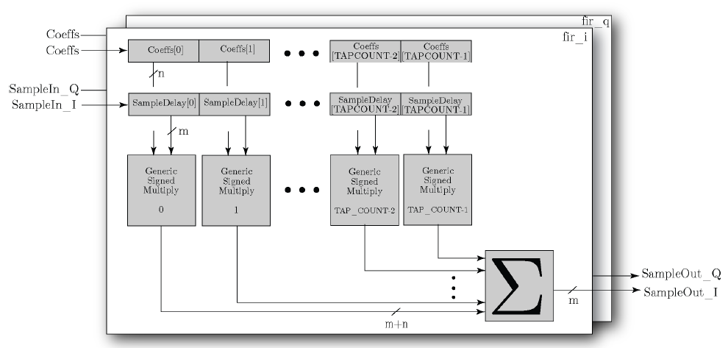
Digital Design: The Low-Pass Filter
Notes:
A finte impulse response (FIR) is a filter whose response to any finite-duration input settles to zero in a finite amount of time.
Filter coefficients are calculated given the desired properties of the filter in MATLAB or python.
The FIR implements the convolution sum as defined by the equation:

Slide 34
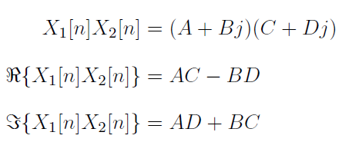
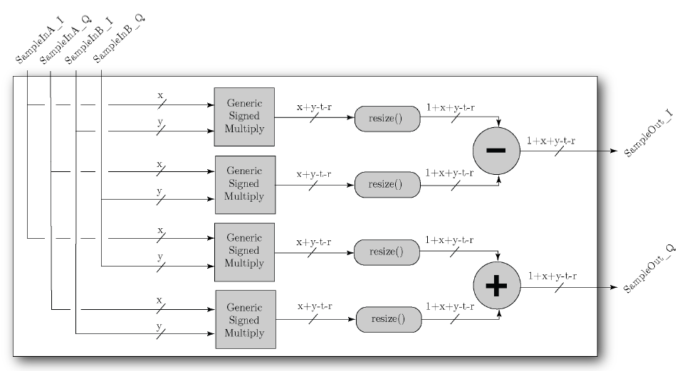
Digital Design: The Complex Power
Notes:
The product of two complex numbers can be expressed in terms of pairs of real and imaginary components as follows:

Slide 35

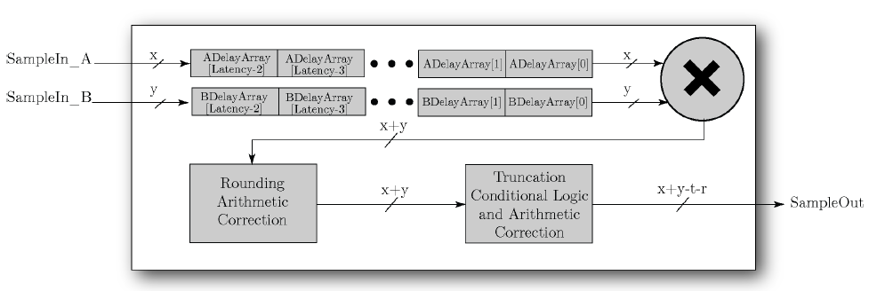
Digital Design: The Multiplier
Notes:
There are many real multipliers used throughout this design.
Although multipliers exist as a primitive operation in HDL languages, a module is used to ensure proper timing, handshaking, bit-widths, delays, fixed-point control, and rounding.
Mathematically, this module performs the multiplication of two real values, expressed as:

Slide 36
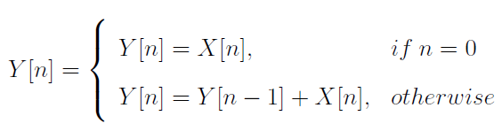
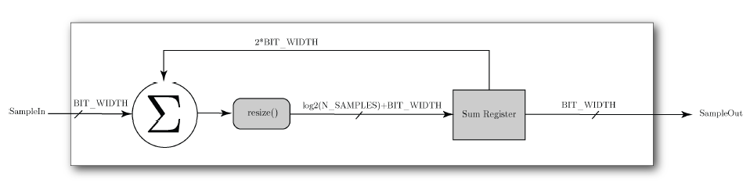
Digital Design: The Accumulator
Notes:
The accumulator is the most important module in the design concerning flow control.
This module has three core functions:
Acting as the summation component of all previous modules,
Acting as the normalization component of all previous components,
Acting as the reset between sample sets.
Mathematically, the accumulator is expressed as the difference equation:

Slide 37
IV.
PERFORMANCE
“t would be so nice if something made sense for a change.”
–Lewis Carroll
Notes:
This chapter will characterize the performance of the streaming SCA's ability to correctly sense and classify the CF and SR of signals in a monitored spectrum.
First, we generate a transmit M-QAM-SRRC waveform in software using python.
The waveform is then passed through a software channel and saved to a file in a fixed-point format using python.
The receiver is a VHDL testbench that reads the file, processes the in-phase and quadrature (IQ) samples using the streaming SCA, then saves CSD results to a new file.
We then plot the CSD in MATLAB, along with its corresponding threshold.
A detected SR is any spectral slice v above the threshold.
A detected CF is a peak k for a detected SR slice. Finally, these bins are mapped to their true values (Rs; fc), respectively.

Slide 38
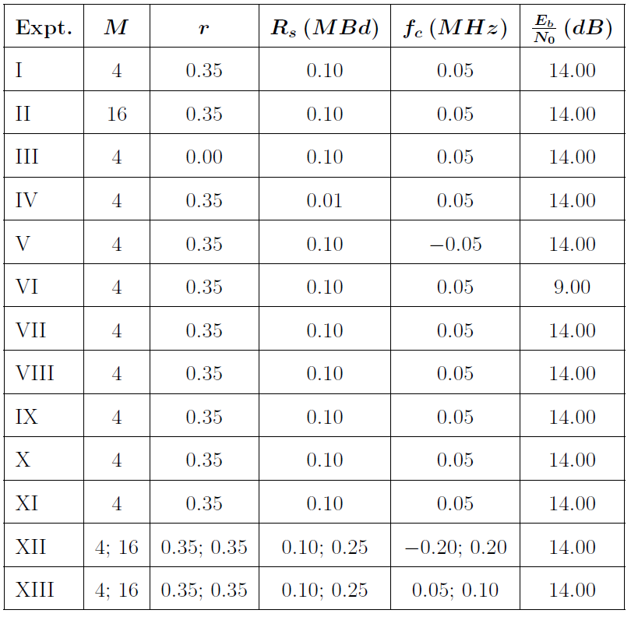
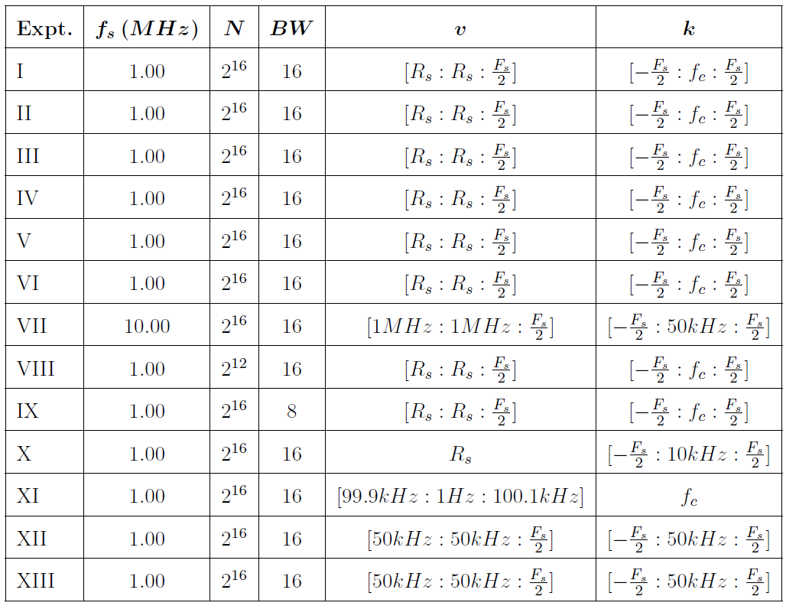
Experimentation: Test Plan
Transmitter & Channel
Receiver
Notes:
Characterization is performed by first establishing baseline parameters for the transmitter and receiver.
While baseline parameters provide results that are easy to be accurately detected, they may not reflect real-world constraints such as hardware restrictions or channel impairments.
Each subsequent experiment is a parametric analysis of the effect of modifying a given parameter.

Slide 39
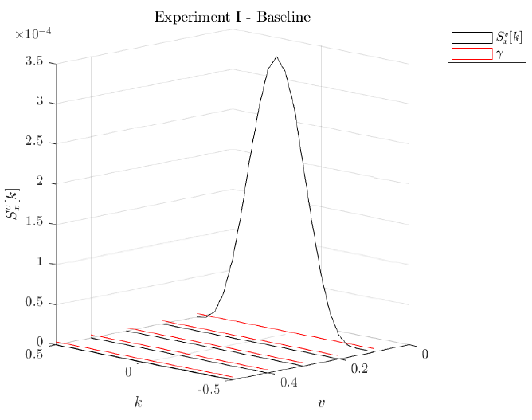
Experiment I: Baseline
Notes:
Characterization is performed by first establishing baseline parameters for the transmitter and receiver.
While baseline parameters provide results that are easy to be accurately detected, they may not reflect real-world constraints such as hardware restrictions or channel impairments.
Each subsequent experiment is a parametric analysis of the effect of modifying a given parameter.

Slide 40
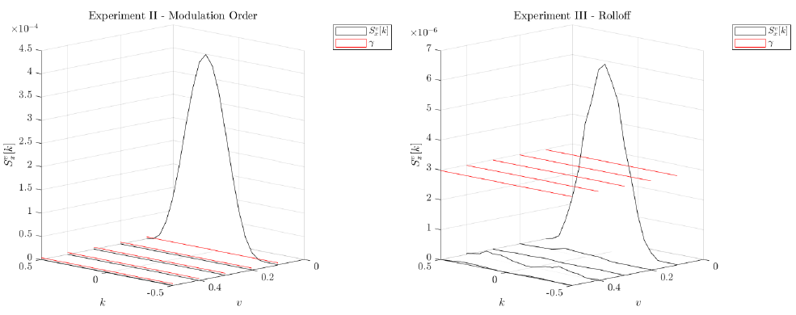
Experiment II & III: Increased M, Decreased Roll-off
Notes:
M = 64
R = 0.00

Slide 41
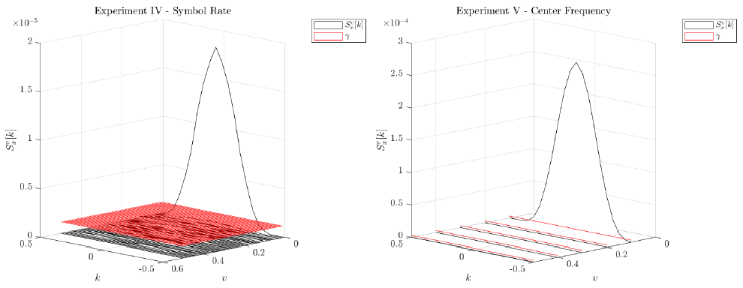
Experiment IV & V: Smaller Symbol Rate, Negative Center Frequency
Notes:
Rs = 0.01MBd
fc=-0.05

Slide 42
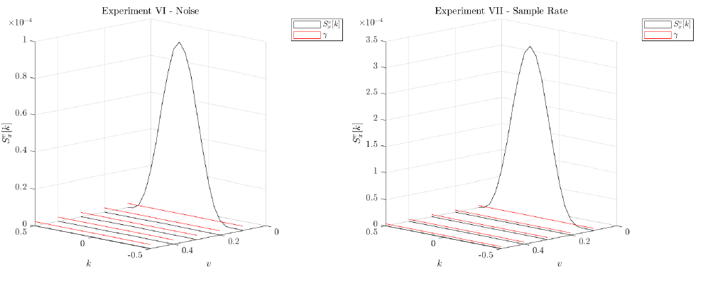
Experiment VI & VII: Decreased Eb/N0, Increased Symbol Rate
Notes:
EbN0=9.00
Fs=10.00

Slide 43
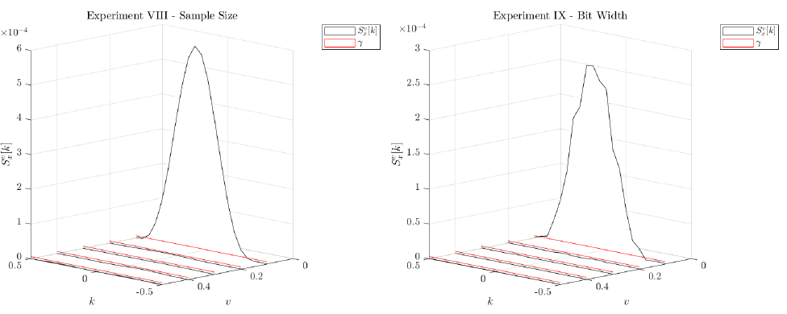
Experiment VII & IX: Decreased Sample Size, Decreased Bit Width
Notes:
N=2^12
BW=8

Slide 44
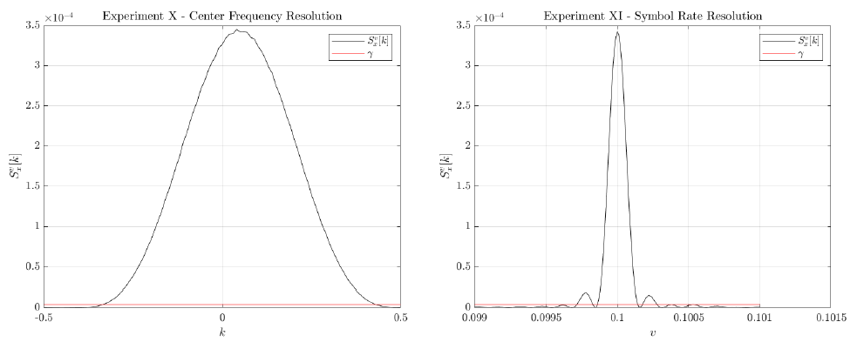
Experiment X & XI: CF Resolution, SR Resolution
Notes:
Rs=Rs
fc=[-fs/2:10kHz:fs/2]
Rs=[99.9kHz:1Hz:100.1kHz]
fc=fc

Slide 45

Experiment XII & XIII: Multiple Waveforms, Overlapping Waveforms
Notes:
Complete resilience to multiple waveforms as long as cycle frequencies are different.

Slide 46


Experimentation: Results
Performance
Resource Utilization
Notes:
Processing time ranges from about 0.4s to 13s.
I was told that anything up to 5 min should be okay.
Resource utilization is very low.

Slide 47
IV.
CONCLUSION
“One of the hardest things in the world is to convey a meaning accurately from one mind to another.”
–Lewis Carroll
Notes:
Finally, we arrive at our conclusion.

Slide 48
Summary
We investigated a low-memory FPGA implementation of an SCA for M-QAM-SRRC SR-CF detection.
We began by developing a set of assumptions that limited the scope of existing SCA paradigms.
We then discussed the HDL design used to construct such a system, which did not rely on FFTs and used no proprietary tools.
Following this, we presented the performance characterization results of the newly formed streaming-SCA.
Notes:
Read slides?

Slide 49
Future Work
Pre-processor
Decimation
Threshold
Reduces search space dramatically
Intelligently sweeps through search space
Requires design of data structure, scheduling
If preprocessor is implemented, new data structure and scheduling mechanisms allow for decimation of Fs/Rs
Greatly reduces number of samples to be processed
The threshold shown is the most basic of examples
Other thresholds exist to be explored but are much more complicated
Increase probability of detection, decrease probability of false alarm
Even lower EbN0, bit widths, etc.
Notes:
Read slides

Slide 50
A Low-Memory Spectral-Correlation Analyzer for Digital QAM-SRRC Waveforms by Dylan Jacob Gormley
“Would you tell me, please, which way I ought to go from here?"
"That depends a good deal on where you want to get to."
"I don't much care where –"
"Then it doesn't matter which way you go.”
–Lewis Carroll
Notes:
Any questions?

