Slide 1

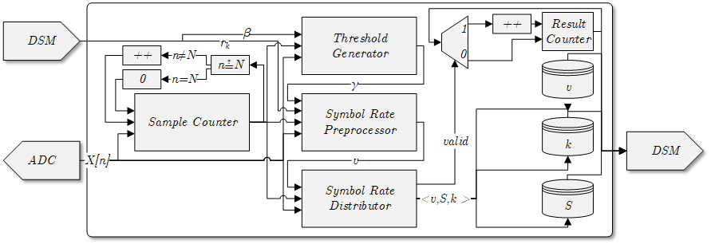
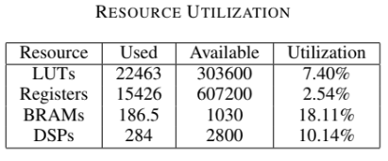
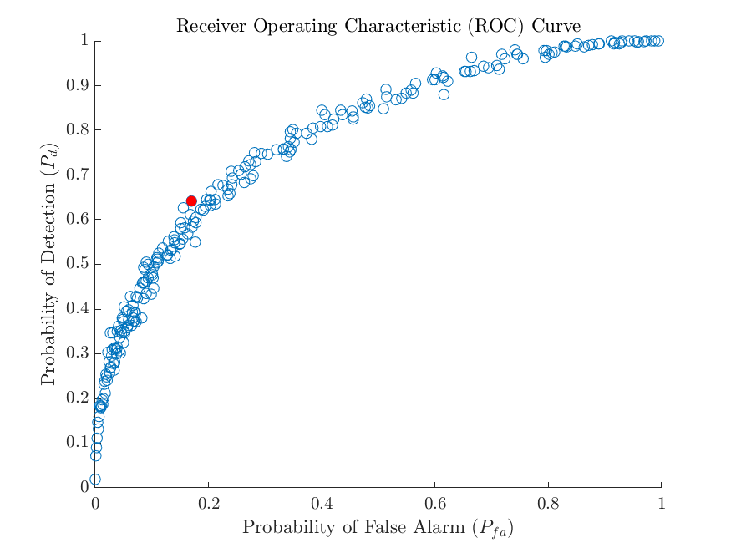
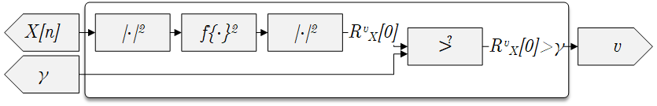
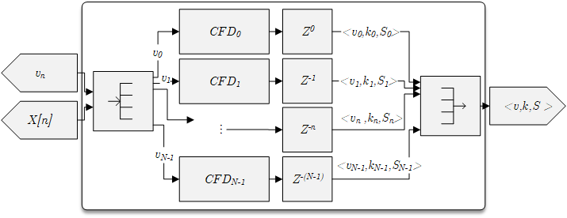
A Hybrid Technique to Increase Throughput of the NASA’s Streaming Spectrum Sensor
Dylan Gormley | NASA Glenn Research Center
Abstract
Top-Level Component
Results
In previous work, there has been significant progress on edge device RF feature detection using a hardware algorithm known as the streaming spectrum sensor (StSS). Unlike other spectrum sensor implementations, the StSS can function on edge devices due to its low memory requirements. While the StSS accomplishes its objective of low memory detection, it sacrifices detection throughput. This work investigates a hybrid technique to balance memory and throughput.
Related Work
The top-level component interfaces with a dynamic spectrum manager (DSM), which controls the StSS and retrieves results. The key update in this paper is the addition of the symbol rate preprocessor (SRP), which adds a single FFT in order to dramatically increase performance of the system.
This is the fourth installment on a series of work related to edge device spectrum sensing. Previous works were
A Low-Memory Spectral-Correlation Analyzer for Digital QAM-SRRC Waveforms
A Spectrum Sensor for CubeSat Radios
Toward the Development of a Multi-Agent Cognitive Networking System for the Lunar Environment
Preprocessor
Streaming Spectrum Sensor Review
A device that can detect radio frequency (RF) spectrum features, whatever the method, is known as a spectrum sensor. The use of this knowledge to improve radio performance is known as cognitive radio (CR). One common technique of RF feature detection is using what is known as spectral correlation analyzers (SCA). SCAs estimate a given channel’s spectral correlation function (SCF), also called cyclic spectral density (CSD). Various implementations are available in the literature, such as the SSCA and FAM, each with strengths and weaknesses.
This paper focuses on one implementation method, the streaming spectral correlation analyzer (StSCA). This method functions on severely resource-constrained platforms, known as edge devices, by estimating the SCF with a focus on memory efficiency. The results of the StSCA are part of the streaming spectrum sensor (StSS). The StSS uses peak detection and a threshold on the SCF generated by the StSCA to detect the symbol rate and center frequency offset of active users in a channel.
This paper discusses design improvements to the StSS. It is primarily concerned with adding a preprocessor component to increase throughput at a minimal memory cost. Also covered in this paper are minor design updates that increase performance, reliability, and resource consumption. Resource utilization is provided for a sample device.
Unlike the original symbol rate estimator, which processes a single-term DFT instances serially, the SRP processes all terms using a N-point FFT.
Feature Detection
For a nominal use case we find that this approach maintains favorable detection and classification results, all while keeping the resource utilization under 20%. This is ideal, as edge devices will also need resources available for baseband processing, at a minimum.
Conclusion
The original StSS design focused on a minimal memory SCA design in order to fit RF Feature Detection onto edge devices, such as cubesats. In this work, we find that we can drastically increase the throughput of the StSS by adding a single FFT to the frontend of the design.
Instead of the StSCA attempting to detect every possible symbol rate, the preprocessor generates candidates, dramatically increasing feature detection throughput.
Notes:
To change this poster, replace our sample content with your own. Or, if you'd rather start from a clean slate, press the New Slide button on the Home tab to insert a new page. Now enter your text and pictures in the empty placeholders. If you need more placeholders for titles, subtitles or body text, copy any of the existing placeholders, then drag the new one into place.

