Slide 1
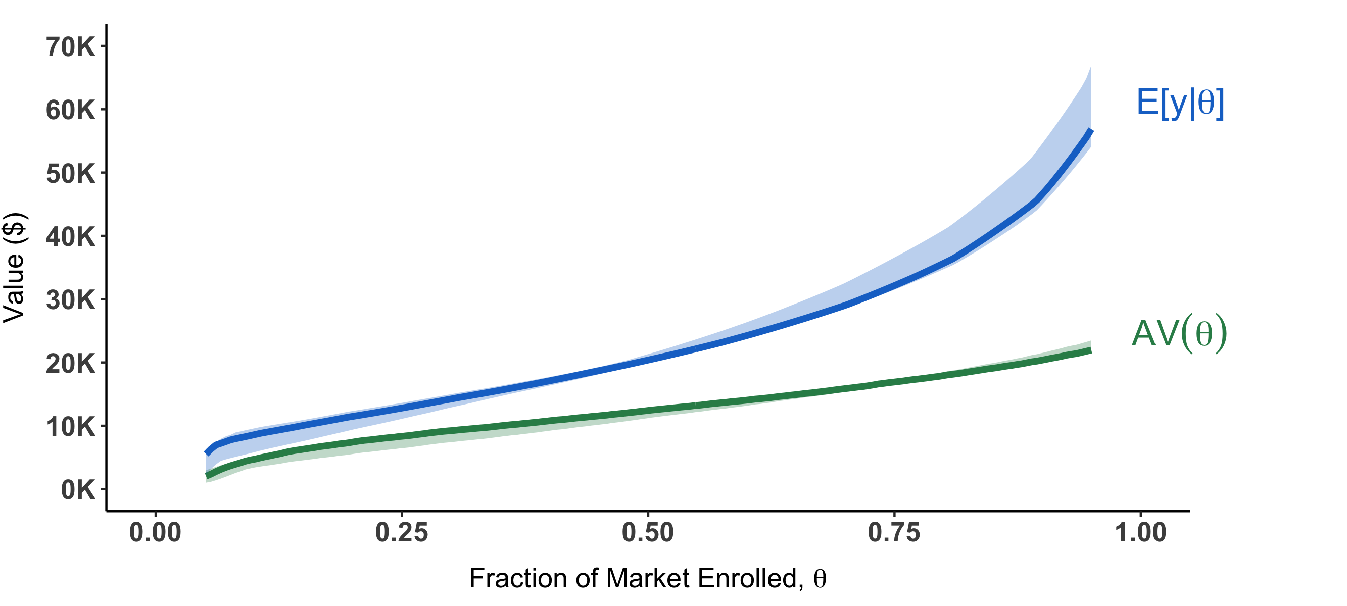
Expected Earnings
Median college-goer expects to earn $20K at age 26
Average Value

Slide 2
Expected Earnings
Median college-goer expects to earn $20K at age 26
Average Value
But the average earnings of those with below-median expectations is $12K

Slide 3
Expected Earnings
Median college-goer expects to earn $20K at age 26
Average Value
So a stake in their earnings is worth only $12K to financiers

Slide 4
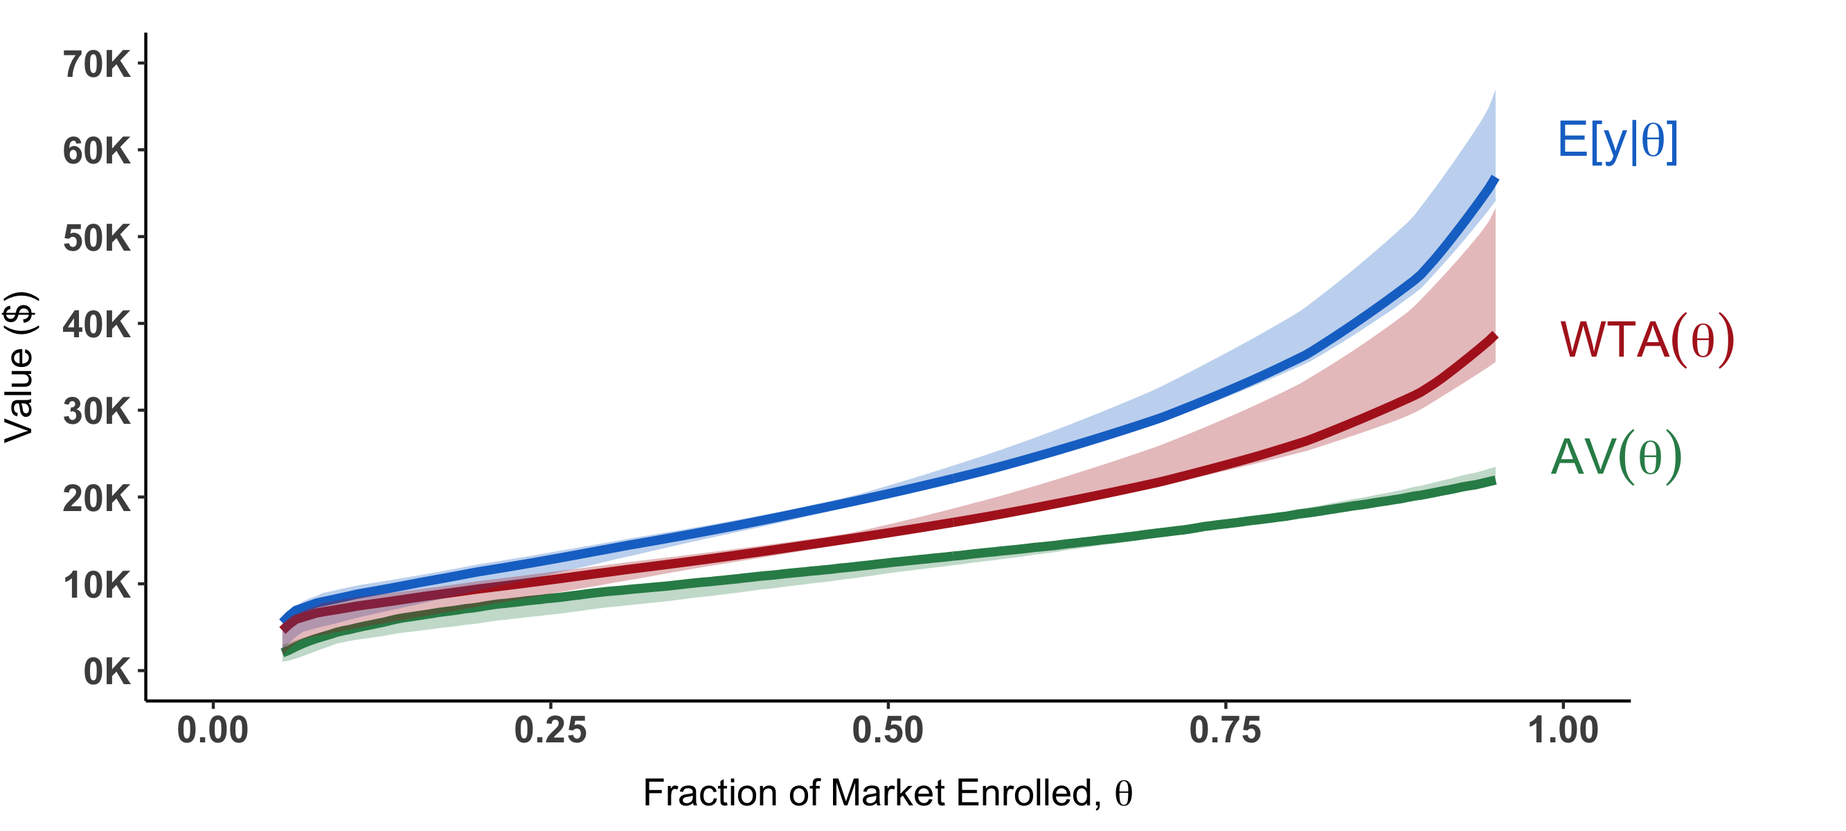
Expected Earnings
Willingness to Accept
Median individual’s WTA is $16K
Average Value
Notes:
Earnings-Equity

Slide 5
Expected Earnings
Willingness to Accept
Average Value
Financier loses 25% ($4K for every $16K)
Notes:
Earnings-Equity

Slide 6
Expected Earnings
Willingness to Accept
They could lower their valuation to $12K…
Average Value
Notes:
Earnings-Equity

Slide 7
Expected Earnings
Willingness to Accept
They could lower their valuation to $12K…
Average Value
But now average earnings of those accepting the contract is just $10K
Notes:
Earnings-Equity

Slide 8
Expected Earnings
Willingness to Accept
They could lower their valuation to $12K…
Average Value
The financier again loses money: $2K for every $12K of financing they offer…
Notes:
Earnings-Equity

Slide 9
Expected Earnings
Willingness to Accept
Average Value
Notes:
Earnings-Equity

Slide 10
Expected Earnings
Willingness to Accept
The process continues and the market fully unravels
Average Value
Notes:
Earnings-Equity

