Slide 1
Ames, Iowa Housing Price Prediction
Hugh Goode, David Jhang, Jack Copelan, Jung Hwan Lim

Slide 2
Overview of Data Set
80 Features
Sale price is target variable
2,580 Observations
Real Estate Data Set used for Addresses to generate mapping
Data from January 2006 – March 2010
RE address data up to 2020
37 numeric data type features and 43 categorical string data type features

Slide 3
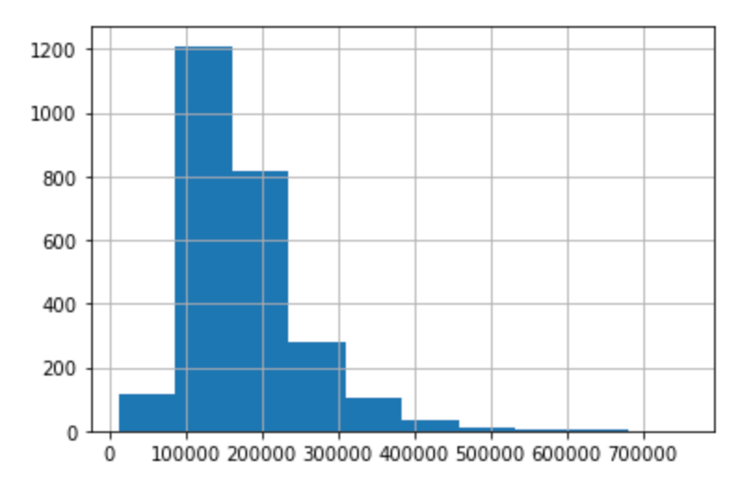
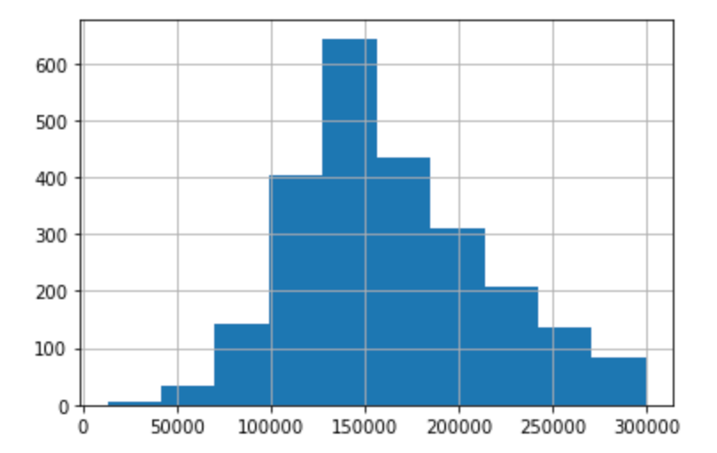
EDA - Histograms of Sale price
($) Sale price all observations
($) Sale price all observations <$300,000

Slide 4
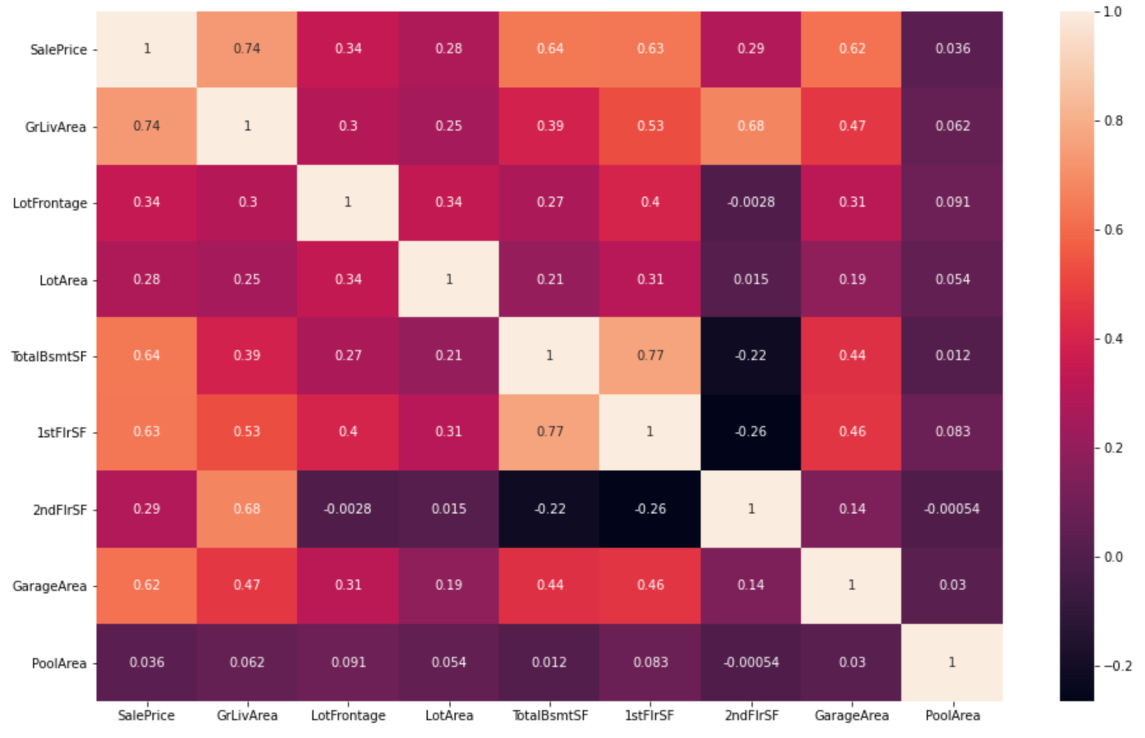
EDA – correlation heat map of numeric features

Slide 5
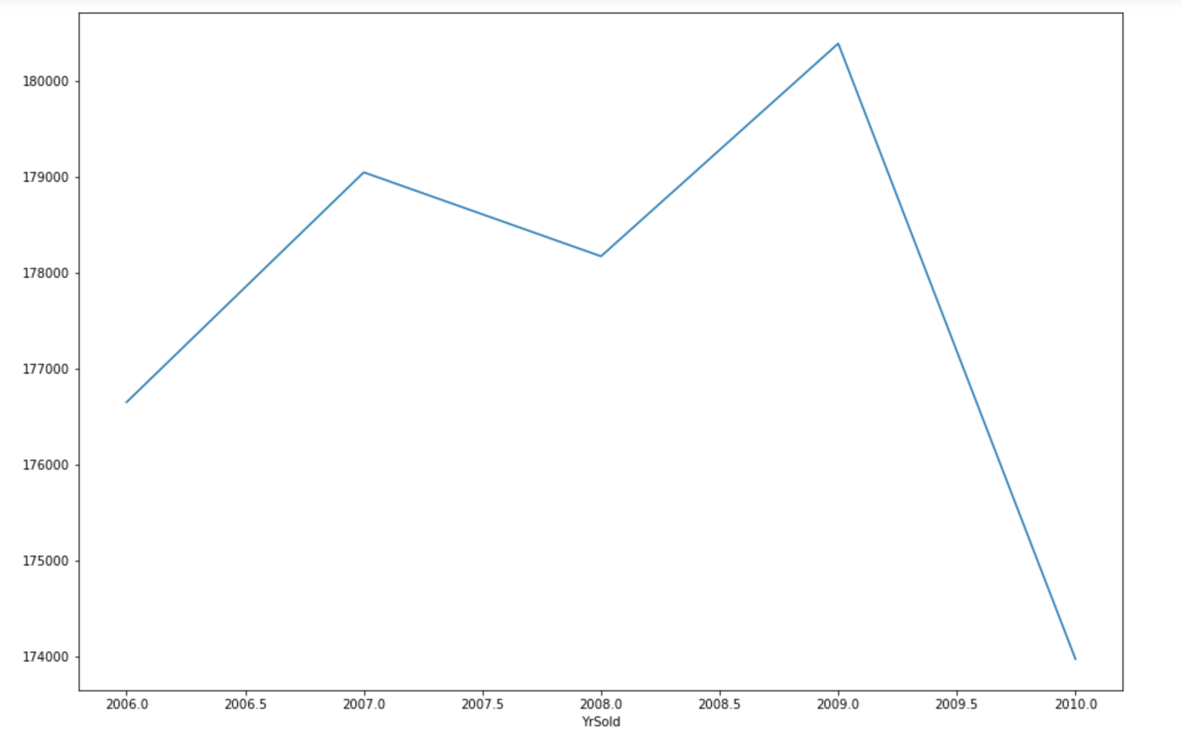
EDA – Average sale price by year

Slide 6
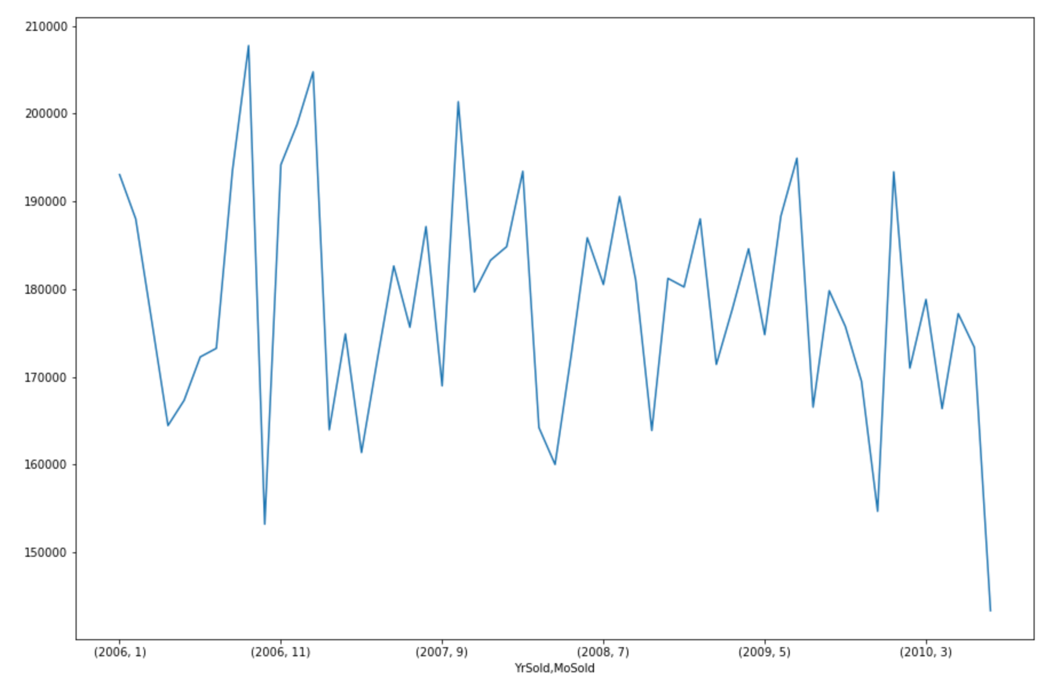
EDA – Seasonal trend in sale price

Slide 7
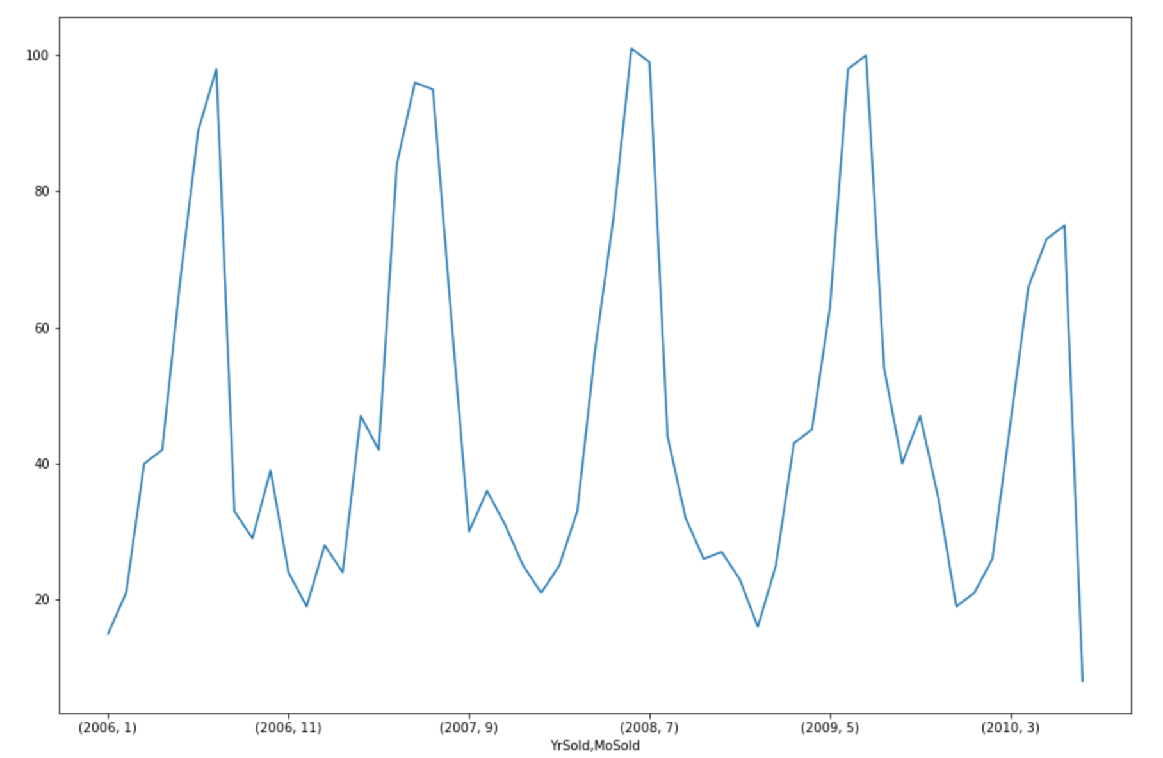
EDA – Seasonal trend # houses sold

Slide 8
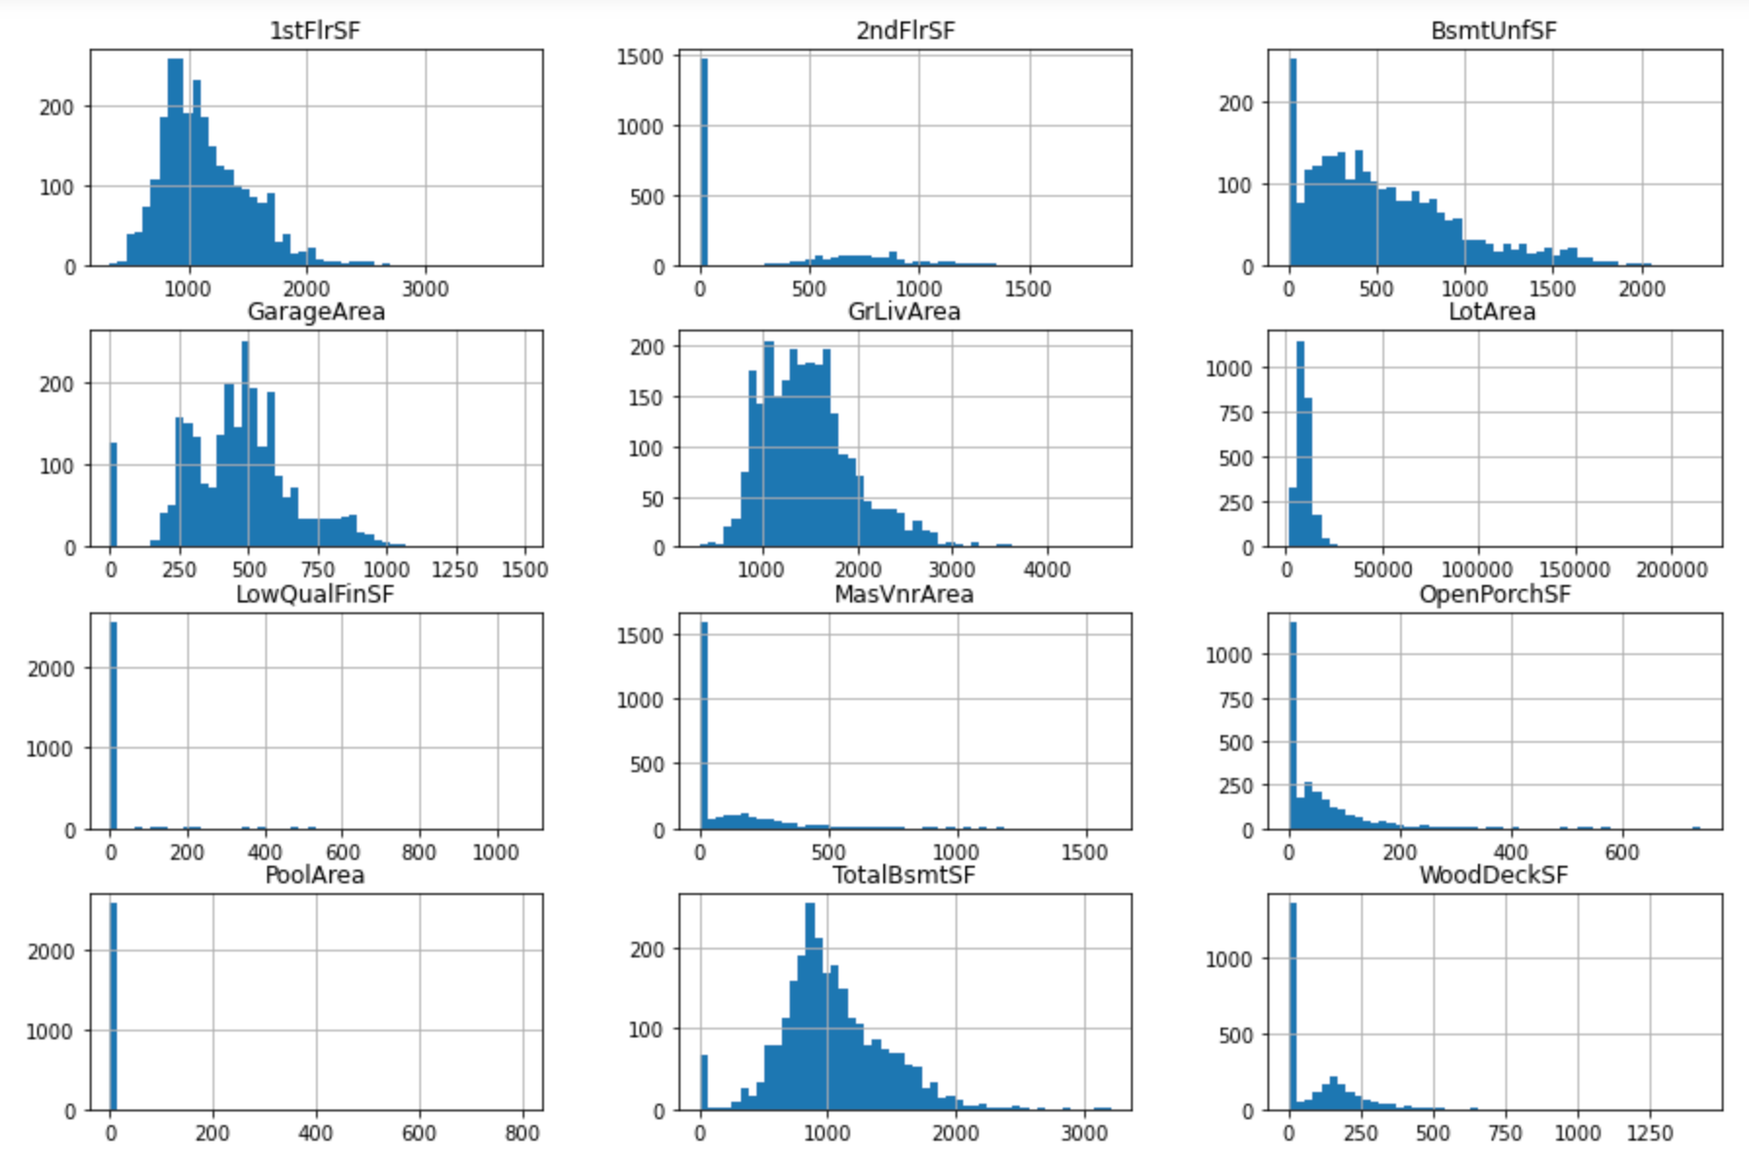
EDA – Distribution of features

Slide 9
Data Cleaning
Assumption – Predicting for 2011 (no inflation adjustment), residential houses can be in commercial zone
Filter out non-normal sale-types
Remove duplicate PID’s
Fill NA’s – Mean vs 0s
Mean : Lot Frontage, GarageYrBlt
0: BsmtFinSF1, BsmtFinSF2, BsmtUnfSF1, MasVnrArea, BsmtFullBath, BsmtHalfBath, GarageCars, GarageArea,
Categorical: Fill with ”No_(InsertFeature)”

Slide 10
Data Cleaning – New Features
TotalBath = FullBath + HalfBath + BsmtFullBath + BsmtHalfBath
TotalLivArea = GrLivArea + TotalBsmtSF
Bsmt_unfin_ratio = BsmtUnfSF / TotalBsmtSF
TotRmsAbvGrd = TotRmsAbvGrd - Bedroom (we already included bedroom but removed kitchen)

Slide 11
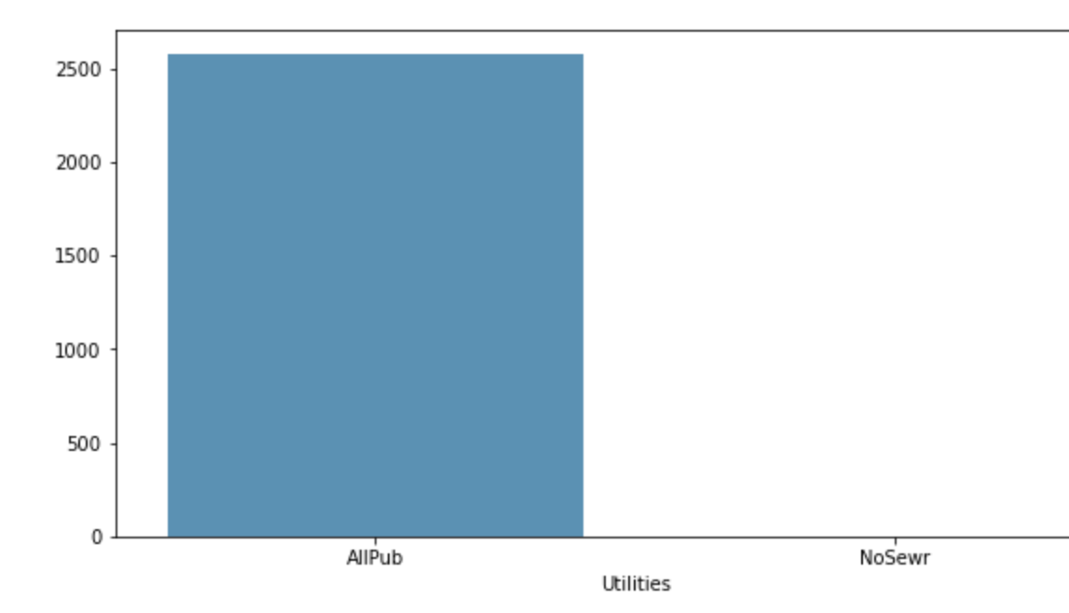
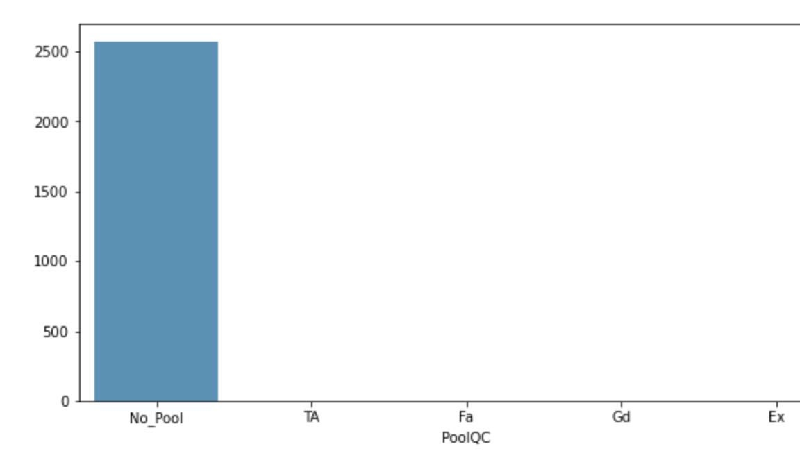
Data Cleaning – Remove Features
GrLivArea
1stFlrSf
2ndFlrSf
BsmfFinSF1
BsmtFinSF2
BsmtUnfSF
FullBath
HalfBath
Street
Alley
Utilities
Condition2
RoofMatl
Heating
Electrical
LowQualFinSF
Kitchen
GarageCars
GarageCond
PoolArea
PoolQC
MiscFeature
MiscValue
SaleType

Slide 12
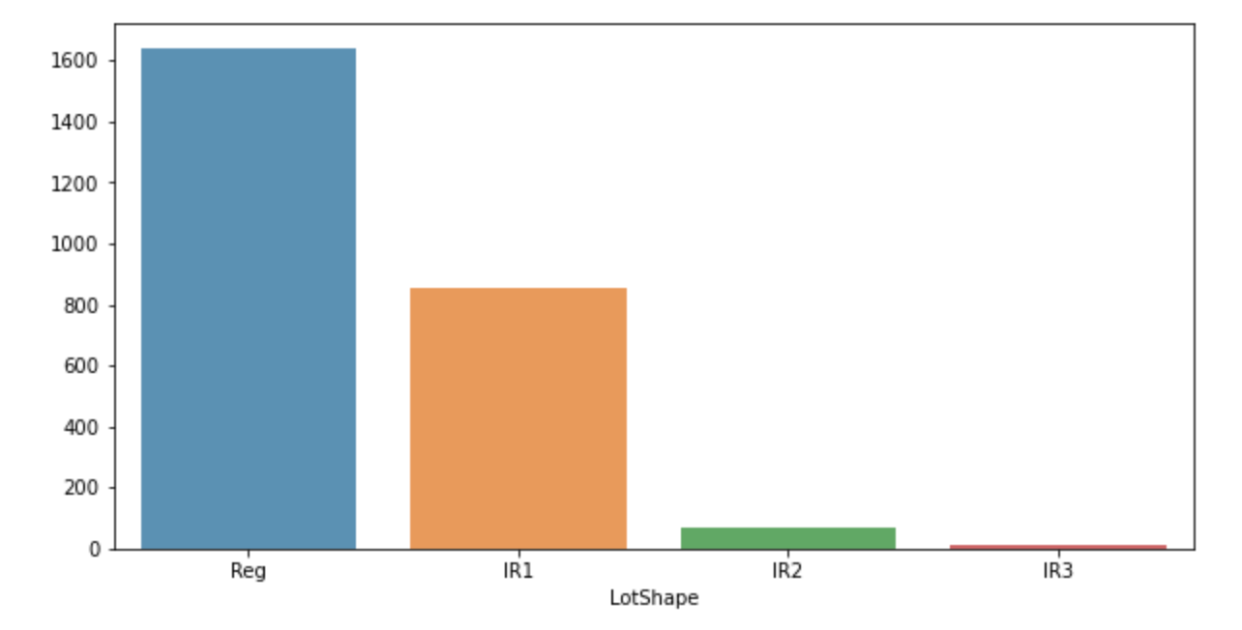
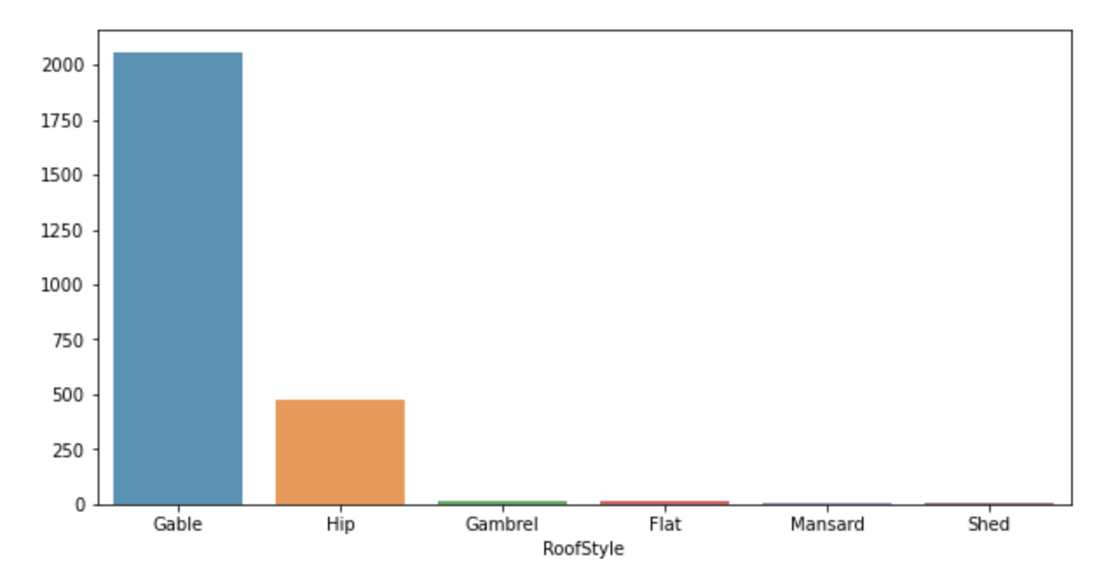
Revised Feature Categories
LotShape = split into Regular Irregular
RoofStyle = Keep Flat/Gable, everything else "other"

Slide 13
Data Cleaning continued
Cook’s Distance to remove 4 observation with P-values > 0.05
MinMax Scaler for numeric values (non-normal distribution)
Dummify for Linear Models/Label Encoding Category
Log Price for Linear Models
Train Test Split with Random State
Shared Data Preprocessing Function

Slide 14
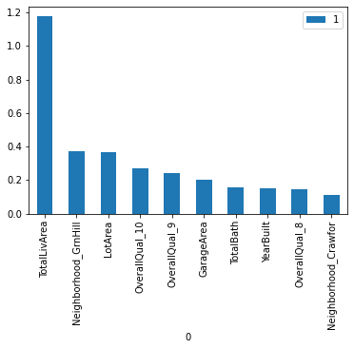
Penalized Linear Regression Model’s
Ridge – Best Score – R2 = 93.33
Params: alpha = 1.0, max_iter= 10,000
Lasso – Best Score – R2 = 93.33
Params: alpha = .0009, max_iter = 10,000
Elastic Net – Best Score – R2 = 93.35
Params: alpha = .0002, rho=0.3, max_iter = 10,000

Slide 15
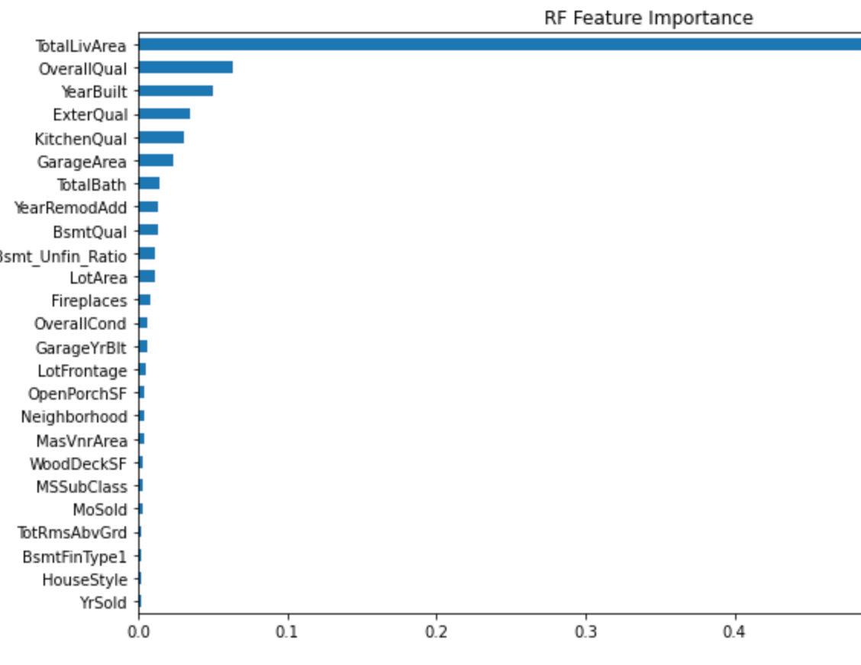
Tree Based Models
Random Forest - Best Score - R2 = 91.13
Params: max_depth = None, max_features=25, min_samples_leaf = 5, n_estimators = 1000
Important Features: TotalLivArea, OverallQual, YearBuilt, ExterQual, KitchQual, GarageArea

Slide 16
Tree Based Boosting Models
Gradient Boost – Best Score – R2 = 93.86
Params: n_estimators = 1000, max_depth = 2, learning_rate = 0.1
AdaBoost Score – Best Score – R2 = 84.54
Params: n_estimators = 41
CatBoost Score – Best Score – R2 = 94.21
Params: depth = 4, iteration = 700, l2_leaf_reg = 0.2, learning_rate = 0.05

Slide 17
Support Vector Machines
Linear Best Score – Best Score – R2 = 94.91
Params:
gamma = 0.1,
C = 1.125,
epsilon = 0.04,
kernel = ‘poly’,
degree = 1

Slide 18
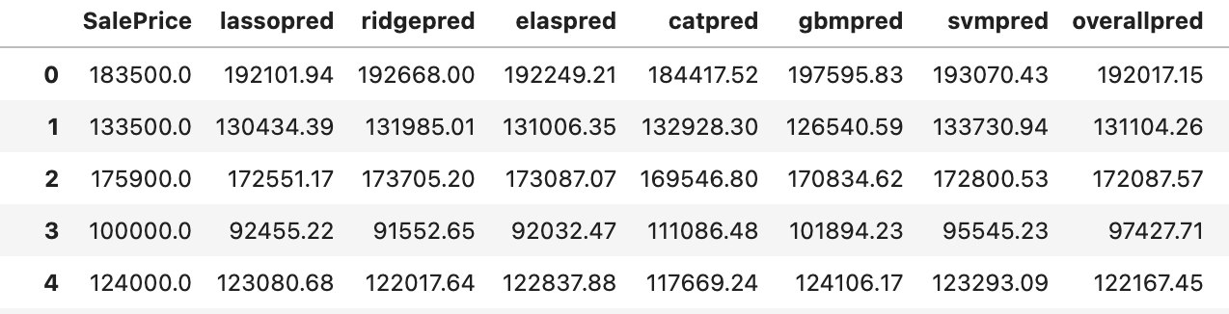
Ensemble
Stacking (average) – Best Score – R2 = 95.61
Models: Lasso, Ridge, ElasticNet, SVM, Gradient Boost, CatBoost
Took the average of the predicted values of each individual model and the average prediction resulted in better predictions than each model.

Slide 19
App Demo

Slide 20
Next Steps/Lessons Learned
Create ensemble model with weighting
Explore more advanced models such as neural network
Increase predictive capability within the app
Getting business feedback from stakeholders
Make predictions relevant to present day
inflation, market trends, & other economic factors

