Slide 1
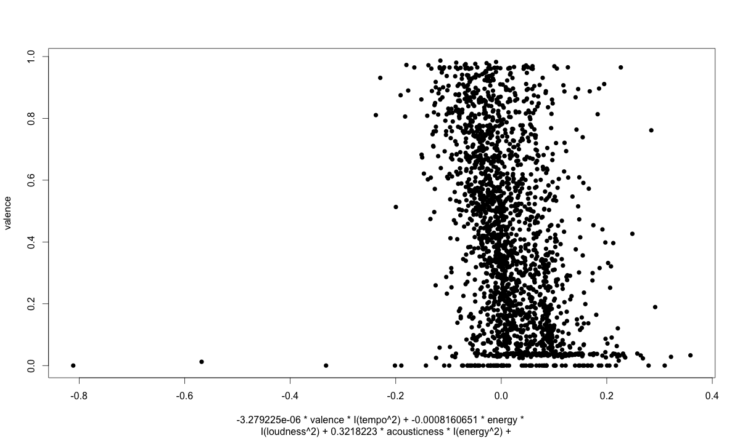
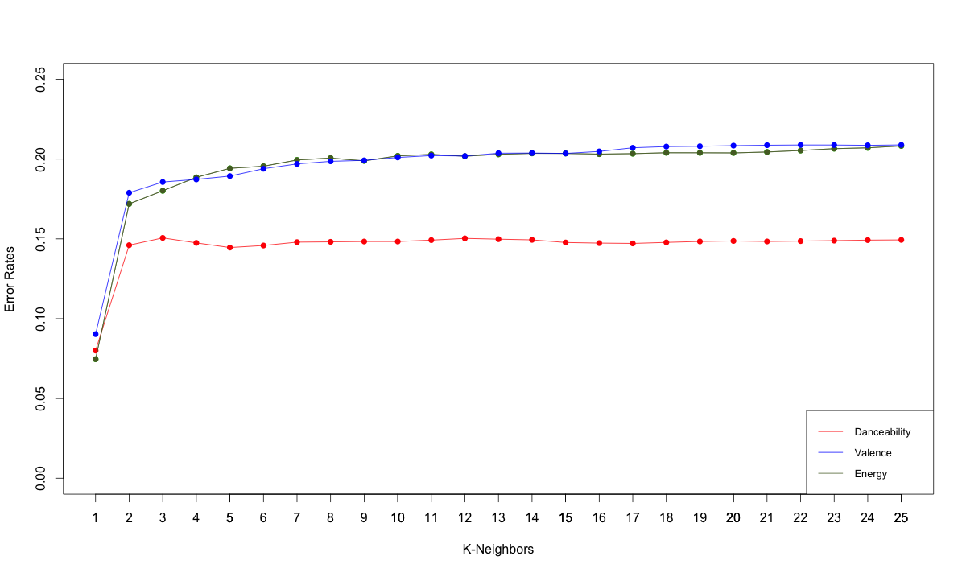
Do You Want To Dance?
By Veena Calambur, Daniel Hanggi, Javier Ortiz & La Vesha Parker
Background & Setup
Project Motivation
Implementation
Feature Mapping Application
Method: with R’s linear fit methods, we derived a model based Variables with high correlations amongst each other
2. Supervised: K-Nearest Neighbors regression
Predicted a song’s danceability, energy, & valence, based on Euclidean Distance Metric on our transformed data
3. Unsupervised: Hierarchical Agglomerative Clustering
employed Group-link HAC from Matlab & Judged
cluster purity by looking at genre distribution within each cluster
Music can be quantified numerically in terms of variables such as valence, energy, tempo, but to what extent can we use these variables to learn more complicated classifications that hinge on human perceptions of music?
Problem Statement
Danceability = -(3.279225 * 10⁻⁶) valence * tempo²
+ -(8.160651 * 10⁻⁴) energy * loudness²
+ (3.218223 * 10⁻¹) acousticness * energy²
+ -(3.27 9225 * 10⁻⁶) liveness * speechiness
+ (3.793979 * 10⁻⁴) tempo * energy
+ -(7.492498 * 10⁻³) loudness *acousticness
+ (7.001209 * 10⁻²) instrumentalness * valence
+ -(6.132415 * 10⁻⁴) valence * loudness
+ (1.359087 * 10⁻²) * energy * loudness * valence²)
Focusing on the following attributes
Danceability: a combination of energy, rhythm, and tempo approximated using algorithmic estimation. (values in range: [0.0,1.0])
Energy: Energy from listener point of view (values in range: [0.0,1.0])
Valence: Measure of the emotional content of a song (values in range: [0.0,1.0])
We want to research the questions:
Can we derive the values of the subjective attributes for a given song?
Can we learn underlying genres of songs based on these given music attributes that we derived in supervised learning?
Analysis & Conclusion
KNN Results
Takeaway from Results
Transformation helped us learn relationships among data attributes
Relatively few “Pure” clusters with distinct genres: We are not considering all attributes that define genre
Challenges Faced
Attributes were not properly defined and were discovered to have all been learned through machine learning algorithms
Provided Motivation to change our project to re-deriving echo nest, to understand our data
Future Work
Attempt to find the missing attribute for better clustering
current ideas: lyric or sentiment analysis to “interact” with our current attributes
Consider using weighted KNN to factor in song distances for predictions
Error Rates for K = [1,25] Nearest Neighbors
HAC Results

