Slide 1
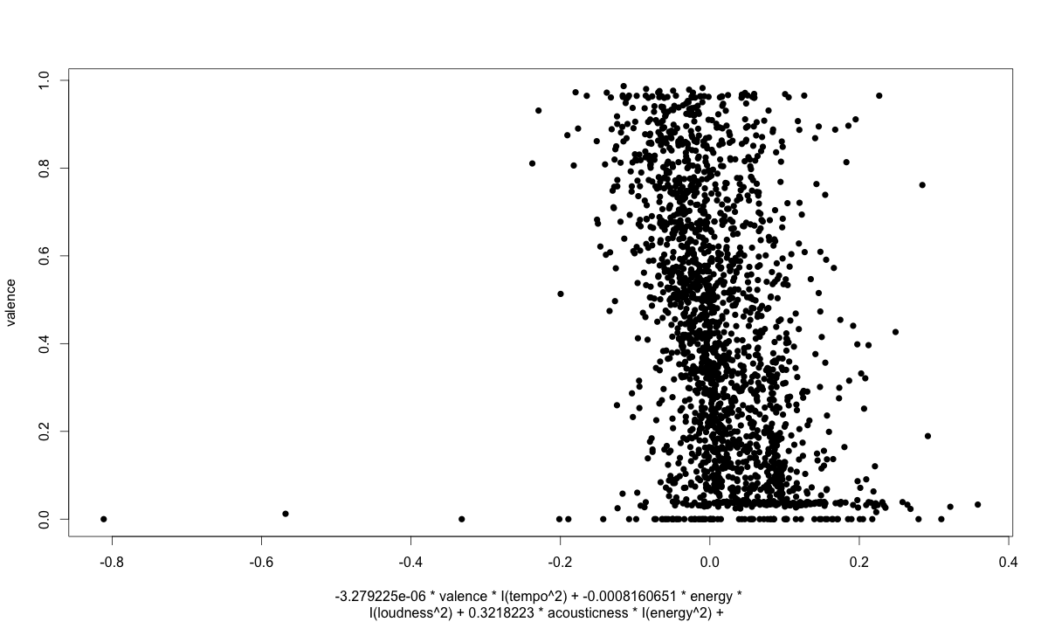
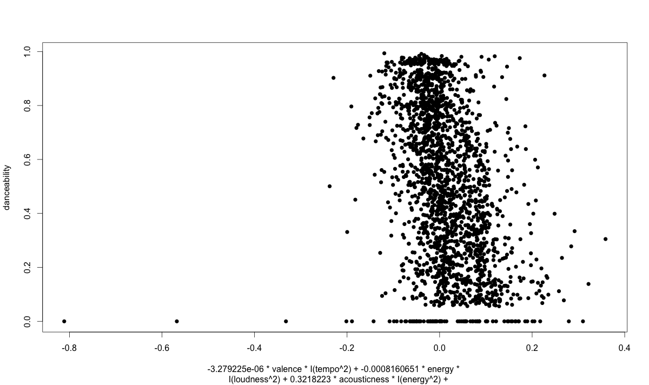
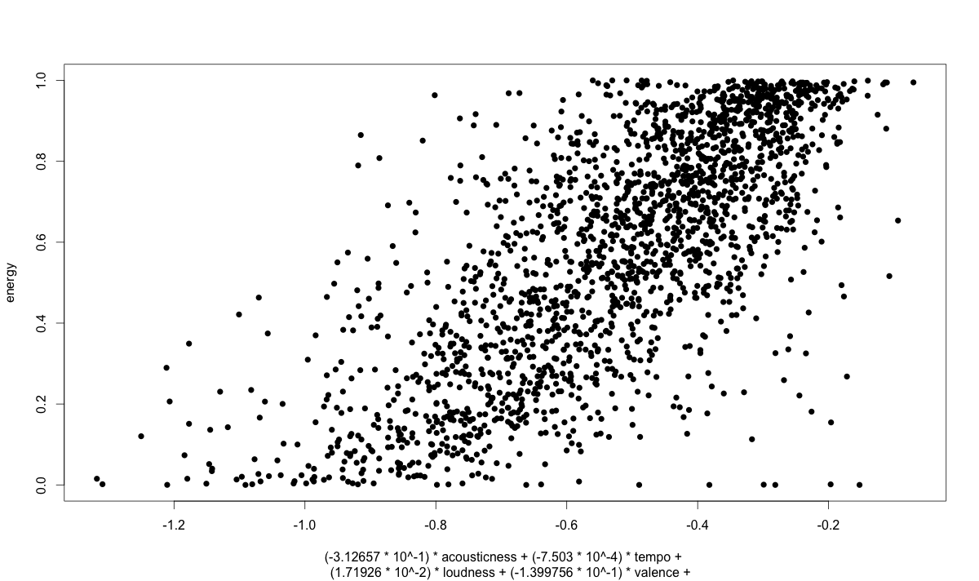
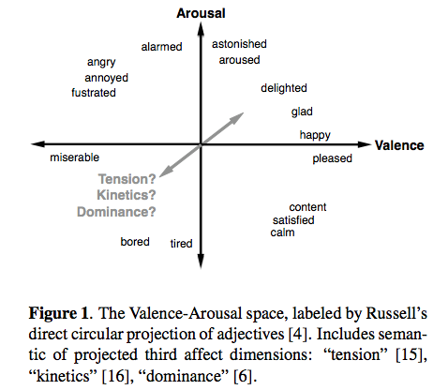
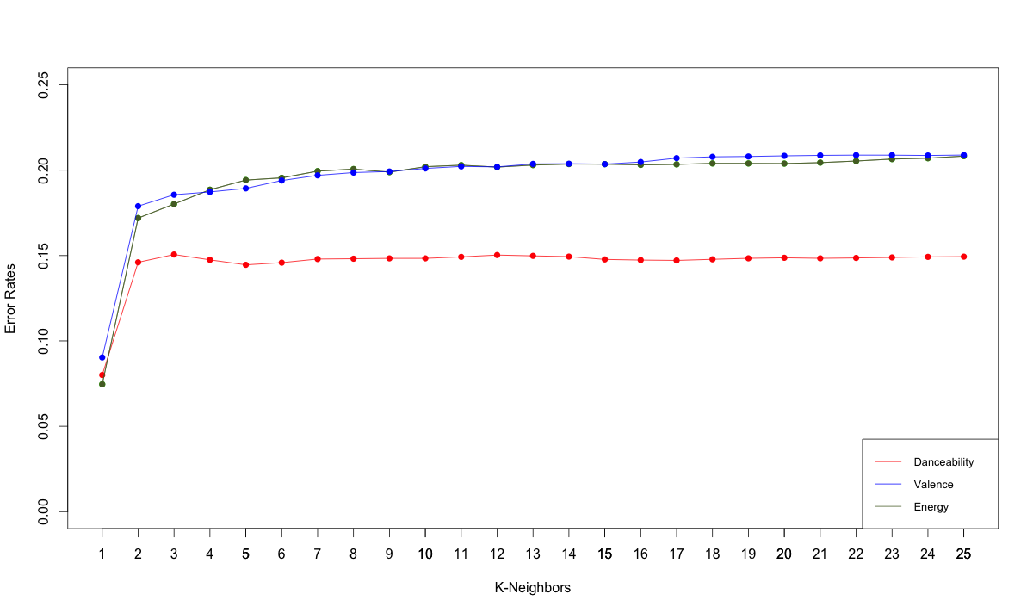
Do You Want To Dance?
Background & Setup
Project Motivation
Music can be quantified numerically in terms of variables such as valence, energy, tempo, but to what extent can we use these variables to learn more complicated classifications that hinge on human perceptions of music?
Problem Statement
Focusing on the following attributes
Danceability: a combination of energy, rhythm, and tempo approximated using algorithmic
Energy: Energy from listener point of view (values in range: [0.0,1.0])
Valence: Measure of the emotional content of a song (values in range: [0.0,1.0])
We want to research the questions
Can we derive the values of the objective attributes for a given song?
Can we learn underlying genres of songs based on these given music attributes that we derived in supervised learning?
General Approach
Data Retrieval
We used php scripts to pull song data from the Echo Nest API, with buckets of equal size for songs with danceability values: [0.0 - a0.1), [0.1 - 0.2), ..., [0.9 - 1.0].
Training (1800 Songs) & Testing (500 Songs)
Feature Mapping Application
Method: using R’s linear fit, we derived a model with variables highly correlated with our objective attributes, or with other variables (interaction terms)
3. Supervised: K-Nearest Neighbors regression
Using the transformation to map song data to two dimensions to apply to a Euclidean distance metric
Found the k Nearest Neighbors for a given song, to predict a song’s danceability, energy, & valence
4. Unsupervised: Hierarchical Agglomerative Clustering
USED the same transformation and euclidean distance metric
Our HAC implementation in MATLAB employed: single link, complete-link, and average-link methods examined the clusters against iTunes API to determine if our songs clustered in genres
Danceability = -(3.279225 * 10⁻⁶) valence * tempo²
+ -(8.160651 * 10⁻⁴) energy * loudness²
+ (3.218223 * 10⁻¹) acousticness * energy²
+ -(3.279225 * 10⁻⁶) liveness * speechiness
+ (3.793979 * 10⁻⁴) tempo * energy
+ -(7.492498 * 10⁻³) loudness *acousticness
+ (7.001209 * 10⁻²) instrumentalness * valence
+ -(6.132415 * 10⁻⁴) valence * loudness
+ (1.359087 * 10⁻²) * energy * loudness * valence²)
Valence= -(3.279225 * 10⁻⁶) Danceability* tempo²
+ -(8.160651 * 10⁻⁴) energy * loudness²
+ (3.218223 * 10⁻¹) acousticness * energy²
+ -(3.279225 * 10⁻⁶) liveness * speechiness
+ (3.793979 * 10⁻⁴) tempo * energy
+ -(7.492498 * 10⁻³) loudness *acousticness
+ (7.001209 * 10⁻²) instrumentalness * Danceability
+ -(6.132415 * 10⁻⁴) Danceability* loudness
+ (1.359087 * 10⁻²) * energy * loudness * Danceability)
Energy= -(3.279225 * 10⁻⁶) Danceability* tempo²
+ - (3.126570 * 10⁻¹) accousticness
+ -(7.503000 * 10⁻⁴) tempo
+ (1.719260 * 10⁻²) loudness
+ -(1.399756 * 10⁻¹) Valence
+ (2.950410 * 10⁻²) Danceability
+ -(2.433880 * 10⁻¹) Speechiness
+ (1.868210* 10⁻²) Danceability* loudness
+ (1.359087 * 10⁻²) * loudness * Danceability)
Analysis & Conclusion
Results of KNN
Results of HAC
Takeaway from Results
The transformation helped us discover a reasonably correct relationship among variables, to aid our prediction of objective attributes & works as well as KNN applied to data directly
Our objective attributes were only able to split up clusters by genre well in few cases
Missing some type of attribute that would result in purer clusters
Although both use the same transformation & metric, a song’s computed neighbors were not necessarily a part of the same cluster
Challenges in our data &Methods
Attributes were not properly defined and were discovered to have all been learned through machine learning algorithms
Motivation to change our project from Beatles ‘influence’ to re-deriving echo nest, to understand our data
Future Work
Attempt to find the missing attribute for better clustering – current ideas include lyric or sentiment analysis in conjunction with our current attributes
Consider using weighted KNN to factor in song distances for predictions

