Slide 1
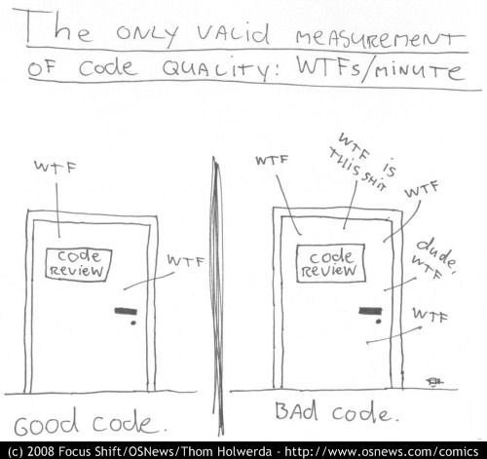
Refactoring towards testable code and happier developers ☺
@dave_mateer

Slide 2








Quorum Network Resources
The kind of clients we work with:

Slide 3
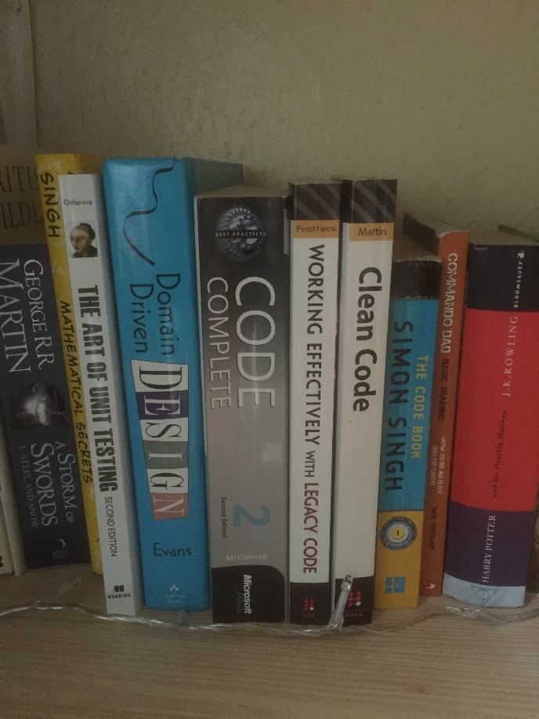
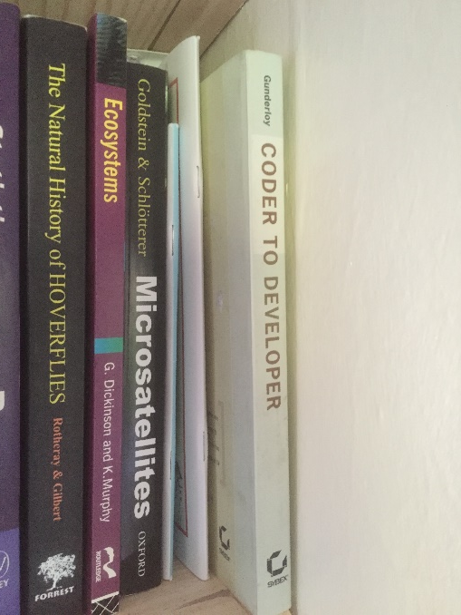
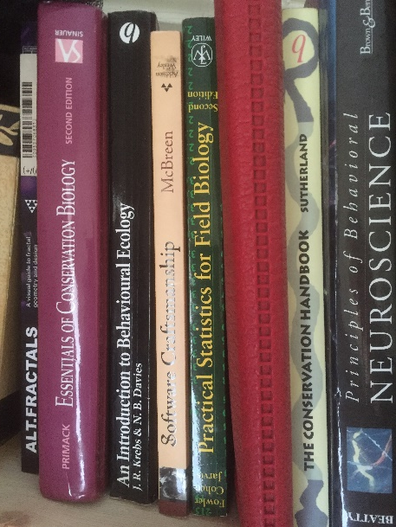
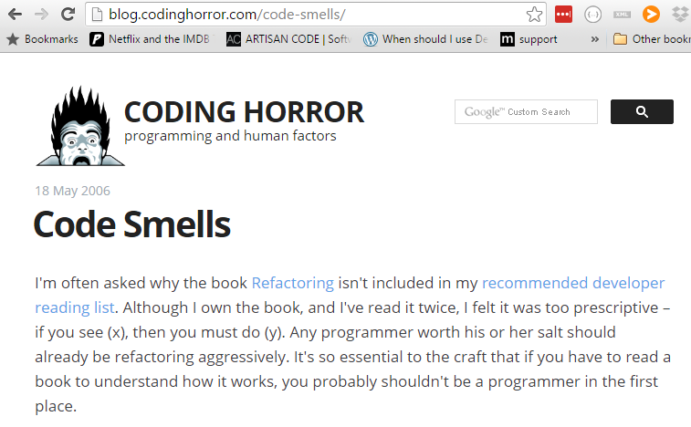
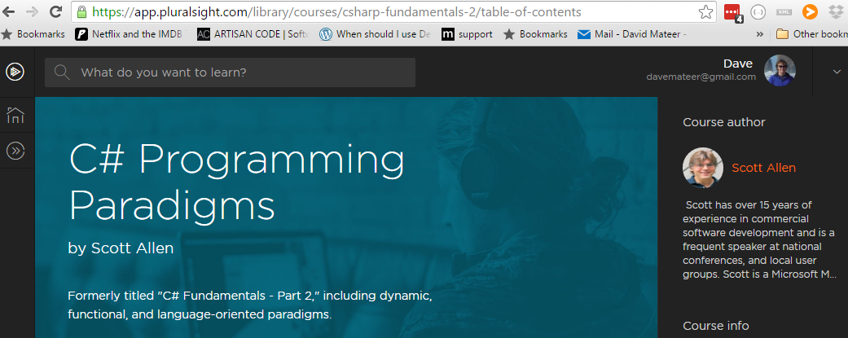
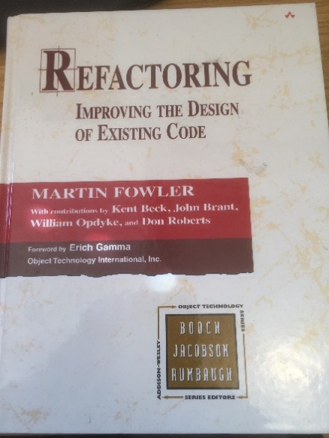
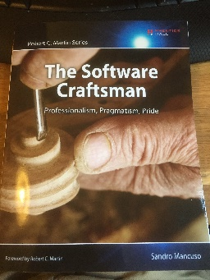
Stand on the Shoulders of Giants

Slide 4
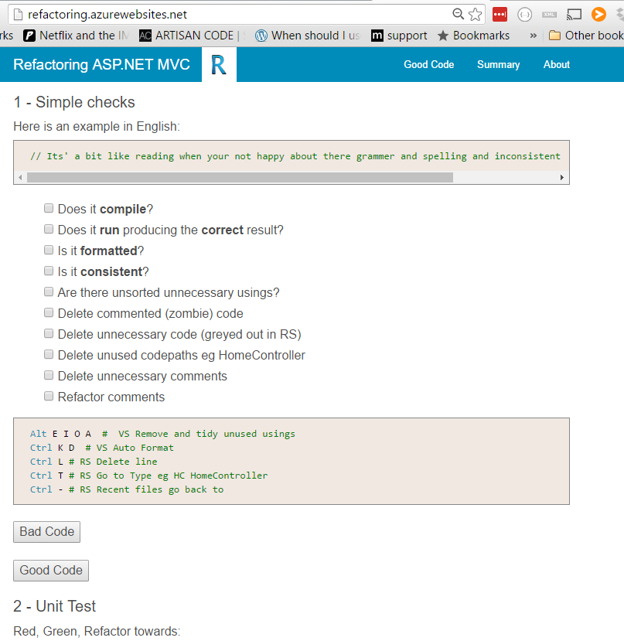
My practical guide on refactoring

Slide 5

1. Naming
Solutions, Projects, Namespaces,
Classes / Files, Methods,
Parameters, Properties, Variables
Adding meaning to code is what readability is about

Slide 6
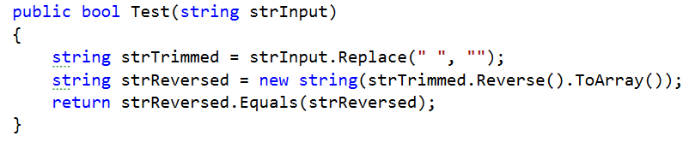
Palindrome tester: words which are the same forwards as reversed eg: noon
Also ignoring any whitespace eg no on

Slide 7
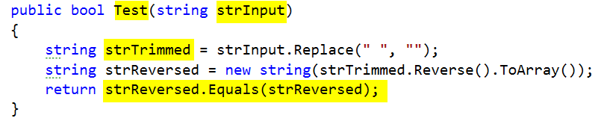
PascalCase convention for method names (C#) - good
camelCase eg firstName
Hungarian Notation eg strInput – bad
strTrimmed – trimmed generally means whitespace trim from beginning and end not middle – bad
Bug at the end – should be strTrimmed.Equals(strReversed) - bad

Slide 8
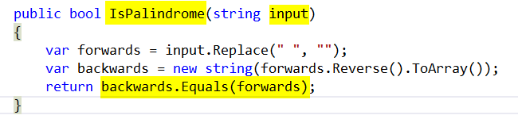
IsPalindrome – descriptive - good
Input – simple - good
Var keyword - good
Symmetry of final line – conveys exactly what IsPalindrome does - excellent

Slide 9
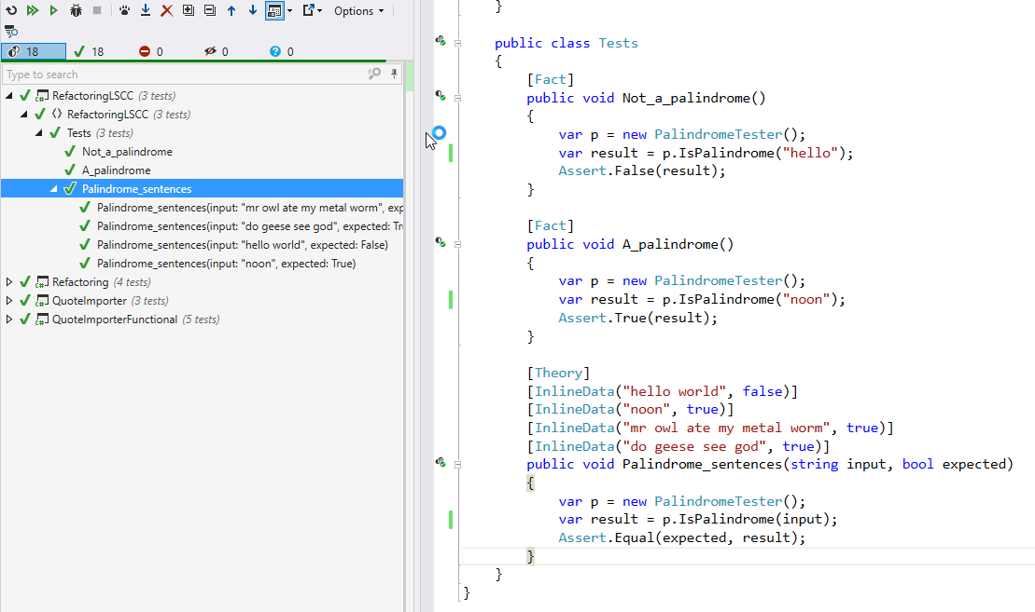

Slide 10
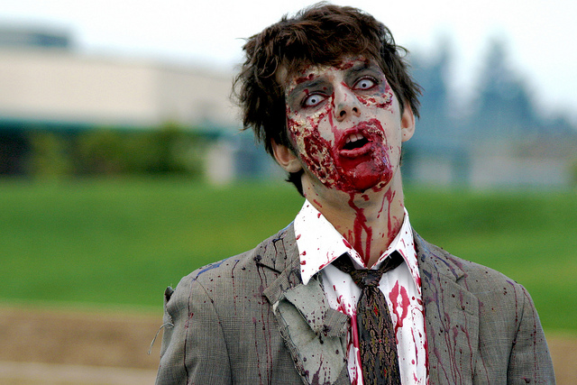
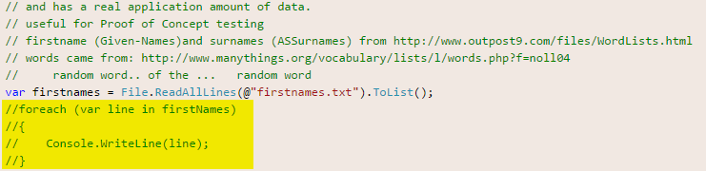
2.The Simple Stuff
Kill Zombie (nearly dead) code
https://www.flickr.com/photos/dhollister/2596483147

Slide 11
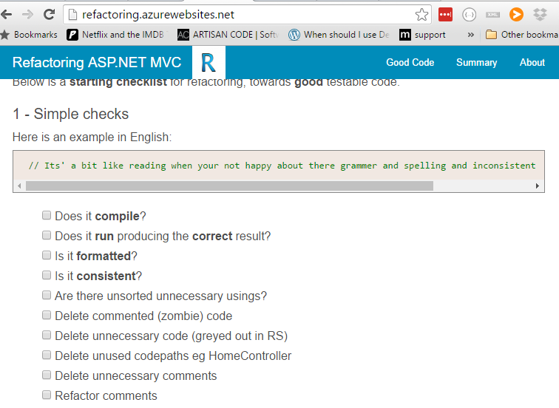

Slide 12

Favour Short local scope variable names

Slide 13

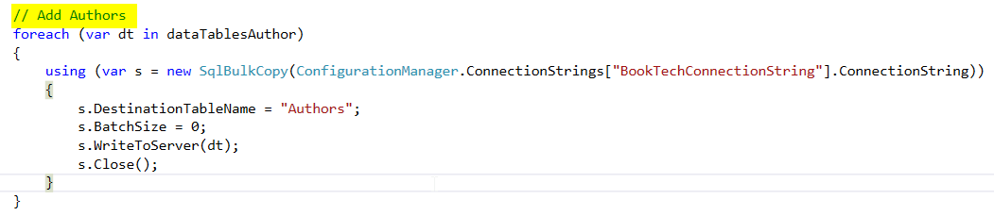
Avoid Comments (duck)
Candidate to refactor into a Method called AddAuthors?

Slide 14
Complex Expressions
Try to encapsulate
Refactoring Lynda Notes (Web view)

