Slide 1
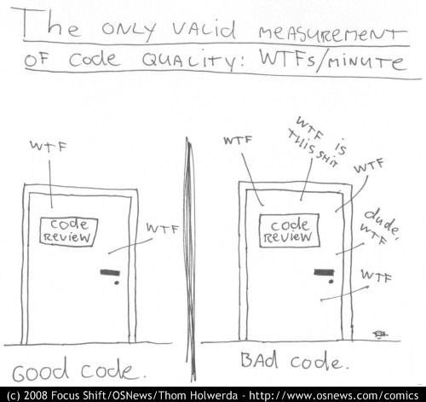
Refactoring towards testable code and happier developers ☺
@dave_mateer

Slide 2
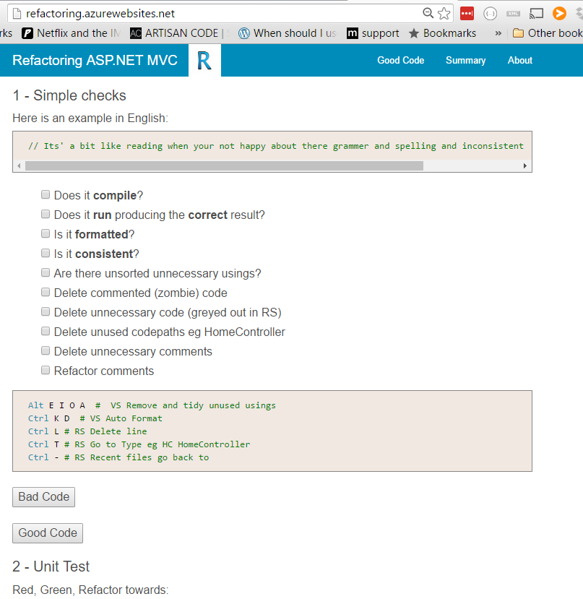
My practical guide (9 months) http:// refactoring .azurewebsites.net tonight.. The good bits

Slide 3








Quorum Network Resources
The kind of clients we work with:

Slide 4
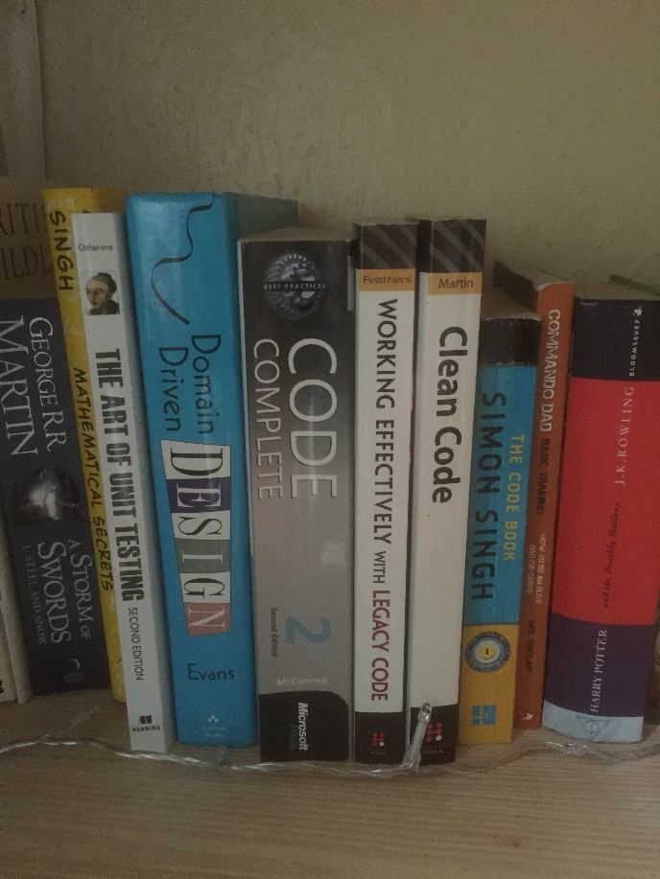


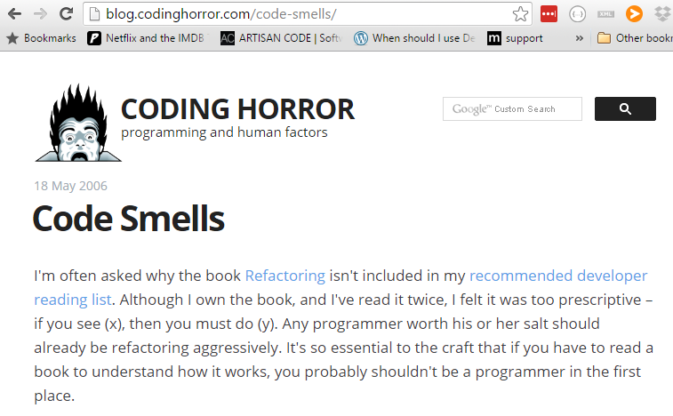
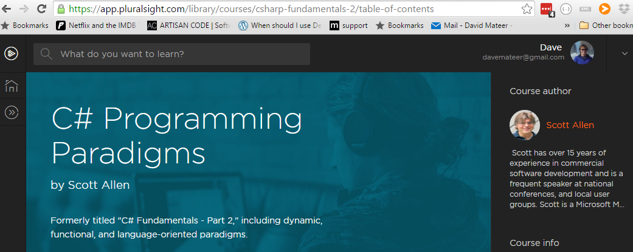
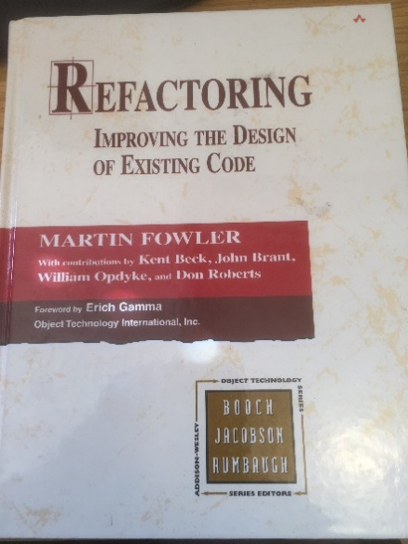
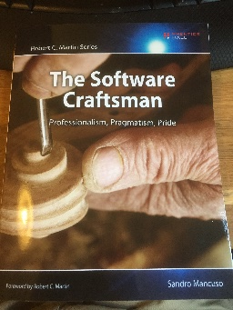
Stand on the Shoulders of Giants

Slide 5

1. Names
Solutions, Projects, Namespaces,
Classes / Files, Methods,
Parameters, Properties, Variables
Adding meaning to code

Slide 6
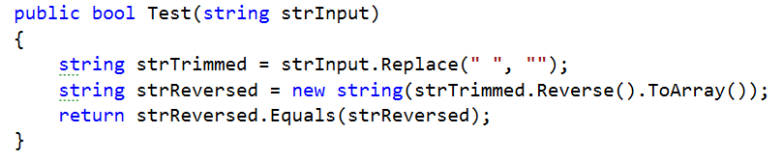
Palindrome tester: words which are the same forwards as reversed eg: noon
Also ignoring any whitespace eg no on

Slide 7
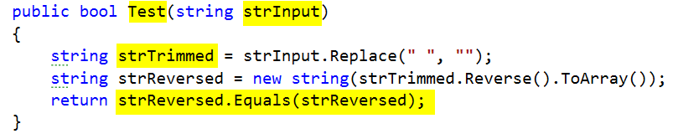
PascalCase convention for method names (C#) - good
camelCase eg firstName
Hungarian Notation eg strInput – bad
strTrimmed – trimmed generally means whitespace trim from beginning and end not middle – bad
Bug at the end – should be strTrimmed.Equals(strReversed) - bad

Slide 8
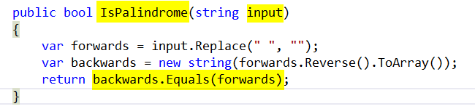
IsPalindrome – descriptive - good
Input – simple - good
Var keyword - good
Symmetry of final line – conveys exactly what IsPalindrome does - excellent

Slide 9
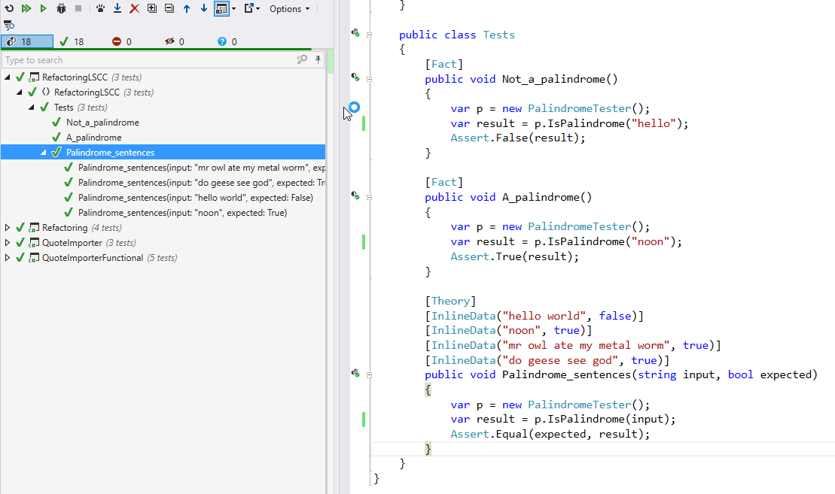

Slide 10

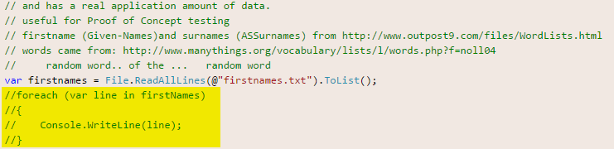
2.Killing Zombies
Kill Zombie (nearly dead) code
https://www.flickr.com/photos/dhollister/2596483147

Slide 11
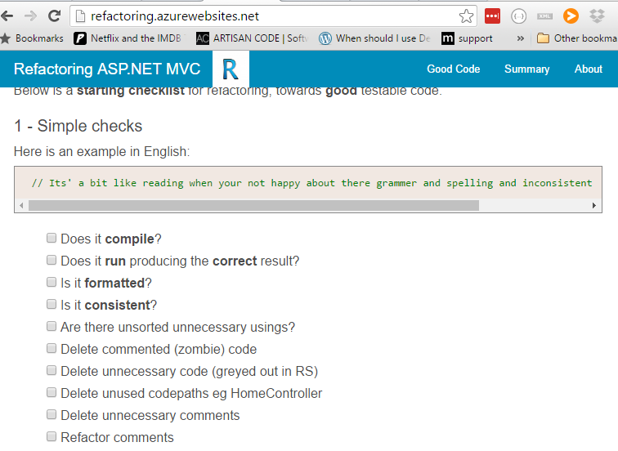

Slide 12

3. Favour Short local scope names

Slide 13

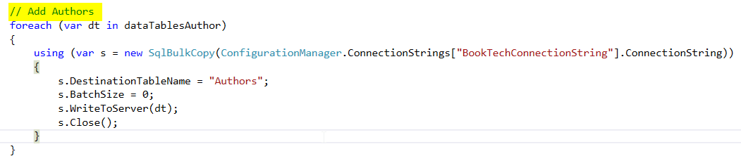
4 Minimise Comments
Candidate to refactor into a Method called AddAuthors?

Slide 14
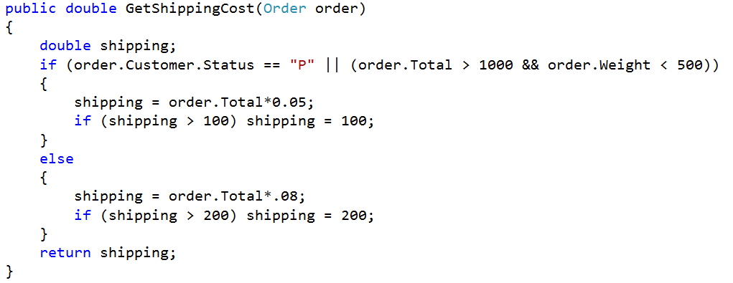
5. Encapsulate Complexity
**Inspired by refactoring course on Lynda.com

Slide 15
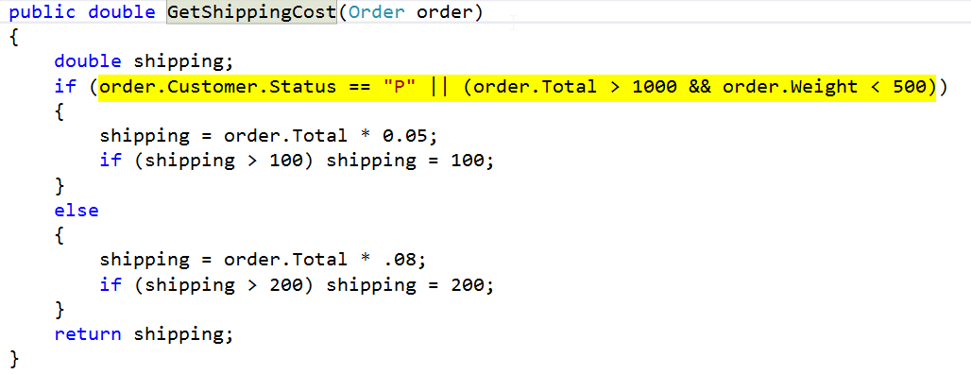
Ctrl R M – Extract Method

Slide 16
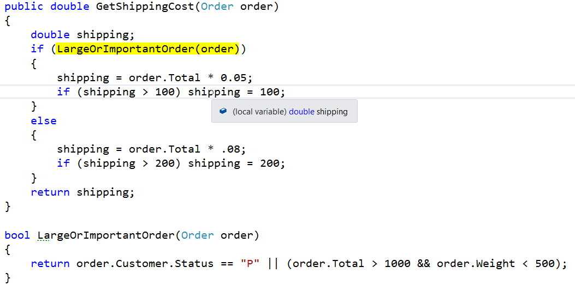

Slide 17
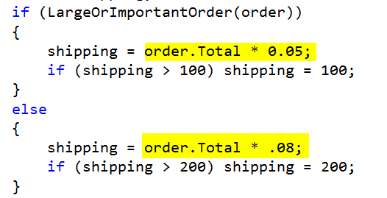
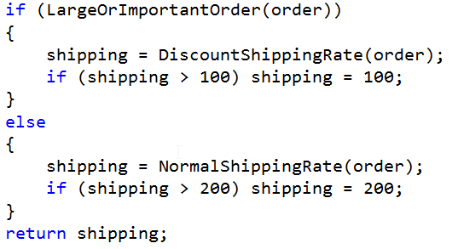

Slide 18
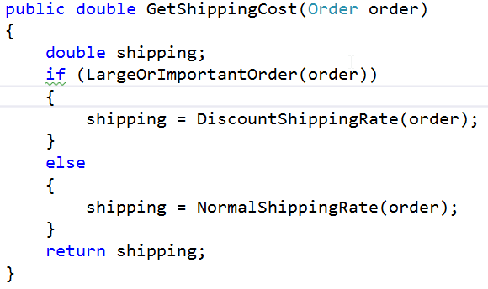
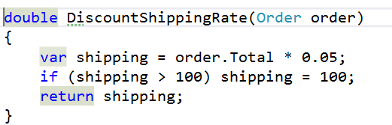
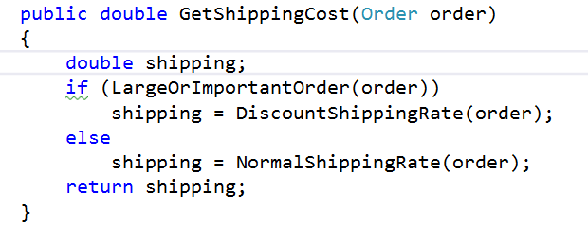

Slide 20
Developer happiness and testability
1.Rename things
2.Kill zombies (nearly dead)
3.Favour short local names eg I
4.Minimise comments
5.Encapsulate complexity
KISS!

