Slide 1
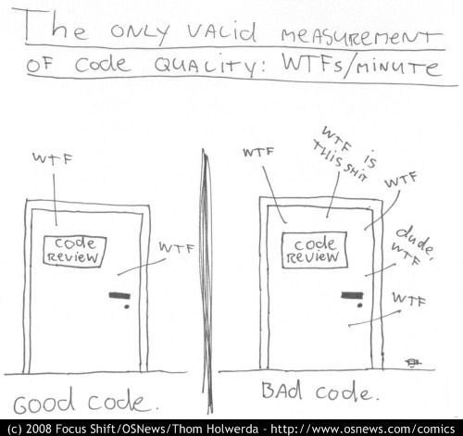
Refactoring towards testable code and happier developers ☺
@dave_mateer

Slide 2
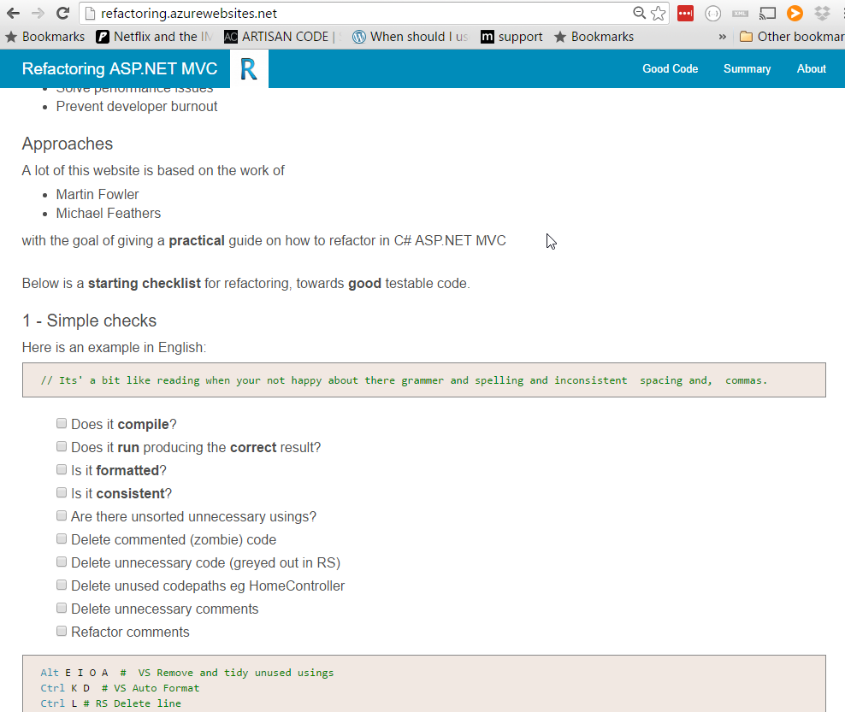
My practical guide (9 months) http:// refactoring .azurewebsites.net tonight.. The good bits

Slide 3








Quorum Network Resources
The kind of clients we work with:

Slide 4
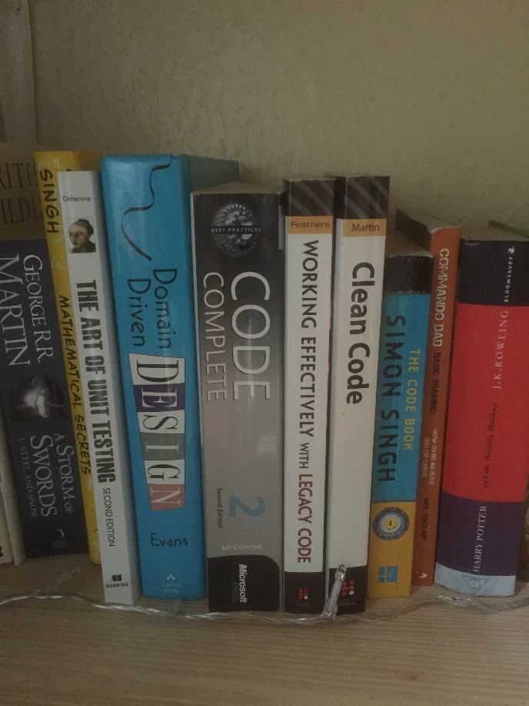
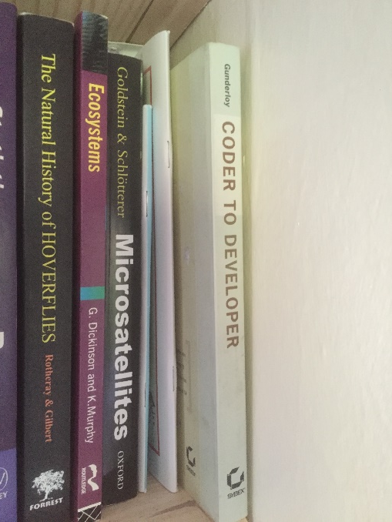

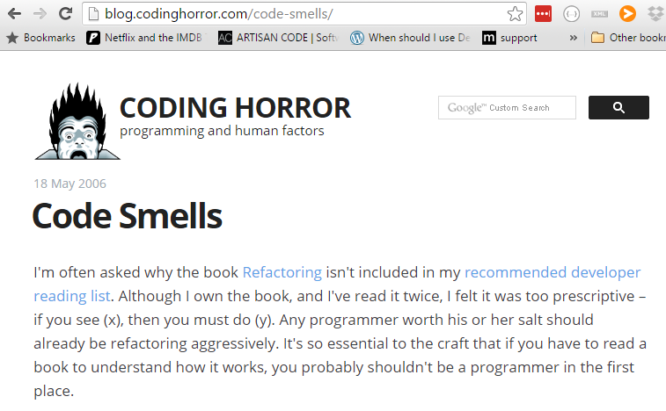
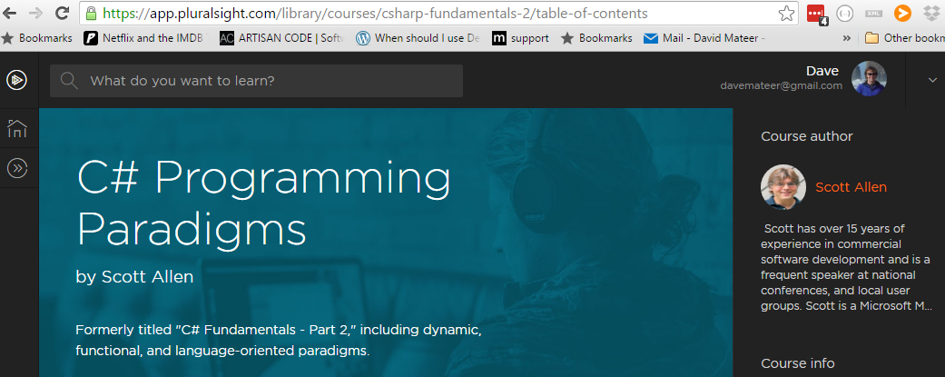
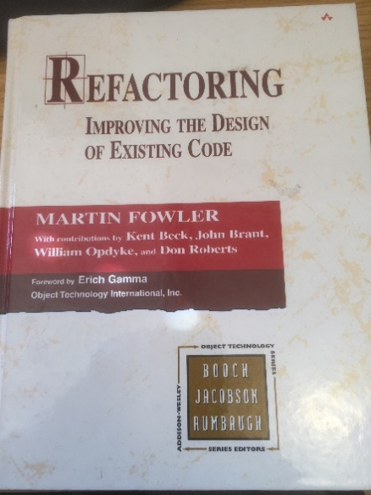
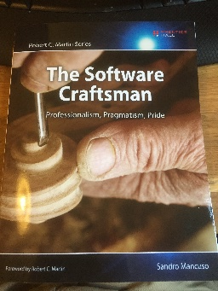
Stand on the Shoulders of Giants

Slide 5

1. Names
Solutions, Projects, Namespaces,
Classes / Files, Methods,
Parameters, Properties, Variables
Adding meaning to code

Slide 6
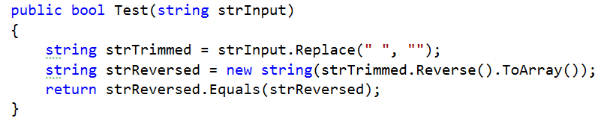
Palindrome tester: words which are the same forwards as reversed eg: noon
Also ignoring any whitespace eg no on
**Example based on K Scott Allen, Pluralsight, C# Programming 2011

Slide 7
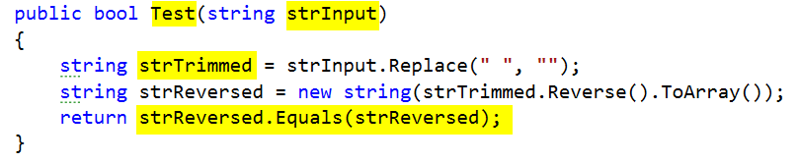
PascalCase convention for method names (C#) - good
camelCase eg firstName
Hungarian Notation eg strInput – bad
strTrimmed – trimmed generally means whitespace trim from beginning and end not middle – bad
Bug at the end – should be strTrimmed.Equals(strReversed) - bad

Slide 8
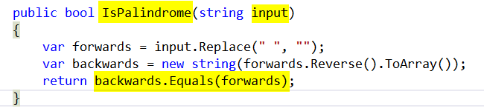
IsPalindrome – descriptive - good
Input – simple - good
Var keyword - good
Symmetry of final line – conveys exactly what IsPalindrome does - excellent

Slide 9
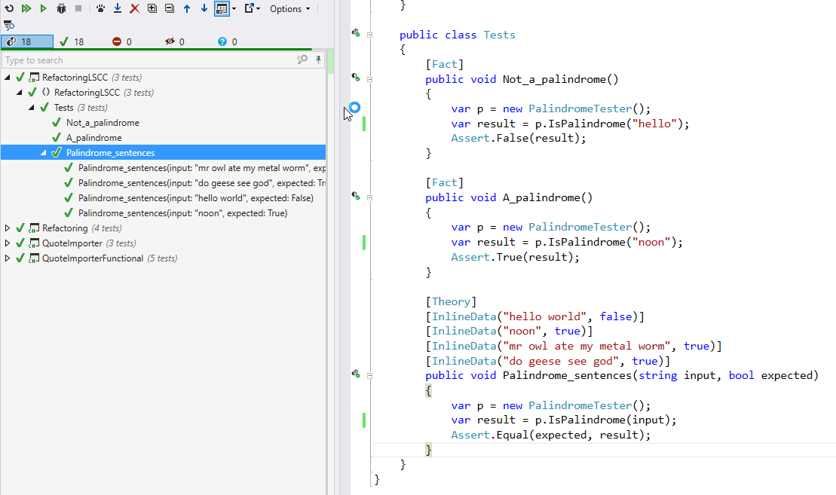

Slide 10

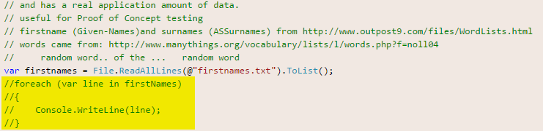
2.Killing Zombies
Kill Zombie (nearly dead) code
https://www.flickr.com/photos/dhollister/2596483147

Slide 11
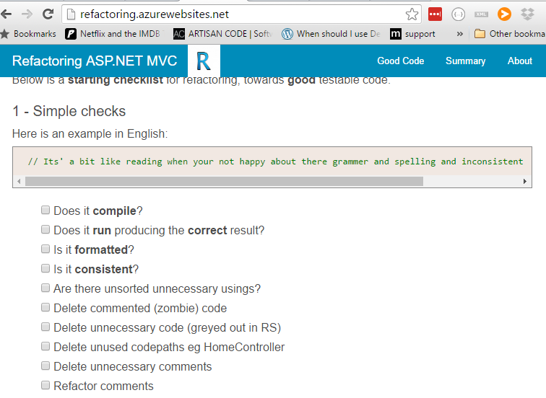

Slide 12

3. Favour Short local scope names

Slide 13

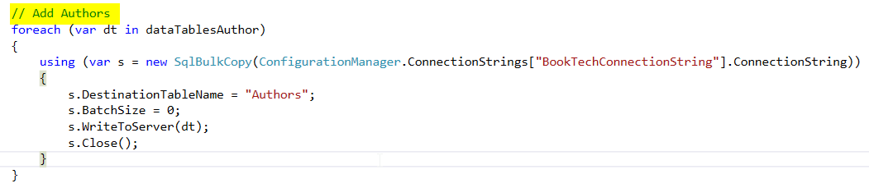
4 Minimise Comments
Candidate to refactor into a Method called AddAuthors?

Slide 14

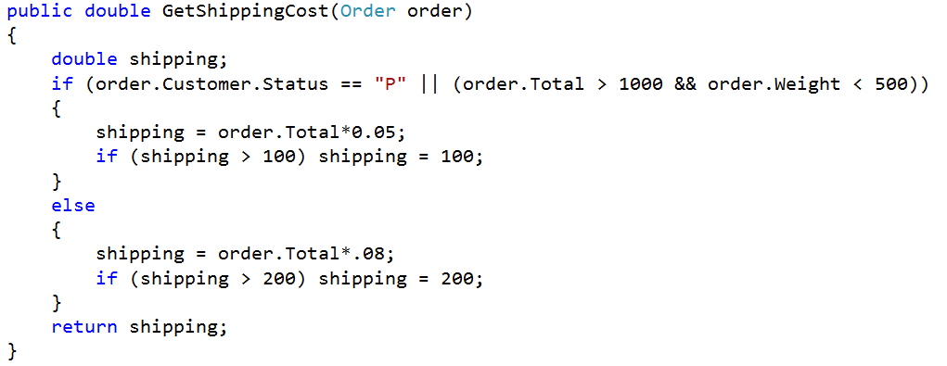
5. Encapsulate Complexity
Inspired by refactoring course on Lynda.com
Bmalarky https://flic.kr/p/9XWL8g

Slide 15
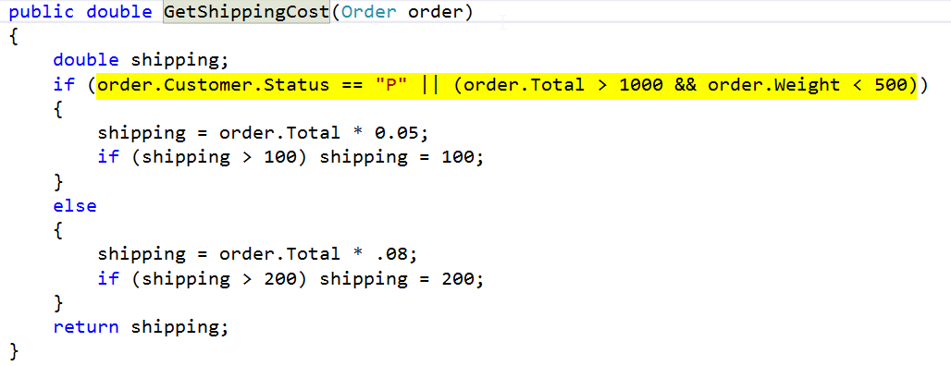
Ctrl R M – Extract Method

Slide 16
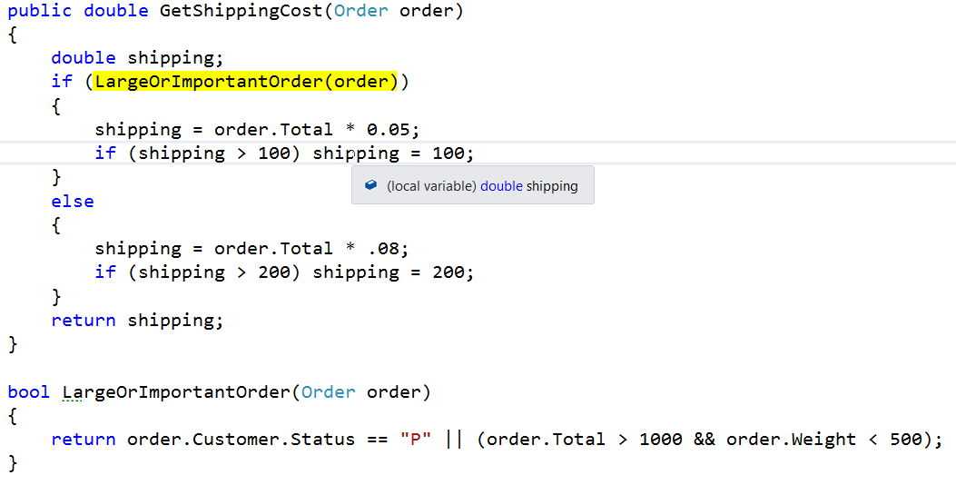

Slide 17
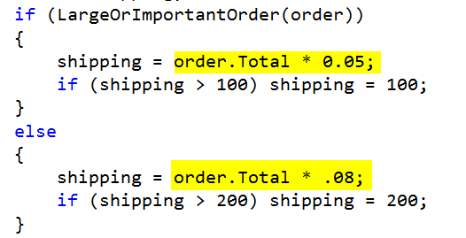
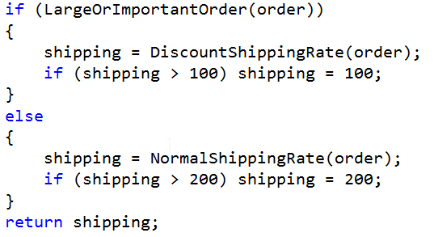

Slide 18
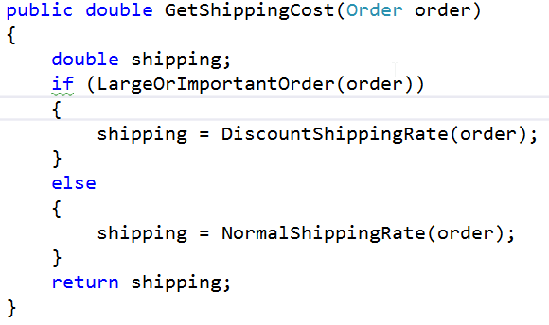
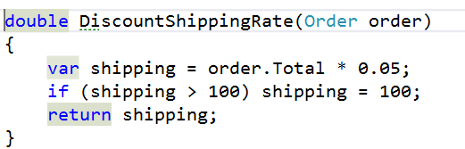
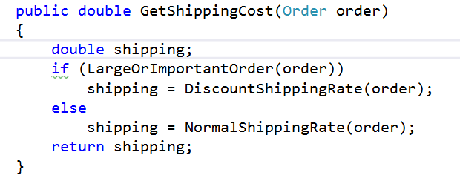

Slide 20
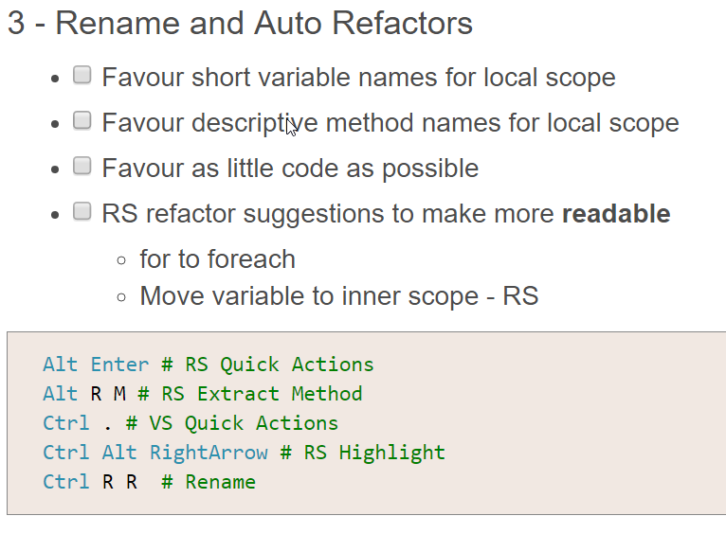
6.WebsiteTips
**move to website from here and talk through..

Slide 21
7.Automation / Tools
Win10 – new shell can copy and paste
code . – for a fast easy editor **DEMO**
.\d trick **DEMO**
Resharper 10 (Personal license okay to use inside work if you buy yourself)
Github Desktop (installs PoshGit – best command line client) **DEMO**
Bitbucket (free private git repos)
Github (public repos)
Appveyor (free build and test server)
Miniprofiler – to see speed of SQL Queries
Source control database (DB Project in VS)
VS2012.5 (inside current corporation)
SSDT to talk to SQL2014
Web tools so can use MVC5
Visio – for mock ups!

Slide 22

8.Refactoring towards Perf / Big Data / Simplicity
Visio diagram of nice DAL tool with inheritance
YAGNI – I don’t need all that mocking etc..
What I need is simplicity
So my ‘DAL’.. Can be called directly from a controller
had a simple util method to feed in a connection
Integration testing is done from an app.config
Refactoring – let SQL Server do heavy lifting
eg Filter / Sort
Return the lightest weight possible
Mulitple returns in SQL Server
Years of junior developers coming into project who need to get up to speed asap
Simple is paramount
Sunny_mjx https://flic.kr/p/qGtWFw

Slide 23
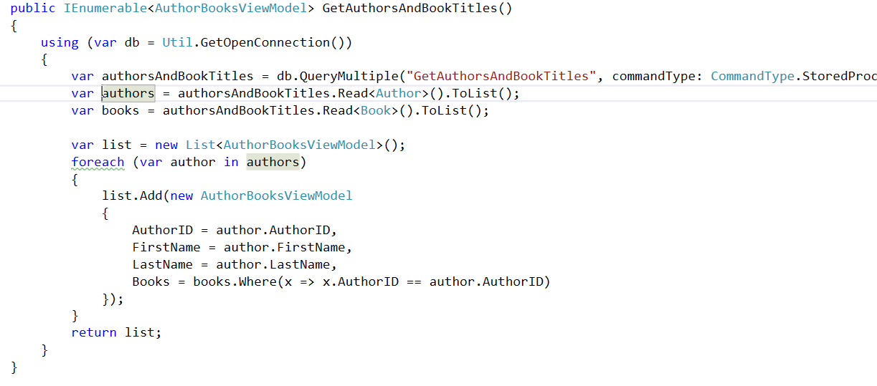
Queries (CQS)
A Command DOES something (and returns void), a Query RETURNS something (no side effects)

Slide 24
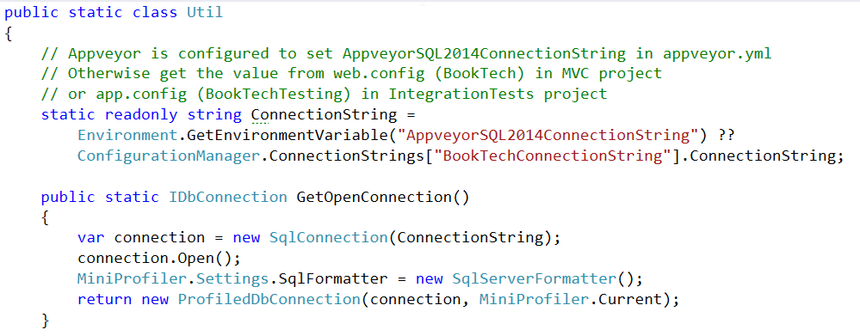
Connection

Slide 25
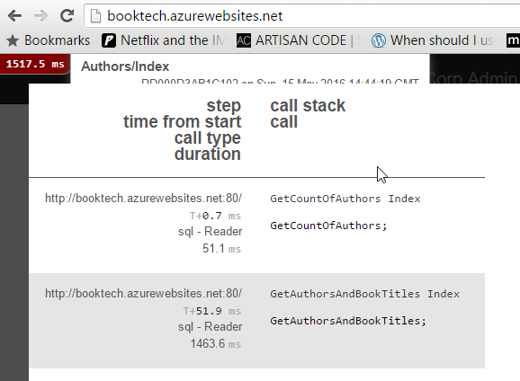
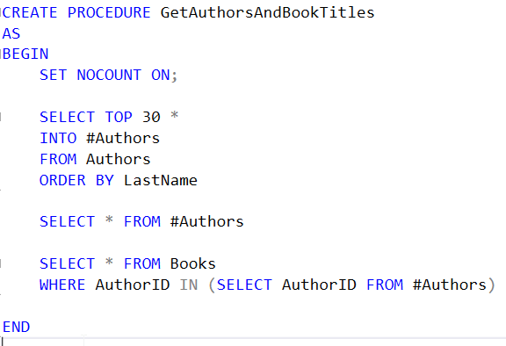
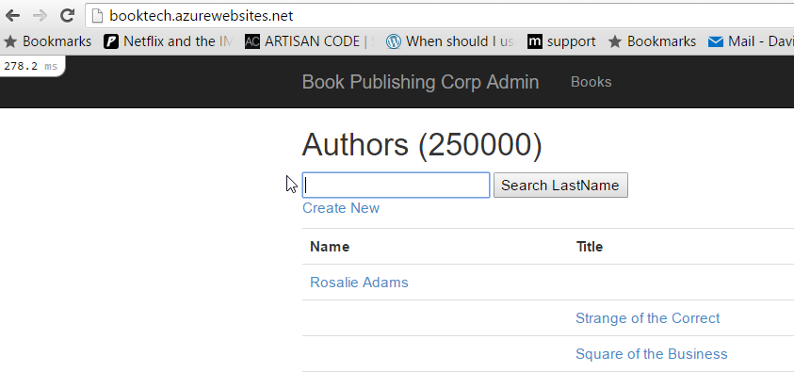
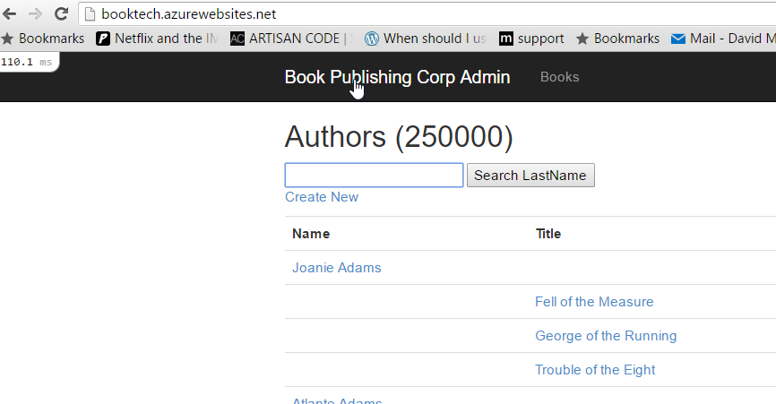
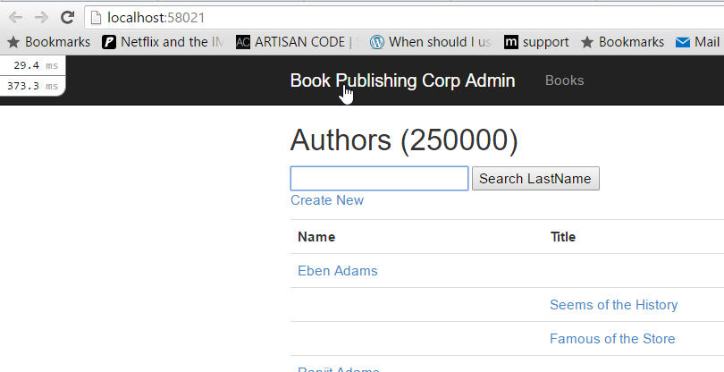
Let the DB do the work
250000 Authors, and 500000 Books.
Query executes in 1500ms (20DTU), 300ms (100DTU), or 110ms (500DTU)

Slide 26
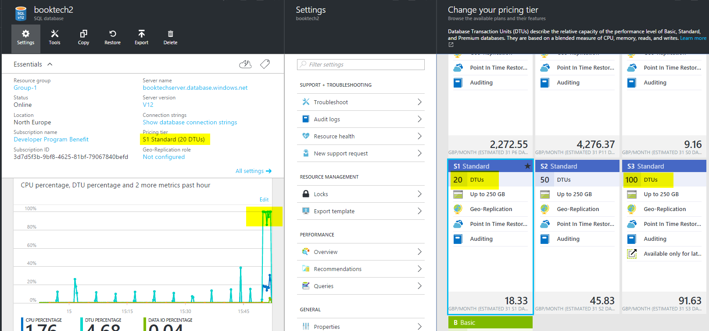

Slide 27
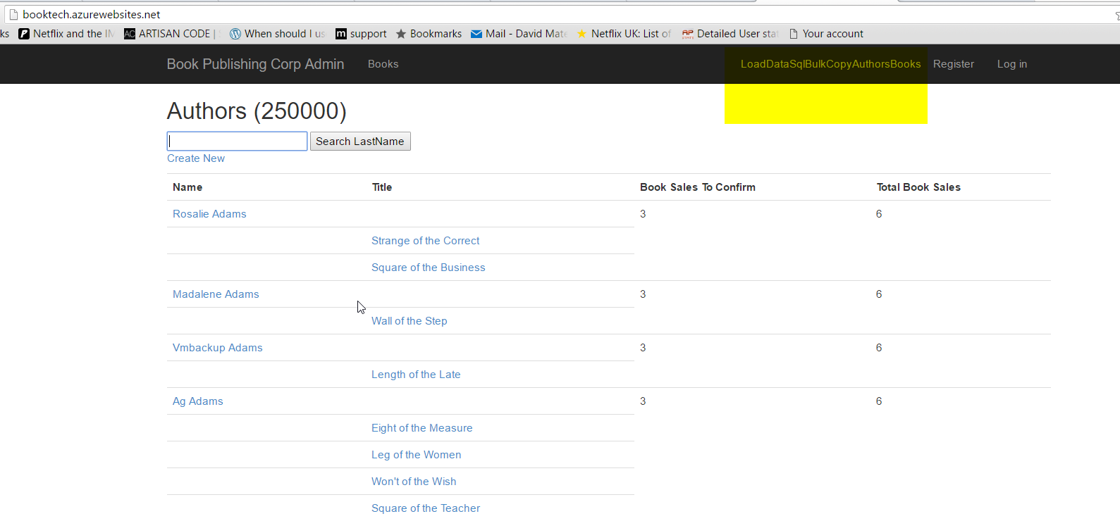

Slide 28
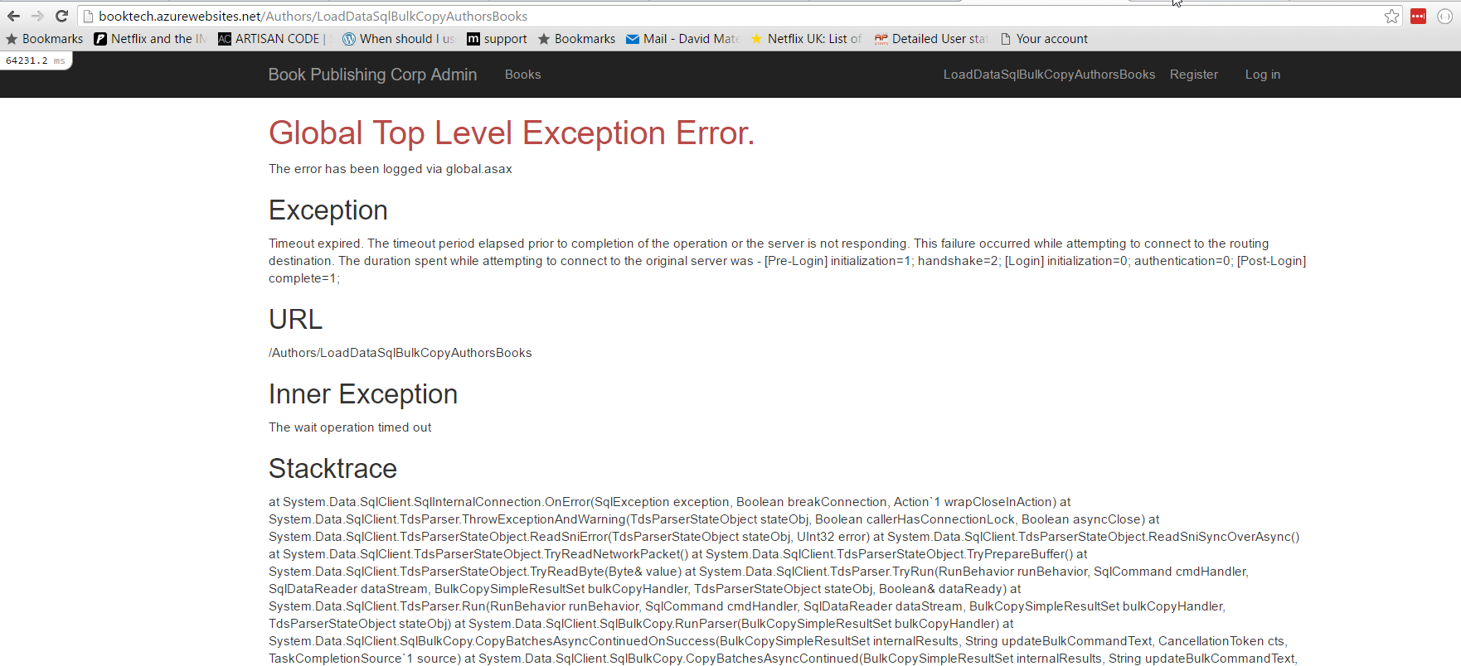

Slide 29
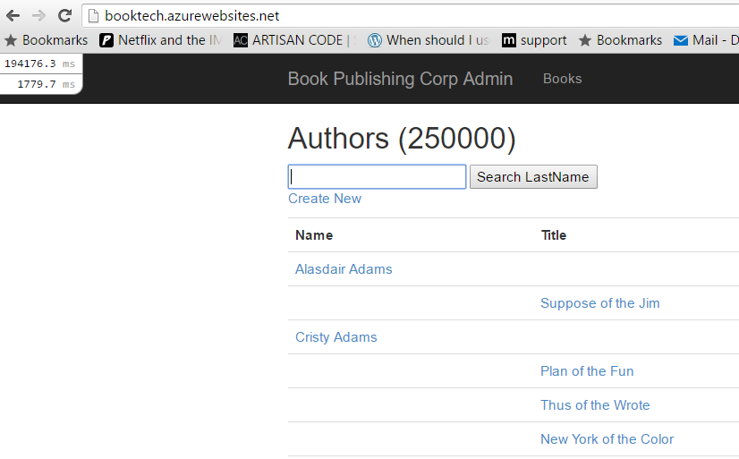
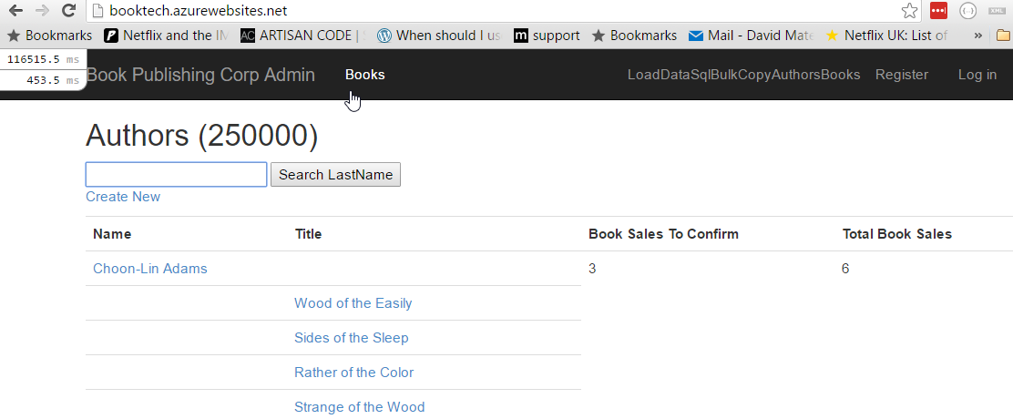
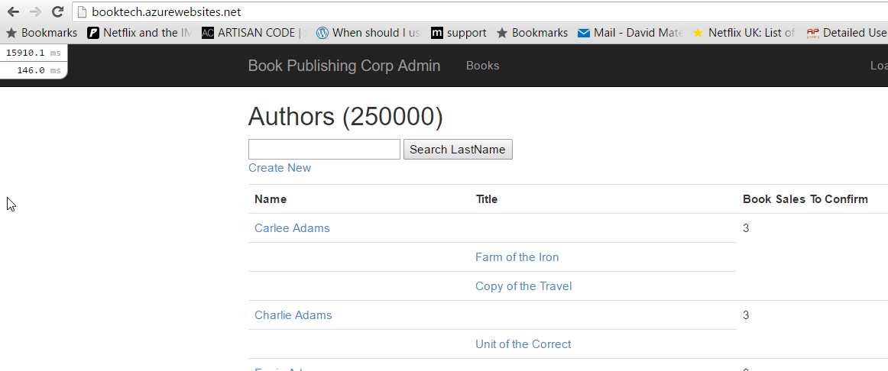
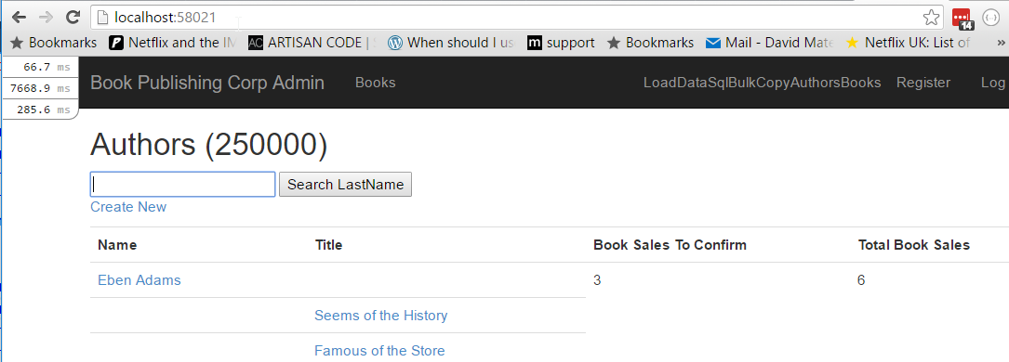

Slide 30
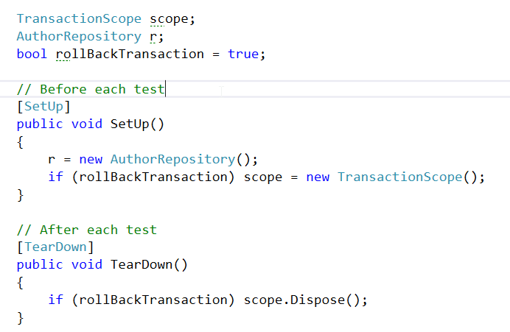
Test Repository against a DB
Have a ‘Minimum’ dataset of a few Authors and Books

Slide 31
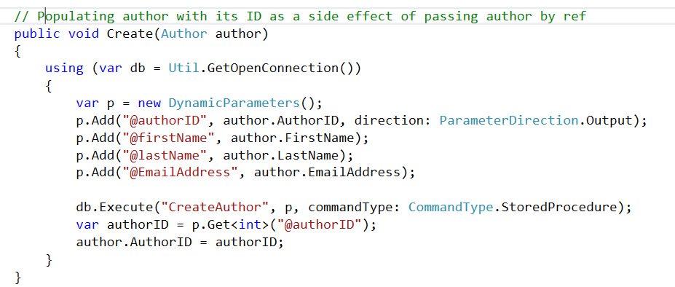
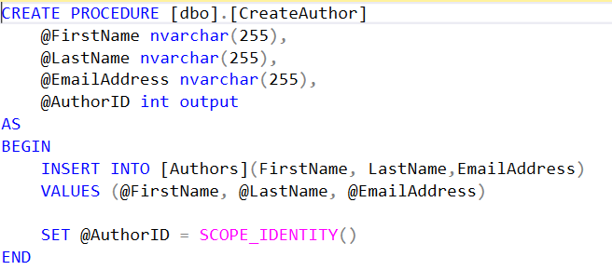
Command

Slide 32
Developer happiness and testability
1.Rename things
2.Kill zombies (nearly dead)
3.Favour short local names
4.Minimise comments
5.Encapsulate complexity
6.Automation / Tooling
7.Let exceptions bubble up
8.Performance measure
9.Rollback transaction integration tests
Thank you for listening
Questions / Thoughts?

