Slide 1
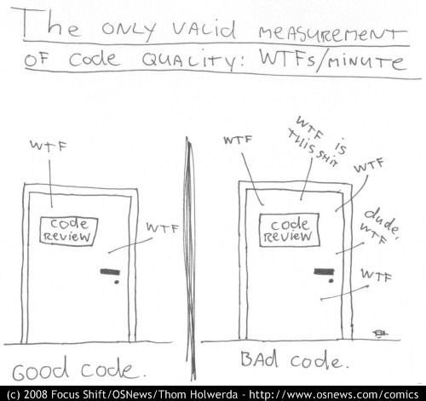
Refactoring towards testable code and happier developers
@dave_mateer

Slide 2
Scott Allen Palindrome Examples
https://app.pluralsight.com/library/courses/csharp-fundamentals-2/table-of-contents

Slide 3
Title and content layout with chart

Slide 4
Two content layout with table
First bullet point here
Second bullet point here
Third bullet point here
 | Group 1 | Group 2
Class 1 | 82 | 95
Class 2 | 76 | 88
Class 3 | 84 | 90

Slide 5
Title and content layout with SmartArt
Step 1 Title
Task description
Step 2 Title
Task description
Step 3 Title
Task description

