Slide 1

Adventures with Spotify!
davemateer at gmail.com
github.com/djhmateer

Slide 2


Thanks Quorum (Dave’s employer)
We do Infrastructure and Software for clients

Slide 3




What’s in this talk for me?
Notes:
Who I am
What this is about
Why they should care

Slide 4
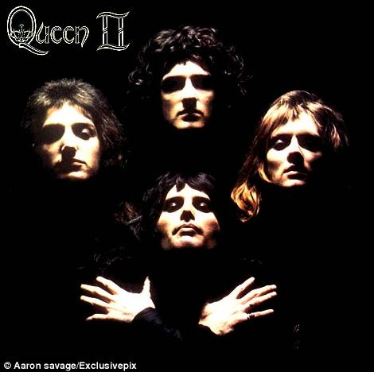
MUSIC!
Notes:
Who I am
What this is about
Why they should care

Slide 5
The Final Demo
Notes:
"While coding at work I want to listen to great songs and albums that I know" . So I curious about Spotify and I set out to find out more. Along the way I encountered many dragons.. Those stories I'll share today.. built website, purely for fun, to help me navigate the 38m songs in Spotify.

Slide 6
What is Spotify?
Music streaming service
2008, Sweden, 60m (15m paid) Users, 38m tracks

Slide 7
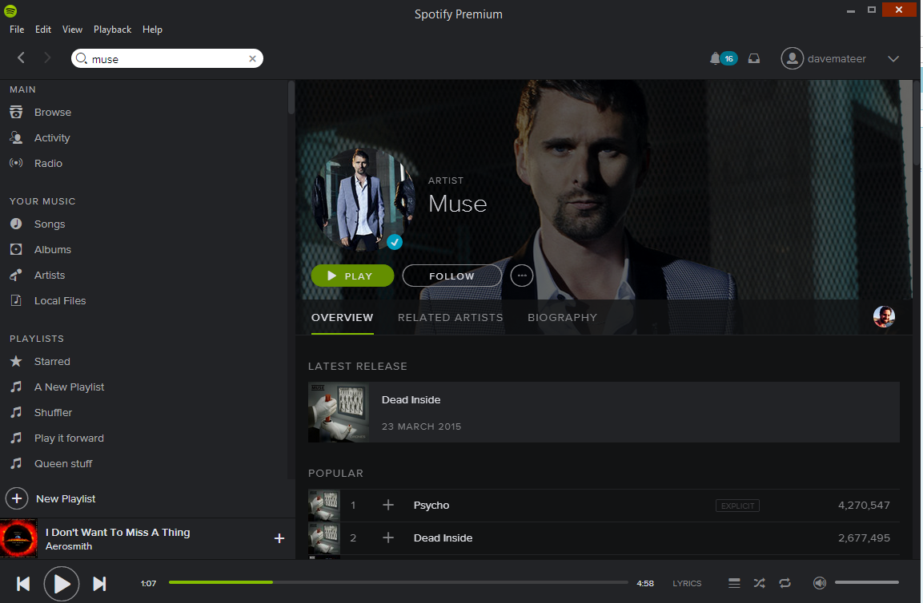
What is Spotify?

Slide 8
There is a Web API to do stuff
Explore Spotify catalogue
Create and add tracks to playlists

Slide 9

Embed
iframe src="https://embed.spotify.com/?uri=spotify:track:0mDHS1Q7HGtpgjYAyG2Svn">

Slide 10
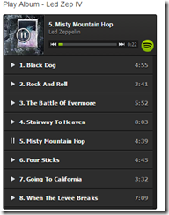
Embed Album / Playlist
iframe src="https://embed.spotify.com/?uri=spotify:user:hoxsd:playlist:0Z7jXtAId643ujM1UPshcte“

Slide 11
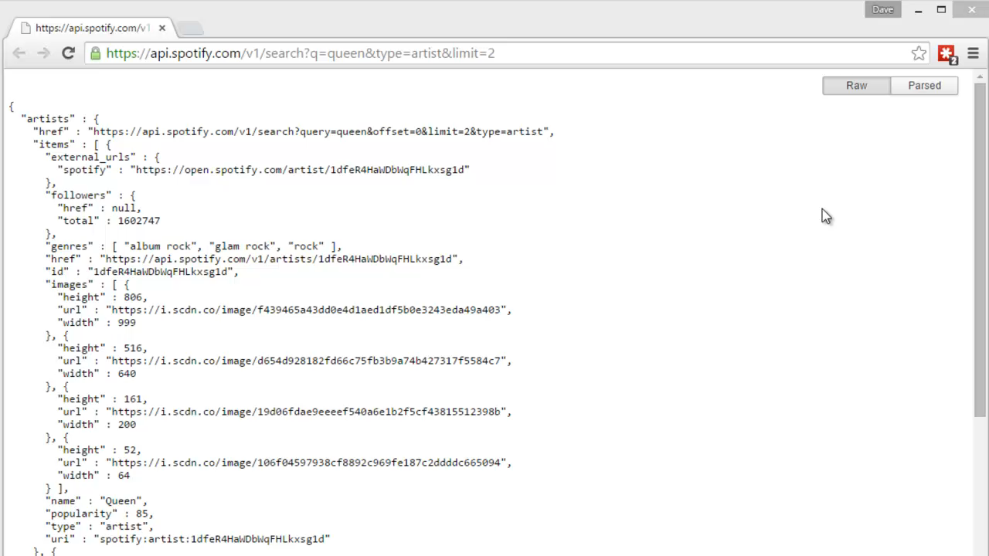

Slide 12
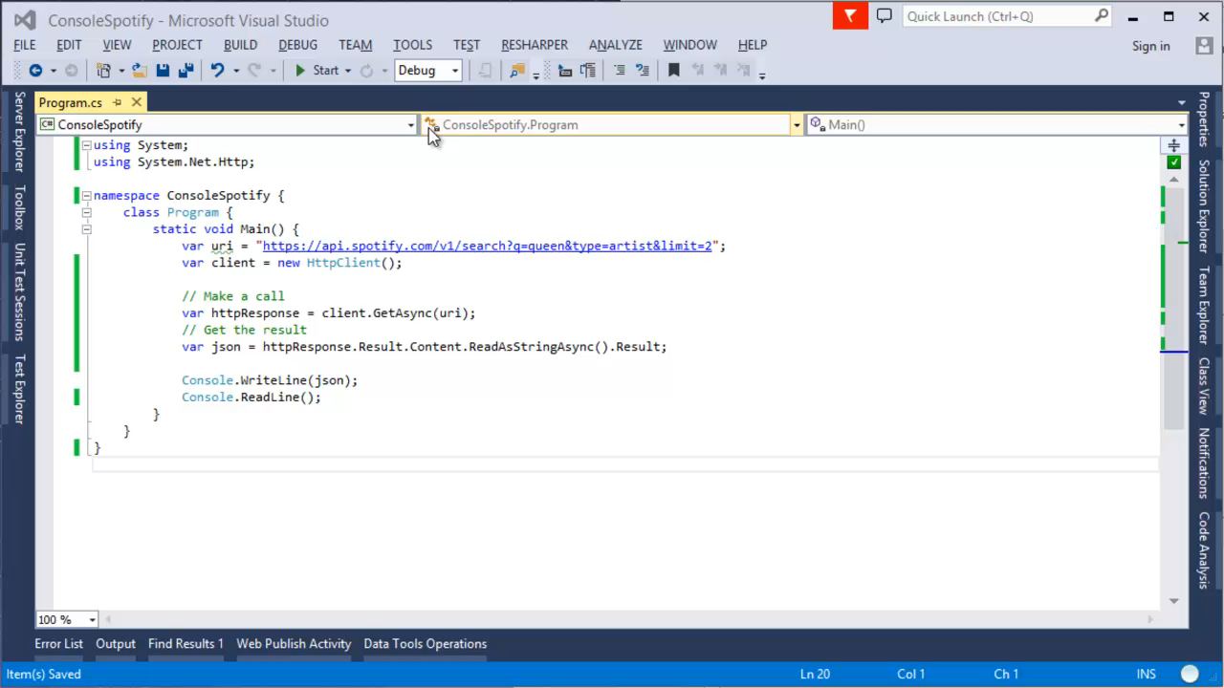
Console App

