Slide 1

Adventures with Spotify!
davemateer at gmail.com
github.com/djhmateer

Slide 2








Thanks Quorum (Dave’s employer)
Notes:
The kind of clients we work with

Slide 3




What’s in this talk for me?
C# 4.5 Async Await
Notes:
Who I am
What this is about
Why they should care

Slide 4
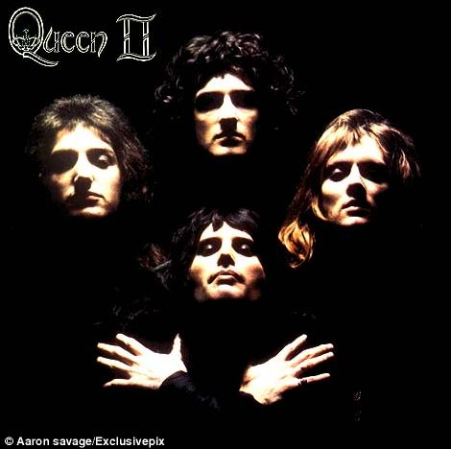
MUSIC!
Notes:
Who I am
What this is about
Why they should care

Slide 5
The Final Demo
Notes:
"While coding at work I want to listen to great songs and albums that I know" . So I curious about Spotify and I set out to find out more. Along the way I encountered many dragons.. Those stories I'll share today.. built website, purely for fun, to help me navigate the 38m songs in Spotify.

Slide 6
What is Spotify?
Music streaming service
2008, Sweden, 60m (15m paid) Users, 38m tracks

Slide 7
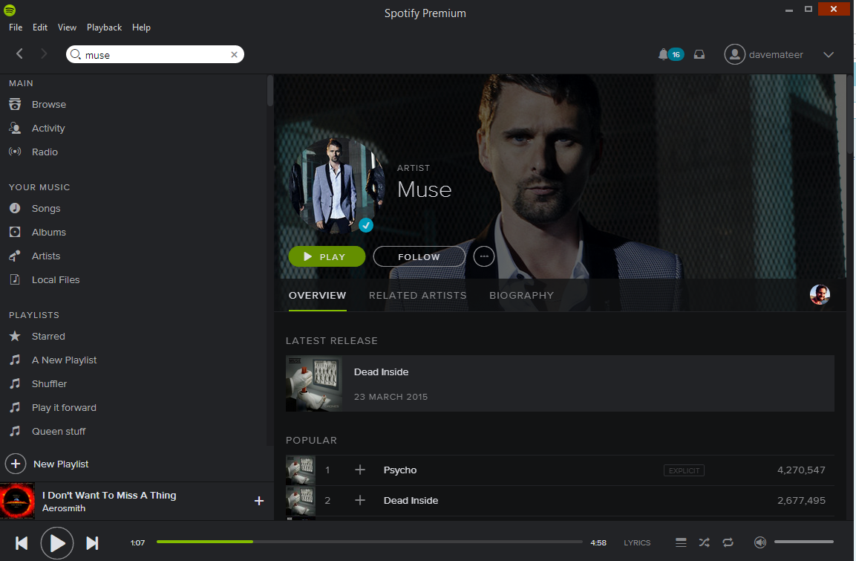
What is Spotify?

Slide 8

Embed
iframe src="https://embed.spotify.com/?uri=spotify:track:0mDHS1Q7HGtpgjYAyG2Svn">

Slide 9
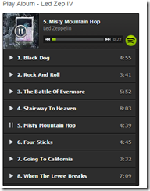
Embed Album / Playlist
iframe src="https://embed.spotify.com/?uri=spotify:user:hoxsd:playlist:0Z7jXtAId643ujM1UPshcte“

Slide 10
There is a Web API to do stuff
Explore Spotify catalogue
Create and add tracks to playlists

Slide 11
Query API via Chrome

Slide 12
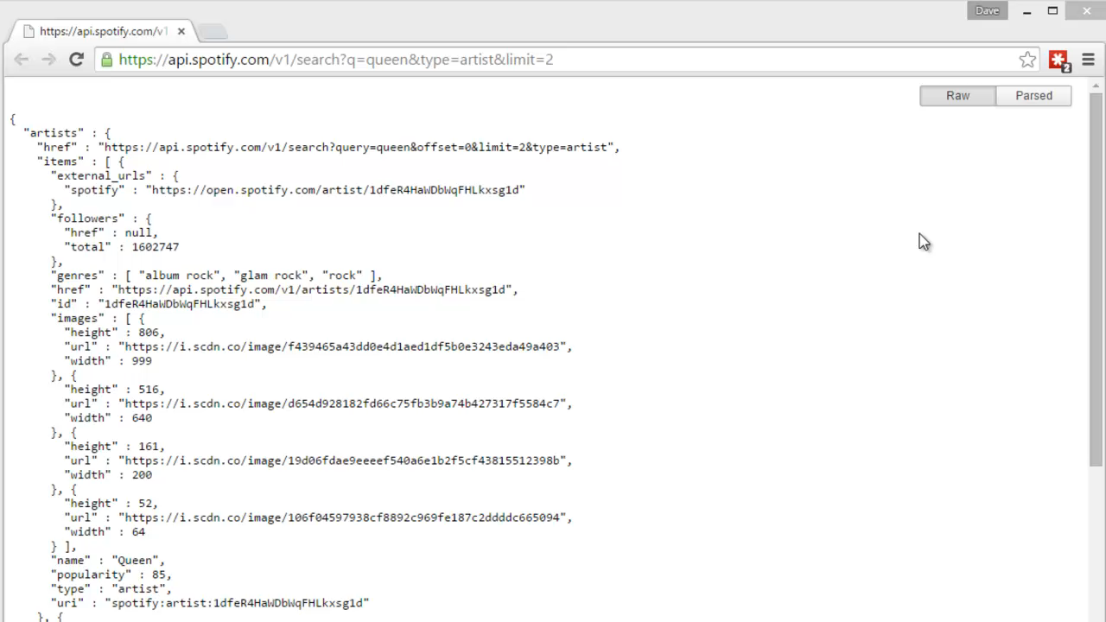

Slide 13
Query API via Console App

Slide 14
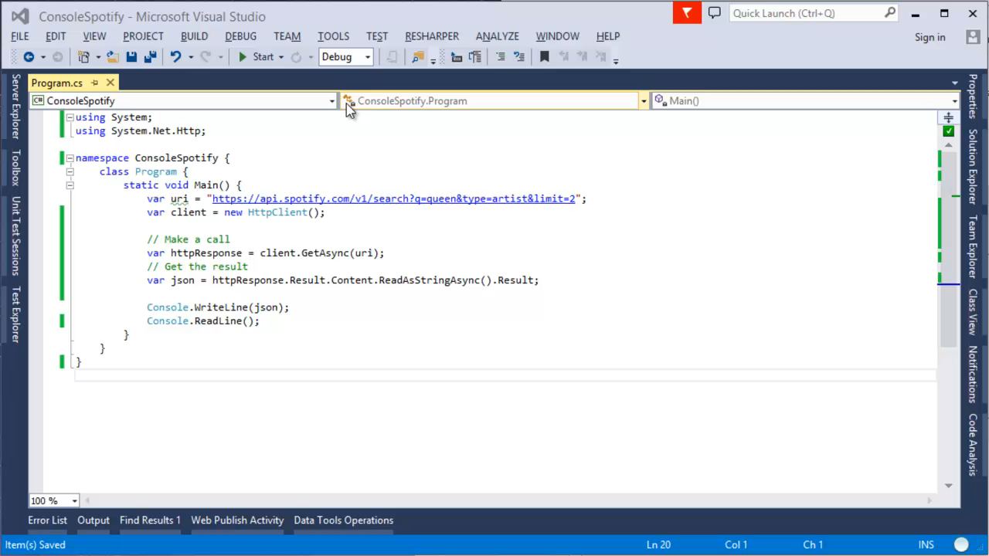
Console App

Slide 15
Deserialise

Slide 16
Console App

Slide 17
Website ASP.NET MVC5

Slide 18
Console App

Slide 19
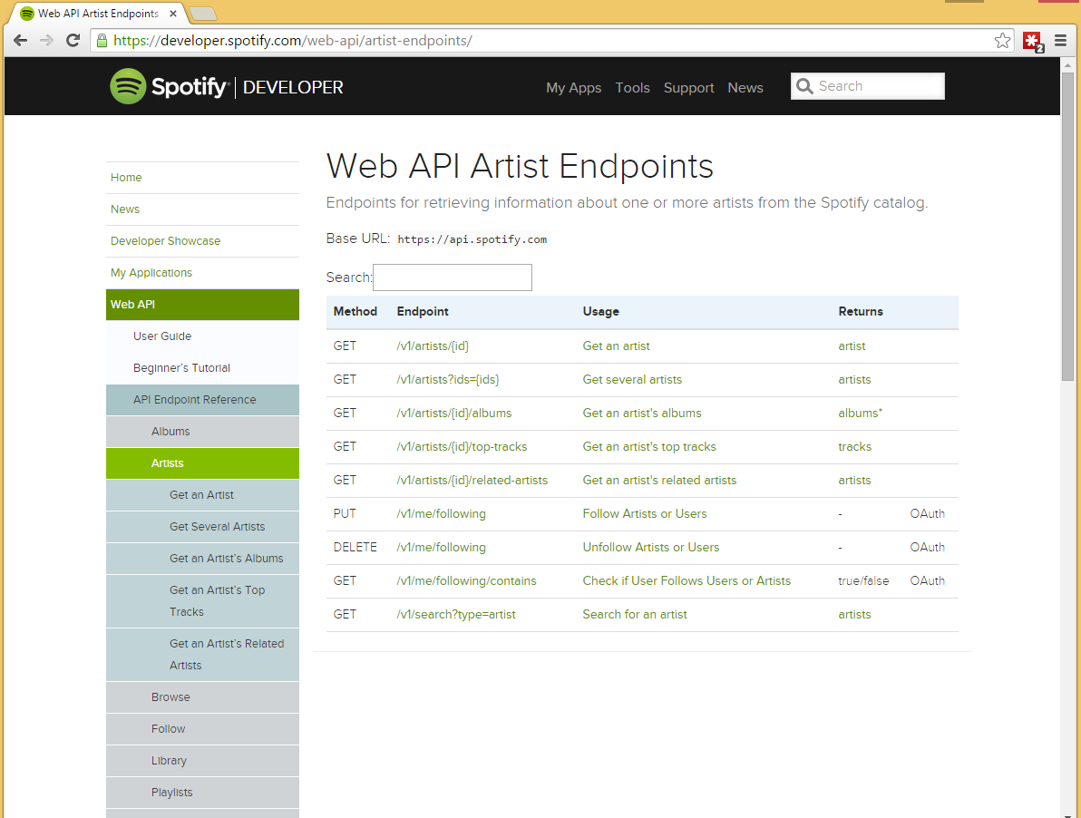

Slide 20
OAuth2

Slide 21
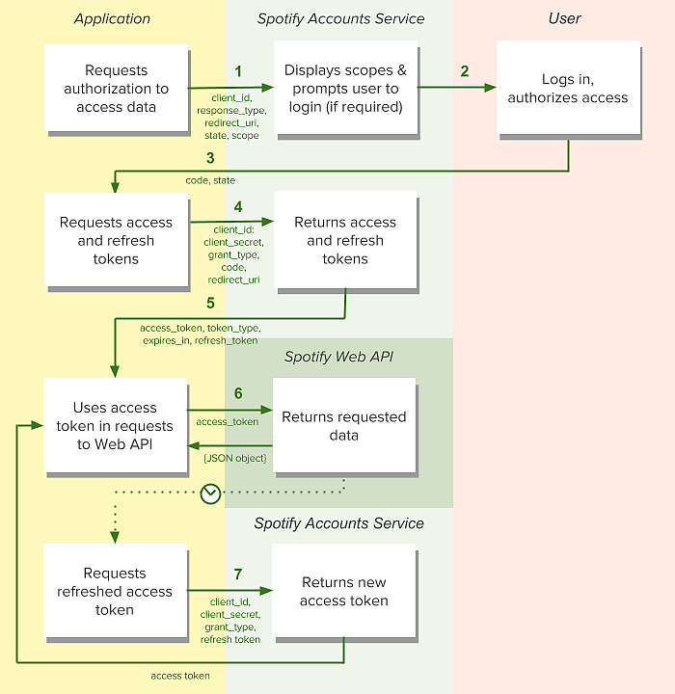

Slide 22
Dapper – a Micro Object Relational Mapper

Slide 23
Console App

Slide 24
MiniProfiler

Slide 25
Console App

Slide 26
Appveyor – Continous Integration / Continuous Delivery

Slide 27
Console App

Slide 28
Webdeploy to EC2 micro VM

Slide 29
Console App

Slide 30
The Final Product (again)
Demo in real time (hopefully)

Slide 31
Console App

Slide 32
Summary
Spotify API
OAuth2
ASP.NET MVC
Dapper (ORM)
MiniProfiler
Appveyor
davemateer at gmail.com
github.com/djhmateer
www.davestopmusic.com

