Slide 1
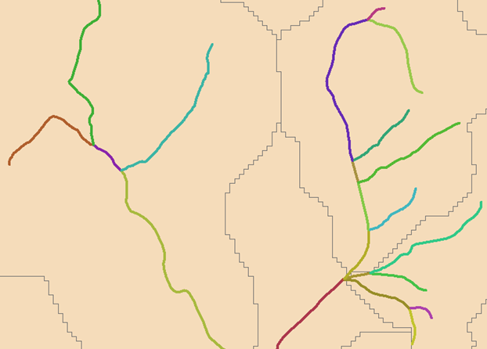
T2
T4
N10
T3
S3
T5
S1
T6
T7
S4
N3
N9
T1
N2
N8
T8
S5
T9
N7
S2
N4
N5
T10
S6
N6
T11
T12
N1

