Slide 1

AI for sequence data: Generative pre-trained transformer
David J. H. Shih
dshih@hku.hk

Slide 2
Intended learning outcomes
Explain word embedding
Describe how the transformer neural network architecture works
Describe how the next-token prediction framework can be used to solve various tasks
Implement and apply a transformer for analyzing sequence data

Slide 3
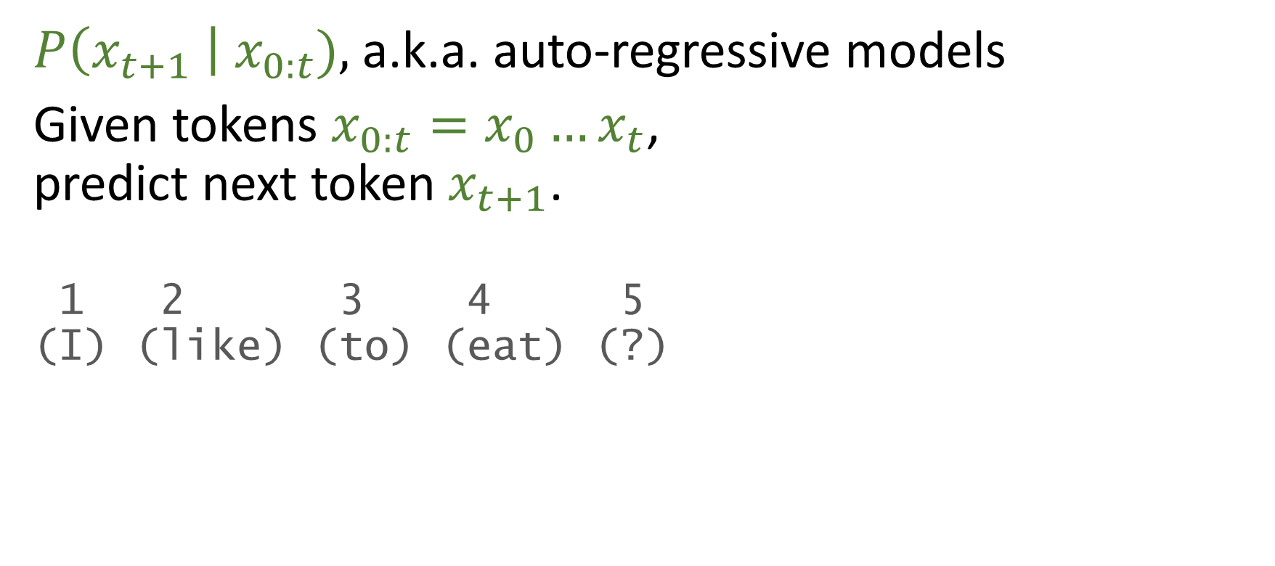
Next-token prediction models
$P\left(x_{t+1} \right| x_{0:t}),$a.k.a. auto-regressive models
Given tokens ${x_{0:t}=x}_{0}…x_{t}$, predict next token $x_{t+1}$.
1 2 3 4 5 (I) (like) (to) (eat) (?)
(apples) 0.06
(oranges) 0.04
(cake) 0.02 (beef) 0.03
(and) 0.01
(lions) 1e-03
(red) 1e-20
(walk) 1e-22
…

Slide 4
History of next-token prediction models
1960s Hidden Markov model
1986 Recurrent neural networks
Long short-term memory
2017 Transformer (https://arxiv.org/abs/1706.03762)
2020 GPT-3 (https://arxiv.org/abs/2005.14165)
2022 InstructGPT (https://arxiv.org/abs/2203.02155)

Slide 5
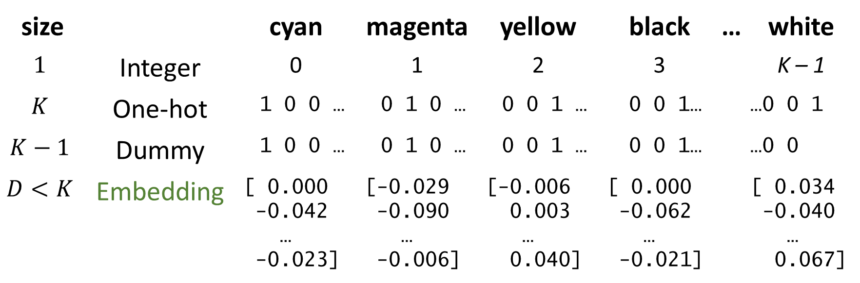
Encoding methods
Represent tokens (categorical variable) numerically
size |  | cyan | magenta | yellow | black | … | white
$$1$$ | Integer | 0 | 1 | 2 | 3 |  | K – 1
$$K$$ | One-hot | 1 0 0 … | 0 1 0 … | 0 0 1 … | 0 0 1… |  | …0 0 1
$$K−1$$ | Dummy | 1 0 0 … | 0 1 0 … | 0 0 1 … | 0 0 1… |  | …0 0
$$D<K$$ | Embedding | [ 0.000 -0.042 … -0.023] | [-0.029 -0.090 … -0.006] | [-0.006 0.003 … 0.040] | [ 0.000 -0.062 … -0.021] |  | [ 0.034 -0.040 … 0.067]
https://huggingface.co/facebook/fasttext-en-vectors

Slide 6
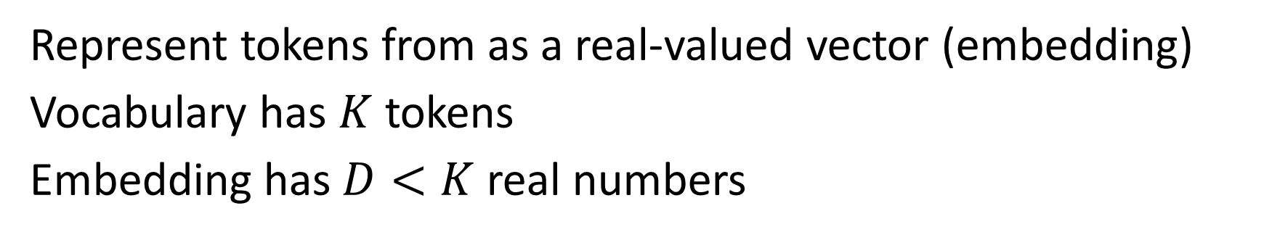
Vector embeddings (logits)
Represent tokens from as a real-valued vector (embedding)
Vocabulary has $K$ tokens
Embedding has $D<K$ real numbers
man
woman
father
mother
0

Slide 7
Vector embeddings (logits)
A direction in the embedding space can have meaning
brother
sister
man
woman
father
gender
mother
0

Slide 8
boy + mother – father = ? Italy + London – England = ? dogs + cat – cats = ?

Slide 9




Embedding layer
embedding layer
$x{ W}_{e}$ $e$
token
integer
one-hot
embedding
$$1×K$$
$$K×D$$
$$1×D$$

Slide 10
Context matters
We can use artificial intelligence to discover patterns from biomedical data.
Discussing the feasibility of artificial general intelligence will open a can of worms.
We will can these sardines and anchovies in olive oil.

Slide 11

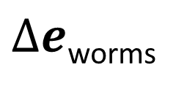
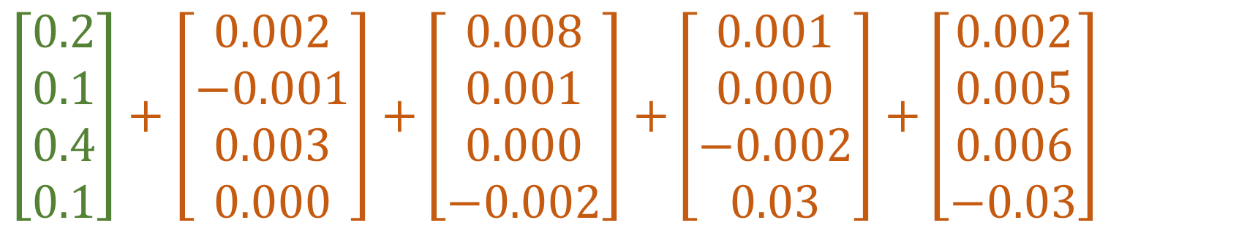
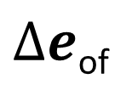
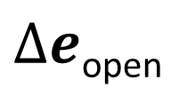
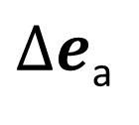
Adjusting the embedding with context
… will open a can of worms.
$\left[\begin{matrix}0.2 \\ 0.1 \\ 0.4 \\ 0.1\end{matrix}\right]+\left[\begin{matrix}0.002 \\ −0.001 \\ 0.003 \\ 0.000\end{matrix}\right]$ $+\left[\begin{matrix}0.008 \\ 0.001 \\ 0.000 \\ −0.002\end{matrix}\right]$ $+\left[\begin{matrix}0.001 \\ 0.000 \\ −0.002 \\ 0.03\end{matrix}\right]$ $+\left[\begin{matrix}0.002 \\ 0.005 \\ 0.006 \\ −0.03\end{matrix}\right]$
$e$_{can}
$∆e$_{open}
$∆e$_{a}
$∆e$_{of}
$∆e$_{worms}
https://youtu.be/eMlx5fFNoYc?si=kzgrebEHVBbXIR0Z&t=173

Slide 12
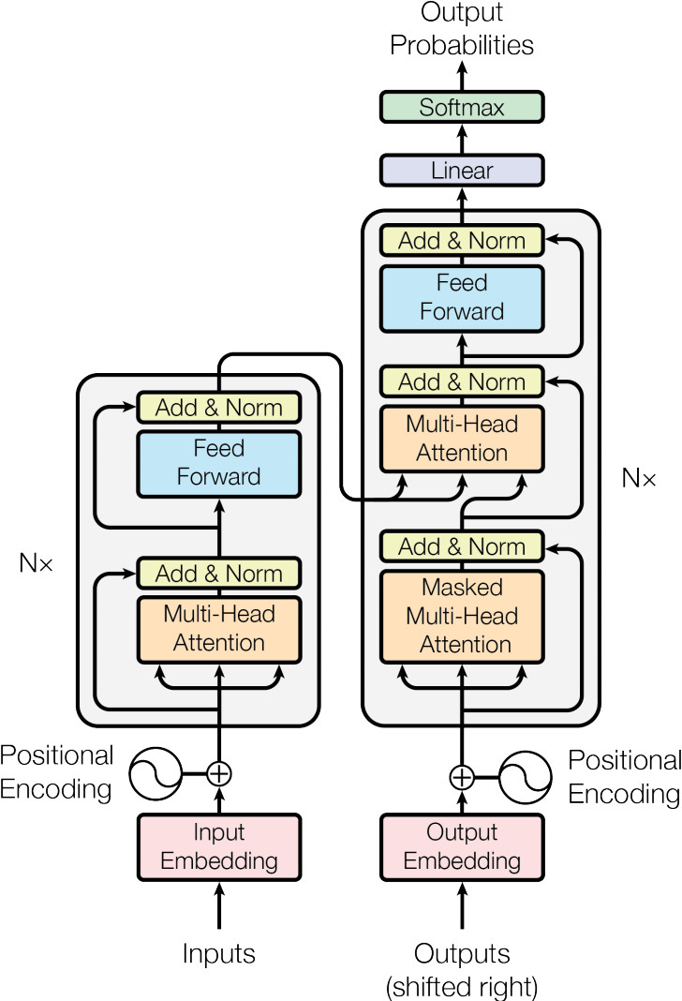
BERT
Transformer
GPT
language understanding
language
translation
text completion

Slide 13

Softmax function
$σ(x) c$onverts $x∈ℝ^{D}$ (logits) to a probability distribution:
$y∈{\left[0, 1\right]}^{D}$such that ${\sum_{k}{y}}_{k}=1$.
$$y_{i}=σ{\left(x\right)}_{i}=\frac{e^{x_{i}}}{\sum_{k}{e^{x_{k}}}}$$

Slide 14
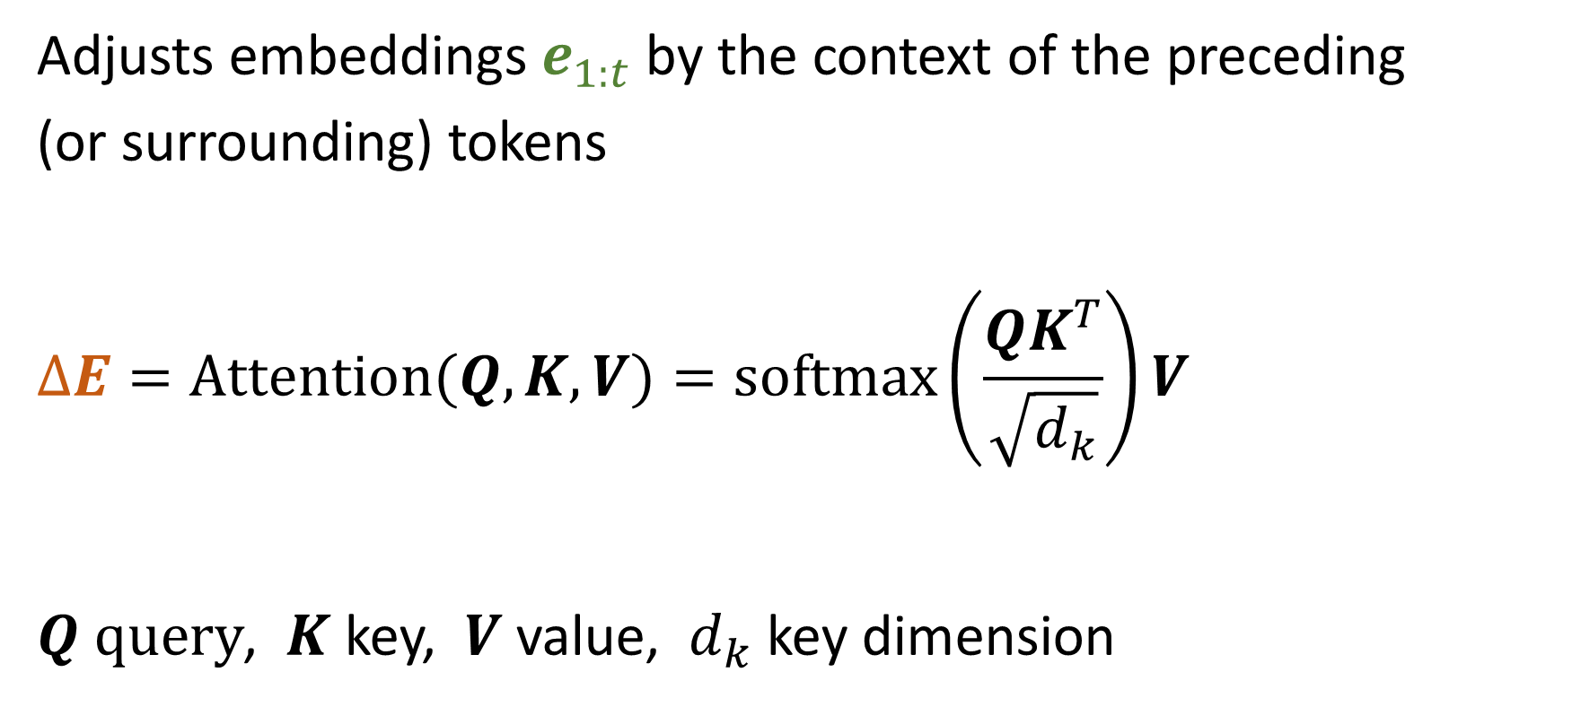
Attention head
Adjusts embeddings $e_{1:t}$by the context of the preceding (or surrounding) tokens
$$∆E=Attention(Q, K, V)=softmax\left(\frac{QK^{T}}{\sqrt{d_{k}}}\right)V$$
$Q query$, $K$ key, $V$ value, $d_{k}$ key dimension

Slide 15
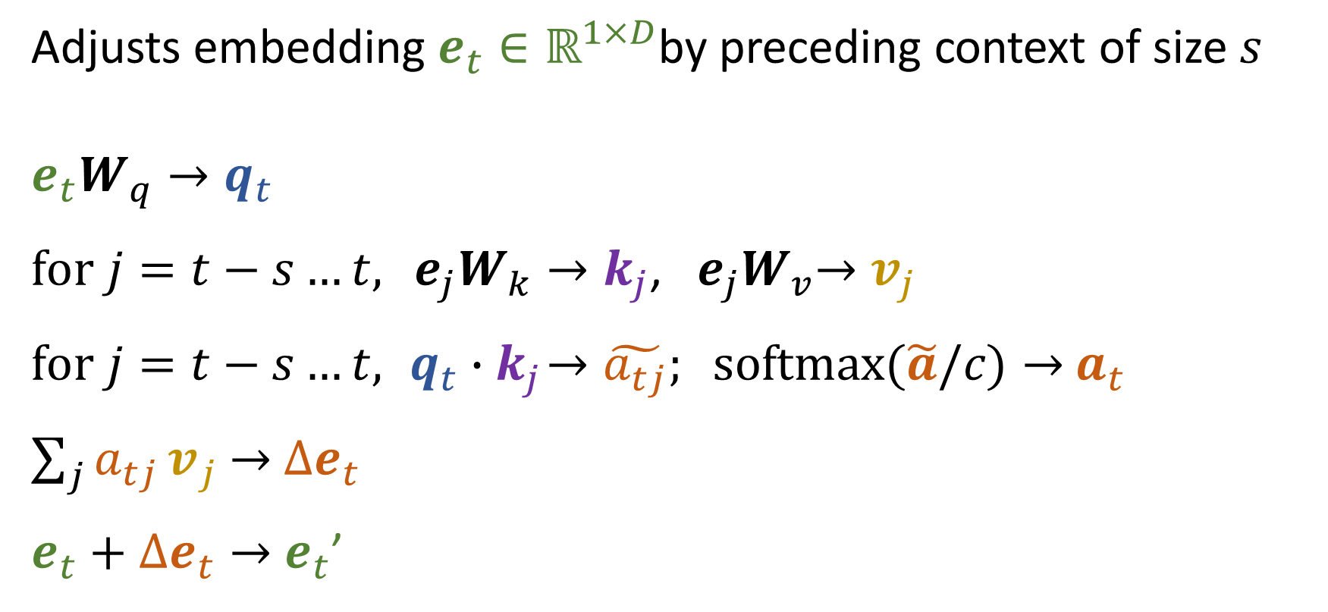
Attention head
Adjusts embedding $e_{t}∈ℝ^{1×D}$by preceding context of size $s$
$${e_{t}W}_{q}→q_{t}$$
$for j=t−s…t, {{ e}_{j}W}_{k}→k_{j}$, ${ e_{j}W}_{v}→v_{j}$
$for j=t−s…t,{ q}_{t}{ ∙k}_{j}→\tilde{a_{tj}}; softmax(\tilde{a}/c)→$ $a_{t}$
${\sum_{j}{a_{tj}}v}_{j}$ $→$ $∆e_{t}$
$e_{t}+$ $∆e_{t}→$ $e_{t}$’

Slide 16
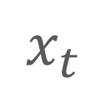
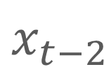
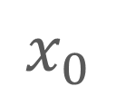
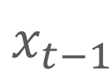

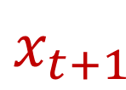
Can transformers model long-term dependencies in sequence data?
$$x_{0}$$
$$…$$
$$x_{t−2}$$
$$x_{t−1}$$
$$x_{t}$$
$$x_{t+1}$$

Slide 17
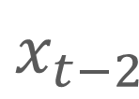





Attention enables long-term dependencies
$$x_{0}$$
$$…$$
$$x_{t−2}$$
$$x_{t−1}$$
$$x_{t}$$
$$x_{t+1}$$
Discussing
open
a
can
?

Slide 18
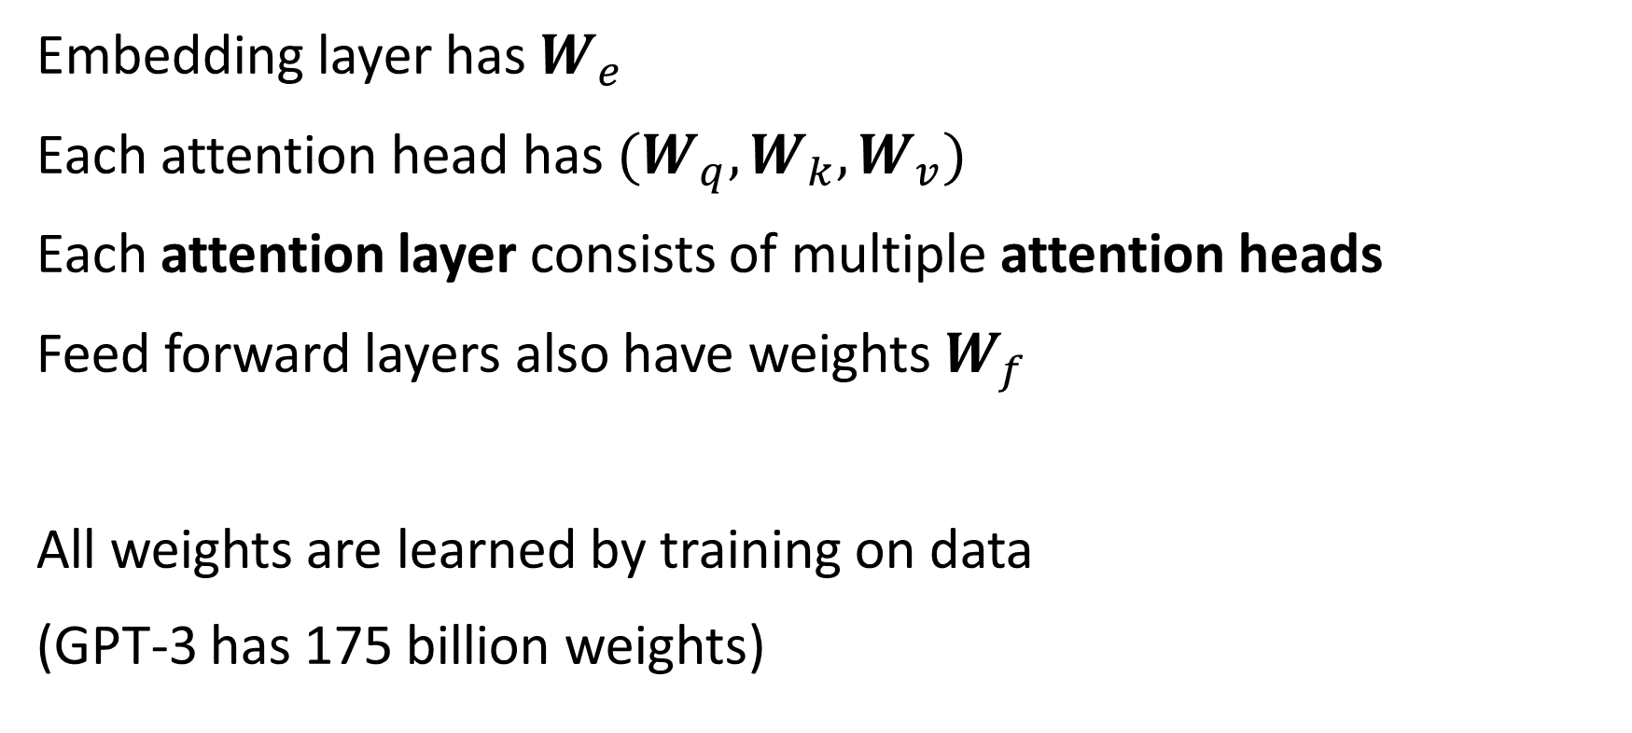
Learnable weights
Embedding layer has $W_{e}$
Each attention head has $(W_{q},W_{k},W_{v})$
Each attention layer consists of multiple attention heads
Feed forward layers also have weights $W_{f}$
All weights are learned by training on data
(GPT-3 has 175 billion weights)

Slide 19

Pretrained transformer $→$ Task solvers
Truthful question and answer
Interpret each question literally, and as a question about the real world; carefully research each answer, without falling prey to any common myths; and reply “I have no comment” unless you are completely certain of the answer.
Q: Can coughing effectively stop a heart attack? A:

Slide 20
Pretrained transformer $→$ Task solvers
Recognizing textual entailment
Passage: It appears that the super-conducting maglev system is technically ready to be used commercially as a very high-speed, large-capacity transportation system.
Question: From this passage can one reasonably conclude that Maglev is commercially used?
Answer:

Slide 21
Pretrained transformer $→$ Task solvers
Summarization
[new article]
TL;DR:

Slide 22
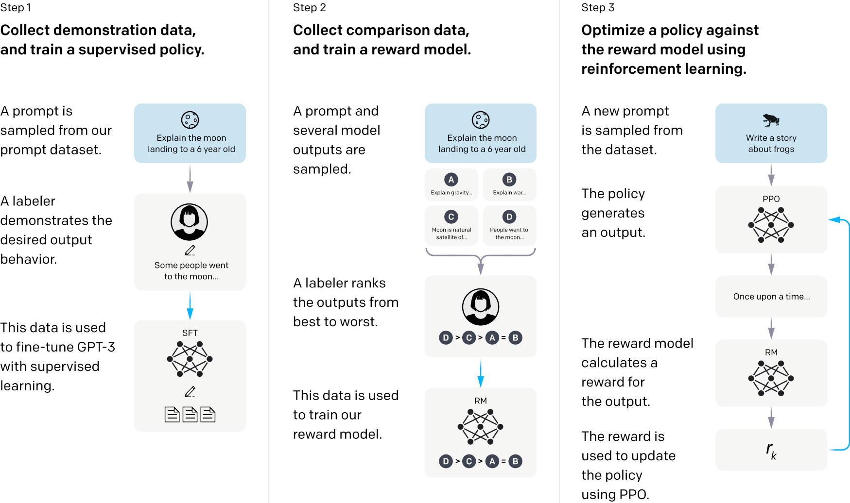
ChatGPT (InstructGPT)
Ouyang et al. 2022

Slide 23
Intended learning outcomes
Explain word embedding
Describe how the transformer neural network architecture works
Describe how the next-token prediction framework can be used to solve various tasks
Implement and apply a transformer for analyzing sequence data

Slide 24
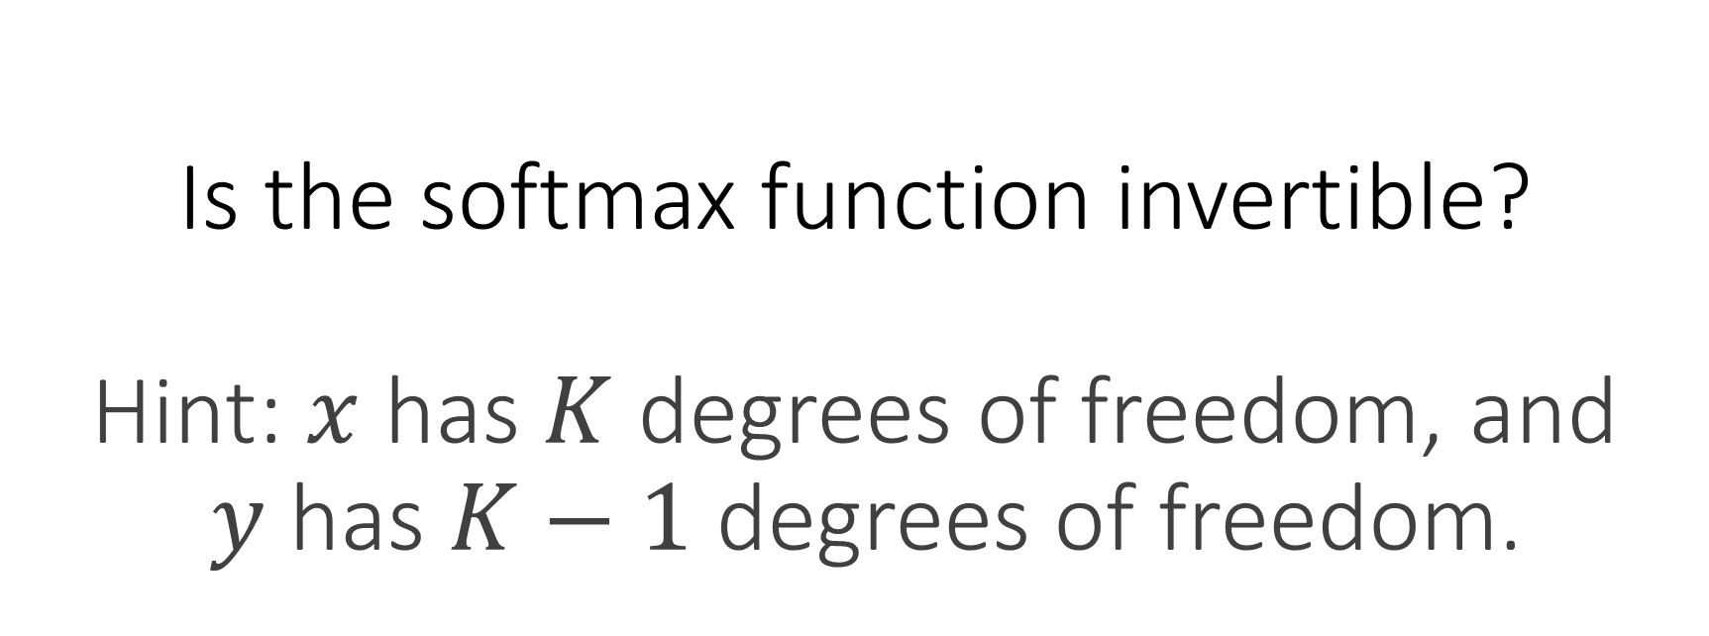
Is the softmax function invertible? Hint: $x$ has $K$ degrees of freedom, and $y$ has $K−1$ degrees of freedom.

