Slide 1
Business Automation using IBM’s Agentic Framework

Slide 2

Business Story
ABC Corp, needs an automated competitive analysis system to help their sales teams quickly identify and position their products against competitors. Traditionally, gathering competitor insights required extensive manual research, making it inefficient and prone to outdated information.
Therefore, the goal of this use case is to create an AI enabled system that support the customer's competitive analysis and market research.
The sales department of ABC Corp, a sales-driven enterprise, when preparing proposals, they were spending a lot of time understanding the features of competing products and comparing them with their own products.

Slide 3
Business Challenge
Time-consuming competitive research –
Sales teams spend excessive time manually gathering competitor insights, delaying decision-making and reducing productivity.
Inefficient product positioning
–
Lack of structured competitor comparison leads to weak sales pitches, making it harder to highlight unique selling points effectively.
Data overload & irrelevant information
–
Traditional search methods yield excessive or low-quality data, making it difficult to extract meaningful competitor insights.
Delayed response to market changes
–
Without real-time competitive intelligence, businesses struggle to adapt pricing, features, and strategies based on evolving market trends.
Lack of automation in sales intelligence
–
Manual processes for feature extraction, web search, and competitor analysis lead to inconsistent data and missed sales opportunities.

Slide 4
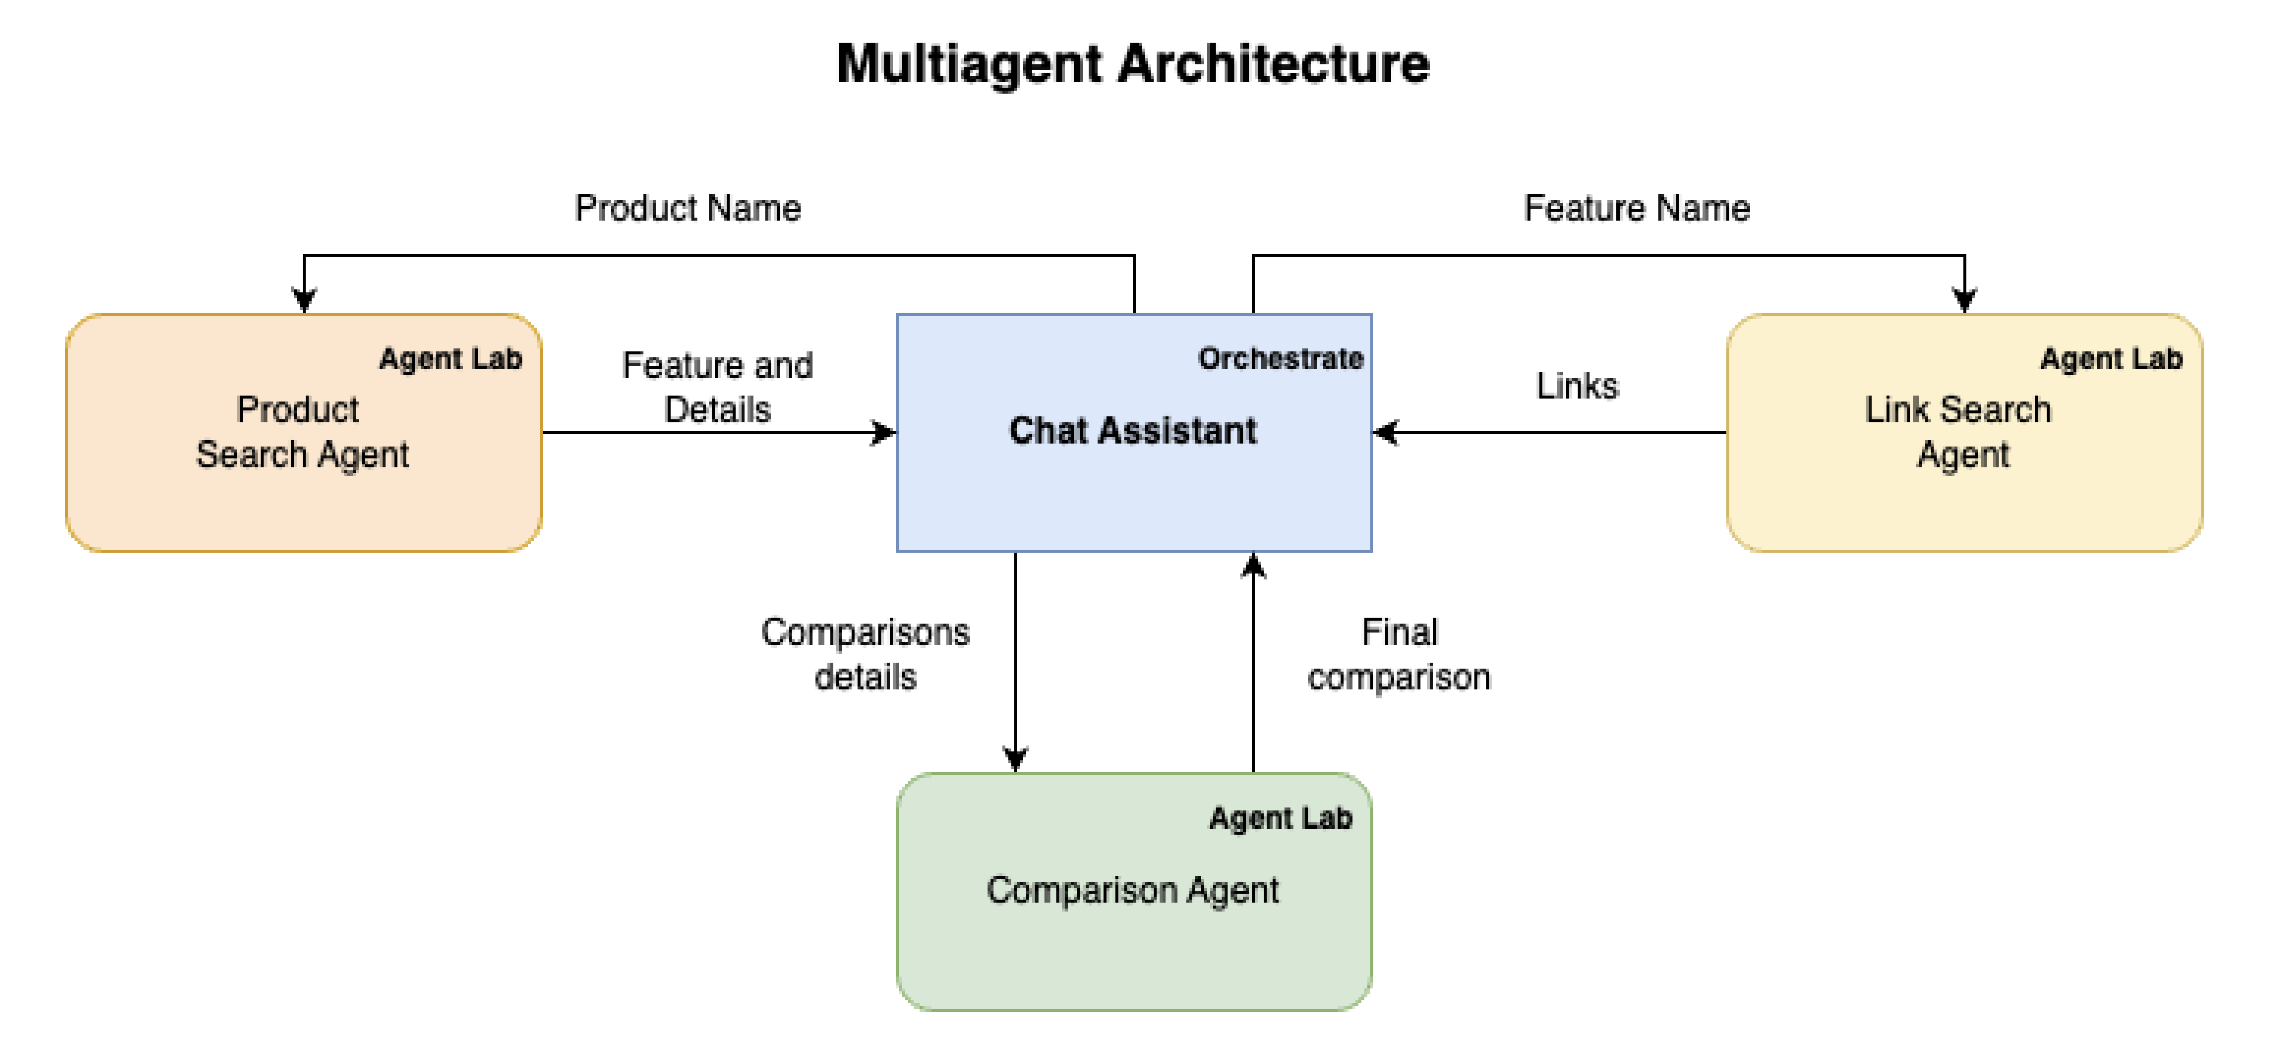
The Solution - Architecture
To streamline this process, a Multi-Agent AI Automation System is proposed that Autonomously extracts product features, searches for competitor products, filters relevant information, and generates a structured competitive comparison table.
This system leverages 3 AI agents that collaborate seamlessly to automate competitive research, enhance sales pitch effectiveness, and reduce manual effort.

Slide 5
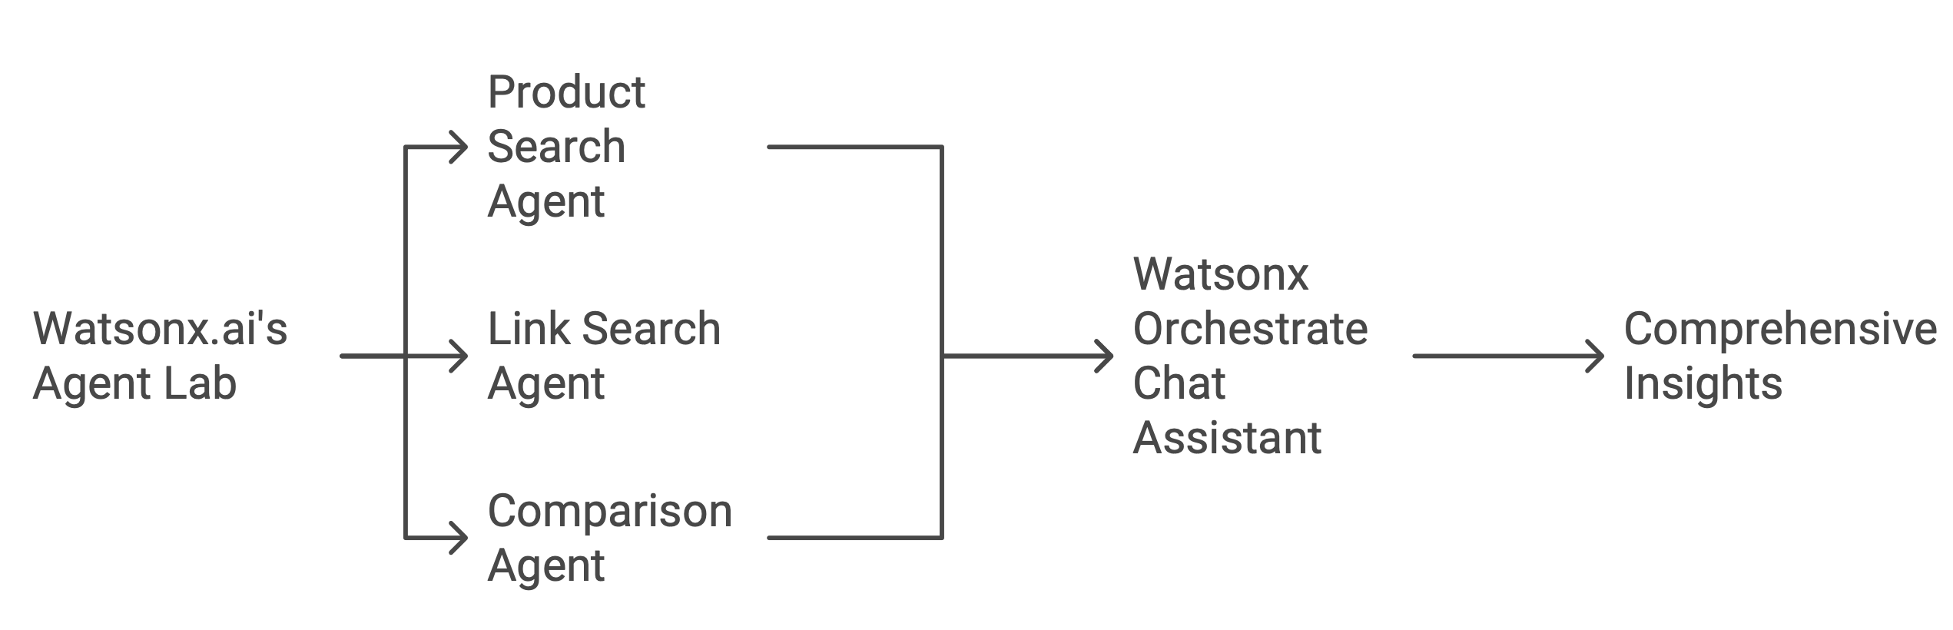
The Solution - Methodology
The use case leverages three specialized agents developed within the Watsonx.ai's Agent Lab, all of which are integrated into Watsonx Orchestrate. Through the Watsonx Orchestrate chat assistant, these agents communicate seamlessly to provide comprehensive insights and facilitate informed decision-making.
Product Search Agent : This agent is designed to *search* for a specified product and retrieve its details and features in a structured format. It ensures clarity and organization by presenting key product information systematically, making it easy to understand and use.
Link Search Agent : This agent is expert in finding URLs or links for similar products that share matching features, ensuring users can explore alternatives efficiently.
Comparison Agent : This agent is designed to compare the given data with additional information gathered from Google search results. Its task is to carefully analyze the input data, extract key insights, and identify both differences and similarities. The findings should be presented in a well-structured table format, making it easy to understand and compare the information briefly.

