Slide 1

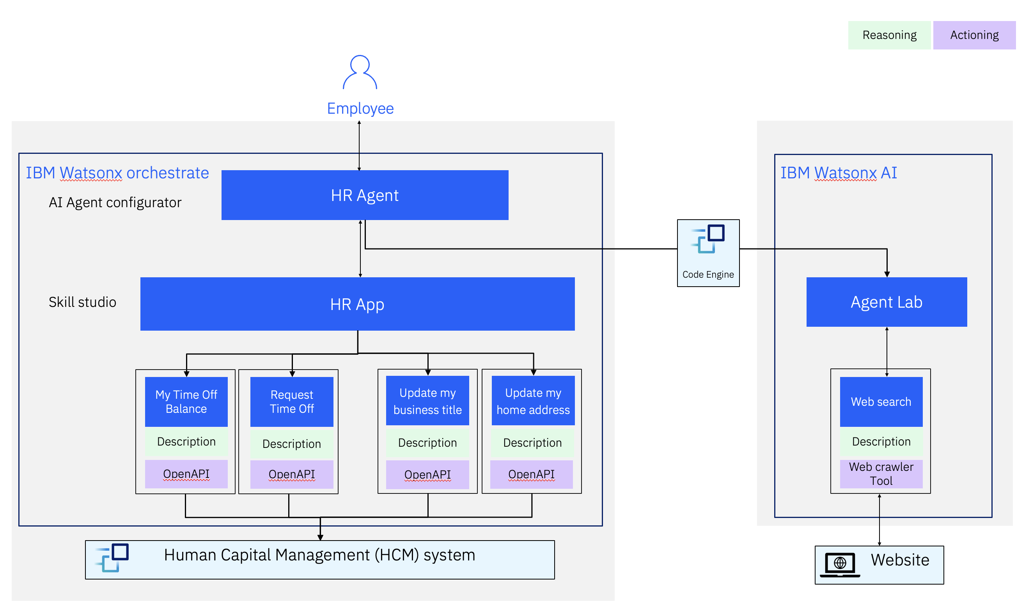


IBM Client Engineering
Client facing
Accenture report says “enterprises are beginning to embrace AI agents, noting that 77% of executives agree AI agents will reinvent how their organization builds digital systems. Additionally, 48% of executives say AI agents would improve flexibility of their organization’s digital architecture”
Usecase: AskHR
Read the Accenture Report
Build an HR Assistant to react and respond to employee inquiries in an organization.
Story / problement statement.
Methodology
Step 1: Requirement gathering
Step 2: Development and configuration
Step 3: Testing and validation
Step 4: Deployment and monitoring
Many organizations struggle with HR workflows due to the challenge of delivering timely and accurate information to the right users, compounded by the critical need for strict control over sensitive HR data and user access.
Goal
Architecture
Create an easy-to-use interface for confidently and easily doing selected HR workflows.
The sensitivity & security of the data should be of at-most consideration.
Resources
Business value
Links to Repo: https://github.ibm.com/skol/agentic-ai-client-bootcamp/tree/main/usecases/ask-hr
Documents: https://github.ibm.com/skol/agentic-ai-client-bootcamp-instructors/tree/main/usecase-setup/askhr
Ease of information retrieval with transparency.
Proper authorization of sensitive data operations.
Highly immune to security threats/cyber-attacks.
No-code approach for easy scaling.
1
IBM Client Engineering / Feb 2025 / © 2025 IBM Corporation

