Slide 1
BNU 2018: Population and Housing Censuses using administrative sources. Part I-III
The past, present and future of population censuses: Methodology and quality aspects when data sources are being reused and combined to transform a census system.
21-24 August 2018

Slide 2
Contents Part I - Part III
Census history and background
Motives for using administrative data
The Nordic model
Registers, data infrastructures and methods
Other census models
What is quality in a Census ? Assessment methods.

Slide 3
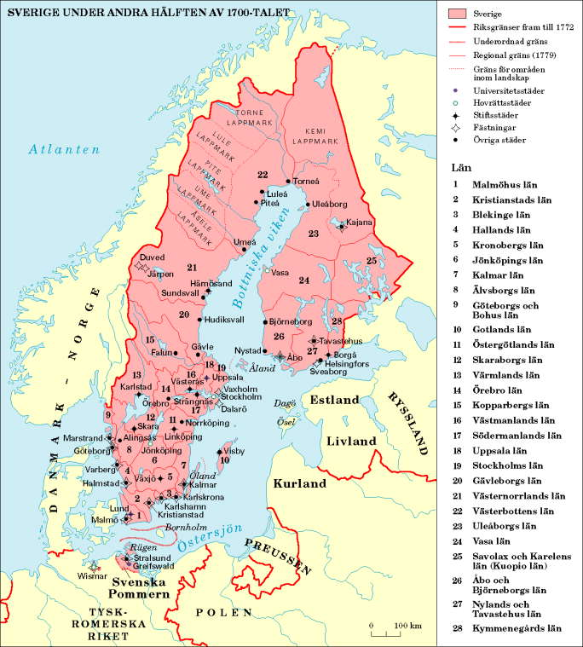
History
American colonies, Quebec
1749 Sweden (Finland)
Italian and German cities 1770:ies
Denmark 1787
US 1790, England 1801
France (tried) 1800, 1806
China 1953
Notes:
Early undertakings, Persia, Palestine, Egypt China, Domesday book in England

Slide 4
Role of the census
Benchmark in a National statistical system
For baseline estimates and small groups/domains
Assisting data collection; Organisation, Frames, Techniques, Routines.
Planning on local and national level
Use Internationally and for the National Accounts

Slide 5
Direct Topics in a Population Census
Geographic: place enumerated and/or place of usual residence;
Family circumstances: relation to head of household or family;
Demographic: sex, age, marital status, children ever born, birthplace;
Economic: type of activity, occupation, industry, employer-employee status;
Social and political: citizenship, language, ethnic or religious affiliation
Educational: literacy or level of education, school attendance.

Slide 6
Examples of Statistics from Population Census
Total population (Counts)
population of towns and local areas
urban-rural distribution
household or family composition
Plus Additional topics
internal migration, income, labour-force participation, duration of marriage, etc…

Slide 7
Statistics from the Housing part of the Census
Total population! (Counts of Dwellings)
Housing arrangements (used as residence, vacant or secondary use)
Occupancy status
Type of Ownership
Useful floor area
Standards of dwelling (Water, toilets, heating)
Dwellings by Type of Building, Size

Slide 8
Motives for a register-based census
Cost-efficiency
Reduced response burden on the population
Provides the means for recurrent register-based production of (some) social statistics
Improves accuracy and timeliness
Provides the means for new, better statistics (e.g. on living conditions)
Improves relevance

Slide 9
NSO-Target!? To create (new) knowledge from recycling existing data
Observations
Time (survey rounds)
Variables
Processes, Statistics och Analyses
Decision, long term use in EU, UN mm
Notes:
Förenklad bild (Arkivstatistiskt system Nordbotten 60-tal) Note observations not units in this version.
Fördelarna som finns
En effektivare statistikproduktion med bra kopplingar, variabelöverblick, enkel dataåtkomst för produktion med standardiserade populationer och standardprodukter baserade på strukturerade datalager med registerdata.
Kvalitetssäkring genom enhetlig hantering och lagring av metadata, klassificeringar och standardiserade variabler samt genom säkra dataleveranser till, inom och ut från en NSI.
Möjligheter att förbättra och skapa nya produkter samt utveckla analysarbete
Möjligheter att minska uppgiftslämnandet
Förutsättningar att förse forskarsamhället med väldokumenterade, longitudinella, bättre och billiga data.
Kostnadsbesparingar i samhället i stort och för NSI med en ökad användning av administrativa data.

Slide 10
Cost of Censuses in Finland
Census data 1950-2000 according to the data source
100
80
Questionnaires
Registers
10 annual
60
Census
censuses
1980
8 MEUR
35 MEUR
40
20
0
1950
1955
1960
1965
1970
1975
1980
1985
1987
1988
1989
1990
1991
1992
1993
1994
1995
1996
1997
1998
1999
2000
Source:Statistics Finland, Kaija Routsalainen, Libourne July 2007

Slide 11
More countries move from a traditional census All countries try to modernize collection
UNECE keeps a good overview
https://statswiki.unece.org/display/censuses/2010+Population+Census+Round
Slovenia, Austria, The Netherlands (Reg)
Belgium, Iceland (reg plus a few surveys)
Estonia,, Germany, Latvia, Lithuania, Switzerland (Mix Reg + surveys)
France (Rolling census system)
US, Canada, UK, New Zealand, Australia, Ireland, Italy (Trad.)
Ukraine (no census)

Slide 12
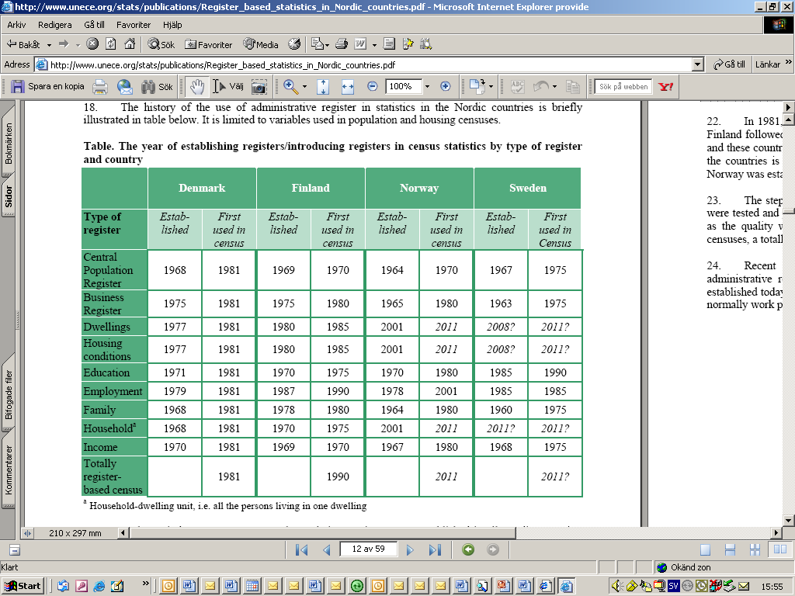

Slide 13
Swedish Censuses in the 20:th century
Modern Population and housing censuses every 5th year between 1960 – 1990. Traditional censuses with increasing use of register data
1985 and 1990
High degree of computerization (main frame)
1985 Public inquiry on increasing the use of registers.
Huge protest campaigns in media
Cancelled 1995, 2000 (some data to Eurostat)

Slide 14
Input to the Swedish register based census
Important external register keepers
National tax
agency
Mapping, cadastral & land registration auth.
Registration of
pop. on dwelling
Dwelling
register
Registers at Statistics Sweden
Population
Business
Real Property
Subject matter Reg
Personal ID-number
Dwelling ID-key
Address
Business ID-number
Emp
Occ
Edu
House-
hold
Family
Living
cond.
Housing
Building
Notes:
The administrative Dwelling register is kept by Lantmäteriet - the Swedish mapping, cadastral and land registration authority
Total population register
Identification key (In Sweden Personal identification number)
Base unit, individual
- Contains basic information on all persons (sex, age, marital status, nationality etc.)
References to parents and spouses
Real property register
Identifier – addresses, geographic coordinates
Base units:
Real Property
Buildings & apartments
- Contains building permits, real estates taxation, geographic codes etc.

Slide 15
Links
Employment
Education
Occupation
Business identification number
Personal identification number
Real Property register
Business register
Population register
Dwelling identification number
Address
Dwellings

Slide 16
The weakest link – the Dwelling ID-key
Two important steps:
Construction of Dwelling register
Unique address for real property (building)
Unique dwelling number within building
Unique dwelling ID-key
Registration of (registered) population on dwelling
Complex processes and tight schedule
Notes:
- Municipality: local administrative unit
- Process started in 2009

Slide 17
Constructing the Dwelling register
Complex interaction required between
Municipalities
Mapping, cadastral & land registration authority
Real property owners
Residents living in multi-dwelling buildings were informed about their dwelling numbers by the property owner
Notes:
Municipaltiy: local administrative unit

Slide 18
Populations, units and definitions
With a well functioning population register, individual person is a basic unit.
Households and Families are trickier.
On the housing side Properties is the basic (legally regulated) unit. Buildings and Dwellings are units assigned to them where people live businesses are active etc. Addresses, Geocodes are attributes.

Slide 19
Populations, units and definitions
De jure or de facto population?
Institutions, dormitories, Age limits?

Slide 20
Type of Household
Household
1.
Household
Not being a Family
2.
Household with
One Family
3.
Households with two or more Families
1.1
Single Household
1.2
Multiperson Household
2.1
Household with married couple
2.2
Household with registered partnership
2.3
Household with cohabitant
2.4
Household
With single father
2.5
Household with single mother
2.1.1
No Children
2.1.2
At least 1 child <25 yrs
2.1.3
Youngest child > 25 yrs
2.2.1
No Children
2.2.2
At least 1 child <25 yrs
2.2.3
Youngest child > 25 yrs
2.3.1
No Children
2.3.2
At least 1 child <25 yrs
2.3.3
Youngest child > 25 yrs
2.4.1
At least 1 child <25 yrs
2.4.2
Youngest child > 25 yrs
2.5.1
At least 1 child <25 yrs
2.5.2
Youngest child > 25 yrs
2.1.1.1
Diff.
Sex
2.1.2.2
Same Sex
So on
So on

Slide 21
Household status
Individual
1.
Household
2.
Not Household
1.2
Person who is not part of Family (Fam type 5)
1.1
Person who is part of Family (Type of Fam. 1-4)
2.1
Institutional Household
2.2
Primary Homeless
2.3
Other
1.2.1
Lives alone
1.2.2
Does not live alone
1.1.1
Married Couple
1.1.2
Registered partner
1.1.3
Cohabitants
1.1.4
Single Parent
1.1.5
Children
1.1.1.1
Diff
Sex
1.1.1.2
Same
Sex
1.1.2.1
Diff
Sex
1.1.2.2
Same
Sex
1.1.3.1
Diff
Sex
1.1.3.2
Same
Sex
1.1.5.1
Not with single parent
1.1.5.2
With single parent

Slide 22
Family Status
Individual
1.
Partners
2.
Single Parents
3.
Children
4.
Unknown / Not Reported
5.
NA
(Not part of family)
3.1
Not with single parent
3.2
With Single Parent
1.1
Married Couple
1.2
Registered partner
1.3
Cohabitant Relationship
1.1.1
Diff. Sex
1.1.2
Same sex
1.1.1
Diff. Sex
1.2.2
Same sex
1.1.1
Diff. Sex
1.3.2
Same sex

Slide 23
Family type
Family
1.
Family with married couple
2.
Family with registered partnership
3.
Family with Cohabitant-Relationship
4.
Family with single father
5.
Family with single mother
1.1
No Child
1.2
At least 1 child <25 yrs
1.3 Youngest child >25 yrs
2.1
No Child
2.2
At least 1 child <25 yrs
3.1
No Child
5.1
At least 1 child <25 yrs
2.3 Youngest child >25 yrs
3.2
At least 1 child <25 yrs
3.3 Youngest child >25 yrs
4.1
At least 1 child <25 yrs
4.2 Youngest child >25 yrs
5.1
At least 1 child <25 yrs
5.2 Youngest child >25 yrs
1.1.1
Family with couple of diff sex
1.1.2
Family with couple of same sex
...
...
2.1.1
Family with couple of diff sex
2.1.2
Family with couple of same sex
...
...
3.1.1
Family with couple of diff sex
3.1.2
Family with couple of same sex
...
...
Notes:
23

Slide 24


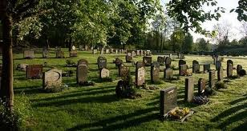




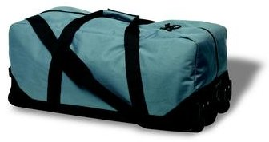
Notifications to the population register

Slide 25
Definition of the census population
Registered population (12 month criteria)
Place of birth – A newborn children born in Sweden, is registered in the parish in which the mother was registered at the time of birth. If the mother was not registered at the time of birth, the child is registered only if the father was registered and guardian. A newborn baby, born abroad, are registered only if the mother was registered at the time of birth.
Notes:
Foreigners (2011)
Marital status – no missing data
Place of birth – country of birth is missing for around 800 out of 1 400 000, 0,06 %
Country of citizenship (600 000) 3 %missing
Stateless 8 213
Unknown 1 585
Country no longer existing 9 432
Data on entry date into Sweden (for foreigners who arrived before 1991)
Missing data for 3 000 out of all foreign born – 2 %
Missing data for 3 000 out of all that came before 1991 born – 5 %
Resided abroad and arrived 1979 or before, or never resided abroad
Ever resided abroad and arrived 1979 or before (optional)
Never resided abroad (optional)

Slide 26
Families
The family nucleus is defined in the narrow sense, that is as two or more persons who belong to the same household and who are related as husband and wife, as partners in a registered partnership, as partners in a consensual union, or as parent and child.
Cohabitation
One person is not a family;
how many families does a household of a married couple and a lodger consist of. 1+0?
The lodgers household status is ”none” but is he included in a type of private household – ”Married couple households”?

Slide 27
Definitions of cohabitation
Two persons are considered to be partners in a ‘consensual union’ when they
belong to the same household
have a marriage-like relationship with each other
are not married to or in a registered partnership with each other.
Sex and age critieria ?
(Assumptions set to minimize misclassification errors )

Slide 28
A selection of concerns
ALL of the traditional error sources in surveys are present!?
Many different authorities are involved
In Sweden: 290 different municipalities and about 2 million real estate owners has to be informed and willing to provide information.
Different actualities in the registers.

Slide 29
A selection of concerns
SWE: Different input (processes) for one- and two-dwelling buildings and multi-dwelling buildings.
Both real property owners, residents and municipalities are respondents, what are their incentives?
Relevance of some of the variables
Large amounts of data
The quality of the other registers ? What happens when they are joined?

Slide 30
Processes and Editing of the Census
Data owner
Data owner
Errors
(→ automatic correction)
RTB system
Errors
(→ automatic correction)
Editing on data arrival
Funnel
Editing on data arrival
Pre-processing
environment
Suspected errors
(signaling)?
Link
Population register
Real Property Register
Register management
Suspected errors
(signaling)?
Register management
Production editing
Feedback?
Output editing
or
Benchmarking/Evaluation
(Disclosure control)
Statistics producer/user of administrative data
Notes:
With this slide, we look at the process of editing administrative data for multiple data sources (or integrated data sets). This is exemplified with the Census and the future, running household, living and housing statistics.
In this case, except for the process from the last slide for each data source, editing across the system of registers or between spheres is relevant. The statistics will depend on the quality of the underlying registers. Editing includes some microediting and output editing, but there must also be assessments of unit coverage and reference dates, evaluations across register sources as well as looking closer at the possibilities of doing geographical editing. Checks have to be done with other statistics. Good subject matter knowledge is most often necessary.
Sometimes, inconsistencies can be seen as errors in objects or variables. Errors in objects should be handled first.
Example) Data from integrated registers are thought to refer to the same object, but don’t.
Example) Data from integrated registers are thought to refer to different objects, but refer to the same object.
These object errors mostly occur for composite objects, like the ones linking real estate with population, i.e. households. The link that is used to build the household is the id of the dwelling (apartment).
(Disclosure control is related to output editing. The two efforts have to be coordinated in order to present as much information as possible without disclosure problems.)

Slide 31
What if the administrative registers do not exist?
Can the NSO create statistical versions for census or other purposes?
Hybrid censuses (Combining registers and ‘direct’ survey type data collections
Investments in statistical systems

Slide 32
A evolutionary model for adminstrative data in statistics
Phase 1
Phase 2
Administrative Registers
Entity Register
Core taxation sources
Intermediate database
Entities with a High-quality indicator of activity
Statistical register creation rules
Core sources
Birthing and updating rules
Entities with an Intermediate quality indicator of activity
The pool of entities with a low-quality indicator of activity
Non-core Sources
Phase 3
Statistical Register
Updates to the Entity Register
Well identified entities in the target population
Estimates from Evolutionary database schema
Linkage of source files with statistical register
Probably identified in the target population
Low probability of being in target population
Notes:
If there are no

Slide 33
Quality aspects of a census based on administrative data
Relevance, Accuracy, Timeliness, Punctuality, Accessibility, Clarity, Comparability and Coherence
How to assure quality?
How to measure quality ?
How to enable continuous improvement?
Notes:
Relevance: (Adequacy) Data sources must be considered inadequate for census purposes if they are flawed by major deviations from the essential features, definitions and concepts required by the EU legislation and if these deviations seriously impair adequate use of the census results. And a completeness concept: cell values that are ‘not available’ or flagged as ‘unreliable’ or ‘confidential on NUTS 2 level.
Accuracy: Quantitative quality information about the data sources. The extent to which the data sources represent the target population!
For each topic, the metadata must name the data source(s) used to produce the statistical data on the topic and report on:
o the definitions relating to the topic;
o the method used to estimate data on the topic;
o the reasons for any general unreliability of the data on the topic;
o the handling of specified cases where Regulation (EC) No 1201/2009 leaves a choice between different concept

Slide 34
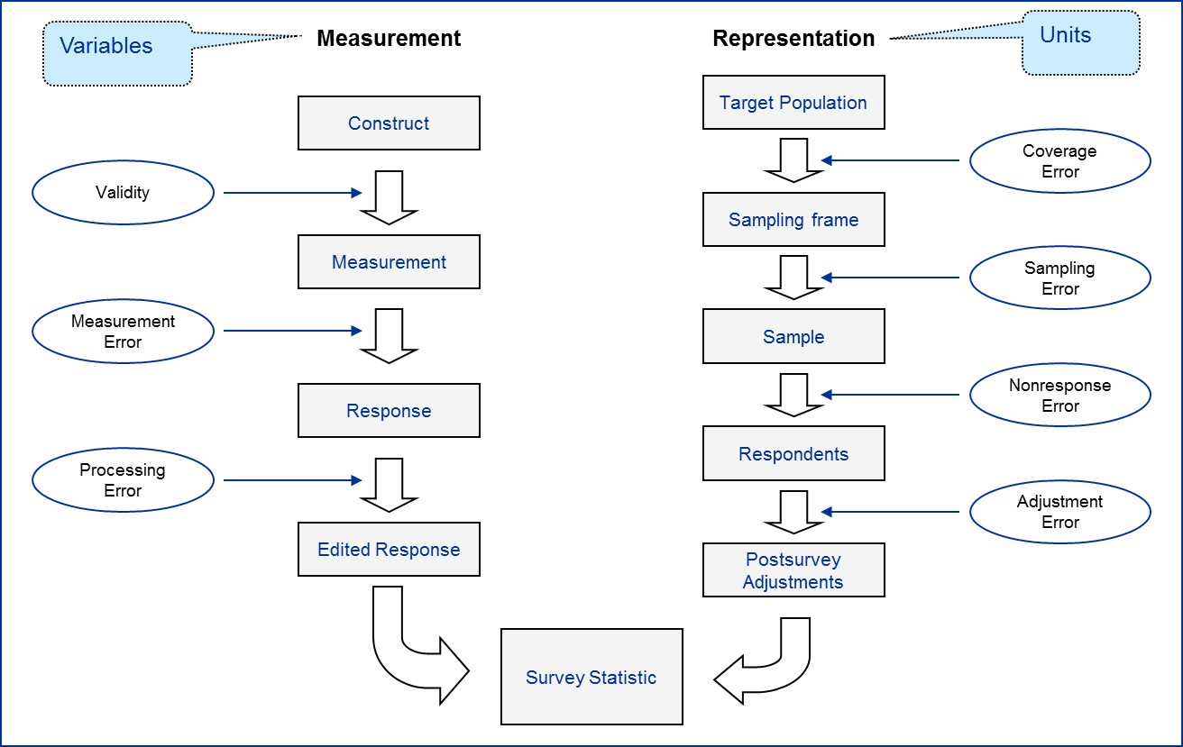
Total survey error framework (Groves et al. 2004, Fig. 2.5)

Slide 35
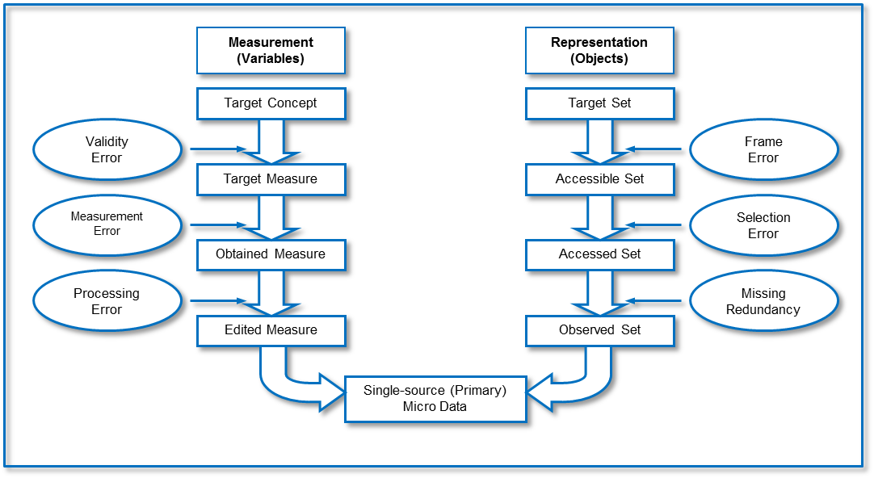
Two-phase life-cycle (I): primary source data (Zhang, 2012)

Slide 36
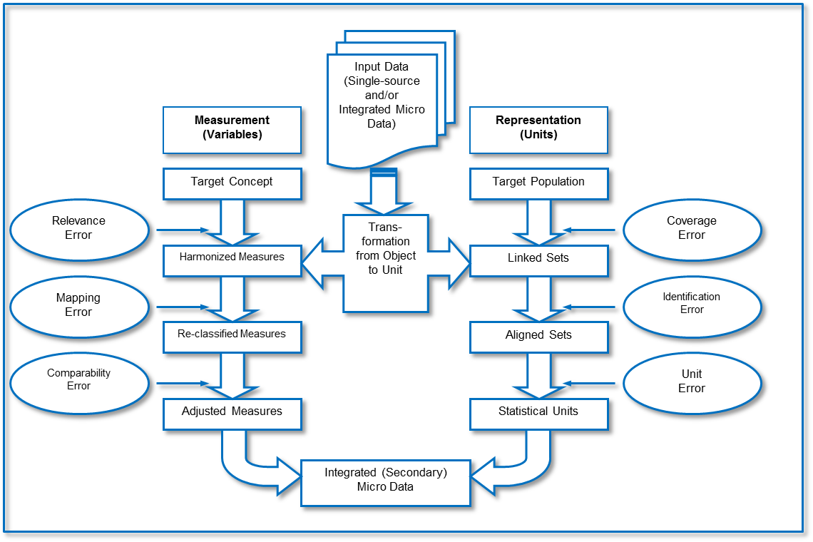
Two-phase life-cycle (II): secondary integrated data

Slide 37
Quality reporting in Eurocensus: Accuracy
Accuracy: Composition of data sources
The data sources used for census purposes often have more than one origin. Data from two registers might be merged or data obtained by means of a field enumeration might be linked to data available in a register.
‘Record linkage’ means the process of merging information from different data sources by comparing the records for the individual statistical units and merging the information for each statistical unit where the unit to which the records refer is the same.
1. How well do the published data reflect the ‘true’ size of the population?
2. How much are the published data based on real observations?
3. How many of the records in the data source have been used for the census?
Notes:
Relevance: (Adequacy) Data sources must be considered inadequate for census purposes if they are flawed by major deviations from the essential features, definitions and concepts required by the EU legislation and if these deviations seriously impair adequate use of the census results. And a completeness concept: cell values that are ‘not available’ or flagged as ‘unreliable’ or ‘confidential on NUTS 2 level.
Accuracy: Quantitative quality information about the data sources. The extent to which the data sources represent the target population!
For each topic, the metadata must name the data source(s) used to produce the statistical data on the topic and report on:
o the definitions relating to the topic;
o the method used to estimate data on the topic;
o the reasons for any general unreliability of the data on the topic;
o the handling of specified cases where Regulation (EC) No 1201/2009 leaves a choice between different concept

Slide 38
Quality reporting: an assessment of coverage and of the imputed and deleted data records.
1. The match between the estimated target population (the best estimate for the ‘true’ population) and the census population (mostly affected by coverage errors),
2. The effect of record imputations and deletions
3. The effect of any method or technique that adjusts the weights of data records to obtain a better fit of the census population to the target population and/or to increase the plausibility and consistency of the data,
4. The effect of frames that are samples.

Slide 39
Quality reporting Accuracy: an assessment of coverage
Coverage assessment means a study of the difference between a specified target population and its census population.
‘Post-enumeration survey’ means a survey conducted shortly after the enumeration for coverage and content assessment purposes.
‘Under-coverage’ means the set of all statistical units that belong to a specified target population, but are not included in the corresponding census population.
‘Over-coverage’ means the set of all statistical units that are included in a census population used to report on a specified target population without belonging to that target population.

Slide 40
Quality reporting Accuracy: an assessment of the imputed and deleted data records. Attributing weights ≠ 1 to data records
Weights different from 1 can be set for the following reasons.
Records are imputed not physically, but only virtually (e.g. a record is weighted by 2 to substitute for an invalid record, which is weighted 0)
NSO can scale some data up or down by systematically increasing or decreasing the weights of parts of the census population
Methods that adjust the weights of data records to improve the plausibility and/or consistency of the data are used.

Slide 41
Quality reporting Accuracy : QUANTITATIVE INFORMATION ON THE TOPICS
Reasons for data records where information on a topics is missing
The data source is a composed data source. It is the result of record linkage from original data sources, some of which might not cover the complete census population.
Unit no-information might have lead to data not being available
There might have been item no-information for that topic

Slide 42
Quality assessment
Aim is to assess quality of both input to and output from a register based sources
Questions that need to be answered: How to
derive data on variables not available in registers?
distinguish between no data and missing data in registers?
resolve discrepancies between sample data and (derived) register data?
Notes:
No data= when no value should be in the register

Slide 43
A key issue: reconciliation
Reconciliation through renewed contact via telephone with respondents will be used, but …
…other methods, e.g., models and rules, will have to be used
Nonresponse in the evaluation survey causes additional problems

Slide 44
Errors in registers categorical variables
 | Register
Evaluation source | Category 1 | Category 2 | Sum
Category 1 |  |  | N1•
Category 2 |  |  | N2•
Sum | N•1 | N•2
The proportion of gross error in a category is given by GEj =(N•j +Nj•−2Njj )/N•j where Njj is the number of objects of category j in both the evaluation and register. N•j and Nj• indicate summation over rows and columns, respectively.
anders.holmberg@ssb.no

Slide 45
Evaluating base register quality: an example from 2011 deciding on a derived a variable.
Register variable based on operational definition of Cohabitant (person living in consensual union)
Sample data from the LFS
 | According to register ,model based on <15 years difference
According to LFS | Cohabitant | Not Cohabitant
Cohabitant | 19.7 % | 3.3 %
Not Cohabitant | 3.5 % | 73.4 %
Net error | 3.5 -3.3 = 0.2 %
Gross error | 3.3 + 3.5 = 6.8 %
Notes:
- Not definitive version of Dwelling register
Process of registering population on dwelling not completed
Net error small – OK for overall estimation
Gross error large – may be problematic to use data for other types of analyses

Slide 46
Evaluating base register quality: an example from 2011 deciding on a derived a variable.
The same backgeound data, but only for people
Resident in large cities (according to register)
15 – 25 years old
 | According to register ,model based on <15 years difference
According to LFS | Cohabitant | Not Cohabitant
Cohabitant | 11.0 % | 5.0 %
Not Cohabitant | 9.5 % | 74.5 %
Net error | 9.5 -5.0 = 4.5 %
Gross error | 9.5 +5.0 = 14.5 %
Notes:
- Not definitive version of Dwelling register
Process of registering population on dwelling not completed
Net error small – OK for overall estimation
Gross error large – may be problematic to use data for other types of analyses

Slide 47
Evaluating base register quality: an example from 2011 deciding on a derived a variable.
The same data, but only for people
Resident in large cities (according to register)
26 – 35 years old
 | According to register ,model based on <15 years difference
According to LFS | Cohabitant | Not Cohabitant
Cohabitant | 29.8 % | 7.1 %
Not Cohabitant | 8.0 % | 55.1 %
Net error | 8.0 – 7.1 = 0.9 %
Gross error | 8.0 + 7.1 = 15.1 %
Notes:
- Not definitive version of Dwelling register
Process of registering population on dwelling not completed
Net error small – OK for overall estimation
Gross error large – may be problematic to use data for other types of analyses

Slide 48
Base register quality: An operational definition of cohabitants
Age | Column 1 | 2 | 3 | 4
15-25 | 11 % | 5 % | 9,5 % | 74,5 %
26-35 | 29,8 % | 7,1 % | 8 % | 55,1 %
36-45 | 21 % | 4 % | 3,5 % | 71,5 %
46-55 | 14,3 % | 3,9 % | 2,8 % | 79 %
56-65 | 9,8 % | 2,2 % | 2,7 % | 85,3 %
66-74 | 7,9 % | 1,8 % | 2,1 % | 88,2 %
75+ | 5,6 % | 0 | 2,2 % | 92,2 %
Total | 17,7 % | 4,3 % | 5 % | 73 %
Larger cities Register definition < 15 years age difference
Column 1: Cohabitant in both sources, 2: Cohabitant in LFS Not according to Base register, 3: Not Cohabitant in LFS Cohabitant in Base register, 4: Not Cohabitant in both sources.
Notes:
Other age differences yielded higher error estimates

Slide 49
Statistics’ Quality and Evaluations
Missing values: their effects and how to treat it.
Imputation techniques or weighting techniques
Quality Evaluation
EU quality requirements on the Census data
Data Quality (Micro and/or macro) ?
Production of recurrent social statistics with the register system
An integrated register and sample survey QC-scheme?
Notes:
Example Bld with 11 flats, 8 occupied. 28 ppl at the address. 21 has an apartment, How to fit 7 into 3? Known relations, from pool of ppl with no address
Multiple imputation!?
One step is to fit a multilevel logistic model to data to assess the relative importance of the individual, property owner and municipality in the data formation process that sometimes ends up with missing data.
When fit for purpose registers need maintenance! Updating processes. LFS for individuals

Slide 50
Swedish Census Household statistics - an evaluation study
To evaluate the quality of
the Dwelling register
the registration of people on dwelling
their combined effect on household statistics
If possible, provide information that can be used to improve the quality of census statistics
Sample survey in order so measure to what extent answers were consistent with the register information at the reference date.

Slide 51
Some errors: causes & consequences
Notes:
There are a number of causes of errors when individuals are to be linked with dwelling numbers.
Moreover the data will provide statistics on where individuals are registered, what and how large is the difference compared to where they actually live?
How can we identify and possibly eliminate the most likely factors of errors?

Slide 52
The setup of the evaluation study
Select sample of individuals
Collect vital household data for sampled individuals
Compare sample and register data at the individual level and try to resolve true circumstances
Estimation of parameters of interest

Slide 53
Questionnaire and data collection
Limited amount of questions regarding
Address and no. of dwellings at the address
The dwelling in which respondent lives
Other people living in the same dwelling
Questionnaire distributed via mail
Data capture via web or self-administered questionnaire
Follow-up of non-respondents via mail and telephone

Slide 54
Issues in design of an evaluation
Collecting data on household status with a self administered questionnaire (Web/paper) is not straightforward!
Nonresponse in the evaluation survey is problematic!
Many possible causes, which call for different actions
Reconciling observed discrepancies requires large resources
The amount of possible combinations in error is large and requires manual handling
Notes:
Causes for nonresponse:
- Person not reached because he/she should not be in register at all (overcovergae)
- Person not reached because he/she lives at another address tahn the one in the register (incorrect address)
- Person reached but not responding.

Slide 55
Sampling design
Stratified SRS, n=15,000, 108 strata, defined by register-data on
Existence of Dwelling ID-key
Residence Municipality (grouped)
Age class
Type of dwelling
Number of families in dwelling
Notes:
Family: derived from TPR using register information

Slide 56
Sample size allocation
Oversampling of persons from strata for which dwelling ID-key is missing (1/3), as they
will cause errors in register-based production
are more likely to be nonrespondents in the evaluation study
Proportional allocation, with upper and lower boundaries, for remaining strata
Notes:
Such validating studies were done for all Swedish censuses between 1960 and 1990, and all of the studies followed the same methodology.
It is important to keep in mind that the TPR shows where a person has his or her registered address, which is not necessarily the same as where the person actually lives. The survey asked for actual living, which was considered as the only reasonable thing to ask for. In this context, accuracy is thus the extent to which the registered address is equal to the actual place of living.
The respondents were asked to confirm whether they were living at the address they were registered at on 31 December 2011 (the reference day of the census). If the address given was incorrect, they were asked for a correct address. Other questions concerned if the dwelling was owned or rented, how many dwellings there were at the same address, and how many other persons were living at the same address on the reference day. For all others living in the same dwelling, name, sex, year of birth, and whether the person in question was living together with parent or spouse/partner was asked for.
Dwelling id-key exists in TPR
Yes
No
Municipality of residence (combined with dwelling id-key exists in TPR)
Stockholm region (Yes)
Göteborg region (Yes or No)
Malmö region (Yes or No)
Municipality with more than 70000 inhabitants excl.
Stockholm, Göteborg, and Malmö (Yes or No)
Other municipalities (Yes or No)
Stockholm county area (No)
Norrtälje (No)
Age class
18-34 years
35-74 years
75 years or older
Type of dwelling
(semi)-detached house
Apartment block
Communal establishment, not dwelling house, or missing value
Number of families in dwelling according to TPR
1-2
3 or more
No dwelling id-key
In 65% of the cases, the initial data collection gave the true value, in 25% the register gave the true value, and in the remaining 10% of the cases neither the initial data collection nor the register was correct.

Slide 57
Data collection
First invitation by mail to respond by web only. Second invitation by mail to those not yet responding, including a printed copy of the questionnaire. Finally a third possibility to respond, by a telephone interview.
Data collected between January and May 2012.
Response rate of 62 percent (65 percent weighted). More than 40 percent response rate in all strata.
If household size or household type differed between survey and register: re-contact by telephone in order to establish the “true” value. Almost 3000 individuals contacted, 85 percent of the 3000 agreed to confirm.
Notes:
Such validating studies were done for all Swedish censuses between 1960 and 1990, and all of the studies followed the same methodology.
It is important to keep in mind that the TPR shows where a person has his or her registered address, which is not necessarily the same as where the person actually lives. The survey asked for actual living, which was considered as the only reasonable thing to ask for. In this context, accuracy is thus the extent to which the registered address is equal to the actual place of living.
The respondents were asked to confirm whether they were living at the address they were registered at on 31 December 2011 (the reference day of the census). If the address given was incorrect, they were asked for a correct address. Other questions concerned if the dwelling was owned or rented, how many dwellings there were at the same address, and how many other persons were living at the same address on the reference day. For all others living in the same dwelling, name, sex, year of birth, and whether the person in question was living together with parent or spouse/partner was asked for.
Dwelling id-key exists in TPR
Yes
No
Municipality of residence (combined with dwelling id-key exists in TPR)
Stockholm region (Yes)
Göteborg region (Yes or No)
Malmö region (Yes or No)
Municipality with more than 70000 inhabitants excl.
Stockholm, Göteborg, and Malmö (Yes or No)
Other municipalities (Yes or No)
Stockholm county area (No)
Norrtälje (No)
Age class
18-34 years
35-74 years
75 years or older
Type of dwelling
(semi)-detached house
Apartment block
Communal establishment, not dwelling house, or missing value
Number of families in dwelling according to TPR
1-2
3 or more
No dwelling id-key
In 65% of the cases, the initial data collection gave the true value, in 25% the register gave the true value, and in the remaining 10% of the cases neither the initial data collection nor the register was correct.

Slide 58
Some important parameters
Proportions
Persons linked to (partly) incorrect address
Persons/households living in a rented dwelling
Gross and net errors (using sample and register data)
Persons after household status
Private households after type of household
Notes:
- Households identified using the household-dwelling concept
- Household-dwelling: all persons living in a dwelling are regarded to be members of the same household

Slide 59
Household status
Individual
1.
Household
2.
Not Household
1.2
Person who is not part of Family (Fam type 5)
1.1
Person who is part of Family (Type of Fam. 1-4)
2.1
Institutional Household
2.2
Primary Homeless
2.3
Other
1.2.1
Lives alone
1.2.2
Does not live alone
1.1.1
Married Couple
1.1.2
Registered partner
1.1.3
Cohabitants
1.1.4
Single Parent
1.1.5
Children
1.1.1.1
Diff
Sex
1.1.1.2
Same
Sex
1.1.2.1
Diff
Sex
1.1.2.2
Same
Sex
1.1.3.1
Diff
Sex
1.1.3.2
Same
Sex
1.1.5.1
Not with single parent
1.1.5.2
With single parent

Slide 60
Some results based on the evaluation study
Variables; household size, household type, type of ownership
Gross error: data quality for different types of analysis
Net error: data quality for aggregates
Notes:
Gross error is the number of households wrongly included in a category plus the number wrongly excluded from a category. Net error is the number of households according to the register minus the number estimated from the evaluation study. The proportion of correctly classified households and the relative net error are calculated relative to the number of households in the register.

Slide 61
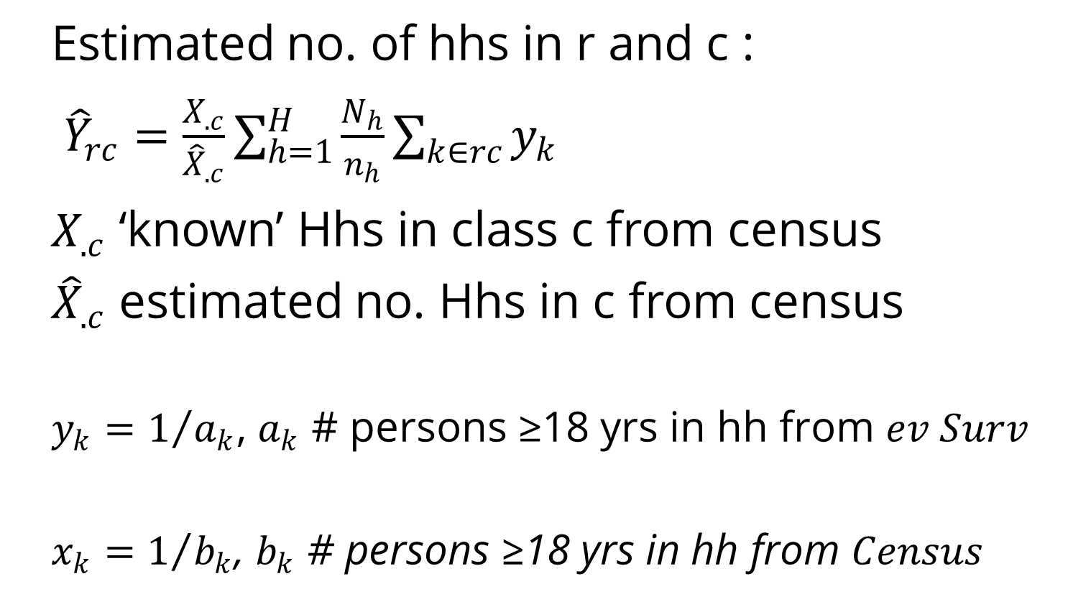
Some results based on the evaluation study (Werner 2014)
Estimated no. of hhs in r and c :
${\hat{Y}}_{rc}=\frac{X_{.c}}{{\hat{X}}_{.c}}\sum_{h=1}^{H}{\frac{N_{h}}{n_{h}}}\sum_{k∈rc}{y_{k}}$
$X_{.c}$ ‘known’ Hhs in class c from census
${\hat{X}}_{.c}$ estimated no. Hhs in c from census
$$y_{k}=1/{a_{k}\text{,} a_{k} \text{\# }\text{persons}\text{ ≥18 }\text{yrs} \text{in} \text{hh} \text{from} ev Surv}$$
$$x_{k}=1/{b_{k}\text{, }b_{k}\text{ \# }\text{persons}\text{ ≥18 }\text{yrs} \text{in} \text{hh} \text{from} Census}$$
Notes:
$$\text{c}\text{lass} \text{r} \text{evaluation} \text{and} \text{class} \text{c} \text{in} \text{register} \text{Census}$$

Slide 62
Some results based on the evaluation study
92,1 % (± 0,8 %) of hhs have correct size (# inhabitants).
Errors higher for class 6-10 and 11+
(5-10 46% net error 36’’ +/- 8’’).
Net error estimates indicate show 1 and 2 person hhs are underestimated by 10.3 and 9.3 % respectively.
Notes:
Totalt har 92,1 % (± 0,8 %) av bostadshushållen i Census 2011 klassificerats rätt med avseende på antal boende. Största andelen fel finns i klasserna 6–10 Bland övriga klasser är andelen fel störst i klasserna 3 och 5 med 17,9 % respektive 22,2 % felklassificerade. De felklassade trepersonershushållen i Census 2011 är enligt EU huvudsakligen en- och tvåpersonershushåll.
Systematiska fel i evalveringsstudien kan t.ex. ha orsakats av
bortfall i evalveringsstudien
att felaktiga kriterier har tillämpats vid bestämningen av sanna värden
felaktigt lämnade svar från respondenterna.
Bortfallet i evalveringsstudien motsvarar ca 39,5 % av nettourvalet (efter exklusion av individer på student- och äldreboenden). Därtill kommer partiella bortfall för de olika variablerna; antingen har den utvalda individen av olika anledningar inte lämnat någon användbar uppgift på en eller flera frågor, eller så har sant värde på aktuell variabel inte kunnat fastställas (i första hand beroende på att individen inte varit möjlig att nå för återintervju).

Slide 63
Some results based on the evaluation study
The results indicate that the number of smaller households are underestimated and the number of larger households are overestimated by the register.
 | 1 | 2 | 3 | 4 | 5 | 6–10 | 11+ | Total
Total | - | - | 0 | 0 | + | + | + | -
Stockholm | - | - | 0 | 0 | 0 | + | + | -
Gothenburg | - | - | 0 | 0 | + | + | + | -
Malmo | - | - | 0 | 0 | 0 | + | + | -
Municip. > 70’’ | - | - | 0 | 0 | 0 | + | + | -
Smaller Municip | - | - | + | 0 | 0 | + | + | -
Notes:
One explanation of the figures could be that younger people and students fail to register their new address as they move away from their parents. Note however that the larger types of households are less common and thus the number of such households in the sample is low.
The census variable on type of ownership differed in categories and definitions from what is commonly used in Sweden and in the registers. Thus this variable called for a rather complicated derivation, and it was necessary to evaluate its quality. A question about type of ownership was added to the evaluation study, and the data from the survey was compared to the derived census variable. The relative net error rate indicates that the quality of the data was sufficient, but the results should be interpreted with caution since some assumptions were made when translating the Swedish situation to fit the Eurostat definition.

Slide 64
Evaluation: Which source is most reliable?
Variable | # Miss-matches | # Where correct information was collected | Register information correct | Questionnaire information correct | Other informa-tion correct
# inhabi-tants | 2 410 | 2 034 | 239 | 1 653 | 142
HH-type | 2 251 | 1 881 | 469 | 1 205 | 207
Total | 2 817 | 2 394 | – | – | –

Slide 65
Other evaluations done in the Swedish census
Evaluation of dwelling ownerships
Comparison of Household counts depending on definitions.
Comparison of the dwelling register and a survey of available rental apartments

Slide 66
Quality treatments in the census
Imputation?
No useful auxiliary information to aid imputation, since no reliable household information existed from another source
Matching persons without dwelling keys to apartments?
Assuming that the relationship between size of apartment and size of household is similar for individuals with and without registered dwelling keys would have yielded doubtful quality of the result: 48 percent of the persons with missing dwelling keys had addresses in buildings with no apartments according to the Real Property Register.
Adjustment for missing data was not required by Eurostat
The number of persons with missing identification key has decreased (2,3% in 2017).
Notes:
The goal was to reach 95 percent in each of Sweden’s 290 municipalities, but 17 municipalities did not reach the goal. The largest rate of missing registration on dwellings was 14 percent.
The total number of dwellings in the census was just above five million. Of these, 900 000 did not have any registered inhabitants. This includes holiday houses, and one person (by law) can only be registered at one dwelling. However, there was also an unknown number of people living in dwellings where they were not registered, ex young people still registered with their parents but living elsewhere or people living in group quarters but not being registered there. About 40% of the group quarters had no registered inhabitants. Thus, the census overestimated the number of unoccupied dwellings, and underestimated the number of people living in group quarters.
This tendency was confirmed when data from a survey on unoccupied dwellings in multi-dwelling buildings were matched to the register. The survey targeted rental units on the open market and had two parts, a total survey of municipal housing companies and a sample survey of private companies. Different reference dates, 1 Sep 2011 and 31 Dec 2011, but the comparison still showed that the register overestimated the number of unoccupied dwellings.

Slide 67
To use the LFS to assess Quality in a Census system?
The Census:
Straightforward goal and delivery
Once done the results are what they are
The population of individuals fairly well known
Only some variables not known
Requirements fairly modest
System of social statistics
More detailed statistics
Flexible output, a core not decided,
User Requirements
Household population, definitions, uses, models
Maintenance over time
Microdata Quality

Slide 68
Sketching an Integrated Register and Sample Survey QC-scheme
Recurrent and inbuilt system to maintain populations and quality assure standardised core variables in a national statistics production system.
How to cope with the Housing statistics and Property and Building population?
Other sources: E.g. Smart meters,
Cross checks with other registers?
Notes:
Cost of Quality Control compared to cost of poor quality

Slide 69
Sketching an Integrated Register and Sample Survey QC-scheme
HST
CAS
EDU
HST
HST
HST
HST
HST
HST
OCC
2nd living
OCC
2nd living
Individual and Household population
The LFS-panels, A tailored complement survey, geographic rotation? Subpopulations? Use of other surveys and sources. Test of assumptions as well , frequency is a function NSOs quality dedication.
Notes:
Education, HST =Household status, CAS Current activity status, OCC occupation

Slide 70
References
Baffour, B., King, T. and Valente P., (2013). The Modern Census: Evolution, Examples and Evaluation . International Statistical Review (2013), 81, 3, 407–425 doi:10.1111/insr.12036
Berka, C., S. Humer, M. Lenk, M. Moser, H. Rechta, and E. Schwerer. (2012). Combination of Evidence from Multiple Administrative Data Sources: Quality Assessment of the Austrian Register-Based Census 2011. Statistica Neerlandica Vol 66 nr. 1 18–33.
Axelson, M., Holmberg, A., Jansson I. and Westling S., (2018) ,A Register-Based Census: The Swedish Experience, Chapter 17 in Administrative records for Survey Methodology, Wiley New York. (forthcoming)
Dunne, J. and MacFeely, S., (2014) Laying the foundations for a new approach to Census taking in Ireland Statistical Journal of the IAOS 30 (2014) 359–365 DOI 10.3233/SJI-140848
Eurostat (2011) EU Legislation on the 2011 Population and Housing Censuses — Explanatory Notes. http://ec.europa.eu/eurostat/web/products-manuals-and-guidelines/-/KS-RA-11-006
Groves, R.M., Fowler Jr., F.J., Couper, M., Lepkowski, J.M., Singer, E. and Tourrangeau, R. (2004). Survey Methodology. New York: Wiley.

Slide 71
References
Holmberg, A., (2012). Discussion on assessing quality of administrative data. Statistica Neerlandica, Vol 66, nr. 1 pp 34-40. doi: 10.1111/j.1467-9574.2011.00507.x
Holmberg, A., and Bycroft, C. (2017). Statistics New Zealand’s Approach to Making Use of Alternative Data Sources in a New Era of Integrated Data. Pp 474-478 In Total Survey Error in Practice, Wiley, New York.
Holmberg, A., Blomqvist, K., Engdahl, J., Irebäck, H., Lundell L.-G. and Svensson, J. (2011). A strategy to improve the register system to store, share and access data and its connections to a generic statistical information model (GSIM). Invited paper presented at Work Session on Statistical Data Editing, UNECE, Ljubljana, Slovenia, 9-11 May.
Nordbotten, S. (2010) The Use of Administrative Data in Official Statistics – Past, Present, and Future – With Special Reference to the Nordic Countries, Official Statistics – Methodology and Applications in Honour of Daniel Thorburn, 2010, pp. 205–223
Laitila, T., Wallgren, A. and Wallgren B., (2011). Quality Assessment of Administrative Data. Research and Development–Methodology Reports from Statistics Sweden, 2011:2, Statistics Sweden.
Lindgren, K (2014). Evalvering av Census 2011 – Utvärdering av variabel ägarkategori, Internal report, Statistiska Centralbyrån, 2014-02-07 (in Swedish)

Slide 72
References
Lothian, J., Holmberg, A., & Seyb A., (2018). An Evolutionary Schema for Using "it-is-what-it-is" Data in Official Statistics. Journal of official statistics (in press).
Reid, G., Zabala, F. and Holmberg A., (2016). Extending TSE to Administrative Data: A Quality Framework and Case Studies from Stats NZ. Journal of Official Statistics, Vol. 33, No. 2, 2017, pp. 1–35, http://dx.doi.org/10.1515/JOS-2017-00xx
Schnetzer, M., Astleithner, F., Cetkovic, P., Humer, S., Lenk, M., and Moser, M., (2015). Quality Assessment of Imputations in Administrative Data. Journal of Official Statistics. Vol. 31, No. 2, 2015, pp. 231–247.
Schulte Nordholt, E., M. Hartgers and R. Gircour (eds.), 2004. The Dutch Virtual Census of 2001, Analysis and methodology. (Voorburg/Heerlen, 2004). (https://www.cbs.nl/-/media/imported/documents/2005/17/b-57-2001.pdf)
Skinner, C., Hollis, J., and Murphy, M. (2013). Beyond 2011: Independent review of Methodology. ONS report.
Statistics Finland (2004): Use of Registers and Administrative Data Sources for Statistical Purposes – Best practices in Statistics Finland.

Slide 73
References
Statistics New Zealand (2012). Transforming the New Zealand Census of Population and Dwellings: issues, options and strategy. Wellington: Statistics New Zealand.
Thygesen, L. (2010) The Importance of the Archive Statistical Idea for the development of Social Statistics and Population and Housing Censuses in Denmark
UNECE (2007) Register-based statistics in the Nordic countries : Review of best practices with focus on population and social statistics, ISSN 0069-8458
UNECE (2012), 60:th Conference of the European Statisticians (CES) , Paris, 6-8 June 2012, Papers submitted by several countries f.ex. Austria, Switzerland, Slovenia, Italy and Finland. https://www.unece.org/index.php?id=28580
Zhang, L.-C. (2012). Topics of statistical theory for register-based statistics and data integration, Statistica Neerlandica, vol 66, nr 1, 41-63.
Zhang, L.-C. (2014). Data integration. The Survey Statistician. No. 70, July 2014. The International Association of Survey Statisticians.
Werner, P., (2014). Evalvering av Census 2011, Slutrapport, Statistiska Centralbyrån, (in Swedish)

