Slide 1

CALIBRATION WEIGHTING IN SURVEY SAMPLING (BASED ON SAMPLE SOCIO-DEMOGRAPHIC SURVEY)
Prepared by Yuliia Halytsia
Taras Shevchenko National University of Kiev

Slide 2
Work objectives
The main goal of the work was to get estimates for a number of indicators for general population that can not be obtained from other sources, on the basis of the latest socio-demographic survey using the methodology of calibration of statistical weights.

Slide 3
Overview of the method
The calibration approach to estimation for finite populations consists of
(a) a computation of weights that incorporate specified auxiliary information and are restrained by calibration equation(s),
(b) the use of these weights to compute linearly weighted estimates of totals and other finite population parameters: weight times variable value, summed over a set of observed units,
(c) an objective to obtain nearly design unbiased estimates as long as nonresponse and other nonsampling errors are absent.
Source: Särndal (2007). The calibration approach in survey theory and practice. Survey Methodology

Slide 4
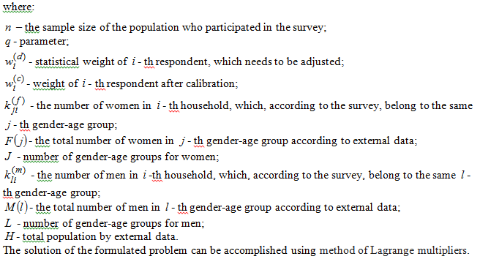
Optimization problem in general case

Slide 5
Application of calibration method
Survey
"Social Inequalities: Perceptions by Ukrainian Society", conducted by the Center "Social Monitoring" in 2017; Sample size: 2046 respondents; The general population of the study is the adult population of Ukraine
External information
The data (estimates) of demographic statistics on the gender and age of the general adult population (“Table RN-2”, 2017)
Subject of research and evaluation for the general population
Nominal variables that reflect the perceptions of the population about the minimum necessary and sufficient level of income, as well as the level at which a household can be considered poor
The data of large survey (Labour Force Survey): number of population in labour force (employed and unemployed)

Slide 6
Necessity of applying calibration in case of sample sociological survey:
A sample survey can not provide estimates of the studied characteristics of the general population. Although such estimates are obtained from the survey, they mainly reflect the parameters that were laid down during the formation of the sample.
The main characteristics of the general population vary in time and, accordingly, some of them at the time of completion of survey data processing differ from those they were during the organization of the survey. Therefore, due to the presence of a certain time lag between the period of the formation of the sample and the processing period of the survey results, it is expedient to adjust the results.
The adjustment of statistical weights is the most reasonable way of solving these problems.

Slide 7
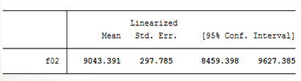

Obtained results and discussion of them
Monthly income per family member, which is considered sufficient for normal life:
Primary weights | Calibrated weights
Average values ​​after calibration appeared to be lower than before calibration of statistical weights. This can be explained by taking into account the high level of demographic aging of general population in Ukraine. The elderly have lower material and financial inquiries and, consequently, lower self-esteem of sufficient income.
Higher self-esteem rates of income for population in labor force are due to an increase of weight of those gender-age groups that have a higher self-esteem of income (this is, in particular, persons aged 40-49 and 50-59 years)
Population in labour force
Primary weights | 10 320
Calibrated weights | 10 444

Slide 8




Obtained results and discussion of them
Monthly income per person, which provides a living wage for today: | Family with such monthly income per capita can be considered poor:
Primary weights | Primary weights
Calibrated weights | Calibrated weights
Population in labour force
Primary weights | 5 210
Calibrated weights | 5 225
Population in labour force
Primary weights | 2 695
Calibrated weights | 2 682

Slide 9
Areas for improvement and further research
Problems related to the initial information base: when forming the sample, stratification of the population was carried out based on factors such as the region and type of terrain; factors "gender" and "age" were not taken into account;
The base was not initially intended to harmonize the results with external distributions, that is, it is not adapted properly for evaluation / dissemination of results for the general population;
Apparently, a method of iterative proportional approximation would be a more effective method of reconciling survey results with several population distributions.

Slide 10
Areas for improvement and further research
The conducted analysis showed that calibration worsened the quality of statistical weights.
However, the application of calibration procedure enabled the task of reconciling the evaluations of the selected indicators with the characteristics of the general population and, thus, obtaining operative self-assessments of the welfare level;
It would be expedient and interesting to conduct calibration using such indicators as, for example, the level of education combined with the age-gender characteristics of the adult population.

Slide 11
THANK YOU FOR ATTENTION!

