Slide 1
All-time low period fertility in Finland: tempo or quantum effect?
Julia Hellstrand
BNU Workshop 2018

Slide 2
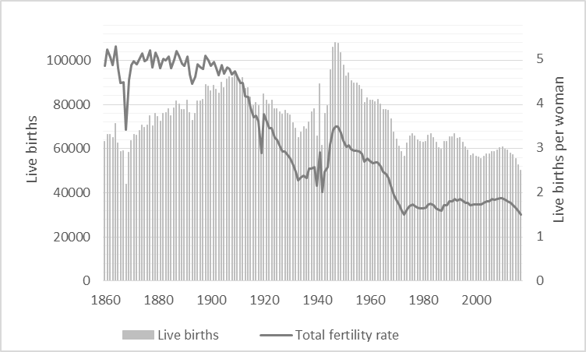
Finland’s birth rate plummets to its lowest level in nearly 150 years
Number of births could fall below 50,000 mark for first time since famine in 1866-1868
Independent, 20.9.2017
Finland’s rapidly declining birth rate left researchers in disbelief
Helsinki times, 7.7.2017
Finland's low birth rate is a concern, admits new Minister of Family Affairs
Helsinki times, 11.7.2017
The number of live births and the total fertility rate in Finland in 1860-2017
Total fertility rate at an all-time low
Statistics Finland, 27.4.2018
According to Eurostat (2018), the total fertility rate in Finland in 2016 was below the average in Europe and the lowest of all total fertility rates in the Nordic countries.
Source: Statistics Finland

Slide 3
Are women actually starting to have less children or is the decrease in the TFR only due to postponement of births?
1. Decomposition of the decrease in total fertility rate in 2010-2017 by age and parity: Which age groups and what parity have produced the greatest contributions to the decrease?
2. Tempo-adjusted total fertility rate:
What would the total fertility rate would have been in the absence of fertility postponement?
3. Forecast cohort fertility:
Will the final lifetime number of children eventually be smaller for women currently in their childbearing age compared to women who already completed their childbearing?

Slide 4
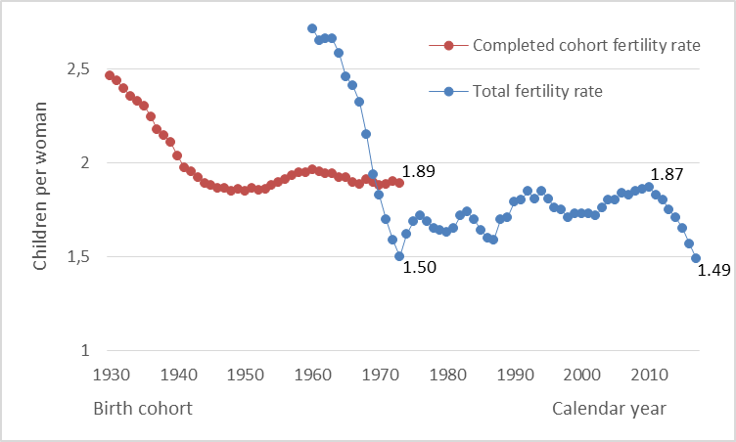
All-time low period fertility in Finland: tempo or quantum effect?
Quantum effect: Women reduce their average lifetime number of children.
Tempo effect: Women postpone their childbearing but do not reduce their average lifetime number of children.
Changes in the completed cohort fertility rate reflects pure quantum effects while changes in the total fertility rate could be due to both tempo and quantum effects.
Source: Human fertility database and Statistics Finland

Slide 5
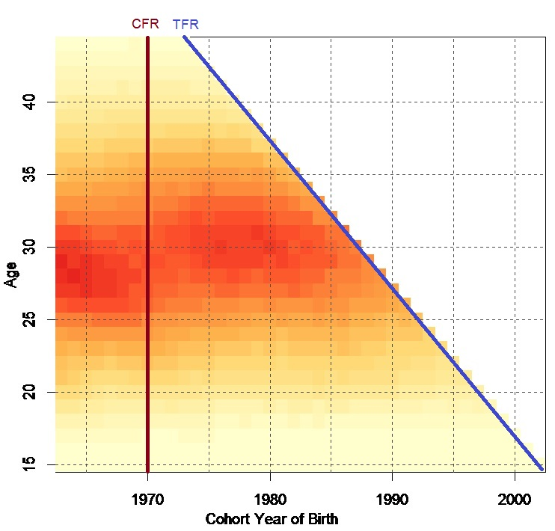
CFR = the sum of all age-specific fertility rates at ages 15-44 obtained from one cohort
TFR = the sum of all age-specific fertility rates at ages 15-44 obtained from one calendar year
Fertility rates highest at ages 25-35
Overall decrease in fertility rates at ages younger than 30 and increase at ages older than 30
Decreases at all ages in the last two years?
CFR estimated by forecasting unobserved age-specific fertility rates
Source: Human fertility database and Statistics Finland

Slide 6
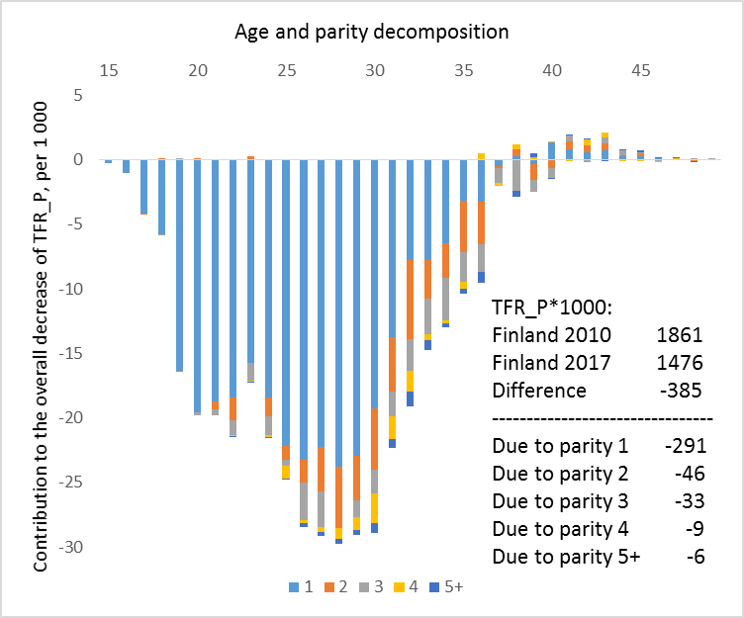
Contributions to the decrease in the total fertility rate in
2010-2017
Greatest decrease at ages 25-29
Decreases in first births most important
Relatively small decreases in second and third order births and nearly no change in higher order births
Tiny increases produced by women older than 40
The decrease in the TFR in 2010-2017 was not mainly due to reduced family sizes but to delayed or possibly eschewed entry to motherhood among young women.
Source: Statistics Finland, own calculations (demographic decomposition)

Slide 7
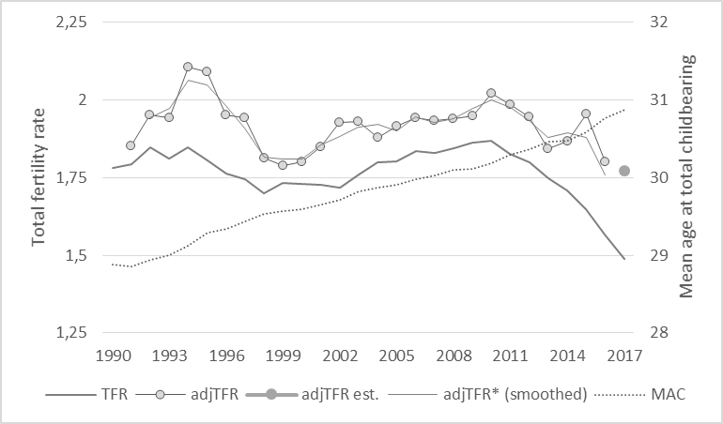
Tempo-adjusted total fertility rate: what would the TFR have been in the absence of fertility postponement?
Increase in the mean age at total childbearing with two years since 1990
adjTFR higher than the observed TFR -> tempo effect since 1990
TFR in 2016 would have been close to 1.8 (instead of 1.57) children per woman in the absence of fertility postponement
Decrease in the adjTFR* since 2010 -> quantum effect as well?
Source: Statistics Finland, own calculations (by the method of Bongaarts and Feeney 1998)

Slide 8
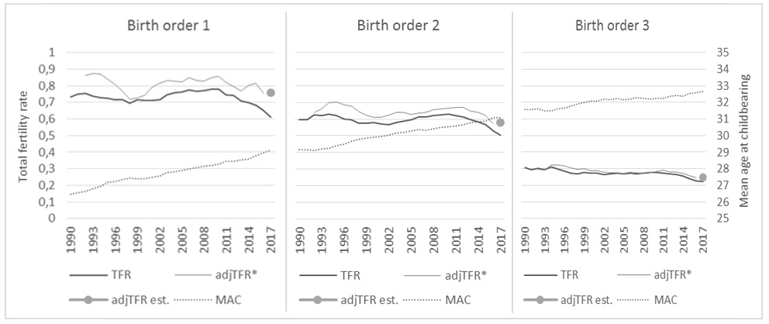
Tempo-adjusted TFR and mean age at childbearing by birth order
Source: Statistics Finland, own calculations
Decreases in third and higher order births are small but ”real” (due to a quantum effect)
Decreases in first (and second) order births are great but to a higher extent due to postponed births

Slide 9
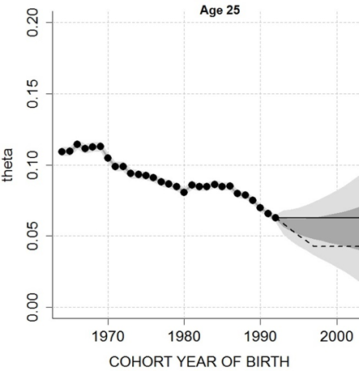
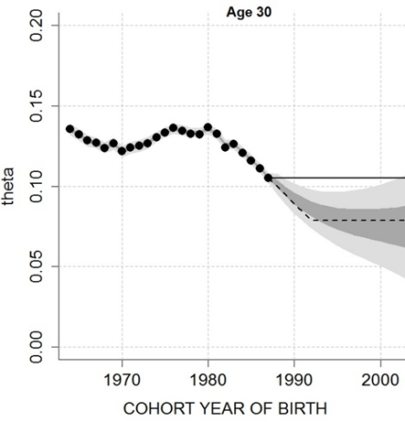
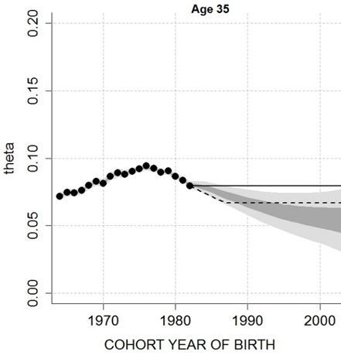
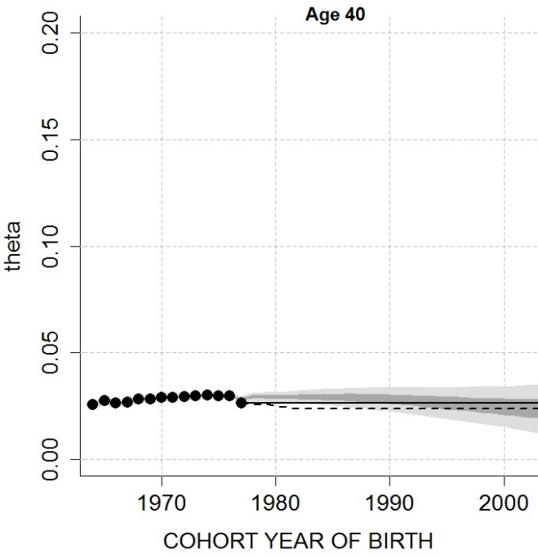
Forecasting methods
Freeze Rate-method
Freezes the latest observed age-specific fertility rates into the future.
5-year extrapolation-method
Estimates the past five years’ fertility trends, extrapolates the estimated fertility trends five years into the future and then freezes the rates.
Bayesian method
Combines already known demographic information about plausible age patterns of fertility together with recent age-specific fertility rates, extrapolates fertility rates over both time and age into the future

Slide 10
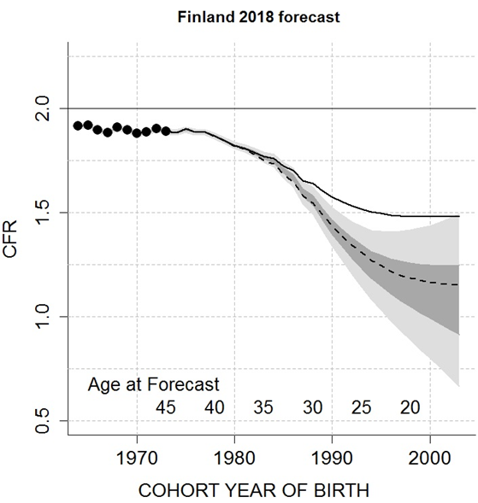
Forecasted completed cohort fertility rate (average total number of children at age 44) for women currently in their childbearing ages
All-time low CFR is to be expected in the near future and extremely low values could be observed later on!
CFR is likely to slowly decrease from the latest observed value of 1.89 children per woman for the 1973-cohort to around 1.75 for the 1985-cohort and then rapidly decrease to a level below 1.50 children per woman for the 1990-cohort.
For women currently younger than 25, CFR is likely to both stabilize on a level below 1.5 children per woman and to further decrease to extreme values.
Forecast results precise for older cohorts, great uncertainty for younger cohorts
The decrease in the total fertility rate in 2010-2017 reflects a huge quantum effect!

Slide 11
Conclusions
The main reason for the rapid decrease in the TFR in 2010-2017 was postponement of first births
Total fertility rate distorted due to fertility postponement, the tempo-adjusted TFR clearly higher than the observed TFR
Women currently in their childbearing age have delayed or even eschewed entry to motherhood to such an extent that they are not likely to be able to “catch up” all postponed births at older ages
Women are not only postponing their births but also starting to have less children!

