Slide 1

Multiple imputation for Income
Seppo Laaksonen¹
¹University of Helsinki, Finland
Box 68, FIN-00014 University Helsinki, Finland
+358442222759

Slide 2
Imputation is for replacing missing values with plausible ones. If this procedure has been done once, it is single imputation (SI). SI is a usual tool in statistical offices or other public survey institutes, in particular. However, SI can be performed several times as well. If this procedure is repeated a number of times and ‘coordinated’ well, the outcome is ‘multiple imputation’ (MI). What such a good coordination means, it is a special question? Rubin in his books (1987, 2004, 118-119) says that each imputation should be ‘proper’. He also gives some rules for proper imputation but they are not necessarily easy to follow, or their implementation is not automatic. A big question here is how to repeat the imputation process well, that is, what is an appropriate Monte Carlo technique in order to get L>1 simulated versions for missing values?

Slide 3
Rubin (1996, 476, 2004, 75&77) also says that a theoretically fundamental form of MI is repeated imputation. Repeated imputations are draws from the posterior predictive distribution under a specific model that is a particular Bayesian model both for the data and the missing-data mechanism.
Several proper MI implementations are given in Rubin’s books and in software packages (e.g. SAS and SPSS) using his book. He thus recommends that imputations should be created through a Bayesian process as follows:
(i) specify a parametric model for the complete data,
(ii) apply a prior distribution to the unknown model parameters, and
(iii) simulate L independent draws from the conditional distribution of the missing data given the observed data by Bayes' Theorem.

Slide 4
These Rubin’s theoretical principles are one starting point of this paper. A good point is that MI is not difficult to apply since most types of estimates can be computed in a usual way (e.g. averages, quantiles, standard deviations and regression coefficients). The Rubin’s framework also serves the formulas both for point estimates and for interval estimates.
The point estimates are simply averages of L repeated complete-data estimates, and thus very logical. His interval estimates are not indisputably accepted. Björnstad (JOS 2007) gives a modified version for the second component of Rubin’s formula. This leads to a larger confidence interval, as a function of the rate of imputed values. This is logical since Rubin’s formula is without any explicit term of the imputation amount but his Bayesian rules might implicitly include the same; this is however difficult to recognize.

Slide 5
The MI point estimate is thus the average of the L imputations
Respectively, the variance estimate is
in which B_{l} is a SI variance of the single imputation l.
There are two alternatives to calculate the MI variance of the L complete data sets. The first term of the variance, called within-imputation variability (variance), is in both cases equal. But the second term, the between-imputation-variability, is larger in Björnstad’s version.
The difference is in the term k=1/(1-f) in which f is the fraction of missing values or the non-response rate; Rubin’s k is simply = 1.

Slide 6
Björnstad (2007, 433) also invents a new term, non-Bayesian MI, since his imputation is not following a Bayesian process. This term ‘non-Bayesian’ is not used in ordinary imputation literature; it cannot be found 9 years after from a book by Carpenter and Kenward (2013) that much follows Rubin’s framework but they use the term ‘frequentist’. We still use the term ‘non-Bayesian,’ since we cannot say whether it is equal to ‘frequentist.’

Slide 7
Björnstad motivates his approach also from the practical points of view saying that in national statistical institutes the methods used for imputing for nonresponse very seldom if ever satisfy the requirement of being “proper.” Moreover, Muñoz and Rueda (2009) say that several statistical agencies seem to prefer single imputation, mainly due to operational difficulties in maintaining multiple complete data sets, especially in large-scale surveys. We agree with these views. Since a non-Bayesian approach also leads to single imputation, that is commonly used if anything has been imputed, a conclusion could be that MI cannot be applied using a non-Bayesian framework. We do not agree with this argument. Consequently, we have over years applied non-Bayesian tools both for single and multiple imputation, although most often for single imputation. This paper first summaries our approach to imputation, and then gives a few examples.

Slide 8
Our approach first makes attempts to impute the missing values once. That is, the focus is first on single imputation. Correspondingly, the main target in imputations is to succeed in such estimates that are most important in each case.
Since it is hard to impute correctly individual values, it is more relevant to try to get least unbiased estimates for some key estimates. Since we here concentrate on a continuous variable, that is, income, two types of estimates are of a special importance.
One is income average and the other is income distribution, respectively. Income distribution can be measured by various indicators such as quantiles or Gini coefficient, but the coefficient of variation (CV) is here considered to be simple enough to indicate well income differences between people.

Slide 9
Rubin’s approach can be implemented in various ways. We do not develop any own implementation but take advantage of the two existing implementations. These are derived from two general software packages, SAS and SPSS.
We assume that their MI procedures follow a Bayesian process since there are such references in their manuals. We thus use the term ‘Bayesian (B) MI’ for applications of SAS and SPSS. Respectively, our own imputation framework is called ‘Non-Bayesian (NB) MI.’

Slide 10
Imputation framework
In order to succeed in imputation, good auxiliary data or covariates are needed. In the case of lacking covariates, simple methods based on observed values only can be applied. But if there are covariates both for the respondents and for the non-respondents, ‘proper’ imputation methods can be used. In this case, the imputation framework includes the two core stages:
(i) Construction and implementing of the imputation model (or several models if one is not enough)
(ii) Imputation itself or imputation task.

Slide 11
An imputation model can be implemented using a smart knowledge of the imputation team or it can be estimated from the same data set or from a similar data set from an earlier survey or a parallel survey of another population. If the model is estimated from the same data set, it is expected that this replacer behaves more surely well in imputations. Hence we estimate the parameters of the imputation model from the same data set.

Slide 12
There are the two alternatives as a dependent variable in an imputation model. It is either
‘the variable being imputed’ or
‘the binary response indicator of the variable being imputed.’ The same auxiliary variables can be used in both models. Naturally, the estimations that are needed in the next step are derived from the different data sets, from the respondents for the model (a) and from both the respondents and the non-respondents for the model (b). The covariates need to be completely observed to compute the predicted values for the stage (ii).

Slide 13
The predicted value of the imputation have a big role in imputation. I will show some example on such predictions in following pages. We see that some are very different, some not so much. They are presented as scatters.
The predicted values can be used in two alternative ways in imputations as we will soon see. One leads to nearness metrics, the other is more directly imputation itself.

Slide 14
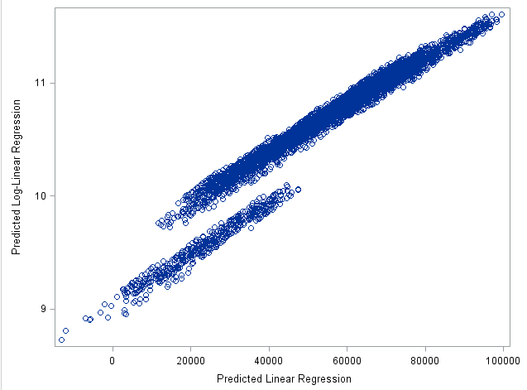
Scatter of two predicted values
for Nearness Metrics

Slide 15
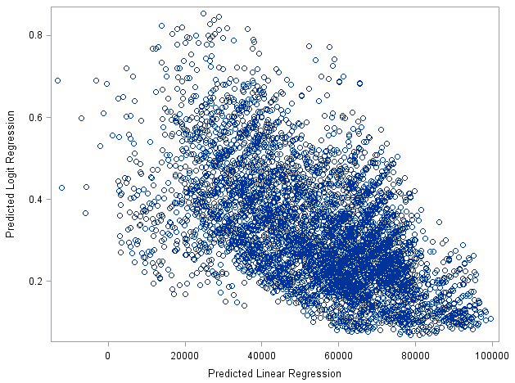
Scatter of two predicted values
for Nearness Metrics

Slide 16
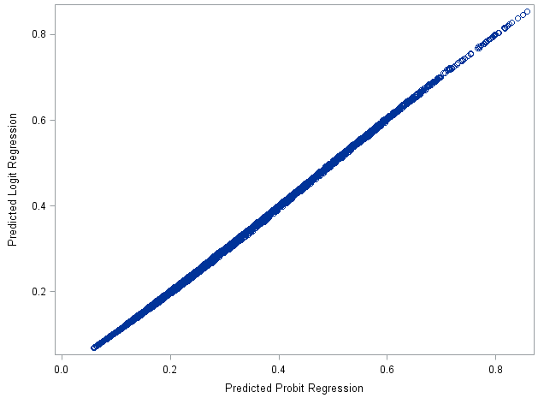
Scatter of two predicted values
for Nearness Metrics

Slide 17
The imputed values themselves can also be determined by the two options:
(i) they are calculated using the imputation model or
(ii) they are borrowed from the units with the observed values using the imputation model as well.
The previous option is called ‘model-donor’ imputation, and the second is ‘real-donor’ imputation, respectively. The latter one is often called ‘hot deck’ but this term is not clear in all cases. Terms for the previous ones are often such that the model and the task are confused. For example, model imputation or regression imputation is not clear since these are referring to imputation model but the second step, imputation task, is not specified (but can guessed maybe).

Slide 18
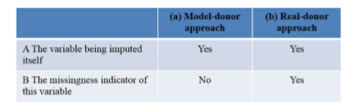
To integrate the model and the task together, we have the options of the scheme set out in the Scheme below. This means that the predicted values of the missingness indicator cannot be used directly for model-donor imputation.
Integrating the Imputation model and the Imputation task

Slide 19
If a real-donor method is applied, an appropriate criterion and a valid technology to select a donor is needed. The natural criterion is to select an as a similar real-donor (observed value) as possible. This may be based on a kind of nearness metrics. If a clear criterion exists, it is good to select the nearest or another from the neighborhood. If any valid criterion does not exist, a random selection from the neighborhood can be used. This thus means that all units with observations are as close to each other within the neighborhood that can be called ‘an imputation cell,’
In our approach, the predicted values of either the model (a) or the model (b)
are used as the nearness metrics, leading to real-donor methods.
We focus on multiple imputation and hence we impute everything 10 times and calculate their average as the point estimate. The variance estimate is the weighted sum of the between variance and the within variance. Rubin’s formula does not include the response rate meaning the variance is smaller than in the case of Björnstad’s formula.

Slide 20
Our framework thus is non-Bayesian and so we simply add the noise term to the predicted values. We test two types of the noise term using random numbers: (i) normally distributed residuals, (ii) normally distributed standard errors. We test several imputation models: (i) linear regression, (ii) log-linear regression, (iii) logistic regression, (iv) probit regression, (v) log-log regression (LL), (vi) complementary log-log regression (CLL).
SPSS and SAS use their methods and we simply apply them but we test two imputation models: (i) linear regression, and (ii) log-linear regression. They thus are Bayesian.

Slide 21
Empirical examples
The number of missing values or the imputation size is 3133 (out of 10000)) that is fairly realistic. The data set consists of a quite good number of covariates which all except age are categorical. The age was however categorized. The full list with the number of categories that is used in all imputation models is as follows: gender (2), five-year age group (11), marriage (2), civil status (2), education level (4), region (12), Internet at home or not (2), socio-economic status (4), unemployed or not (2), children or not (2). As seen any of these covariates is not well predicting yearly income (R-square of the linear regression model is about 40% (log-regression a bit higher 43%) whereas it could be 80-90% in well fitting models). This low fit is common in real-life but such examples are not much used in articles or books.

Slide 22
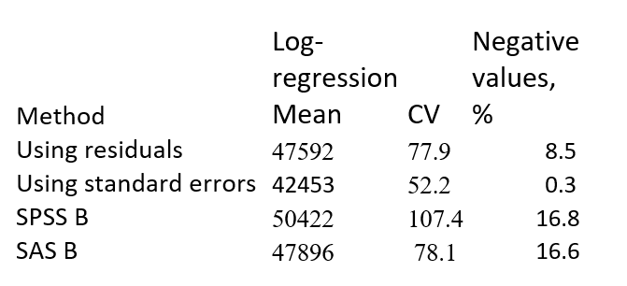
Model-donor methods
The linear regression model is easy to apply for model-donor imputation but it does not give excellent results due to many negative values. Table 1 gives the results. It also includes non-good results then using logarithmic regression
Table 1. Means and negative values of model-donor methods (NB = Non-Bayesian, B = Bayesian)
True value | 43531 | 67.7

Slide 23
We find that all methods give negative values but Bayesian methods much more. The means are not either good and using a log-model they are more worse. Hence we do not use more model-donor methods but go to real-donor methods. We have explained already the basics of non-Bayesian methods but do not go to details as far as Bayesian methods are concerned. Both SPSS and SAS have the method called ‘Predictive mean matching’ that always gives observed values, thus not negative. We thus apply this method.

Slide 24
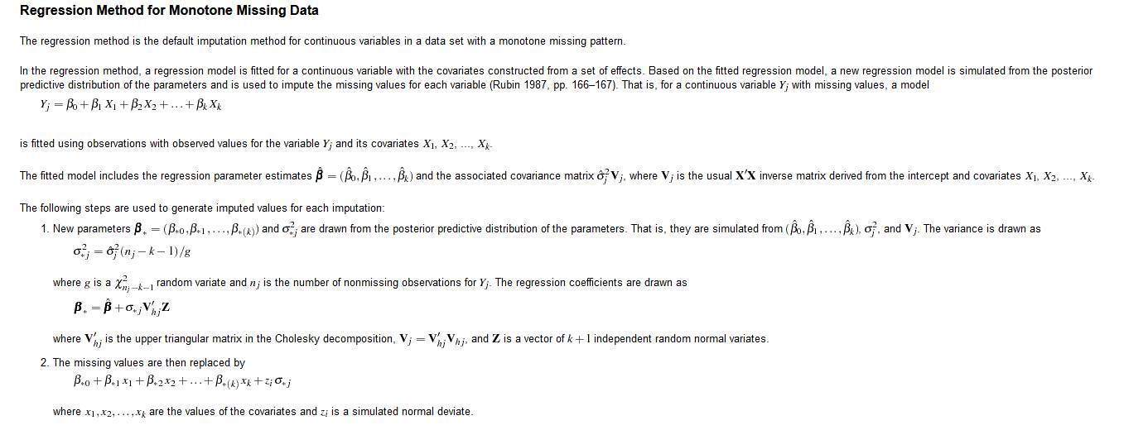
This is a basis for predictive mean matching as well
This is special in Bayesian

Slide 25
Posterior Predicted distribution of parameters is used both in SAS MI and SPSS linear regression imputation.
There are several parameters and imputation assumes that they are normally distributed. I have to say that I am not happy with so many parameters. For example, I do not know how they take into account collinearity that a ordinary problem in multivariate regression models. Hence I have used one parameter only. Earlier this was based on empirical residuals of the model and assuming normality. This works rather well but in this study this ‘posterior’ distribution is also a standard error of the predicted values. I never see this approach that seem to work fairly well but negative values are still met without logarithmic transformation.

Slide 26
Real-donor methods
Table 2 presents the results. They are ordered by the imputation model applied. The last four methods are for binary regressions where are both symmetric (probit, logit) and asymmetric link functions (CLL and LL). We find that log-linear regression is worst but it is not easy to know the reason. All imputed averages seem to be too big but the CV’s almost always too small. Some imputation methods are however fairly good as far as income differences are concerned. One general conclusion could be that the imputations are leading to reduce the bias but not enough, concerning averages especially.

Slide 27
Method |  |  | Ranking |  | Mean | Standard error
 |  |  |  |  |  | of the mean
 | Ave-rage | CV | Ave-rage | CV | Rank-ing | Ru-bin | Björn-stad
Linear regression NB | 46178 | 66.3 | 8 | 7 | 7.5 | 692 | 729
Linear regression SAS | 45121 | 68.0 | 3 | 3 | 3 | 896 | 1017
Linear regression SPSS | 45471 | 66.2 | 5 | 8 | 6.5 | 710 | 757
Log regression NB | 46722 | 65.2 | 10 | 10 | 10 | 772 | 846
Log regression SAS | 46034 | 66.7 | 7 | 5 | 6 | 864 | 973
Log regression SPSS | 46179 | 66.1 | 9 | 9 | 9 | 692 | 728
Logit regression NB | 45468 | 67.7 | 4 | 1 | 2.5 | 845 | 950
Probit regression NB | 44785 | 67.9 | 1 | 2 | 1.5 | 754 | 822
CLL regression NB | 44898 | 67.3 | 2 | 4 | 3 | 915 | 1047
LL regression NB | 45493 | 66.4 | 6 | 6 | 6 | 864 | 976
True value | 43531 | 67.7
Table 2. Averages and
Coefficients of variation of yearly income and standard errors by Rubin and Björnstad

Slide 28
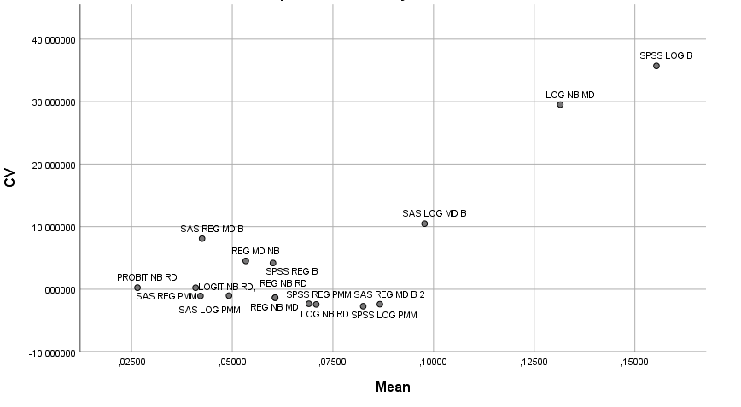
The in the graph

Slide 29
The major part of the standard error is derived from the within variance (from 59% to 79%). This is one reason that the differences between Rubin’s and Björnstad’s standard errors respectively are not big. They vary fairly much by methods. If the standard error is big, it is easier to get the result that covers the true value. On the other hand, a small standard error is often good. The reader can make his/her interpretation what method is best and which standard error formula. I prefer the probit regression NB.

Slide 30
Conclusion
Model-donor methods (either Bayesian or non Bayesian) are not well working, much due to a high number of negative incomes. However, non-Bayesians are less problematic.
Real-donor methods are working relative well both for non-Bayesians or Bayesians. I cannot be convinced that Bayesians would be better. It is of course possible to find new methods that can work better. It is good to keep in mind the predictions of the imputed values are not good as it is the case in real life often. Be careful when imputing whether using your own method or applying the software such as SPSS or SAS.

Slide 31
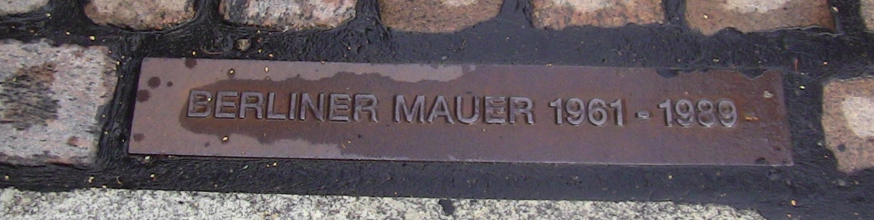
Thank you Danke schön Tack Takk Kiitos Tänu Paldies Padėkojimas Cпасибі
This ‘Mauer’ was imputed in 1961 but later deleted almost completely.

