Slide 1
Population Estimation Beyond 2021
Mārtiņš Liberts
Central Statistical Bureau of Latvia
22 August 2018

Slide 2
Outline
Population statistics 2012 – 2021
Precision evaluation of register/model statistics
Population statistics beyond 2021

Slide 3
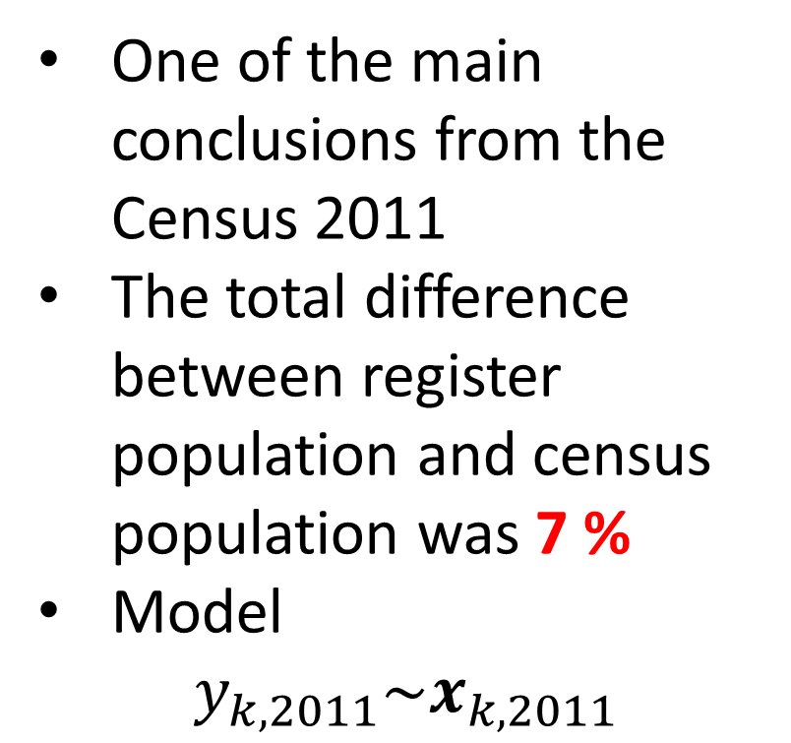
One of the main conclusions from the Census 2011
The total difference between register population and census population was 7 %
Model
$$y_{k,2011}\sim x_{k,2011}$$

Slide 4
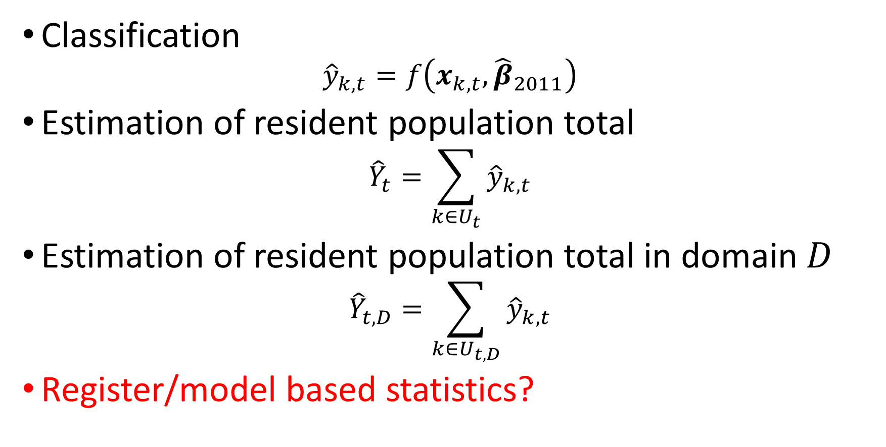
Classification
$${\hat{y}}_{k,t}=f\left(x_{k,t},{\hat{β}}_{2011}\right)$$
Estimation of resident population total
$${\hat{Y}}_{t}=\sum_{k∈U_{t}}{{\hat{y}}_{k,t}}$$
Estimation of resident population total in domain $D$
$${\hat{Y}}_{t,D}=\sum_{k∈U_{t,D}}{{\hat{y}}_{k,t}}$$
Register/model based statistics?

Slide 5
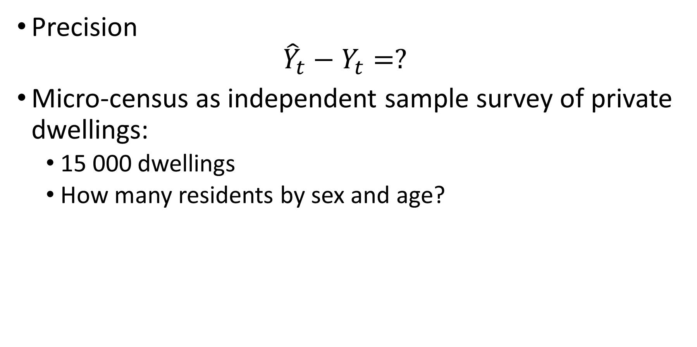
Precision
$${\hat{Y}}_{t}−Y_{t}=?$$
Micro-census as independent sample survey of private dwellings:
15 000 dwellings
How many residents by sex and age?

Slide 6
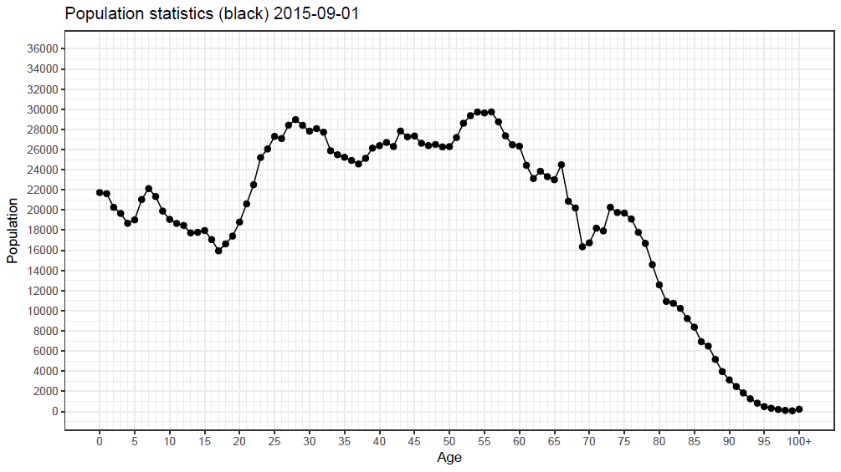

Slide 7
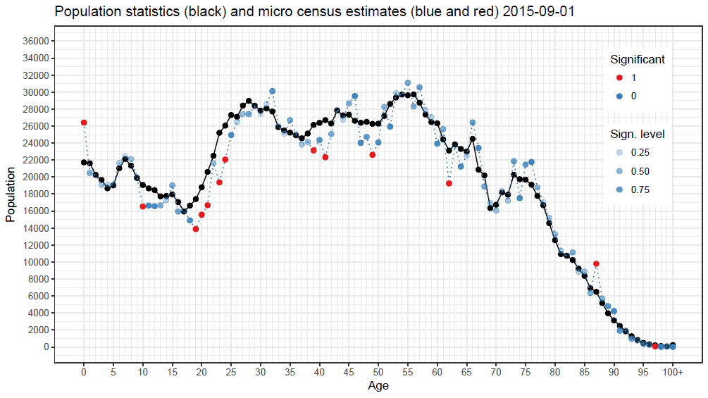

Slide 8
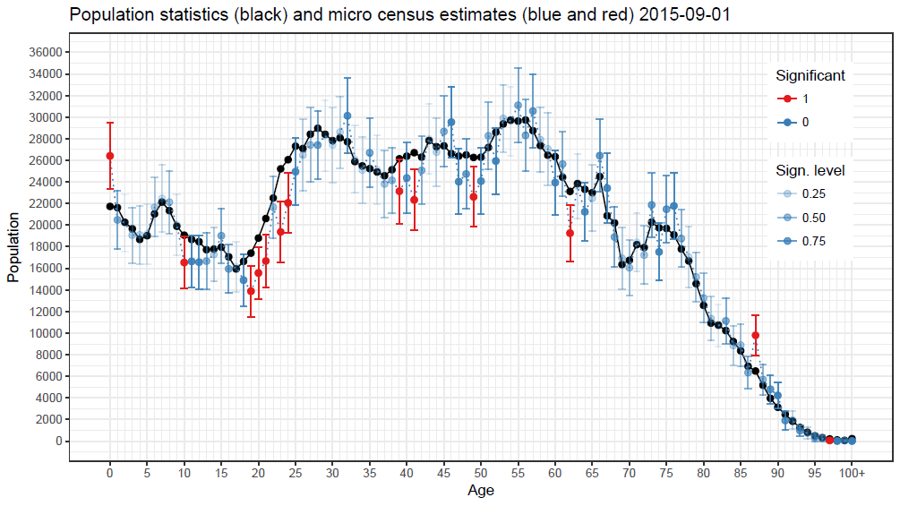

Slide 9
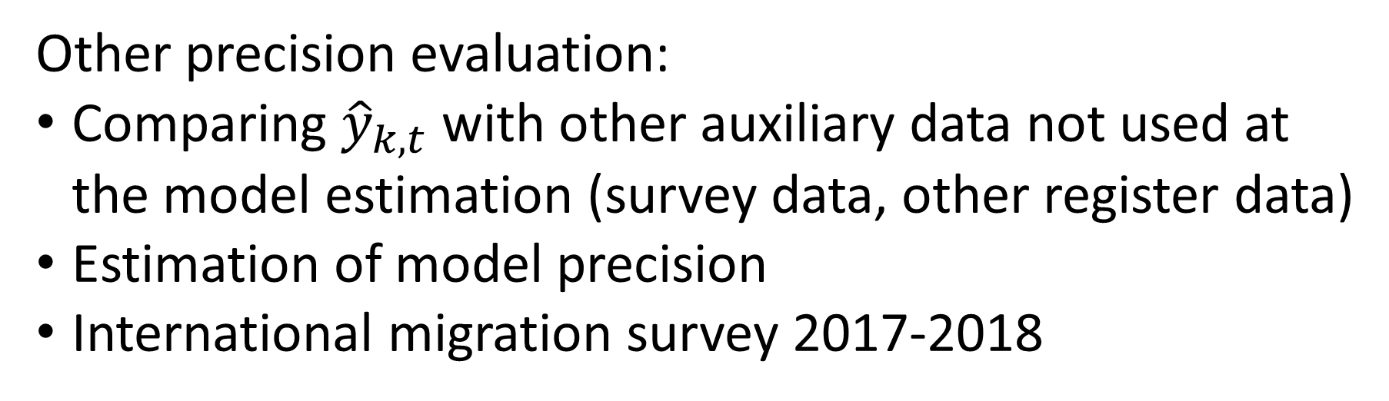
Other precision evaluation:
Comparing ${\hat{y}}_{k,t}$ with other auxiliary data not used at the model estimation (survey data, other register data)
Estimation of model precision
International migration survey 2017-2018

Slide 10
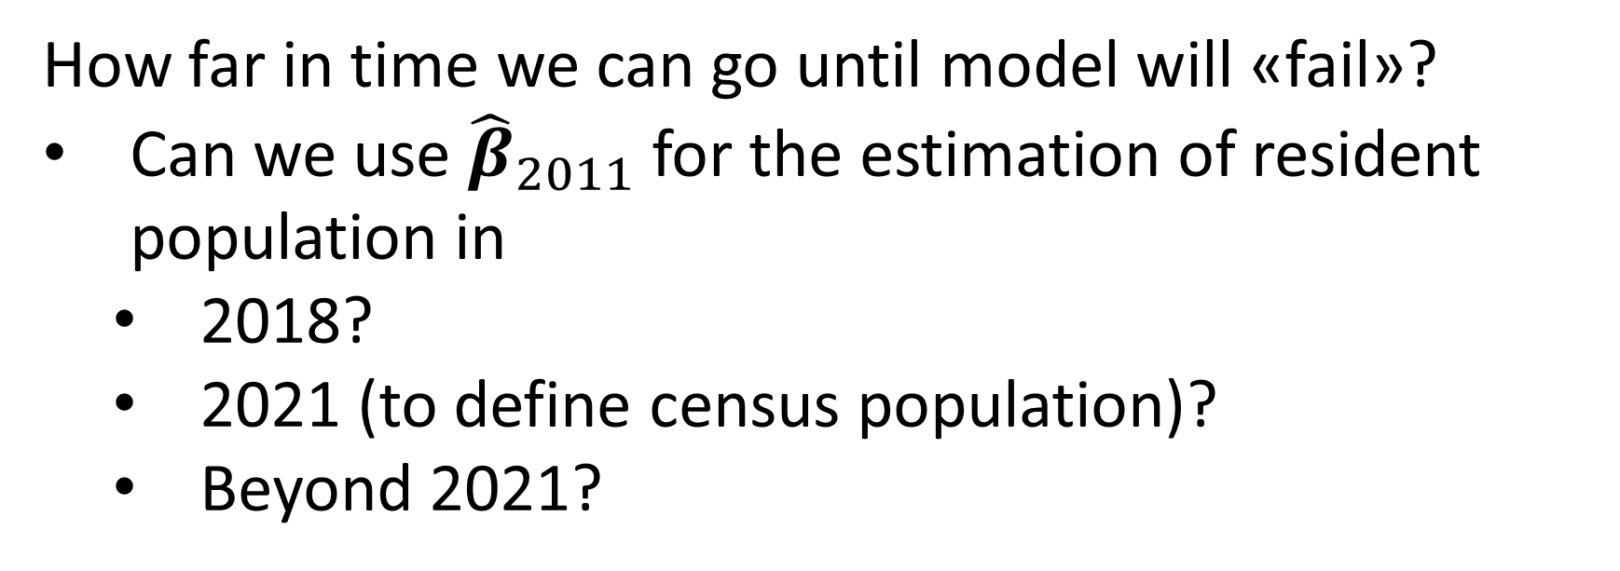
How far in time we can go until model will «fail»?
Can we use ${\hat{β}}_{2011}$ for the estimation of resident population in
2018?
2021 (to define census population)?
Beyond 2021?

Slide 11
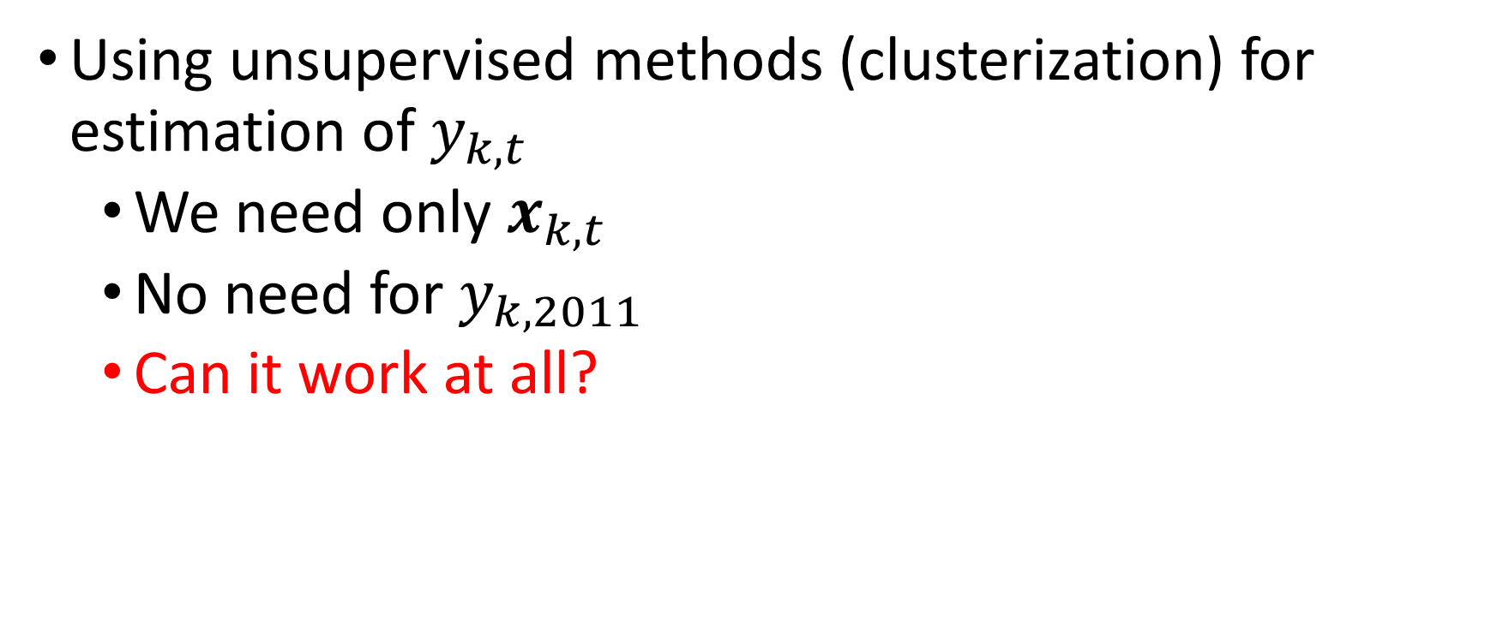
Idea #1
Using unsupervised methods (clusterization) for estimation of $y_{k,t}$
We need only $x_{k,t}$
No need for $y_{k,2011}$
Can it work at all?

Slide 12
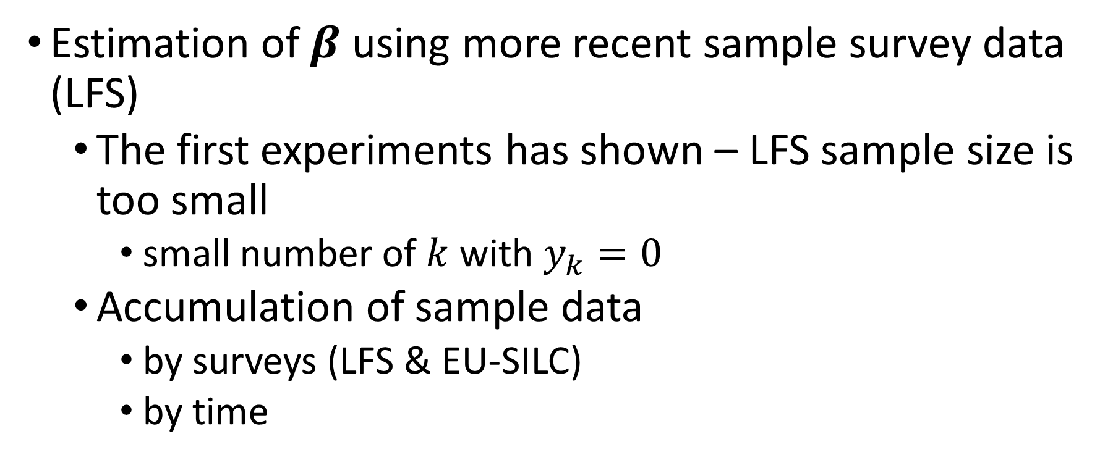
Idea #2
Estimation of $β$ using more recent sample survey data (LFS)
The first experiments has shown – LFS sample size is too small
small number of $k$ with $y_{k}=0$
Accumulation of sample data
by surveys (LFS & EU-SILC)
by time

Slide 13
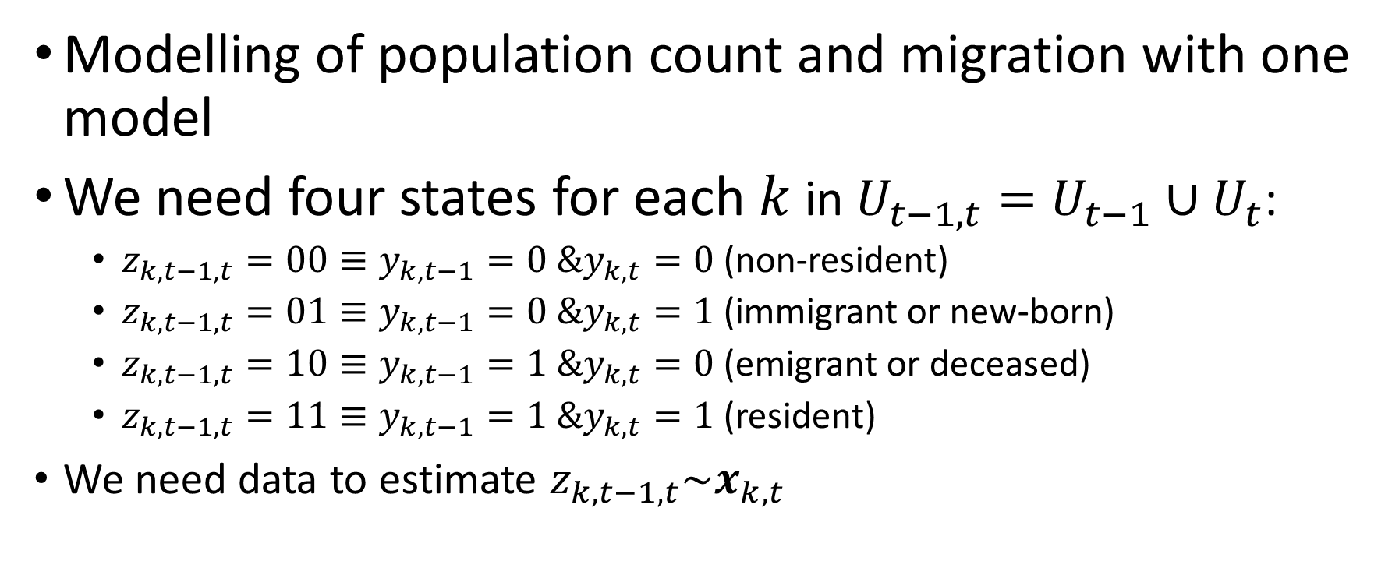
Idea #3
Modelling of population count and migration with one model
We need four states for each $k$ in $U_{t−1,t}=U_{t−1}∪U_{t}$:
$z_{k,t−1,t}=00≡y_{k,t−1}=0 \&y_{k,t}=0$ (non-resident)
$z_{k,t−1,t}=01≡y_{k,t−1}=0 \&y_{k,t}=1$ (immigrant or new-born)
$z_{k,t−1,t}=10≡y_{k,t−1}=1 \&y_{k,t}=0$ (emigrant or deceased)
$z_{k,t−1,t}=11≡y_{k,t−1}=1 \&y_{k,t}=1$ (resident)
We need data to estimate $z_{k,t−1,t}\sim x_{k,t}$

Slide 14
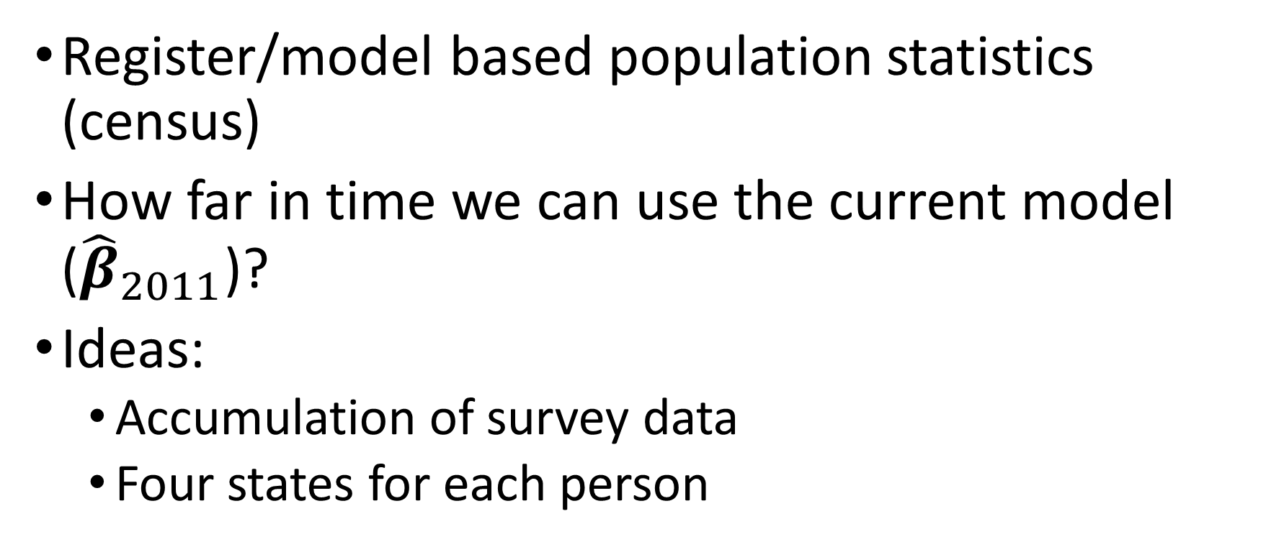
To conclude
Register/model based population statistics (census)
How far in time we can use the current model (${\hat{β}}_{2011}$)?
Ideas:
Accumulation of survey data
Four states for each person

