Slide 1
Impact Factors Modeling of Households Deposit Dollarization in Ukraine
Nataliia Versal and Iryna Rozora
Taras Shevchenko National University of Kyiv, Ukraine
BNU, Latvia
2018

Slide 2
Goals:
to define household deposits dollarization (HDD) in Ukraine for the period from Jan 2006 to Dec 2017;
to determine the significance of factors influencing the change of level HDD;
to analyze HDD as time series;
to construct forecast for HDD.

Slide 3
In countries with unstable economies the economic agents consider foreign currency to be a reliable asset worth of investing money in.
Main reasons for DD in emerging markets:
hysteresis or ratchet effect due to high inflation, exchange rate volatility, interest rates volatility;
currency risk premium;
money flow from abroad;
currency competition in value storing etc.

Slide 4
The model proposed by Neanidis and Savva, 2009.
According to this model DD depends on
the exchange rate (erf),
the monetary base (mbf),
the error correction term related to the size of the desired dollarization (ec),
the interest rate differential,
the rate of inflation,
an index of asymmetry of exchange rate movements,
an index of exchange rate intervention etc.

Slide 5
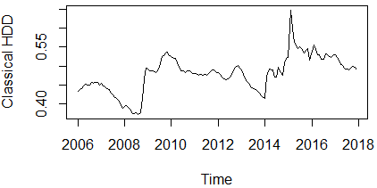
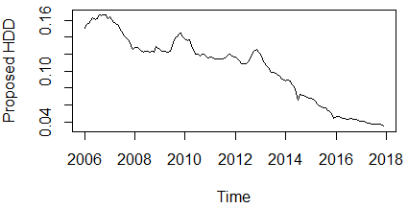
Classical HDD | Proposed HDD
HDD=FD/TD | HDD=FD/LD
FD is volume of deposits in foreign currency;
LD is volume of deposits in local currency;
TD=FD+LD is a total amount of deposits.

Slide 6
Our model
HDD_{i}=β₀+ β₁ gerf_{i} +β₂ gmbf_{i}+β₃ dir_{i}+β₄ CPI_{i}+β₅ gw_{i} + e_{i}
where
gerf is a growth rate of the exchange rate,
gmbf is a growth rate of the monetary base,
dir is a difference in interest rates on deposits in national currency and in foreign currency,
CPI is the level of inflation,
gw is a growth rate of wages

Slide 7
Parameter | Estim. value | Std. Error | t value
β0 | 0.1617318 | 0.0050433 | 32.069
β1 | -0.0706502 | 0.0423588 | - 1.668
β2 | 0.0866216 | 0.0895068 | 0.968
β3 | -0.0082190 | 0.0006089 | -13.499
β4 | -0.0024468 | 0.0012103 | -2.022
β5 | -0.0613168 | 0.0425139 | -1.442
σ = 0.02512
R² = 0.6042,
R²_{ad} = 0.5898,
F(5, 137)= 41.83
p-value < 2.2 · 10⁻¹⁶.

Slide 8
Decomposition of HDD as time series

Slide 9
New model with trend
HDD_{i}=β₀+ β₁ gerf_{i} +β₂ gmbf_{i}+β₃ dir_{i}+β₄ CPI_{i}+β₅ gw_{i} + β₆ tr_{i} + e_{i}
Parameter | Estim. value | Std. Error | t value
β0 | -0.0061173 | 0.0022759 | -2.688
β1 | 0.0025280 | 0.0057819 | 0.437
β2 | -0.0144030 | 0.0123238 | -1.169
β3 | 0.0002934 | 0.0001361 | 2.156
β4 | 0.0002216 | 0.0001656 | 1.338
β5 | -0.0030319 | 0.0058710 | -0.516
β6 | 1.0390761 | 0.0132822 | 78.231
σ = 0.003298
R² = 0.9923,
R²_{ad} = 0.9919,
F(6, 125)= 2680
p-value < 2.2 · 10⁻¹⁶.

Slide 10
Forecast of HDD using ARIMA processes

Slide 11

Thank you!!!!

