Slide 1
Brexit: challenges to estimate UK (hidden) population
Natalia Rozora
Nielsen
BNU, Latvia
2018

Slide 2
Agenda
Brexit : possible scenarios
Challenges
Possible data sources
Possible approaches for population estimation

Slide 3
Brexit Timelines
23 June, 2016
The referendum
31 December, 2020 The transition period is due to end.
19 March, 2018
Transition plan released
31 October, 2018
Negotiations must be complete
29 March, 2019 Brexit day.
“Uncertainty of any sort results in volatility and Brexit will be no exception”

Slide 4
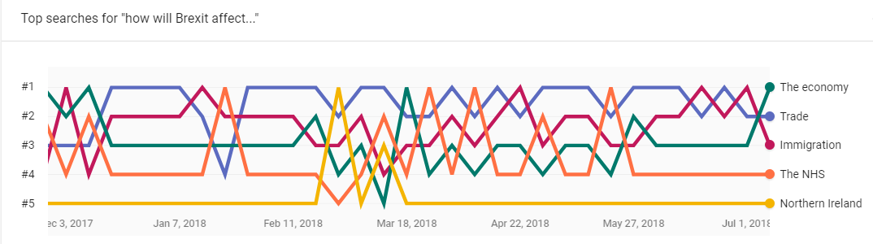
Google trends for Brexit
Top "how will Brexit affect...?"
1 Euro
2 Pound
3 House prices
4 Immigration
5 Stock market

Slide 5
Possible scenarios of Brexit
Soft Brexit
staying as closely aligned to the EU as possible. Single market or the customs union or both. free movement of people, allowing European Union citizens rights to settle in the UK with access to public services and benefits.
Open
Norway model
freedom of movement of people, make a contribution to the EU budget and abide by the rulings of the European Court of Justice, in exchange for remaining in the single market.
Canada model
Refers to a free-trade agreement which removes lots of barriers to trade between the two, but not as many as the Norway model
Customs partnership
hybrid model, would enable trade in goods without the need for customs checks.
Single Market / Custom Union,
Low
High
Hard Brexit
A hard Brexit would be one where few of the existing ties between the UK and the EU were retained
Closed
Freedom of movement of people

Slide 6
Challenges
Changes in
Migration ….
Homelessness…..
Hidden population…

Slide 7
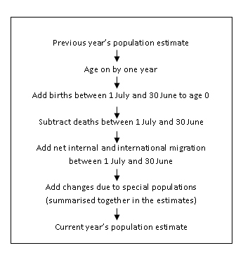
Methodology for population estimation in UK
Cohort component methods
Following data sources are used:
Births Deaths UK Armed Forces US Armed Forces Patient Register (PR) Higher Education Statistics Agency (HESA) Prisoners National Health Service Central Register (NHSCR) Migrant Workers Scan (MWS) Asylum Seeker Data and Non-Asylum Enforced Removals Home Office Immigration Asylum Seekers Support

Slide 8
UK population 2017
Estimates of the resident population of the UK by country of birth and nationality, 2016
 | Country of birth |  | Nationality
 | Estimate | Percentage | Estimate | Percentage
All residents | 64,727 | 100 | 64,727 | 100
UK born/British National | 55,554 | 86 | 58,710 | 91
Non-UK born/Non-British National | 9,152 | 14 | 5,998 | 9
EU27 | 3,537 | 5 | 3,572 | 6
EU14 | 1,596 | 2 | 1,563 | 2
EU8 | 1,443 | 2 | 1,569 | 2
EU2 | 395 | 1 | 413 | 1
Non-EU | 5,616 | 9 | 2,425 | 4
Asia | 2,923 | 5 | 1,269 | 2
Rest of the World | 2,353 | 4 | 988 | 2
Source: Annual Population Survey (APS), Office for National Statistics

Slide 9
Non-UK born residents Trends
Estimates of the non-UK born resident population of the UK by country of birth, 2004 to 2016 (ths)
Source: Office for National Statistics

Slide 10
Who are homelessness?
People sleeping rough.
Single homeless people living in hostels, shelters and temporary supported accommodation.
Statutorily homeless households – that is, households who seek housing assistance from local authorities on grounds of being currently or imminently without accommodation.
‘Hidden homeless’ households – that is, people who may be considered homeless but whose situation is not ‘visible’ either on the streets or in official statistics. Examples are shared / overcrowded
Available statistics is limited:
¬9ths people are sleeping rough in London snapshot and it is >200% over decade (GLA/CHAIN ‘Street to Home’ monitoring ) . Nationality-wise : 54% -UK, 27% - CEE, 19% -other
~50 ths people are single homeless or Statutorily homeless households (DCLG statutory homelessness statistics)
7% are overcrowded tenures and it is growth by 2pp over decade (Survey of English Housing/English Housing Survey)

Slide 11
Hidden population in scenarios
Same
Soft Brexit
.
Open
Norway model
Canada model
Customs partnership
Single Market / Custom Union,
Low
High
Hard Brexit
Closed
High
Freedom of movement of people

Slide 12
Problem statement
How to measure hidden population with expectation of change in trends?

Slide 13
Consideration for solution
Census-like enumeration is not used for hidden population estimation? sample frame is not available…
Network-based approaches:
Snowball sampling (case for Hungary homelessness estimation).
The network scale-up method. It based on defining social networks of target population (It is identified their personal network size of sampled ones and based on proportion of members belonging to target population, the target population is defined)
Other?

Slide 14
Network-based approach: sampling technique
Sample selection approach : respondent-driven sampling (RDS)
Recruitment process can be through reference (“coupon” service proposal)

Slide 15
Further consideration
RDS is practical and easier in implementation to collect minimum list of target population
Method defining for target population size estimation (currently it is ideation)

Slide 16
Thank you!

