Slide 1
Tourism Incomes and Expenditures Surveys in Belarus
Natallia Sakovich
Jelgava, 2018

Slide 2
The national System of Tourism Statistics (STS):
statistical sources
data derived from those sources: statistical drawn from surveys, administrative records, other statistical sources (Balance of Payments and the National accounts)
the specific tools and instruments used at certain stages of process (concepts, definitions, databases)
Households surveys, tourism industry entities surveys This surveys are the main methods of tourism expenditures and income estimation

Slide 3
Main definitions (IRTS 2008):
1) Domestic tourism comprises the activities of a resident visitor within the country of reference, either as part of domestic tourism trip or part of an outbound tourism trip
2) Outbound tourism comprises the activities of a resident visitor outside the country of reference
3) Inbound tourism comprises the activities of a non-resident visitor within the country of reference
4) National tourism – comprises domestic tourism (1) and outbound tourism (2), the activities of resident visitors within and outside the country of reference

Slide 4
Main definitions:
5) Domestic tourism expenditure is the tourism expenditures of a resident visitor within the economy of reference
6) Inbound tourism expenditure is the tourism expenditures of a non-resident visitor within the economy of reference
7) Outbound tourism expenditure is the tourism expenditures of a resident visitor outside the economy of reference

Slide 5
Main definitions:
8) Tourism consumption – is formal definition as tourism expenditure. This concept used in the Tourism Satellite Account more widely that of tourism expenditure.
It’s possible to find same differences: consumption also includes
services of vacation accommodation on own account,
tourism social transfers in kind
and other imputed consumption
Their informational sources are:
reports on home exchanges,
estimations of rents associated with vacation homes,
calculations of financial intermediation services indirectly measured

Slide 6
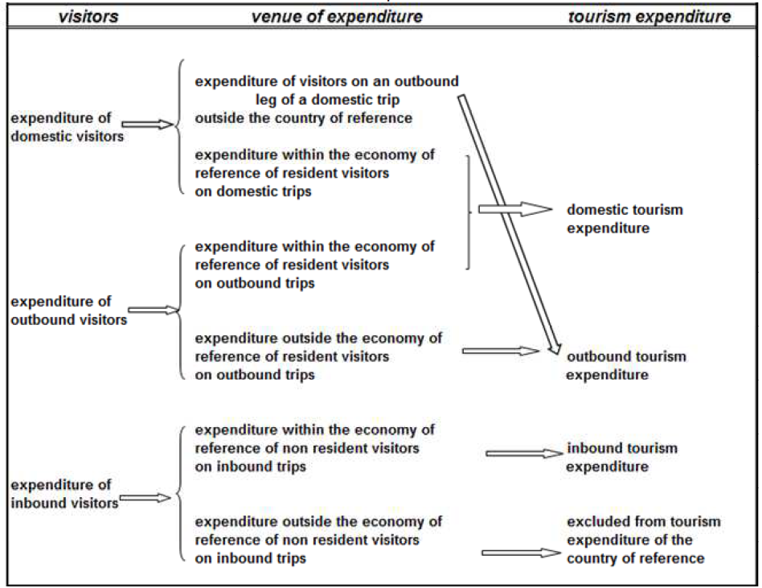
Relationship between trips, the venue of expenditures and tourism expenditures

Slide 7
Household Sample Survey (is conducted since 1995)
Main purpose is to get the information about the welfare of all population and particular demographic groups, detailed income and expenditure data.
Main components are:
baseline interview
four-quarterly interviews
four two-week interviews
Survey object is households. Survey is carried out in all country regions and separately in Minsk.
Annually the survey covers 0,2 % or 6000 HH.

Slide 8
Household Sample Survey
In this survey is used Three-stage probabilistic territorial sampling:
1) at the first step sampling units - cities and village councils;
2) at the second step – local-polling districts in city and data of the soviet account in village councils;
3) at the third – household (HH).

Slide 9
Specific questions on tourism:
Did you make tourism trips?
What were general parameters of your tourism trip (purpose; domestic, inbound or outbound; number of households members; durations)?
Did you have tourism expenditures during reference quarter?
What kind of the tourism expenditures did you have (package travel, package holidays and package tours; accommodation; food and drinks; local transport; international transport; recreations, culture and sporting activities; shopping; others)?

Slide 10
Table 1 - Tourism expenditures (from Household Sample Survey, % of total serves expenditures)
 | Sanatorium services | Tourist and excursion services | Culture and sporting services | Total tourism services
2011 | 0.6 | 3.8 | 2.7 | 7.1
2012 | 1.1 | 6.3 | 3.2 | 10.6
2013 | 1.2 | 6.1 | 3.4 | 10.7
2014 | 0.8 | 5.6 | 3.4 | 9.8
2015 | 0.7 | 4.9 | 3.0 | 8.6
2016 | 0.9 | 3.0 | 2.9 | 6.8
2017 | 1.1 | 3.5 | 2.9 | 7.5

Slide 11
Labour Force Survey (LFS) (is conducted since 2012)
One of the purposes - to obtain statistics on employed by kind of activity, including tourism
Frequency: quarterly and annual
Sample frame is based on the 2009 Census and includes:
set of cities and of village councils in each region;
census enumeration districts in each selected city;
villages in each selected village council;
the households in each selected unit

Slide 12
Sample size of LFS
Calculation results by different variants have shown that required sample size is 26-29 thousand of HH (in average – 28).
Without taking into account non-responses sample size is 22 thousand.
Sample fraction is 0,6% HH

Slide 13
Sample design:
survey object is the private households in urban and rural areas for each region, resident persons aged 15-74 years
Territorial three-stages sample is used:
primary unit – city or village council
secondary unit – census enumeration district or village (zone)
third unit – household
at each stage units are selected with systematic selection with probability, that proportional population number or household number

Slide 14
Weighting procedure of LFS
is connected with HH’s weights and individual’s weights.
HH weights are calculated as inverse of overall sample probabilities. There are 25 census enumeration districts in cities and 16 village councils (zones).
Individual’s weights are based on iterative weighting (two iteration).

Slide 15
Weighting procedure of LFS
Iteration I:
a) weights are calculated by sex, five-years group design
b) the first correct coefficient (k₁) is calculated; variables of weighting are region, sex, rural/urban
c) the second correct coefficient (k₂) is calculated; variables are region, sex, 11 five-years groups.
Weight is equal within each region, five-years group in urban/rural
Iteration II: follow adjustment of weights
Final individual weight for each five-years group:

Slide 16
Establishment-based survey
Tourism activity is a complex, demand driven phenomenon.
The typical tourism products are:
accommodation of visitors,
services of public catering entities,
air transport, transport, used to cross land borders (railways, other public transport by land, private transport by land, pedestrians)
tourism industry entities, culture services, sporting and others.

Slide 17
Establishment-based survey
Main information sources:
1) Establishment-level data (measuring labour demand) or enterprise reports;
2) Administrative records, such as:
employment office registers,
social security files,
tax records, etc.

Slide 18
Establishment-based survey
Establishment surveys are
establishment censuses
establishment-based sample surveys, including small business surveys.
The priority is given to the continuous reporting.
There are a large variety of establishment surveys, each designed to obtain specific information: production, export, employment, average earnings, etc.
Detailed industrial classifications are more reliably derived from establishment reports.

Slide 19
Conclusion
The experience of households survey and establishment surveys has shown following:
main problems are: small sample localization; non-responses (20-30%); building of regional subsamples; the usage of methods combination to extrapolate each indicator from questionnaire becomes inadequate in some cases; different weighting schemes; structural parameters of employment estimation (for LFS);
data from two sources (Households surveys and establishment-based surveys) differ from each other because of variations in definitions and coverage, source of information, methods of collections, estimating procedures. Sampling variability and response errors are additional reasons for discrepancies;
additional specific tourism surveys are planned to use (informal tourism sector, telephone surveys, tourism employment).

Slide 20
References
Bokun, N (2013). Sample Survey of Households in Belarus: state and perspectives. Statistics in transition, Warsaw, 110-121
International Recommendation for Tourism Statistics 2008. Complicative Guide (2010)
Metodologicheskie polozheniya po postroeniyu vspomogatelnogo scheta turizma Respubliki Belarus (2017). Minsk, Belstat.

Slide 21
Thank you

