Slide 1
Calibration of Register Based Census Data
Elvijs Siliņš
Central Statistical Bureau of Latvia

Slide 2
Aims
Satisfy growing demand after more detailed statistics,
Produce more detailed statistics with higher precision,
Introduce with experimental statistics – get data users assessment of the results.

Slide 3
Definitions
Unemployed are all persons aged from 15 to 74 who are:
without a job,
searching for a job,
currently available for employment.
Unemployment rate is share of unemployed persons to the active population (employed and unemployed persons) of the same age group.

Slide 4
Labour Force Survey
Regularly obtain information about economic activity (employed, unemployed and economically inactive persons) of inhabitants of Latvia is one of the Labour Force Survey (LFS) targets,
Obtained estimations are credible only in large domains but not in small population subgroups.

Slide 5
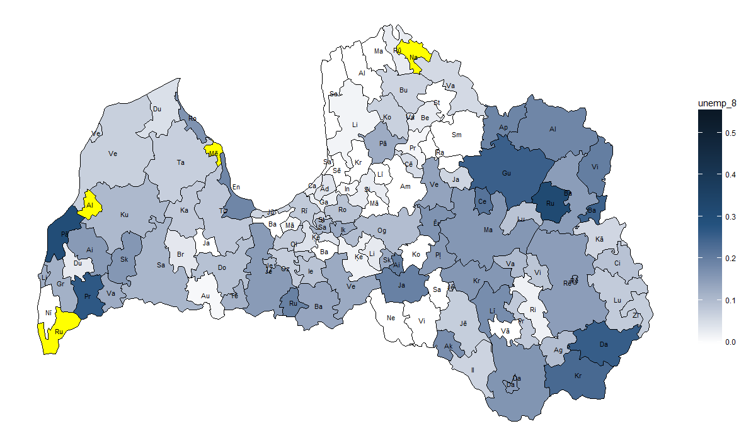
Unemployment rate 2017 (LFS)

Slide 6
1. Register based census data
Central Statistical Bureau of Latvia prepares data once in a year for each inhabitant of Latvia. This is done as a test for Census 2021.
These data include information about:
demography,
status of economic activity,
industries and occupations (only for employees),
education.
Formed from administrative registers.

Slide 7
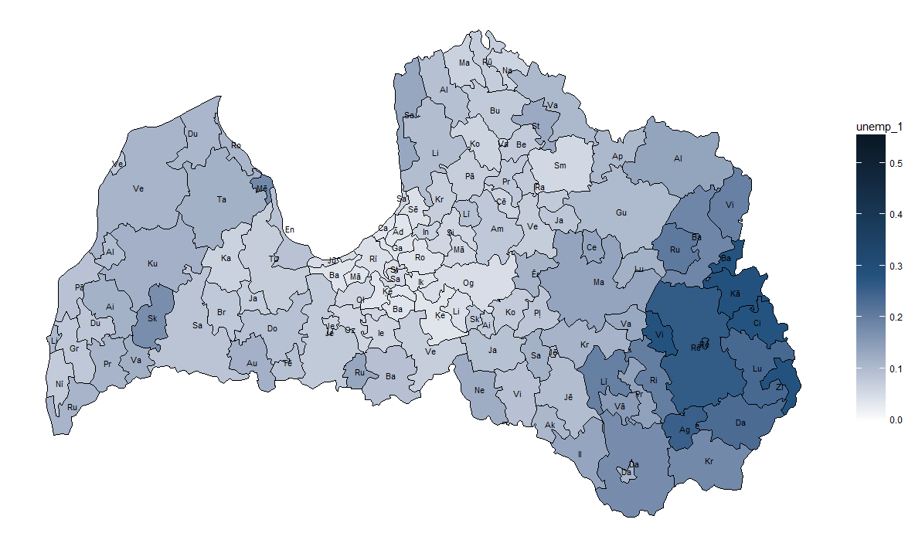
Unemployment rate 2016 (register based census pilot)

Slide 8
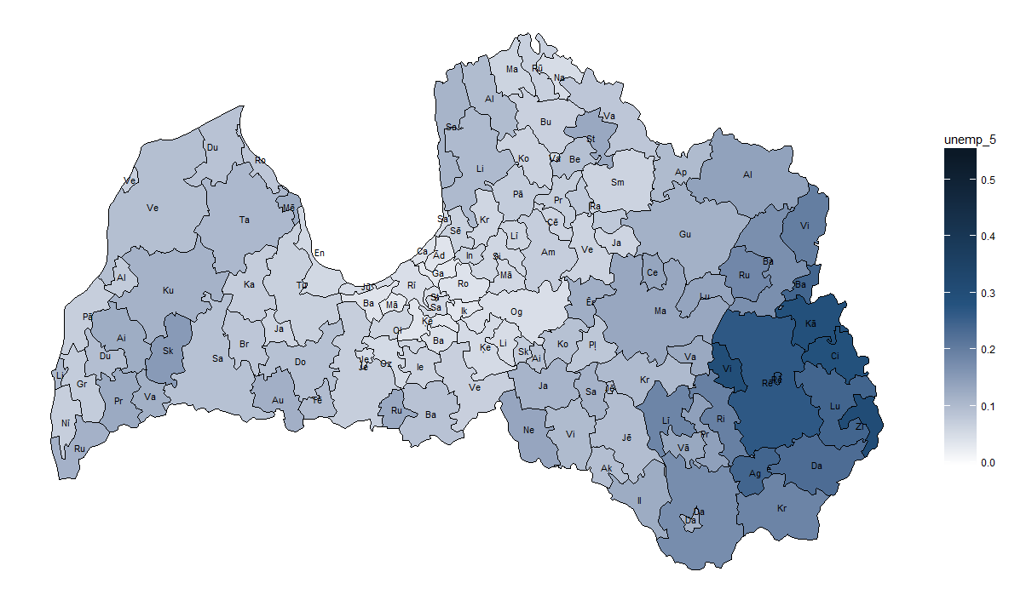
Unemployment rate 2017 (register based census pilot)

Slide 9
2. Imputation of unemployed persons
Necessary to identify those persons who are unemployed but have not registered with the State Employment Agency (SEA),
Unemployed persons in LFS are observed in accordance with the definition of unemployed persons (regardless of the registration status in SEA),

Slide 10
2. Imputation of unemployed persons
Regularized discriminant analysis model has been created by persons characteristics (gender, age, nationality, marital status, region of residence and employee income) which classifies if a person is unemployed,
LFS data was used to create the model.
Imputation was done in program R using function ‘rda’ from package ‘klaR’.

Slide 11

Unemployment rate 2016 (Census after imputation)

Slide 12
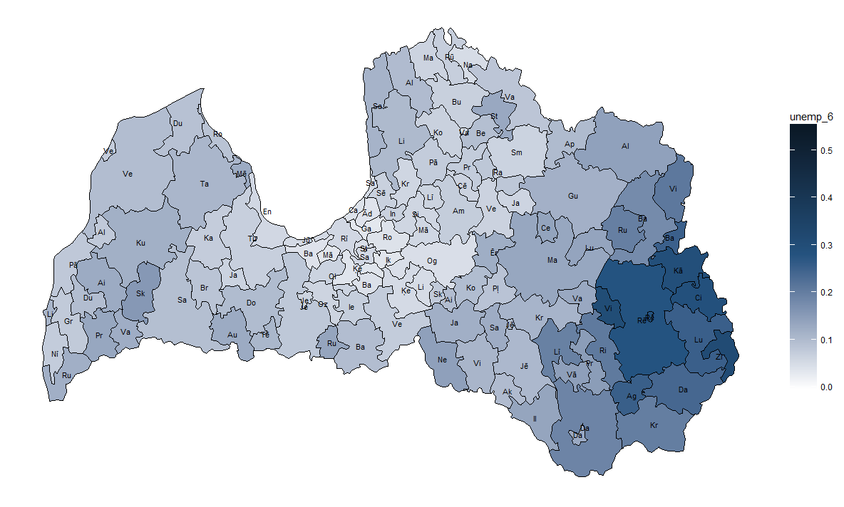
Unemployment rate 2017 (Census after imputation)

Slide 13
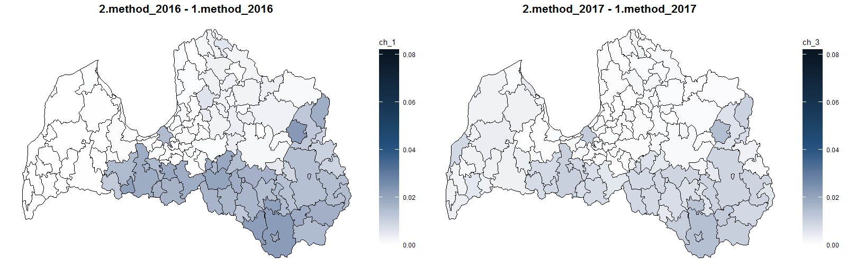
Changes

Slide 14
3. Reconciliation of results between census and LFS
LFS sufficiently accurate estimates of unemployment rate in country and in sufficiently large population subgroups,
Reconciliation was done in order to improve the accuracy of the results of the census and to gain coherence with LFS main results:
Results of LFS with sufficient precision were chosen that characterize the economic activity of the population:
Number of employed, unemployed and economically inactive population by gender, age and place of residence.
Linear calibration was performed to reconcile the census results with the selected LFS results
Calibration was done using function ‘calib’ from package ‘sampling’.

Slide 15
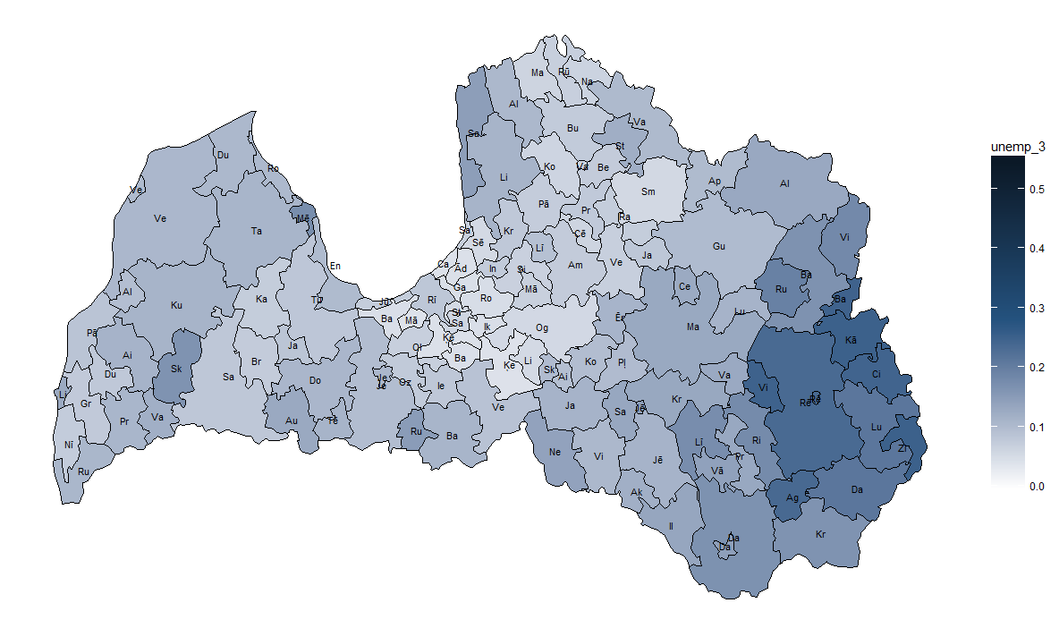
Unemployment rate 2016 (Census after imputation and calibration)

Slide 16
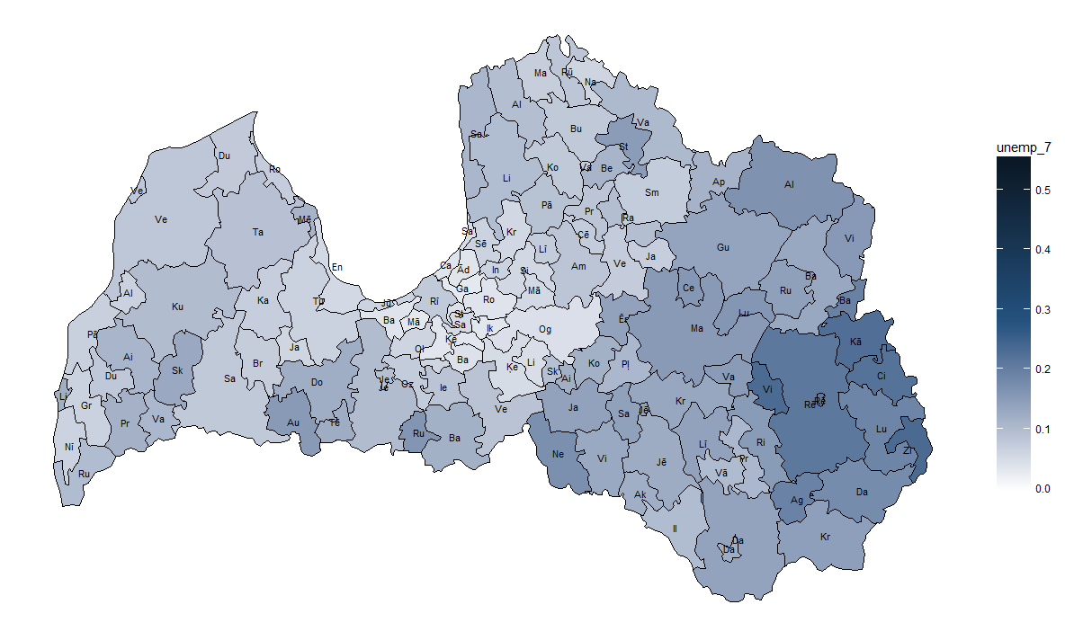
Unemployment rate 2017 (Census after imputation and calibration)

Slide 17
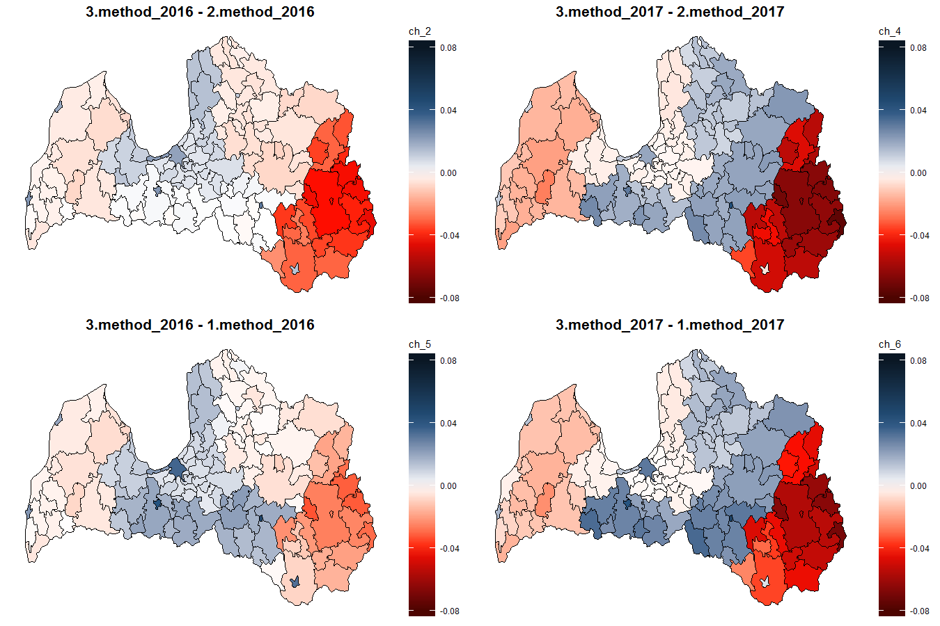

Slide 18
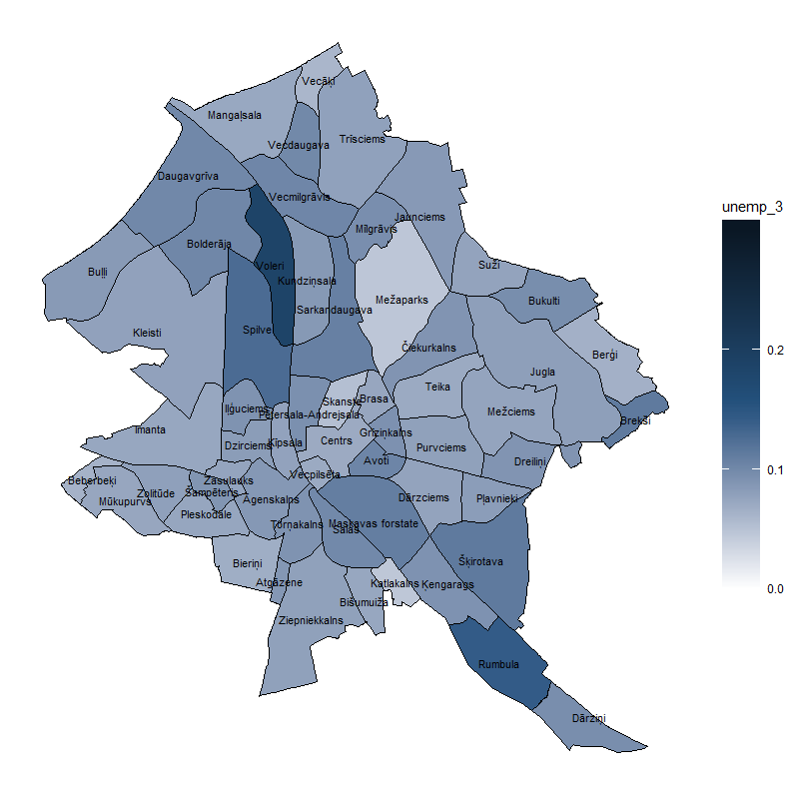
Unemployment rate for neighbourhoods in Riga 2016 (Census after imputation and calibration)

Slide 19
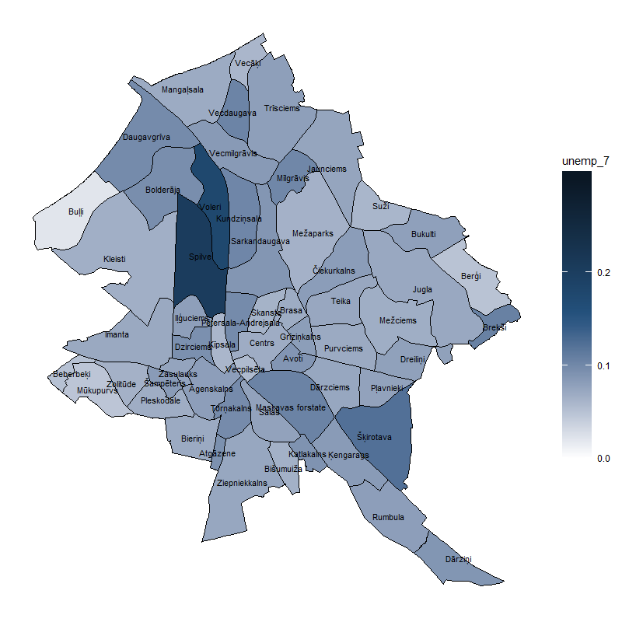
Unemployment rate for neighbourhoods in Riga 2017 (Census after imputation and calibration)

Slide 20
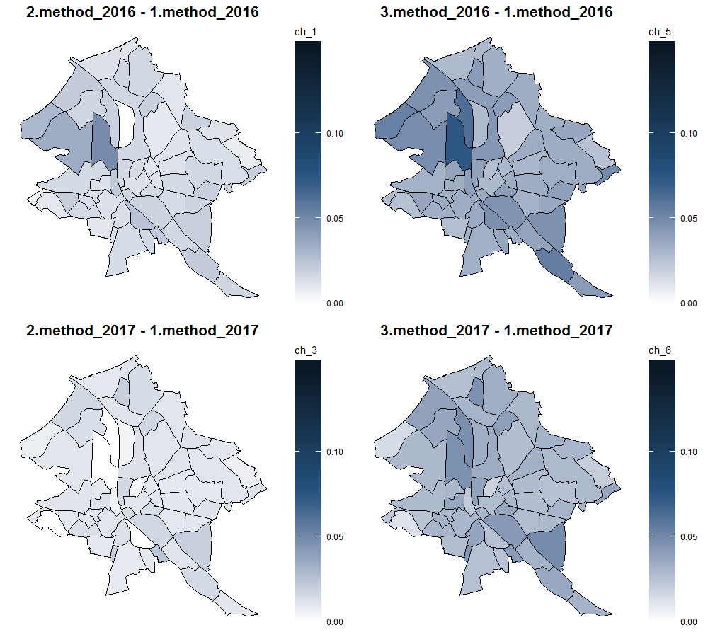

Slide 21
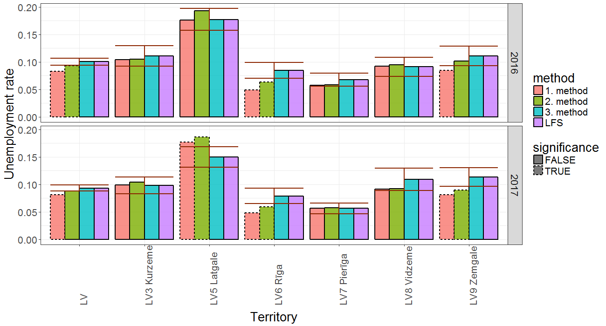
Results for regions

Slide 22
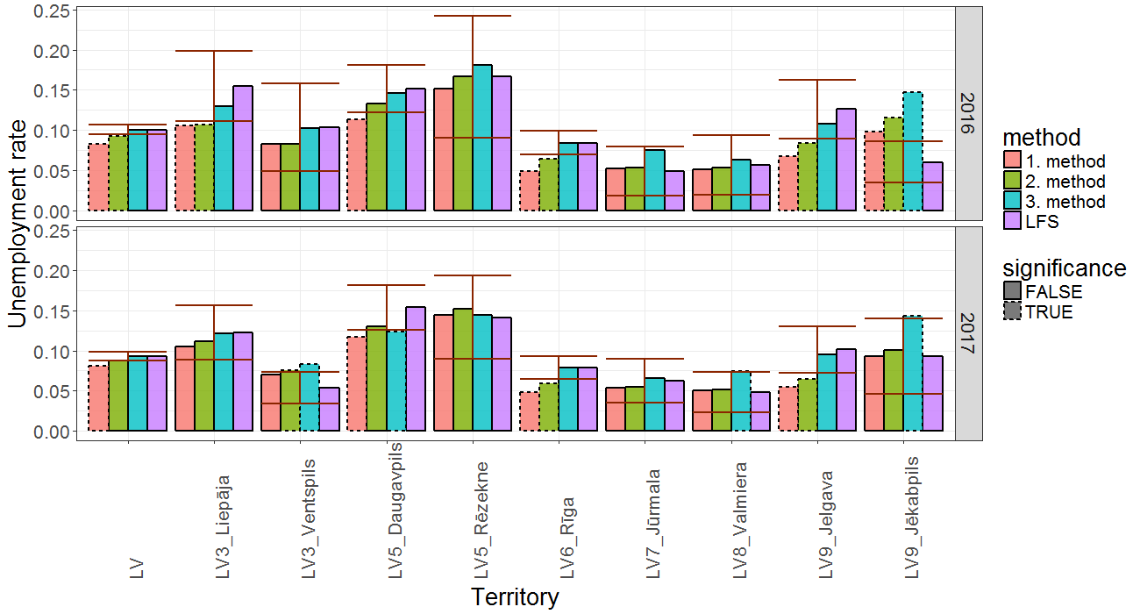
Results for major cities

Slide 23
Conclusions
Provisional indicators of economic activity in administrative territories with different methods have been obtained,
To obtain better quality territorial statistics it would be necessary to continue working, including studies of other methods.

Slide 24
Thank you!

Slide 25
Template diagrammām un kartēm

