Slide 1

Preparation for Census 2021
Milda Šličkutė-Šeštokienė
Statistics Lithuania
21−24 August 2018
BNU WORKSHOP 2018
‹#›
Notes:
‹#›

Slide 2
Content
Preparation for register-based Census 2021
Key challenges

Slide 3
Administrative sources in SL
106 Administrative data sets at the aggregated level (52 data holders);
57 Administrative data sets at the micro level (21 data holders)
42% of published data are based on administrative sources. In Social Statistics - 52,3%.
21−24 August 2018
BNU WORKSHOP 2018
‹#›

Slide 4
Changing profile of census
2001 – Traditional approach;
2011 – Combined approach – administrative sources were extensively used:
Some data were derived from administrative sources ;
Users were able to fill-in electronic questionnaire (34%).
2021 – Completely register-based, no field-work:
2019 Pilot register-based census.
After 2024 some indicators will be produced annually.
21−24 August 2018
BNU WORKSHOP 2018
‹#›

Slide 5
How will the 2021 Census be built?
Census will be build around the Population Register (PR);
The PR contains some variables for each person: identification number, sex, date and place of birth, citizenship, declared place of residence.
personal information will be linked with other administrative sources using personal ID or address ID.
data coming from different sources will be integrated to add census variables.
For each Census variable not included in the PR different sources of information may be considered and different methodological approaches must be adopted.
21−24 August 2018
BNU WORKSHOP 2018
‹#›

Slide 6
Administrative sources for census 2021
34 administrative sources analyzed;
18 administrative sources were chosen for census 2021 (this number constantly changing).
21−24 August 2018
BNU WORKSHOP 2018
‹#›

Slide 7
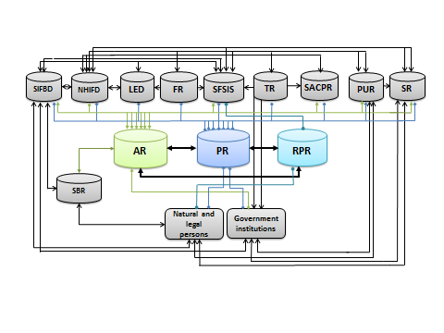
Integrated Social Statistics Data Warehouse
The linkage variables: personal ID and address ID
21−24 August 2018
BNU WORKSHOP 2018
‹#›

Slide 8
Administrative data integrated into Social Statistics Data Warehouse
Name of the administrative data source | Holder of the administrative data
Population Register | State Enterprise “Centre of registers”
Address Register
Real Property Register
Statistical Business Register | Statistics Lithuania
Social Insurance Fund Board database | Social Insurance Fund Board
National Health Insurance Fund data | National Health Insurance Fund
Labour Exchange data | Labour exchange Office
Tax Payers Register | State Tax Inspectorate
Farmers Register | State enterprise “Agricultural Information & Rural Development Centre”
Students’ Register | Ministry of Education & Science
Pupils’ Register
Pedagogues’ Register
Suspects, Accused & Convicted Persons Register | Information technology & communication department
Social Family Support Information System | Ministry of Social Security & Labour
21−24 August 2018
BNU WORKSHOP 2018
‹#›

Slide 9
Biggest challengers at the moment
Identification of usual residents (high number unofficial migrants)
Household and family formation (>20% of persons declared only the locality of residence but not the full address)
21−24 August 2018
BNU WORKSHOP 2018
‹#›

Slide 10
Number of usual residents and persons who declared place of residence in LT 2016.01.01
Age | Persons, who declared residence in LT (PR) | Usual residents published by SL | (SL*100 /PR)-100
Total | 3176481 | 2888558 | -9.1
0-9 | 313447 | 292005 | -6.8
10-19 | 310102 | 293884 | -5.2
20-29 | 436479 | 391756 | -10.2
30-39 | 429557 | 352392 | -18.0
40-49 | 451346 | 400702 | -11.2
50-59 | 479796 | 437936 | -8.7
60-69 | 343023 | 317838 | -7.3
70-79 | 259251 | 250172 | -3.5
>= 80 | 153480 | 151873 | -1.0
21−24 August 2018
BNU WORKSHOP 2018
‹#›

Slide 11
Number of households by size
Household size | Census 2011 | Population Register 2017 | 2017 compared to 2011, in %
Total | 1.267.316 | 1.125.681 | 88,8
1 | 401.402 | 334.855 | 83,4
2 | 359.013 | 271.045 | 75,5
3 | 242.965 | 206.379 | 84,9
4 | 183.655 | 163.410 | 89,0
5-9 | 79.885 | 142.531 | 178,4
10-19 | 396 | 7.038 | 1777,3
20-49 | - | 361 | -
50-99 | - | 38 | -
100-199 | - | 11 | -
>= 200 | - | 13 | -
21−24 August 2018
BNU WORKSHOP 2018
‹#›

Slide 12
Draft census budget 2021 compared to 2011
Budget | 2011, in euros | 2021, in euros | 2021 compared to 2011
Total | 8.587.407,70 | 1.769.634,91 | 20,6%
Management | 693.582,00 | 693.582,00 | 100,0%
Printing census sheets and forms | 196.912,70 | - | 0,0%
Public awareness campaign | 217.794,30 | - | 0,0%
Pilot Studies/Census | 218489,4 | 109.244,70 | 50,0%
Maps | 143.680,50 | - | 0,0%
E-census | 405.294,30 | - | 0,0%
Salaries of temporary staff, rent of premises, logistics etc. | 5.606.058,90 | - | 0,0%
Data processing | 925249,3 | 786.461,91 | 85,0%
Dissemination of results | 54.390,60 | 54.390,60 | 100,0%
Other | 125.955,70 | 125.955,70 | 100,0%
21−24 August 2018
BNU WORKSHOP 2018
‹#›

Slide 13
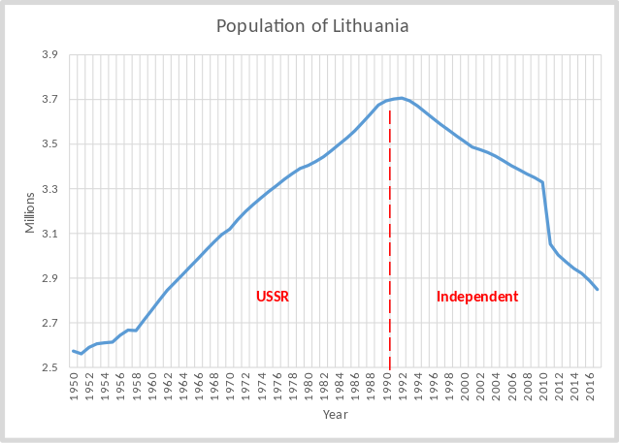
Population of Lithuania
21−24 August 2018
BNU WORKSHOP 2018
‹#›

Slide 14
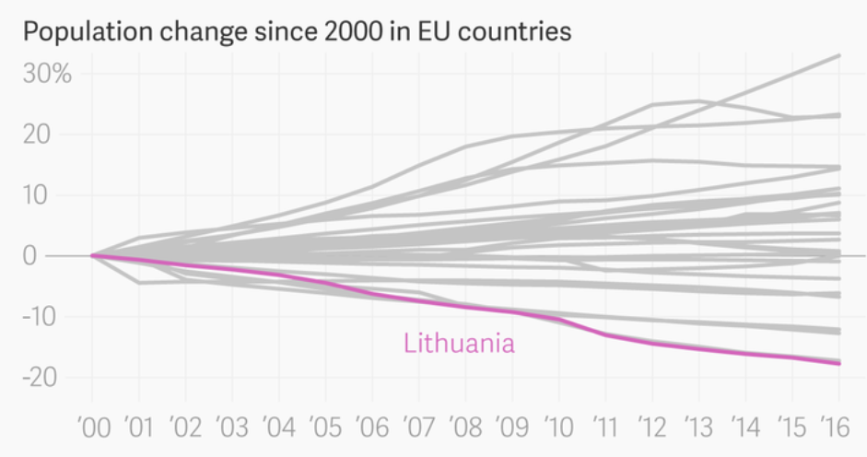
21−24 August 2018
BNU WORKSHOP 2018
‹#›

Slide 15
Thank you ☺
21−24 August 2018
BNU WORKSHOP 2018
‹#›

