Slide 1
The Local Pivotal Method and its Application on StatVillage Data
Diana Sokurova
University of Tartu
National Institute for Health Development
Notes:
Hello!
My name is Diana Sokurova.
Here I represent the University of Tartu and the National Institute for Health Development.
My presentation about The Local Pivotal Method and its Application on StatVillage Data

Slide 2
What is the Survey Sampling?
The aim of a probabilistic survey sampling is to find out sampling strategy and the estimator that leads to the best estimate of a population parameter under interest.
Notes:
The aim of a probabilistic survey sampling is to find out sampling strategy and the estimator that leads to the best estimate of a population parameter under interest.
In my papers I had compared new sampling method with other common sampling methods

Slide 3
Well-known sampling methods
Simple Random Sampling
Stratified sampling
Stratified simple random sampling
Systematic stratified sampling
Notes:
These sampling methods are
- simple random sampling, for which all objects in population have the equal inclusion probabilities,
-and stratified sampling, for which population is divided into strata by determined criteria and after that some sampling method is applied in every stratum separately.
The stratified simple sampling method, with simple random sampling applied in each stratum, is called stratified random sampling. The method, where systematic sampling is applied in each stratum, is called systematic stratified sampling, where is systematic sampling is based on the selection of elements from an ordered sampling frame.

Slide 4
What is Pivotal Method?
Was introduced in 1998 by Deville, J.-C. & Tillé, Y.
“Unequal probability sampling without replacement through a splitting method”
The special case of splitting method
Repetition
Simplification
Notes:
And now I present you the Pivotal method.
The first mention of this method was in year 1998 in article ”Unequal probability sampling without replacement through a splitting method”, which authors were Deville ja Tille.
In this article was told about sampling technique, which called “splitting method”. These class of sampling methods consists of splitting the inclusion probability vector into several new inclusion probability vectors.
The basic features of this method are repetition and simplification of each step

Slide 5
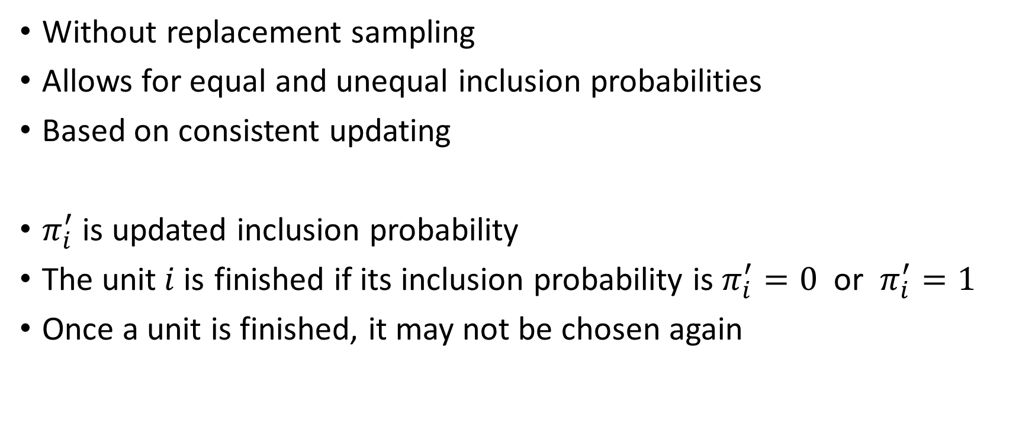
Pivotal Method
Notes:
The pivotal method is the sampling without replacement, which allows using the unequal inclusion probabilities as the initial ones. Method updates the initial inclusion probabilities interactively so that in each step the inclusion probabilities are recalculated until they becomes equal 0 or 1. The value of 1 means that corresponded unit is in sample, the value of 0 - not in a sample.
To describe the updating rule,some notation have to be introduced.
We denote possibly updated inclusion probabilities with pi_i_primm(?) , and that the unit “i“ is finished if its inclusion probability is zero or one.
Once a unit is finished, it is not used in algorithm again.

Slide 6
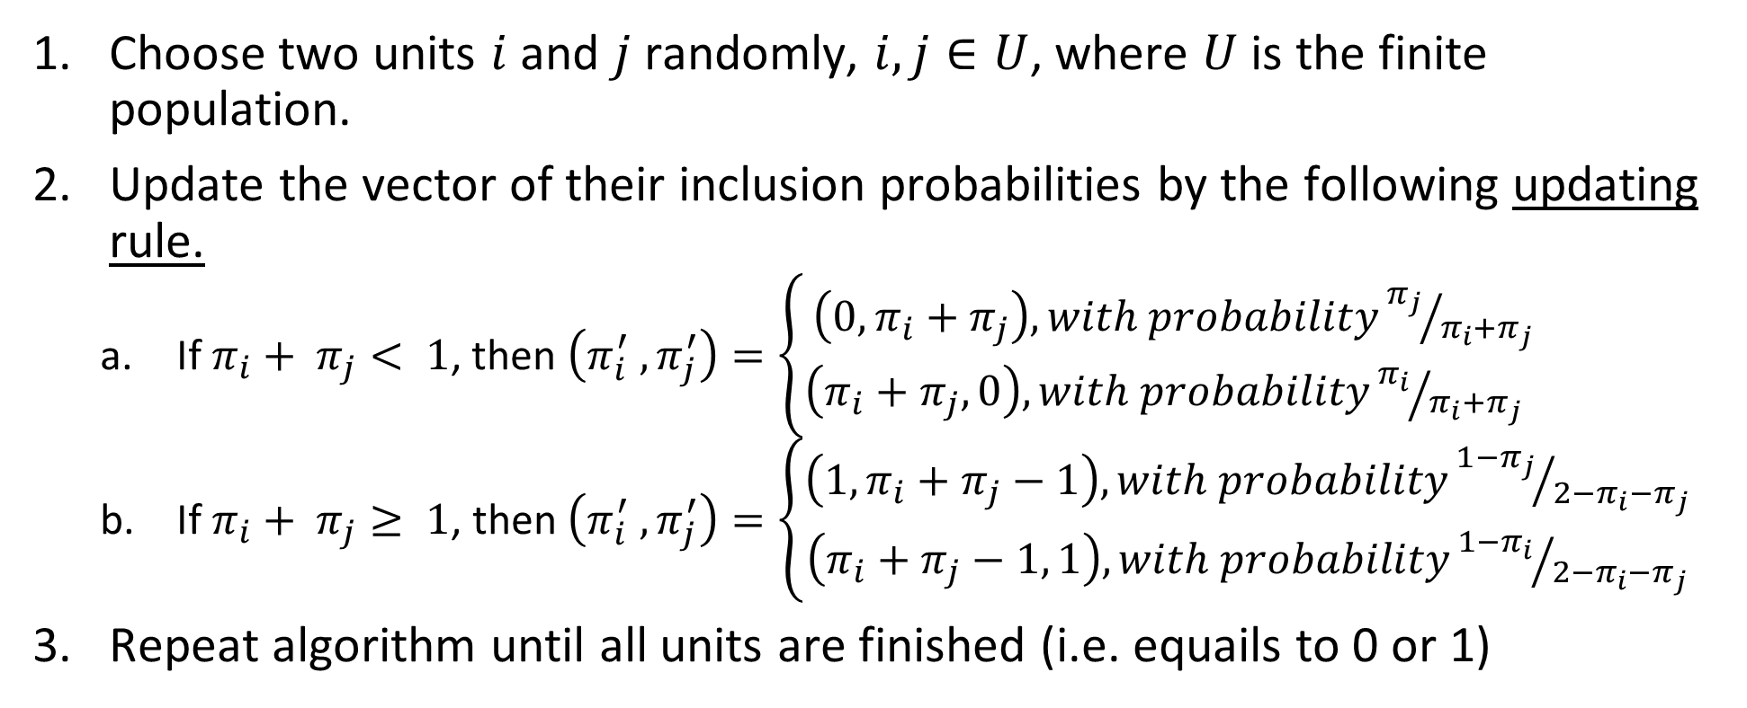
Algorithm 1. Pivotal Method
Choose two units $i$ and $j$ randomly, $i,j∈U$, where $U$ is the finite population.
Update the vector of their inclusion probabilities by the following updating rule.
$\text{If} π_{i}+ π_{j}< 1\text{, }\text{then} \left(π_{i}^{′} ,π_{j}^{′}\right)=\left\{\begin{aligned}\left(0,π_{i}+π_{j}\right), with probability{π_{j}}/{π_{i}+π_{j}} \\ \left(π_{i}+π_{j},0\right),with probability{π_{i}}/{π_{i}+π_{j}} \end{aligned}\right.$
If $π_{i}+ π_{j}≥ 1$, then $\left(π_{i}^{′} ,π_{j}^{′}\right)=\left\{\begin{aligned}\left(1, π_{i}+π_{j}−1\right), with probability{{1−π}_{j}}/{{2−π}_{i}−π_{j}} \\ \left(π_{i}+π_{j}−1, 1\right), with probability{{1−π}_{i}}/{{2−π}_{i}−π_{j}}\end{aligned}\right.$
Repeat algorithm until all units are finished (i.e. equails to 0 or 1)
Notes:
There is the algorithm how to commit the Pivotal Method.
First of all , randomly choose two units from finite population. Then update their inclusion probabilities by the following updating rule. This updating procedure is repeated with the updated inclusion probabilities until all units are finished.
Look into this updating rule

Slide 7
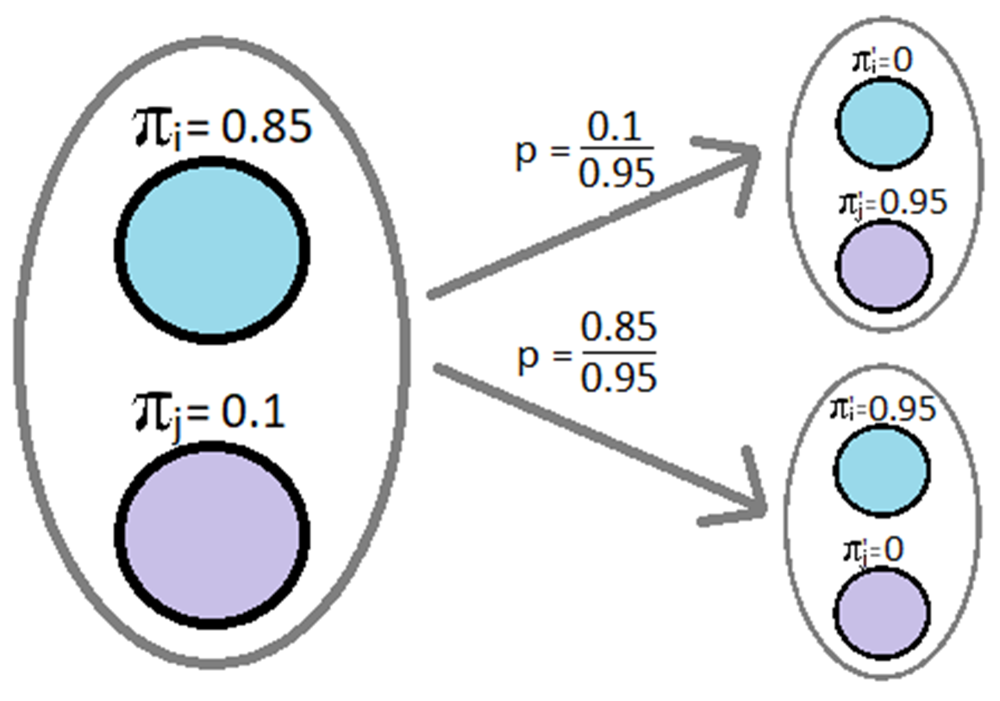

$$\text{If} π_{i}+ π_{j}< 1\text{, }\text{then} \left(π_{i}^{′} ,π_{j}^{′}\right)=\left\{\begin{aligned}\left(0,π_{i}+π_{j}\right), with probability{π_{j}}/{π_{i}+π_{j}} \\ \left(π_{i}+π_{j},0\right),with probability{π_{i}}/{π_{i}+π_{j}} \end{aligned}\right.$$
Notes:
If the sum of inclusion probabilities of two units is less than one, then the probability that the first unit’s inclusion probability becomes zero and the second is the value of their probabilities’ sum, is the inclusion probability of the second unit divided by the sum of both inclusion probabilities.
Similarly is calculated, the probability that the inclusion probability of the first unit will be the value of their sum and the second is zero. Here, the inclusion probability of the first unit is divided by the sum.

Slide 8
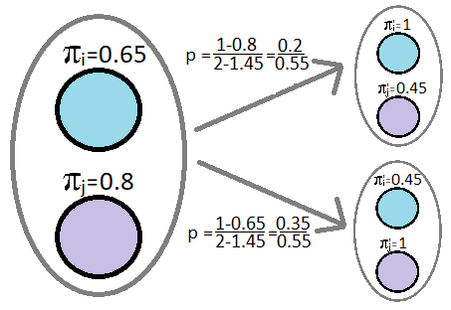
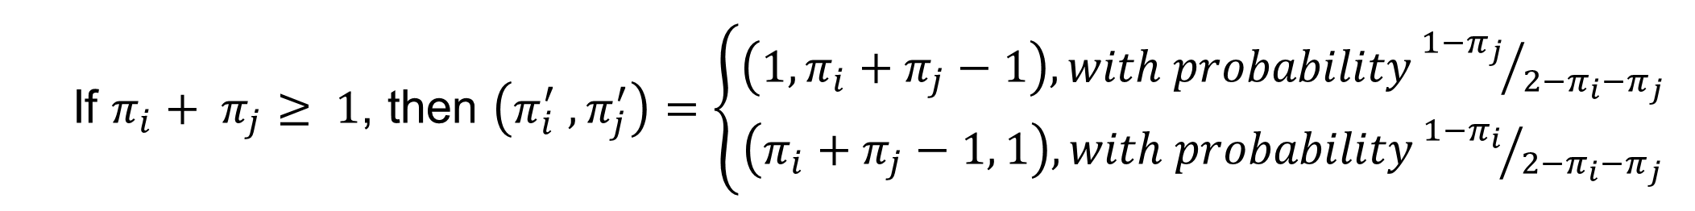
If $π_{i}+ π_{j}≥ 1$, then $\left(π_{i}^{′} ,π_{j}^{′}\right)=\left\{\begin{aligned}\left(1, π_{i}+π_{j}−1\right), with probability{{1−π}_{j}}/{{2−π}_{i}−π_{j}} \\ \left(π_{i}+π_{j}−1, 1\right), with probability{{1−π}_{i}}/{{2−π}_{i}−π_{j}}\end{aligned}\right.$
Notes:
If the sum of inclusion probabilities of two units is equal or greater than one, then the probability that the inclusion probability of the first units will be one and the other will be the sum of both inclusion probabilities minus 1 is 1 minus the inclusion probability of the second unit divided by 2 minus their sum.
Similarly is calculated, the probability, that the inclusion probability of the first units becomes the sum of the both values minus 1 and the second is one. Here the inclusion probability of the first unit is used (shown on the board)

Slide 9
The Local Pivotal Method
Was introduced in 2012 by Grafström, A., Lundström, N. L. P. & Schelin, L.
“Spatially balanced sampling through the pivotal method”
The special case of the Pivotal Method
Provides spatially balanced sampling
Inclusion probabilities are updated according the same rule
There is two different ways to choose two nearby units.
Notes:
The Local Pivotal Method was introduced in 2012 by Grafström, A., Lundström, N. L. P. & Schelin, L. in article “Spatially balanced sampling through the pivotal method” This is the special case of the Pivotal Method, which provide spatially balanced sampling by choosing two nearby units. Inclusion probabilities are updated according the same updating rule There is two different ways to choose two nearby units.

Slide 10
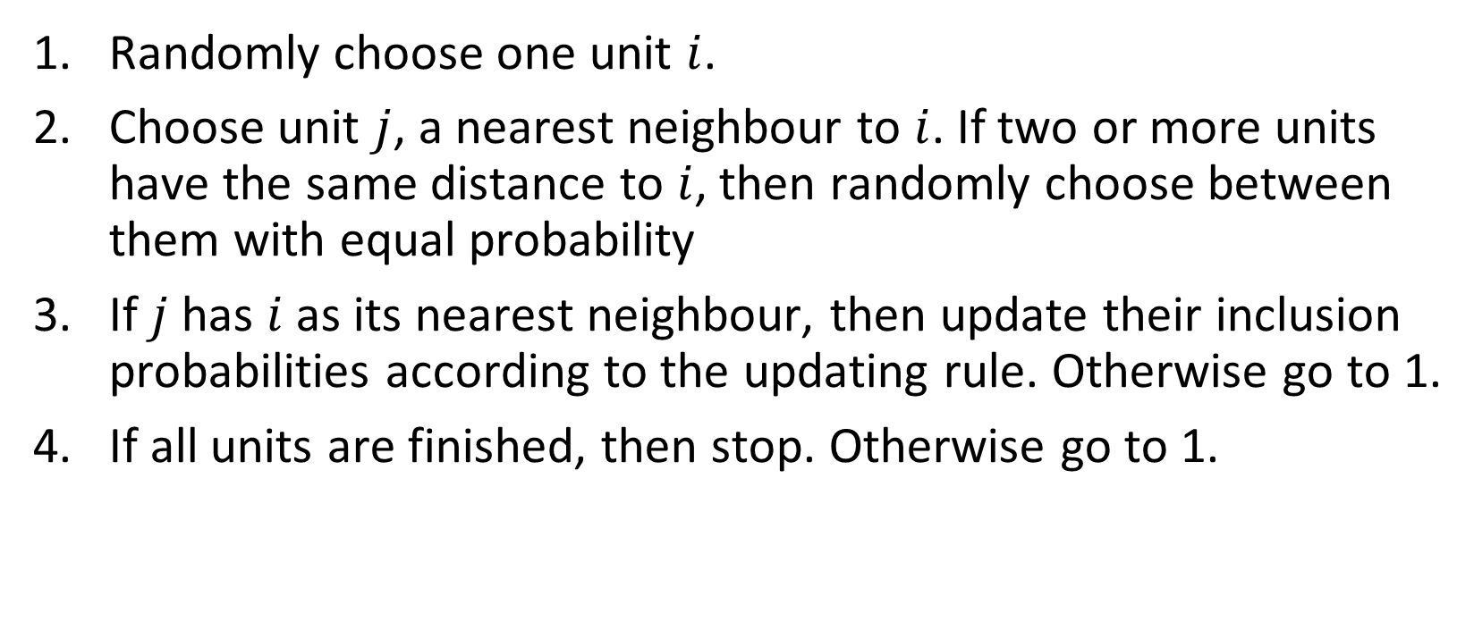
Algorithm 2: Local Pivotal Method I
Randomly choose one unit $i$.
Choose unit $j$, a nearest neighbour to $i$. If two or more units have the same distance to $i$, then randomly choose between them with equal probability
If $j$ has $i$ as its nearest neighbour, then update their inclusion probabilities according to the updating rule. Otherwise go to 1.
If all units are finished, then stop. Otherwise go to 1.
Notes:
The first-way is called the Local Pivotal Method I.
There is the algorithm how this method is committed
Randomly choose The first unit
Choose The second one to be a nearest neighbor tothe first. If two or more units have the same distance to the first, then randomly choose between them.
If the first unit is also the nearest neighbor to the second unit, then update the inclusion probabilities according to the updating rule. Otherwise repeat the algorithm from the beginning
Repeat this procedure until all units are ﬁnished

Slide 11
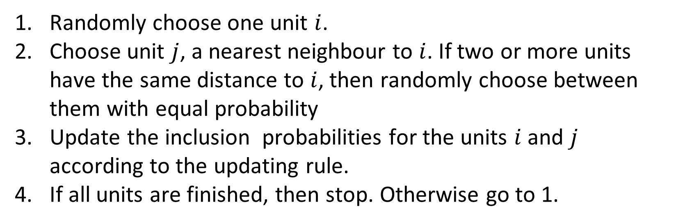
Algoritm 3:Local Pivotal Method II
Randomly choose one unit $i$.
Choose unit $j$, a nearest neighbour to $i$. If two or more units have the same distance to $i$, then randomly choose between them with equal probability
Update the inclusion probabilities for the units $i$ and $j$ according to the updating rule.
If all units are finished, then stop. Otherwise go to 1.
Notes:
We now look at a second-way algorithm, called the Local Pivotal Method II. This algorithm is almost the same as the previous algorithm, excepted the third point. Here, the first unit is chosen, its nearest neighbor is found, and then their inclusion probabilities are directly updated without checking the other distance . The process ends when all units are finished

Slide 12
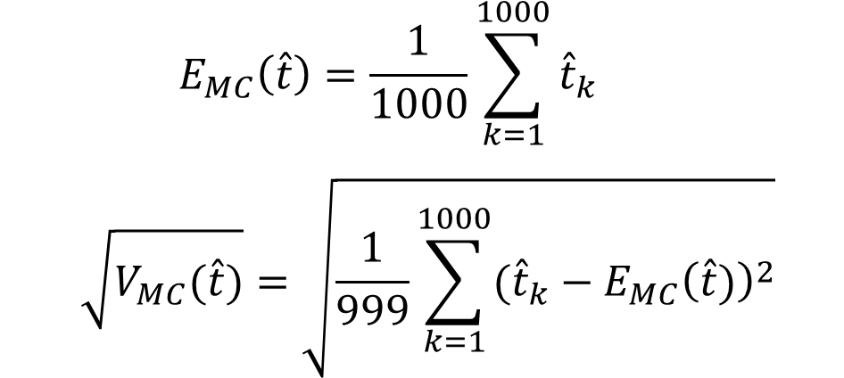
Simulation
$$E_{MC}\left(\hat{t}\right)=\frac{1}{1000}\sum_{k=1}^{1000}{{\hat{t}}_{k}}$$
$$\sqrt{V_{MC}(\hat{t})}=\sqrt{\frac{1}{999}\sum_{k=1}^{1000}{{({\hat{t}}_{k}−E_{MC}\left(\hat{t})\right)}^{2}}}$$
Monte-Carlo simulation
Estimation of total
Data is taken from StatVillage
Study variables
Continuous variable - household month income(moninch)
Discrete variable – household size(hhsize).
Auxiliary variables
Stratified Sampling - number of income recipients
Local Pivotal Method– the block and the house numbers from address of household and number of income recipients
Notes:
To compare Local Pivotal Method with other sampling methods was used the Monte-Carlo simulation.
For each sampling method, 1000 samples were drawn and 1000 estimations of total were found. Then Monte-Carlo mean and Monte-Carlo standard error was calculated by following equation.
Data was taken from a hypothetical village in Canada, named StatVillage. The data of StatVillage is real, because was taken from the 1991 census of Canada.
Simulations was done for two study variables: continuous variable household month income (moninch) , and discrete variable household size (hhsize).
The block and the house numbers from address of household and number of income recipients were taken as the auxiliary information.

Slide 13
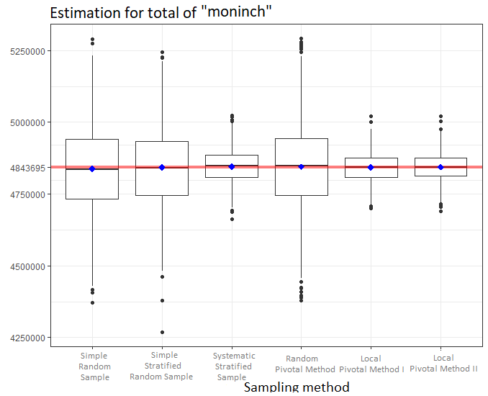
Accuracy of continuous variable estimate
Sampling Method | Monte-Carlo standard error
Simple Random Sampling | 152 718.57
Stratified Random Sampling | 139 327.05
Systematic stratified sampling | 58 380.02
Random Pivotal Method | 156 132.98
Local Pivotal Method I | 50 190.02
Local Pivotal Method II | 49 183.08
Notes:
Let's first look at the simulation results for the continuous variable.
Based on the table, the most accurate estimates are gotten from the systematic stratified sampling and both local pivotal methods. Where is small difference in standard errors between both local pivotal methods.
In the figure, it can be seen that, in the case of a local pivotal method II, the difference between the upper and lower quartile of the estimates is the smallest.

Slide 14
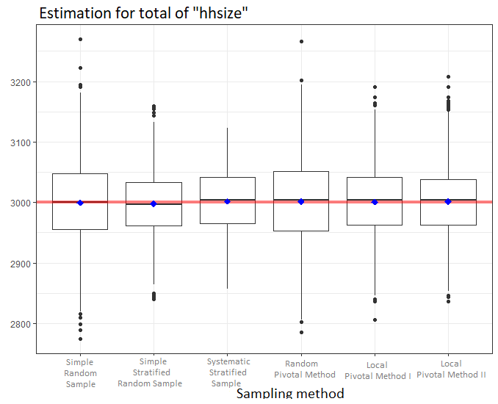
Accuracy of discrete variable estimate
Sampling Method | Monte-Carlo standard error
Simple Random Sampling | 73.22
Stratified Random Sampling | 54.13
Systematic stratified sampling | 51.15
Random Pivotal Method | 71.17
Local Pivotal Method I | 60.19
Local Pivotal Method II | 58.42
Notes:
Here is the simulation results for the discrete variable.
Based on the table, the most accurate estimate for standard error is derived from a systematic stratified sampling. Both local pivotal methods did not give the best or worst estimate, but the local pivotal method II is a bit more accurate than the local pivotal I.
In addition, the figure shows that there is no exceptions in the systematic stratified sampling. At the same time, the difference between the upper and lower quartile is less in the case of a Stratified Random Sampling.
Diskreetse tunnuse korral ei andnud lokaalsed pöördemeetodid parimat ega halvimat hinnangut.
Kõige täpsem hinnang on saadud süstemaatilise kihtvaliku abil.
Joonisel on lisaks näha, et süstemaatilise kihtvaliku korral ei ole ühtegi erindit.
Samal ajal lihtsa juhusliku kihtvaliku korral ülemise ja alumise kvartiili vahe on väiksem.

Slide 15
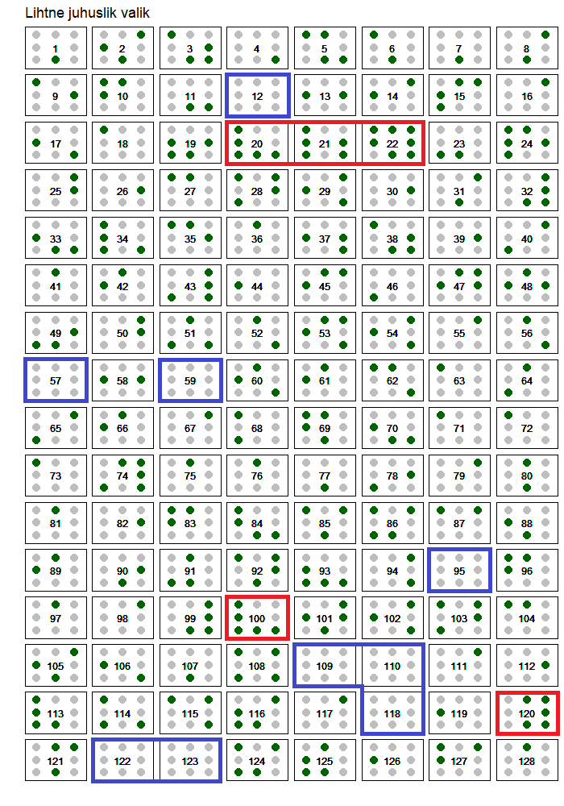
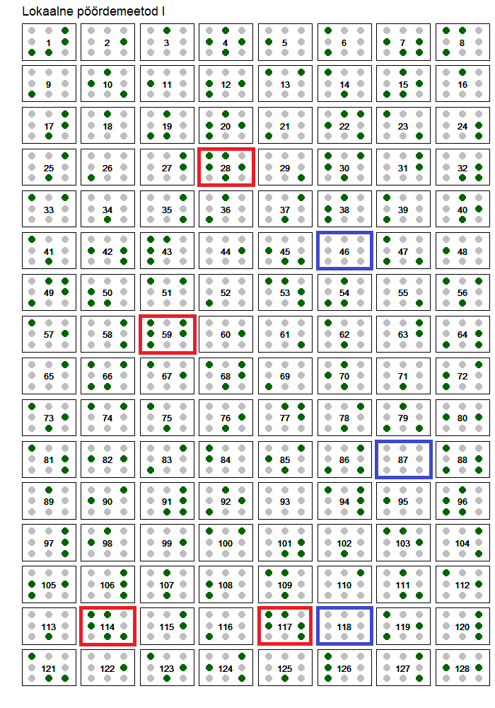
Visualisation of samples
Notes:
On this slide, the StatVillage village is shown. The green points are the houses that were included in the sample using simple random sampling and local pivotal method I.
Every square is the block of 8 houses.
With blue are marked these blocks, in which none of houses were chosen
With red are marked these blocks, in which more than 4 houses were chosen
It is seen that, in the case of a simple random sampling, there are more marked blocks and they are placed closer to each other than in the case of local pivotal method II. This shows that the local pivotal method I is more balanced than the simple random sampling.

Slide 16
Conclusion
In the case of a continuous variable, both local pivotal methods provide more accurate estimates, and in this case, it is recommended to use local pivotal method II because it is more accurate and faster in execution.
In the case of a discrete variable, each of the local pivotal methods did not provide any better estimates, and in this case, it is advisable to use a systematic stratiﬁed selection.
Notes:
To sum up, in the case of a continuous variable, both local pivotal methods provide more accurate estimates, and in this case, it is recommended to use local pivotal method II because it is more accurate and faster in execution. In the case of a discrete variable, each of the local pivotal methods did not provide any better estimates, and in this case, it is advisable to use a systematic stratified selection.

Slide 17
Thank you!
Notes:
That's where my presentation ends. Thank you for attention! I will be happy to answer all your questions

