Slide 1
Combining data from registers, surveys and 2011 Population and Housing Census to prepare database for 2021 register-based Population and Housing Census in Latvia
Peteris Vegis, Senior Methodology Expert, Social Statistics Methodology Section,
Social Statistics Department, CSB of Latvia
Jelgava, Latvia, 21 -24 August, 2018 BNU Seminar

Slide 2
Plan of the presentation
Introduction
Economically active population:
2.1. Occupation of employed persons
2.2. Branch of economic activity of employed persons
2.3. Unemployed persons
Educational attainment
Population estimates
Households and family nucleus
Conclusions
Jelgava, Latvia, 21 -24 August, 2018
BNU Seminar
Notes:
I will give a short introduction as document is available and than will concentrate on main problems that are recognized during the feasibility studies as regards economically active population, educational attainment, population estimates, households and family nucleus.

Slide 3
Introduction
2000 Census – the first Combined Census
2011 Census – Combined Census with wider use of administrative data
2021 Census – the first register based Census
Feasibility studies:
Economic characteristics of population(started in 2015)
Educational attainment (started in 2016)
Housing and household characteristics (started in 2017)
Other activities:
Population estimates (started in 2012)
Social Statistics Data Warehouse (SSDW, started in 2015)
Family nucleus (started in 2016)
Jelgava, Latvia, 21 -24 August, 2018
BNU Seminar

Slide 4
Occupation of employed persons
• State Revenue Service (SRS) covers 83% of all employed persons and data not available for:
persons working in micro - enterprises
persons employed only on the basis of
a work performance contract
self-employed persons
Compliance rate of occupation codes in SRS and Labour Force Survey (LFS) at the two-digit level is 61.5% and at the one-digit level – 68.9%
Jelgava, Latvia, 21 -24 August, 2018
BNU Seminar
Notes:
SRS collects data about occupation since 2014
SRS information of employees corresponds with the ILO methodology and covers 83% of all employed persons.
• Data not available for:
• persons working in micro-enterprises
• persons employed only on the basis of a work-performance contract
• self-employed persons
Compliance rate of occupation codes in SRS and LFS at the two-digit level is 61.5% and at the one-digit level – 68.9% (valued as satisfactory)

Slide 5
Occupation compliance in administrative data and LFS
  Occupations with the highest compliance between LFS and SRS were: dentists; physiotherapists; customs and border inspectors; locomotive engine drivers; bus and tram drivers; general medical practitioners etc.
  Occupations with the lowest compliance between LFS and SRS were: manufacturing supervisors; Web technicians; production clerks; handicraft workers not elsewhere classified; mixed crop growers etc.
  Occupations, where more precise information available in the SRS: police officers, accountants, teachers etc.
Jelgava, Latvia, 21 -24 August, 2018
BNU Seminar
Notes:
Some data available from regular statistical surveys:
LFS
EU-SILC
EHIS
Gathering data on occupation from institutions in 2017:
Health Inspectorate (on medical practitioners)
Notary Council
Lawyer Council
Bailiffs Council
State Building Control Bureau
2020 Agriculture Census (possible adding of extra questions)

Slide 6
Industry / branch of economic activity (NACE)
  The compliance rate between LFS and administrative data (on level of sections) accounted for 72.8%;
  The lowest compliance rate – 45% – was observed in Section N (Administrative and support service activities), followed by Section O (Public administration and defence; compulsory social security) – 45.9%.
Jelgava, Latvia, 21 -24 August, 2018
BNU Seminar
Notes:
The NACE Section code was available from SBR (Statistical Business Register) or SRS (State Revenue Service) data for 99.4 % of employees that had the occupation code;
The compliance rate between LFS and administrative data (on level of sections) accounted for 72.8% that is satisfactory;
The highest level of compliance was observed in Section Q (Human health and social work activities) – 93.5 %, in Section K (Financial and insurance activities) – 91.9%;
The lowest compliance rate – 45.0 % – was observed in Section N (Administrative and support service activities), followed by Section O (Public administration and defence; compulsory social security) – 45.9 %.
NACE code 8411 (general public administration activities) should be studied more in detail.
Methodology for imputation of missing values is worked out.

Slide 7
Industry / branch of economic activity (NACE)
  NACE code 8411 (Section O)
  (general public administration activities)
  the most problematic
  includes local government institutions/ enterprises
  code is also applied to the municipal education, culture etc. institutions,
  no information in SBR about NACE code of local unit,
  all employees are assigned with NACE code 8411, resulting in significant increase in this group.
Jelgava, Latvia, 21 -24 August, 2018
BNU Seminar
Notes:
NACE code 8411 (general public administration activities) should be studied more in detail.

Slide 8
Industry / branch of economic activity (NACE)
On January 1st 2017 the NACE code wasn’t detected for 12.1 thousands employees or 1.1% (on January 1st 2015 – 5.9%) of employed persons
Problems and solutions:
  NACE for persons employed in local government institutions/ enterprises
    use of SES survey – all local governmental institutions/ enterprises will be surveyed in 2019
  Agriculture
    data from Agricultural Census 2020 could be used
  «Shadow economy»
Jelgava, Latvia, 21 -24 August, 2018
BNU Seminar
Notes:
SES - Structural Earnings Survey

Slide 9
Unemployment status
Only persons registered in the State Employment Agency (SEA) are included in the SSDW
LFS includes unregistered unemployment - SEA data on 1st of January 2017 was by 15.8 thsd or 17.4% less than in the LFS estimate
Part of the persons registered with the SEA as unemployed / job seeker in LFS were employed (4% of respondents) or inactive (23%)
Possible solutions:
using SEA and State Social Insurance Agency (SSIA) data for previous year on unemployed (Estonian experience);
data imputation
Jelgava, Latvia, 21 -24 August, 2018
BNU Seminar
Notes:
Possible solution taking into account Estonian experience – checking unemployment data for one year and adding persons who did not work

Slide 10
Educational attainment
Only 1.4% of all population aged 15 and over have no information about the educational attainment
Information from 2011 Census and administrative data sources is used to update or determine the level of education
Lack of Higher Education Register up to 2017
Partly lack of information about education obtained abroad
ISCED 2011 has more detailed classification of higher education as ISCED 1997 (used in Census 2011)
Possible solutions:
For unknown and for ‘higher’ level of education (level 5 according to the ISCED 1997) - imputation based on occupation, age and other criteria
Jelgava, Latvia, 21 -24 August, 2018
BNU Seminar
Notes:
Data sources:
Ministry of Science and Education – school children
Higher Education Establishments (on base of bilateral agreements)
Ministry of Finance
Specific professions’ associations – sailors, medical personal etc.
Statistical sample surveys
Doctoral level is not imputed.

Slide 11
Population estimates
Difference between 2011 Census and Population Register – 7%
Reason - unregistered migration – according to the Population Register, usual residence of person (de jure) – Latvia, however, according to the Census data (de facto) – outside Latvia
In 2012 the CSB worked out a new method for estimating the number of population.
The method is based on:
    The Population Register,
    Other administrative register data.
Jelgava, Latvia, 21 -24 August, 2018
BNU Seminar

Slide 12
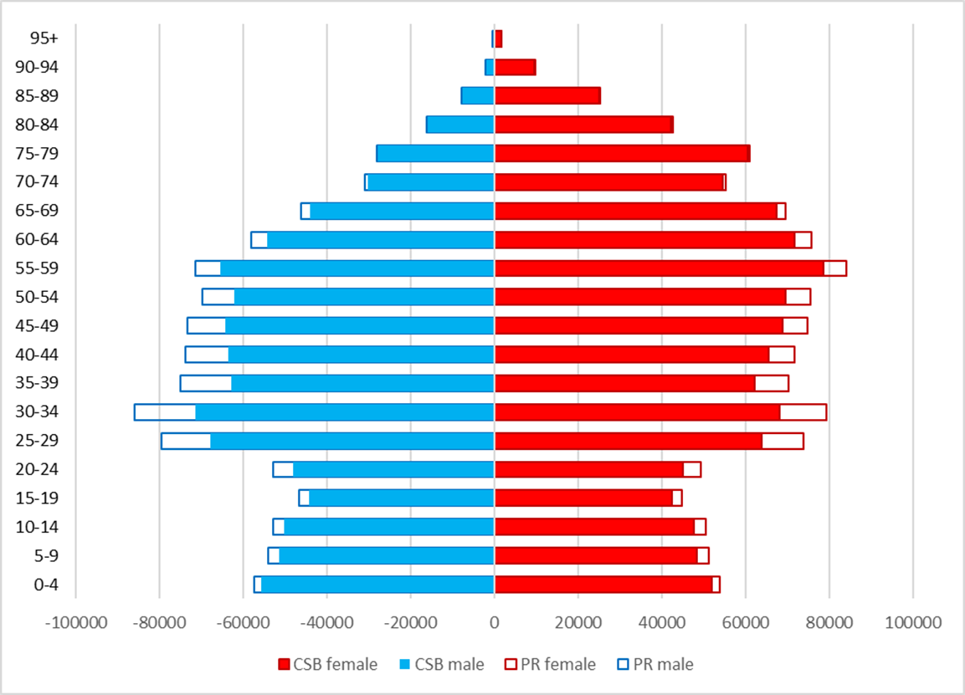
The number of population at the beginning of 2018
(Comparison of the Population Register (PR) and CSB estimation)
Jelgava, Latvia, 21 -24 August, 2018
BNU Seminar
Notes:
Difference – 169 thsd (8%)
The biggest difference in age groups 25-29 (21.7 thsd.) and 30-34 (25.7 thsd).

Slide 13
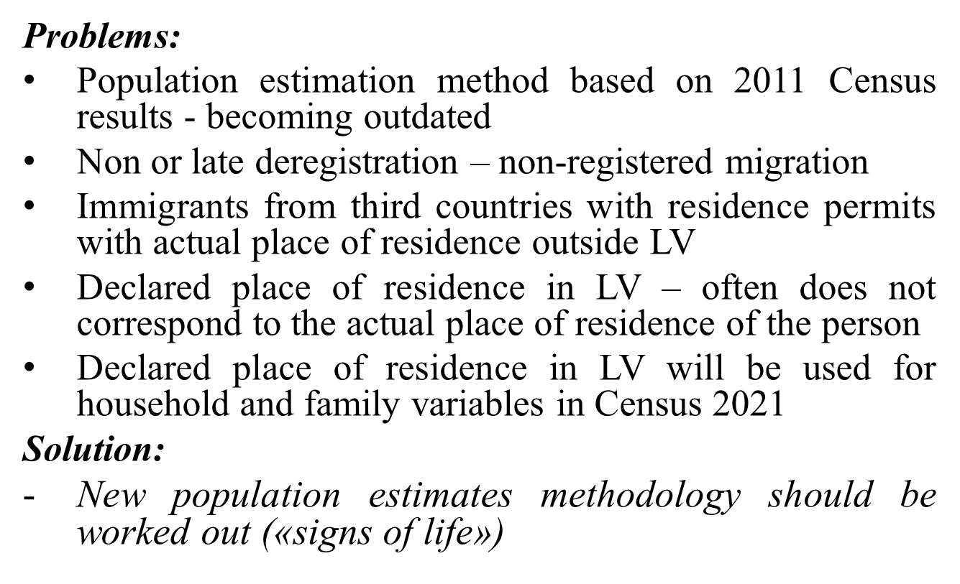
Population estimates
Jelgava, Latvia, 21 -24 August, 2018
BNU Seminar

Slide 14
Households and family nucleus
Households:
As mentioned before – declared place of residence will be used in Census 2021
Household concept changed from housekeeping concept to household – dwelling concept
Problems and solutions:
Children below 16 declared in dwelling without adults
  Child's address is changed to the parent's address
Very big private households (workers with residence permits)
  Evaluation; exclusion from the list of private households (probably also from number of usual residents)
Jelgava, Latvia, 21 -24 August, 2018
BNU Seminar

Slide 15
Households and family nucleus
Family nucleus:
As mentioned before – declared place of residence will be used in Census 2021
More two or more family nucleus in one household (address)
Problems and solutions:
In comparison with 2011 Census more lone parents, especially lone fathers (due to the use of declared address)
  Evaluation of information on mother; father’s and children’s address is changed to the mother’s address
Problems to count cohabiting couples
  The use of additional information for declared persons at the address
Jelgava, Latvia, 21 -24 August, 2018
BNU Seminar

Slide 16
Conclusions
«Shadow economy" should be explored more
On the basis of administrative data and the agricultural census data for 2020, further studies are needed on employment in agriculture
Identifying new data sources, analysing their quality and monitoring changes to existing legislation is very important
New population estimates methodology should be worked out based on «signs of life»
Work on imputation methodology for occupation, branch of economic activity and educational attainment will be continued
Jelgava, Latvia, 21 -24 August, 2018
BNU Seminar
Notes:
Population estimation methodology for and beyond 2021 will be explained by my colleague Mārtiņš Liberts and calibration of register based census data by Elvijs Siliņš.

Slide 17
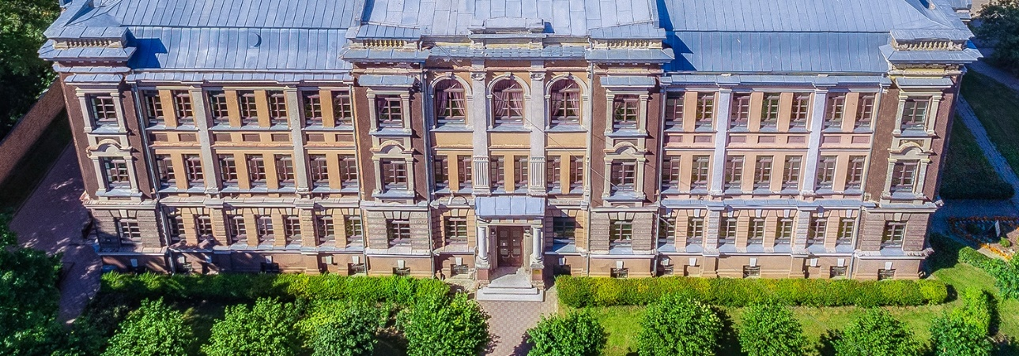
Thank you for your attention!
Jelgava, Latvia, 21 -24 August, 2018 BNU Seminar

