Slide 1
Using Mobile Positioning for Improving the Quality of Register Data
Kaja Sõstra, PhD
Leading analyst
Statistics Estonia
Workshop of the Baltic-Nordic-Ukrainian Network
on Survey Statistics 2018
20-24.08.2018

Slide 2
Content
Problem with difference of registered and actual place of residence
Organisation of pilot study
Anchor point model
Validation of register addresses

Slide 3
First register based Population and Housing Census in Estonia in 2021
All mandatory census topics are covered in registers
Register data can be linked using personal ID, address ID and enterprise ID
One of the biggest challenges is the difference between registered and actual places of residence

Slide 4
Place of residence in Population Register
Everybody is obliged to register their right address to PR by the law
Due to different reasons people don’t always do that
20–25% of all permanent residents of Estonia at a different address than registered in PR
people do not consider registration necessary (historical reason)
different benefits (school places, free public transport, land tax, wish to support another local government)

Slide 5
Pilot study of mobile positioning data
Objective: test the feasibility of specifying actual place of residence with the help of mobile positioning data
Study was conducted in cooperation with the University of Tartu and Positium LBS
Positium LBS requested data from mobile operators and calculated and analysed the anchor points
SE analysed register data with the help of the calculated anchor points

Slide 6
Steps of pilot study
SE asked volunteers to participate in the pilot
Set of potential addresses was created for each participant based on registers
The anchor points of the place of residence were estimated based on the mobile positioning data
Anchor points and other auxiliary information was used to validate place of residence from the set of addresses.

Slide 7
Participants
SE asked volunteers to participate in the project
Employees of Statistics Estonia
Employees of other institutions
All people of Estonia
Participants filled in written consent (digitally signed) to use their mobile positioning data.
In addition the actual place of residence of volunteers was collected to compare positioning data with actual address

Slide 8
Response
Division of participants by mobile operator:
Telia – 158
Elisa – 103
Tele 2 – 53
Telia and Elisa data have been used in the analysis of anchor points. In total, 261 phone numbers and 257 persons
Anchor points were calculated for 243 phone numbers (93%) and 240 persons

Slide 9
Types of anchor points
Home anchor – average starting time of daily calls is after 17:00 and standard deviation of beginning time of calls is greater than 0.175
Working time anchor – average starting time of daily calls is before 17:00 and standard deviation is less than 0.175
Work-home anchor – anchor point in which the home and work-time anchor points are located in the same network cell and cannot be separately identified.

Slide 10
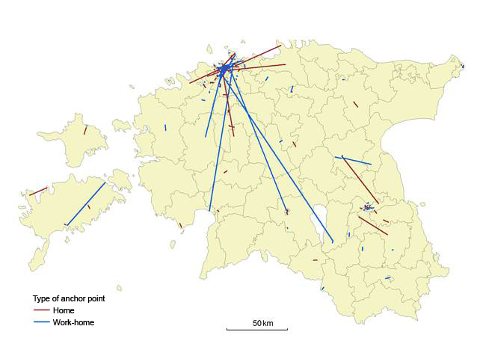
Actual place of residence, home and work-home anchor points

Slide 11
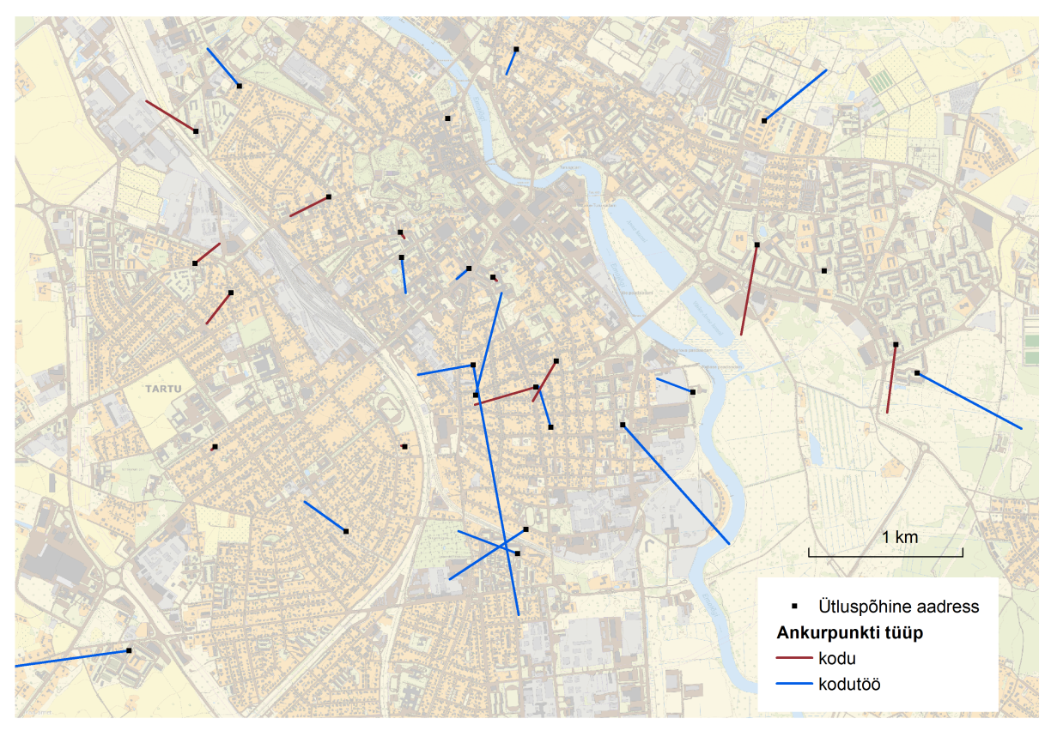


Actual place of residence, home and work-home anchor points

Slide 12
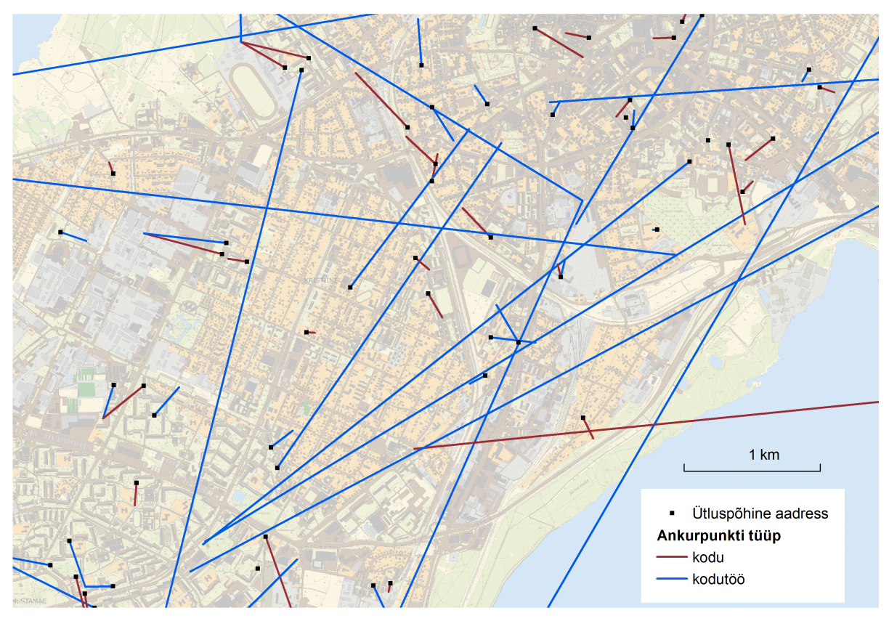
Actual place of residence, home and work-home anchor points

Slide 13
Number of anchor points
Anchor point | Number of anchor points | Number of mobile numbers | Share, %
Home | 126 | 126 | 51,9
Work-home | 116 | 116 | 47,7
Home or work-home | 242 | 242 | 99,6
Second home | 199 | 136 | 56,0
Work | 251 | 194 | 79,8
Other | 6110 | 241 | 99,2

Slide 14
Anchor points and actual address
82% of participants have their actual place of residence in the polygon of their home or home-work anchor point
91% of persons have their actual place of residence in the polygon of their home, home-work or second home anchor point
Actual place of residence and anchor point
in the same county – 97 %
In the same municipality – 87%
In the same settlement – 67%

Slide 15
Validation of PR address using mobile data
Validation if polygon of anchor point (home, work-home or second home) includes coordinates of PR address
Decision
PR address is actual address if any polygon includes coordinates of PR address
PR address is not actual address if PR address is outside of all polygons

Slide 16
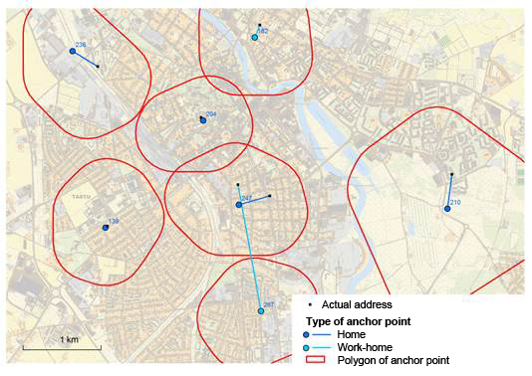
Polygons of anchor points in the city

Slide 17
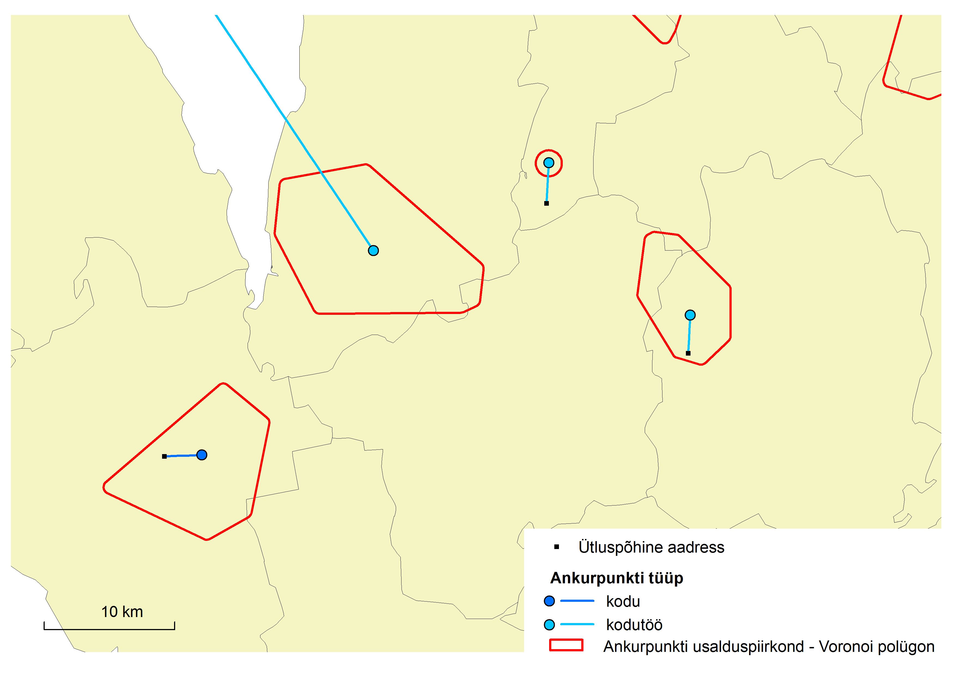

Polygons of anchor points in rural areas

Slide 18
Results of validation of PR address
 |  | Decision made using mobile positioning data (home, home-work and second home anchor points)
 |  | PR = Actual | PR ≠ Actual | Total
Coincidence of actual place of residnece with PR address | PR = Actual | 146 | 15 | 161
 | PR ≠ Actual | 16 | 63 | 79
 | Total | 162 | 78 | 240
Right decision 146 + 63 = 209 (87%) cases

Slide 19
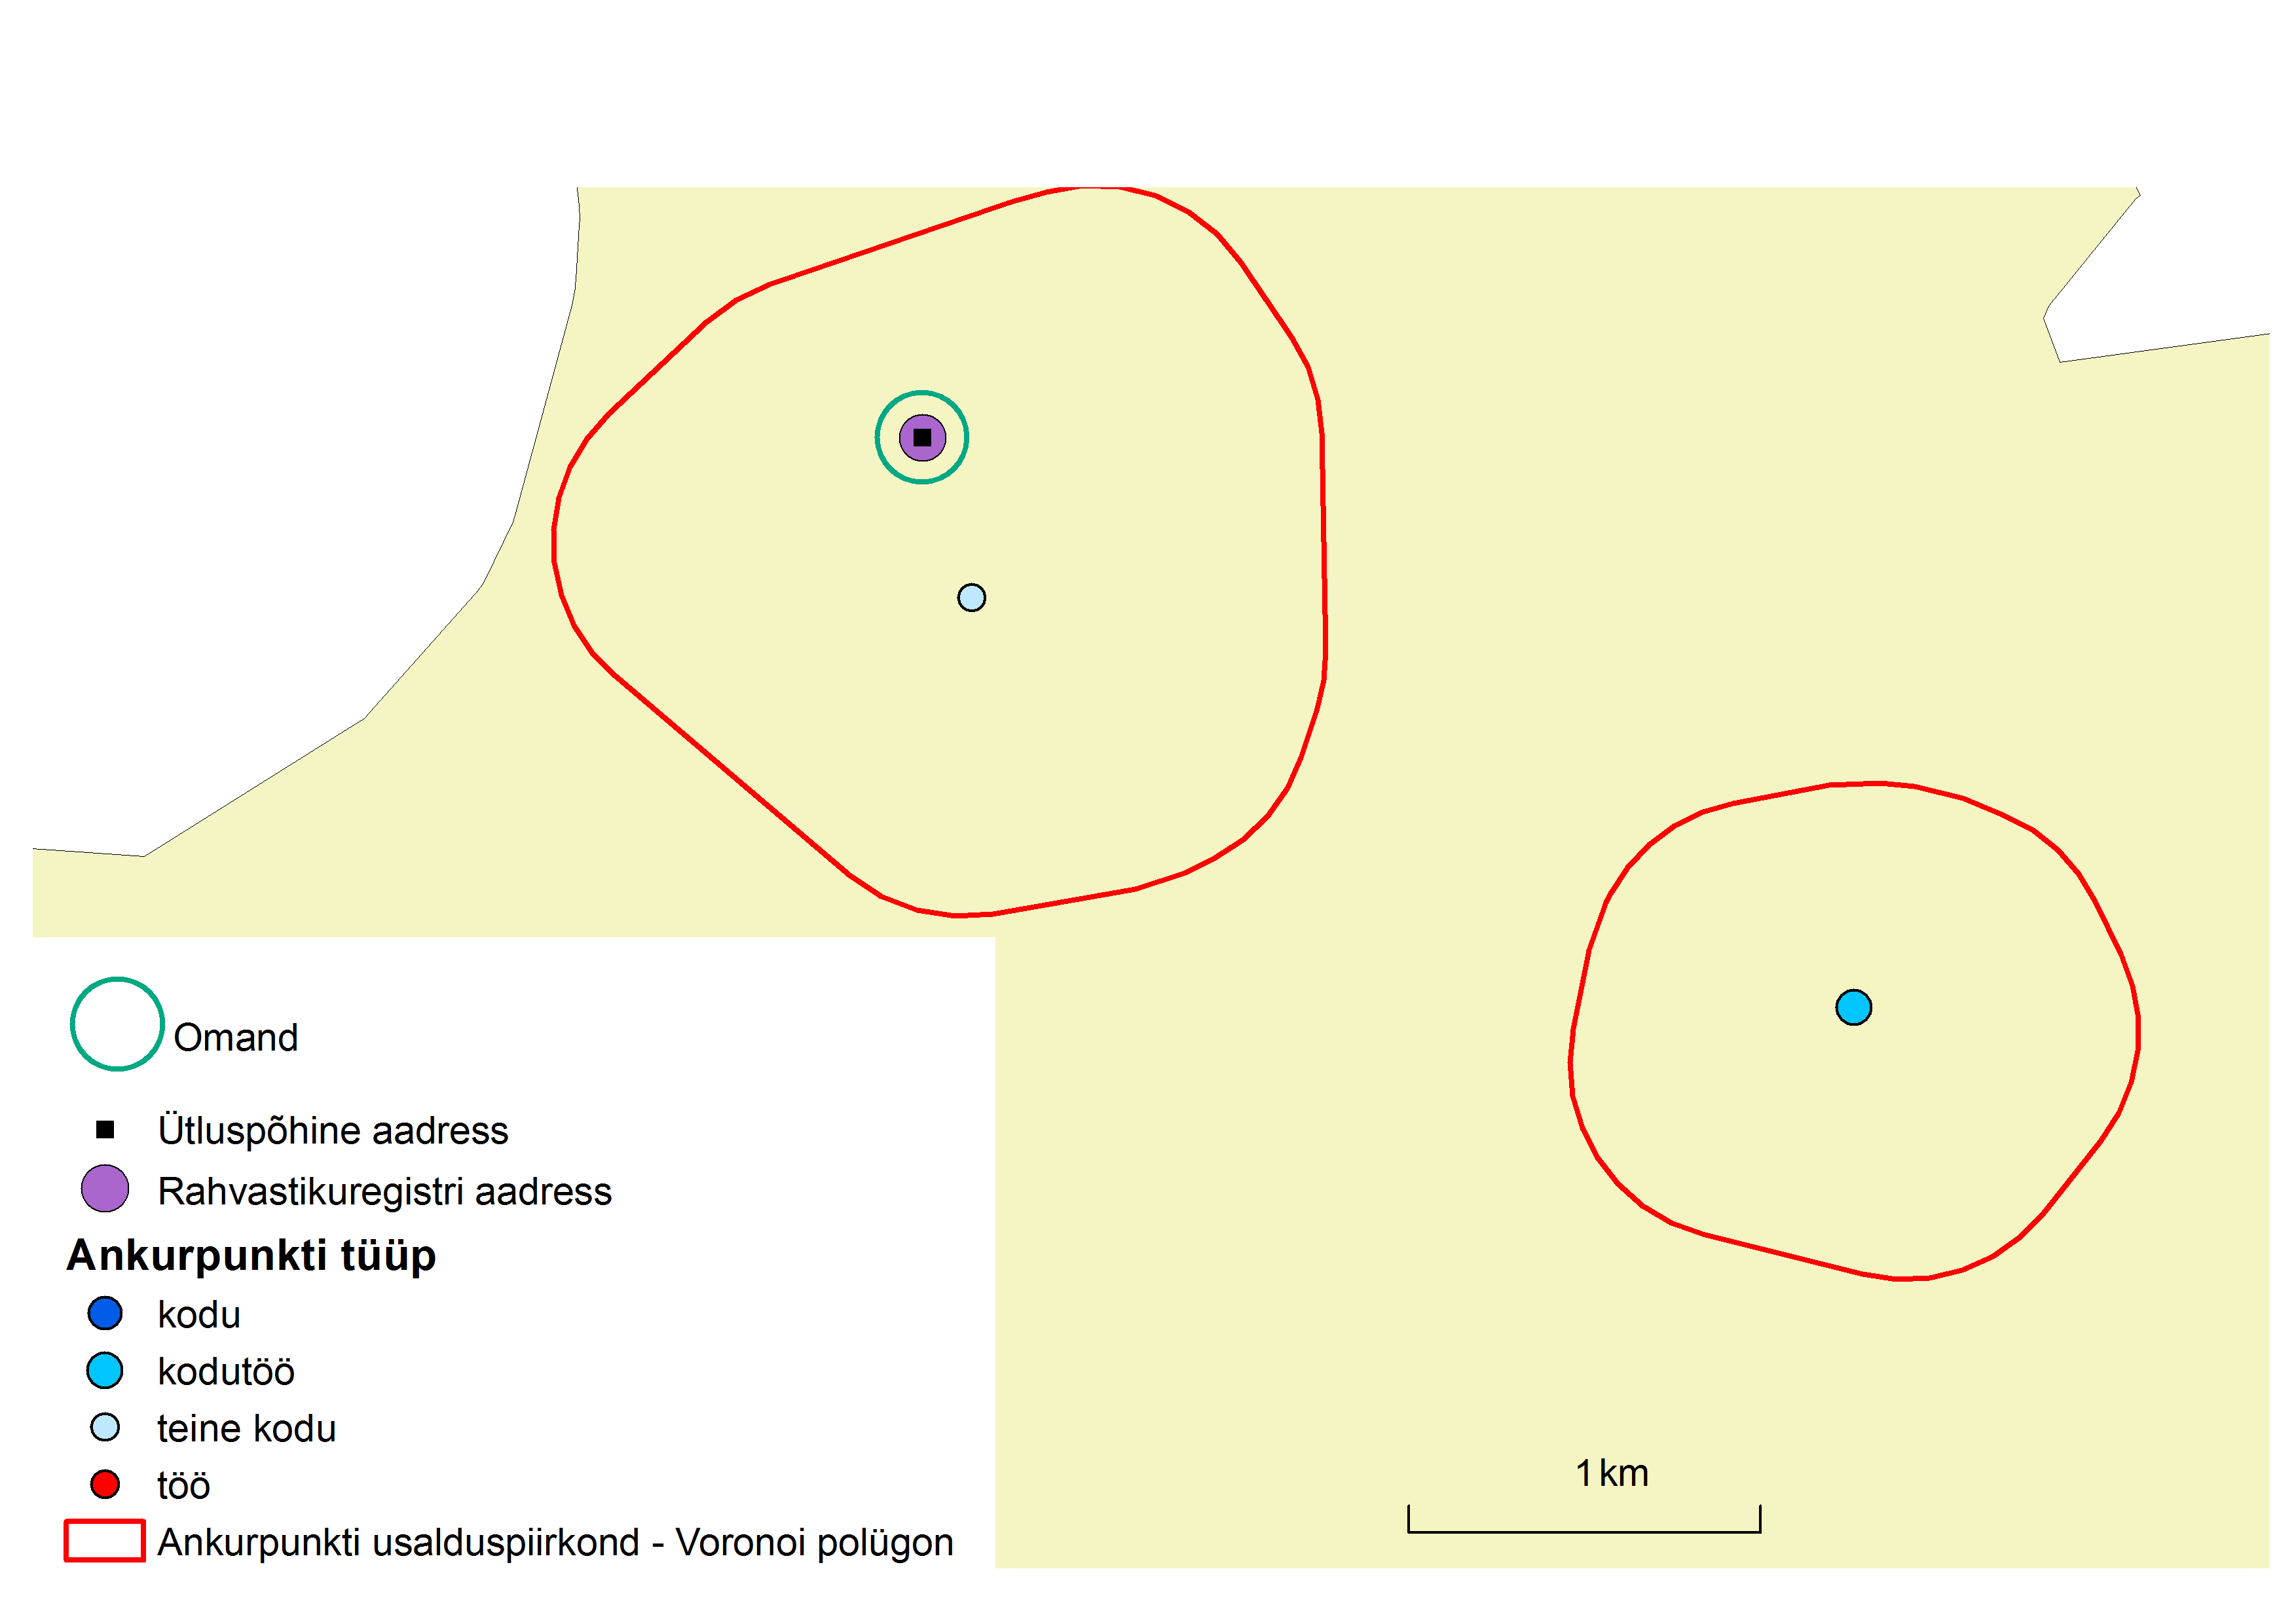
Example

Slide 20
Other addresses from registers
The following addresses were linked from registers to the participant in the study:
PR address of spouse
Addresses of registered real estate of participant in the land register
Addresses of registered real estate of spouse in the land register
Those addresses were most likely to coincide with the actual place of residence
Decision – if the polygon of some anchor point includes an additional address, it is considered the person’s actual address

Slide 21
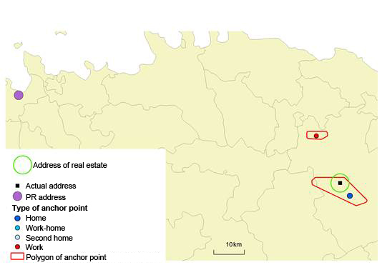
Anchor points and addresses from registers

Slide 22
Conclusions
One of the biggest challenges on the way to register based census in Estonia is the difference between registered and actual places of residence
Feasibility study showed that mobile positioning data is useful for validation of the quality of registered addresses

Slide 23


