Slide 1

Could You beat The Devil?
Devil Game!!
By: Samuel Djiani

Slide 2

D ESCRIPTION
If the user clicks on the devil’s image the user will lose, however matching all the cards will take the user to the next level.
Which means more devil cards to remember with more cards!!
In case the user doesn’t pass level n, the devil’s image will shuffle at random and will appear anywhere he wants!!
You have only 5 seconds to remember where Devil’s images are!
I can appear anywhere I want!
There is only one rule in the Game:
Don’t Deal with the Devil
Remembered!

Slide 3
Project Structure
BeatTheDevil
index.html
css
js
HTML5 , CSS, Javascript
Animate.css
Typedjs
Giphy api
speech Synthesis interface of Web speech api
Technology
style.css
index.js
images
sounds
RESPONSIBLE WEB APPS

Slide 4
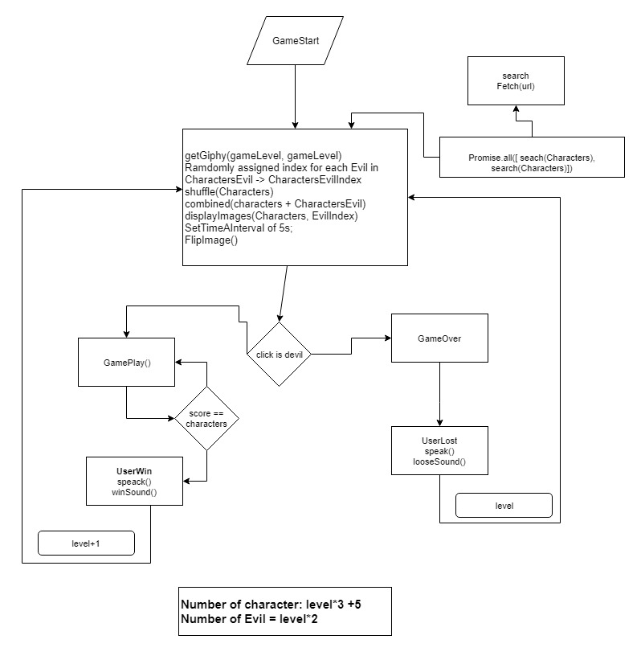
Game Logic!!
Game Options
Background
Characters choice
Voices choices
Play with a timer
More projects

Slide 5
Game Demo
https://djiani.github.io/BeatTheDevil/

Slide 6
Icebox
Play against the time(coming soon…)
Login user to keep track of level and score
Implement more strategy(timer, …)
Ask for help(score might be affected)
…

