Slide 1
Your First Decentralized Web App
What is a decentralized web app?
An application that runs on a P2P network of computers. Unlike centralized applications, there is no single authority or set of servers responsible for running application logic.
Censorship resistant (no Napster kill switch)
Fault Tolerant
Open source and transparent

Slide 2
Ethereum Blockchain
Created by Vitalik Buterin, went live in July 2015
A decentralized open source platform based on blockchain technology that enables developers to build and deploy decentralized applications.
A Turing-complete scripting language providing trustless smart contracts. Smart contracts function as “cryptographic ‘boxes’ that contain value and only unlock it if certain conditions are met”

Slide 3
Our DApp Toolbox
Truffle – “Sweet tools for smart contracts”
npm install –g truffle
Metamask – Browser extension for interacting with Ethereum apps
https://metamask.io/
Web3 – Ethereum JavaScript API
npm install web3
Angular – Front-end JavaScript framework
npm install –g @angular/cli
Notes:
cd vob
truffle init
ng new web

Slide 4
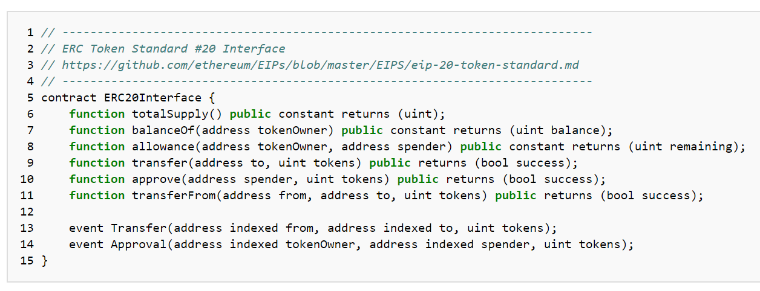
Create a New Smart Contract
truffle init
ERC20 Token Standard - https://theethereum.wiki/w/index.php/ERC20_Token_Standard
OpenZepplin – open source library of secure smart contracts
npm install –E openzepplin-solidity
Notes:
mkdir blockchain
cd blockchain
truffle init
ERC20 - common interface defining basing rules of ownership and coin transfer

Slide 5
Test Contract
Write tests to ensure contract does EXACTLY what it is supposed to and ONLY what it is supposed to
Compile Contract
truffle compile
Launch Development Console
truffle develop
truffle migrate --reset
Run Tests
truffle test
Notes:
cd vob
truffle init
ng new web

Slide 6
Deploy Contract
Infura – Your Access to the Ethereum Network
https://infura.io/
Setup Truffle Deployment Config
npm install --save-dev truffle-hdwallet-provider
truffle migrate --network ropsten
Notes:
cd vob
truffle init
ng new web

Slide 7
Create and Launch Web App
Angular CLI – create new web project
ng new vob-web
Launch web app
ng serve
Notes:
cd vob
truffle init
ng new web

Slide 8
https://github.com/djimoh5/vob-dapp
Notes:
This would conclude our presentation. We are happy to set up a one-on-one meetings with you where we can answer any specific questions, share the financials and term sheet.

