Slide 1
Viva Deck: Query-Time Use of chunks.parquet and chunk_meta.parquet
RAG Pipeline

Slide 2
One Question
How does a query become a cited answer?
FAISS row -> chunk_meta -> chunk_id -> chunks text -> LLM answer

Slide 3
Slide 2: The Two Files
chunk_meta.parquet
Retrieval-facing metadata
Row-aligned to FAISS index
Gives: chunk_id_global, pages
chunks.parquet
Full content store
Gives: chunk_text
Also keeps richer metadata for analysis/debug
Connection key
chunk_id_global (fallback: chunk_id)

Slide 4
Slide 3: Query-Time Pipeline
User query is embedded.
FAISS returns top row IDs.
Row IDs select entries in chunk_meta.parquet.
Meta provides chunk IDs + page grounding.
IDs retrieve full text from chunks.parquet.
LLM generates answer with citations.

Slide 5
Slide 4: Concrete Example
Example
FAISS hit row: 44
chunk_meta row 44:
chunk_id_global = Grampian-2022-2023:p0102_001
pages = [102]
Use ID to fetch chunk text from chunks.parquet.
LLM answer cites page 102.
Why this matters
Fast retrieval (chunk_meta)
Trustworthy grounding (pages)
Rich answer context (chunks text)

Slide 6
Slide 5: Takeaway
Retrieval and evidence are decoupled:
chunk_meta.parquet finds and grounds
chunks.parquet provides full evidence text
Together, they enable accurate, cited answers.

Slide 7
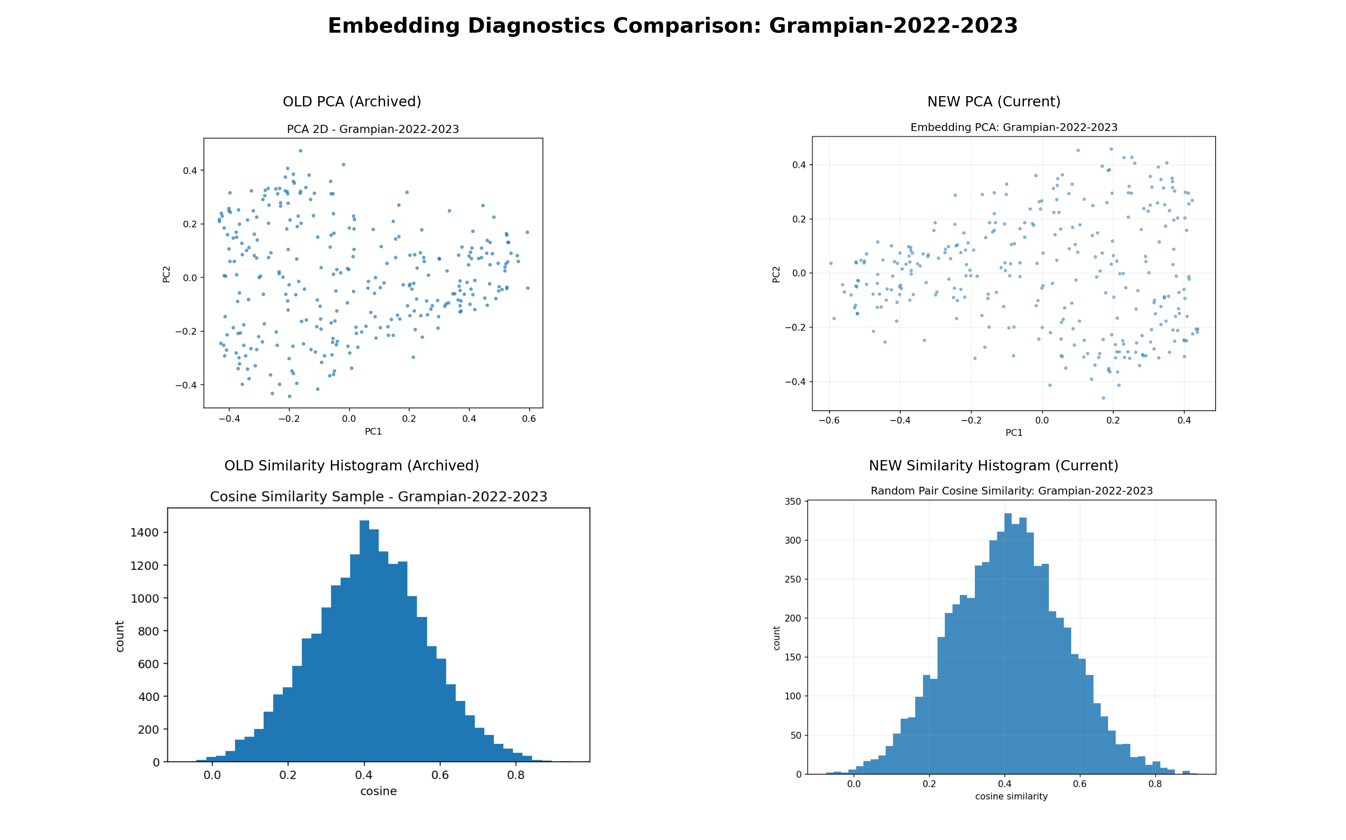
Slide 6: Old vs New Charts (2022-2023)

Slide 8
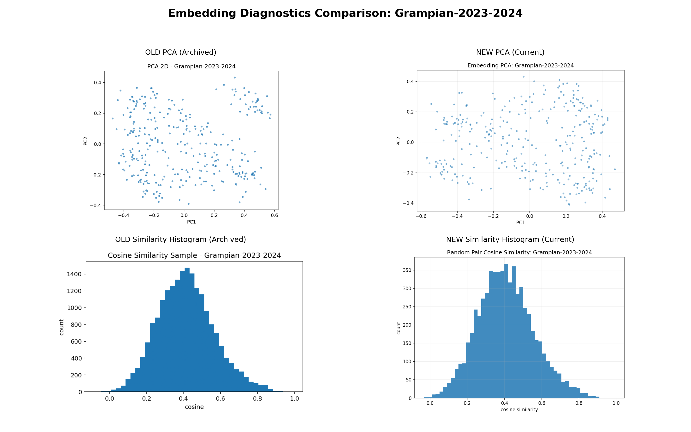
Slide 7: Old vs New Charts (2023-2024 and 2024-2025)

Slide 9
