Slide 1
Q2 Status
Revenue: 120% of target
Pipeline: 18 active deals
Risks: hiring delay

Slide 2
Q2 Status
Revenue: 120% of target
Pipeline: 18 active deals
Risks: hiring delay

Slide 3
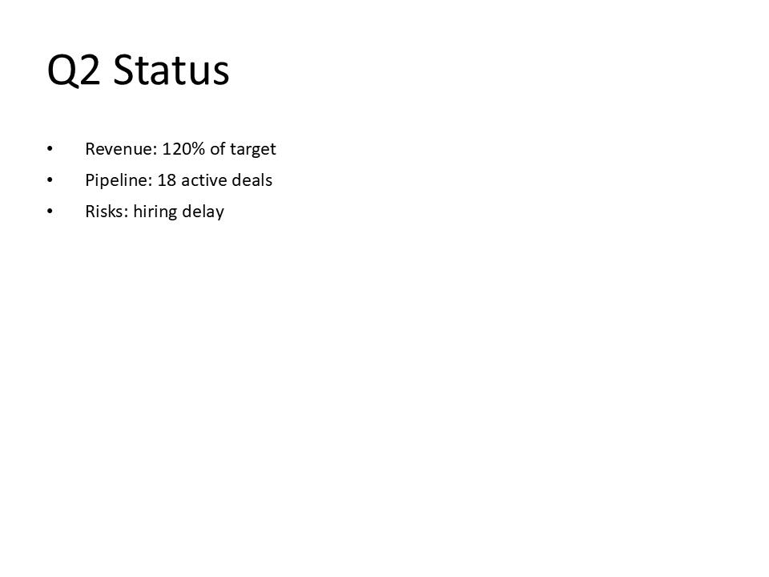
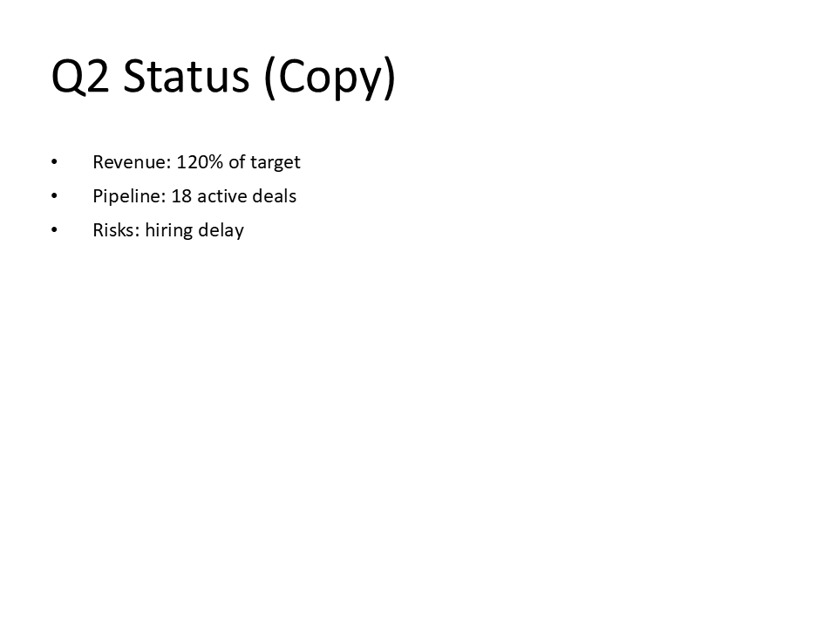
Q2 vs Q3 Comparison

