Slide 1
Placeholder Overrides

Slide 2
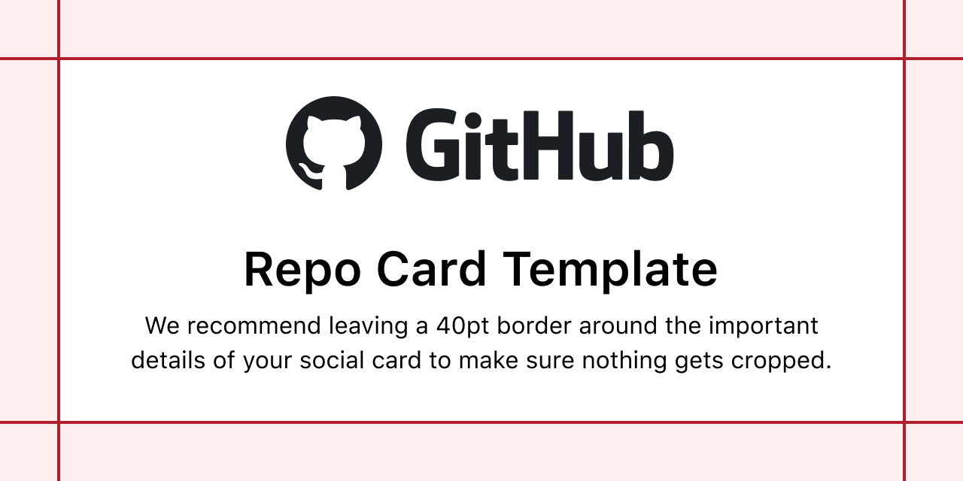
Placeholder Image

Slide 3
Placeholder Table

