Slide 1
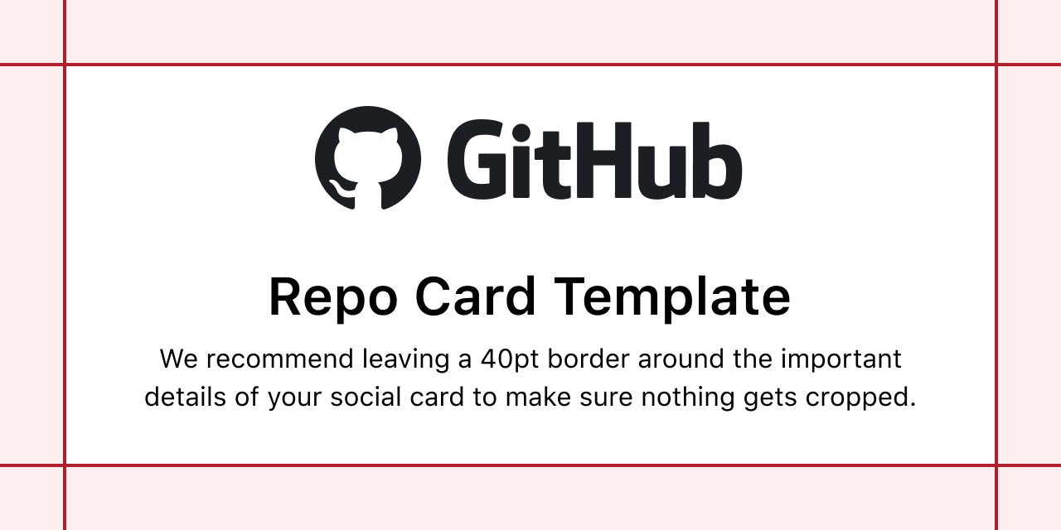
Advanced Image Sources
Bytes, Base64, and URL sources supported
Rotation, Flip, and Crop effects

