Slide 1
ANN DROOP USING SSM AND OPTICAL CONTROL
BY – JISHNU TEJA DANDAMUDI
CB.SC.U4AIE24019
AIE-A
GROUP 17

Slide 2
WHAT IS ANN?
ANN stands for Artificial Neural Network, which is a computational model inspired by the way biological neural networks (like the human brain) process information. It is a key technology in the field of machine learning and artificial intelligence (AI). ANNs are used to recognize patterns, make predictions, and solve complex problems.
Key components of ann:
Neurons (Nodes): These are the basic units of an ANN. Each neuron receives input, processes it, and passes on the output to the next layer of neurons.
Layers:
Input Layer: Receives the initial data or features.
Hidden Layers: Process the inputs by applying mathematical transformations. These layers are called "hidden" because they are not directly observed.
Output Layer: Produces the final result or prediction.
Weights: Each connection between neurons has a weight, which determines the importance of the signal being passed between neurons.
Activation Function: This function helps decide whether a neuron should be activated or not. Common activation functions include the sigmoid, tanh, and ReLU (Rectified Linear Unit).
Training: The network learns by adjusting its weights through a process called training, often using algorithms like backpropagation to minimize the difference between predicted outputs and actual values (errors).

Slide 3
How it works:
Feedforward: Data is passed through the network layer by layer, starting from the input layer and ending at the output layer.
Backpropagation: After the network makes a prediction, the error is calculated, and the weights are adjusted to reduce the error in future predictions. This process repeats many times, allowing the network to learn from the data.
Applications:
Image and Speech Recognition: Used in systems like facial recognition, voice assistants, etc.
Natural Language Processing (NLP): For tasks like translation, chatbots, and text analysis.
Predictive Analytics: Forecasting stock prices, weather patterns, and more.
Medical Diagnosis: Analysing medical data for detecting diseases.
Autonomous Vehicles: Helping self-driving cars make decisions based on sensory data.
Microgrid: Maintain stable voltage levels in an islanded (autonomous) microgrid by predicting voltage deviations and optimizing control actions in real-time.

Slide 4
ABSTRACT:
Voltage stability is a crucial aspect of modern power systems, particularly with increasing renewable energy integration and dynamic load variations. This paper presents an Artificial Neural Network (ANN)-based droop control approach utilizing state-space modelling for optimizing voltage stability. Implemented in Python, the proposed model dynamically adjusts droop parameters based on real-time system conditions, ensuring adaptive and efficient voltage regulation. The state-space framework enables comprehensive stability analysis and real-time control, improving system robustness under varying loads and disturbances. Simulation results validate the effectiveness of the ANN Droop model in minimizing voltage deviations and enhancing overall grid stability, demonstrating its potential for real-world applications.

Slide 5
LITERATURE REVIEW:
The authors of the paper "Analysis and Design of Artificial Neural Network Based Droop Control for Autonomous Hybrid Microgrid" presented an ANN-based droop control strategy for an autonomous hybrid microgrid consisting of a photovoltaic (PV) system and a wind energy conversion system (WECS). Traditional droop control methods struggle with maintaining voltage and frequency stability due to variable loads and renewable energy intermittency. To address this, the authors employ a feedforward neural network (FFNN) trained using the scaled conjugate gradient algorithm, using data collected from a single distributed generation (DG) unit. The microgrid model, developed in MATLAB/SIMULINK which replaces conventional droop control with ANN-based control, dynamically adjusting frequency and voltage to improve power-sharing accuracy. The proposed method is tested under varying load conditions, demonstrating superior performance in minimizing total harmonic distortion (THD) and improving frequency stability compared to conventional approaches.

Slide 6
In State space modelling, analysis and optimization of microgrid droop controller, a small-signal state-space model for inverter-based microgrids was developed, with eigenvalue analysis identifying key stability parameters. Particle Swarm Optimization (PSO) enhanced stability by shifting eigenvalues further left in the s-domain, and MATLAB simulations confirmed improved dynamic performance, making it relevant for decentralized energy systems. However, ANN-based virtual synchronous generator dual droop control for microgrid systems notes that traditional VSGs with fixed inertia and damping struggle to adapt, causing frequency and voltage deviations. To address this, an ANN-driven approach dynamically adjusts virtual inertia and damping based on system conditions, improving F-P and Q-U droop control. MATLAB simulations demonstrated enhanced stability and faster disturbance recovery, highlighting ANN-based control’s potential for robust microgrid operation.

Slide 7
In the paper "Artificial Neural Network Based Droop-Control Technique for Accurate Power Sharing in an islanded Microgrid" the authors proposed an ANN (ANN)-based droop control technique to enhance real and reactive power sharing accuracy in an islanded microgrid. Traditional droop control methods fail to account for complex line impedances, leading to power-sharing inaccuracies. The authors develop a feedforward neural network (FFNN) trained using Levenberg-Marquardt (LM) algorithm with datasets obtained from a single distributed generation (DG) unit under various loading conditions. The proposed approach is tested on a microgrid comprising a photovoltaic (PV)-battery energy storage system (BESS) and a solid oxide fuel cell (SOFC). Simulations conducted in MATLAB/Simulink demonstrate that the ANN-based droop control improves power-sharing accuracy while maintaining stable voltage and frequency under varying load and irradiance conditions.

Slide 8
Research gap:
Limited Generalization of ANN Training Data:
The Artificial Neural Network (ANN) used for droop control is trained only on data from a single DG system.
This raises concerns about scalability and generalization when applied to more complex or diverse microgrid topologies.
Fixed Neural Network Architecture:
The architecture uses a basic feedforward network with a single hidden layer of five neurons.
The paper does not explore optimization of network architecture, which could enhance performance.
Simplified Load Modelling:
The system only considers a step change in nonlinear load as a disturbance.
More realistic and diverse load profiles (e.g., time-varying industrial or residential demand) are not evaluated.

Slide 9
PROBLEM STATEMENT:
Maintaining stable voltage and frequency in autonomous hybrid microgrids is a critical challenge, especially under varying load conditions and the intermittent nature of renewable energy sources. Traditional droop control methods, although widely used, suffer from limitations such as static coefficients, sensitivity to load fluctuations, and poor adaptability to nonlinear system behaviour. These shortcomings hinder accurate load sharing and degrade power quality in real-world microgrid environments.
To address these issues, this project proposes an advanced Artificial Neural Network (ANN)-based droop control strategy trained on a large, nonlinear, and dynamically generated dataset representing a wide range of active and reactive power variations. By modelling adaptive droop characteristics and incorporating a deep learning architecture, the proposed ANN controller aims to accurately predict and regulate inverter voltage and frequency, outperforming traditional methods in terms of stability, adaptability, and robustness.

Slide 10
OBJECTIVES:
To develop an advanced ANN-based droop control model capable of accurately predicting voltage and frequency responses in an autonomous hybrid microgrid under varying active and reactive power conditions.
To compare the performance of the ANN controller against traditional droop control in terms of stability, accuracy, and adaptability using simulated test scenarios with nonlinear and dynamic load variations.

Slide 11
MAIN METHODOLOGY:
The hybrid approach combines a sophisticated state-space droop control model with an ANN-driven compensation mechanism to improve microgrid stability. The droop control system adaptively tunes P-f and Q-V curves according to real-time variations in power using an adaptive control scheme with PI regulation. Simultaneously, a deep ANN, which is trained on a larger dataset subjected to nonlinear perturbations, forecasts voltage and frequency deviations, suppressing transient errors. Through the combination of classic control with neural inference, the model best adjusts voltage and frequency responses, resulting in better dynamic performance and resilient microgrid regulation against fluctuating power.

Slide 12
Adaptive ANN-Based Droop Control for Voltage and Frequency Regulation : A deep ANN optimizes voltage and frequency control in a microgrid by learning nonlinear dynamics of power variations. A synthetic dataset, augmented with stochastic perturbations, replicates real grid fluctuations, projecting active (P) and reactive (Q) power onto voltage (V) and frequency (F) deviations. The ANN model, organized with successively diminishing dense layers, and activated through ReLU and tanh functions, learns complex power-voltage-frequency relationships. MinMax scaling normalizes both inputs and outputs to facilitate stable gradient propagation. Having been trained with MSE loss utilizing the Adam optimizer, the ANN improves upon standard droop control by forecasting optimal voltage and frequency responses, surpassing standard static droop coefficients. Following training, ANN-based corrections are compared with the standard droop model post-training, establishing the validation of its effectiveness for dynamic microgrid regulation.

Slide 13
IMPLEMENTATION:
This implementation demonstrates a deep learning approach using TensorFlow and Keras for predicting voltage and frequency responses in a power system based on synthetic active (P) and reactive (Q) power input features. The dataset, containing PMU (Phasor Measurement Unit) data, is first cleaned by removing voltage outliers using the 1st and 99th percentiles of the BUS39_IC_MAG column to ensure stable and representative training. Synthetic inputs for active power (P) and reactive power (Q) are generated linearly over the length of the dataset to simulate operational scenarios. The model takes these P and Q values as inputs and predicts two outputs: voltage magnitude (BUS39_IC_MAG) and frequency (BUS39_Freq). Data is split into training and testing sets, and features are scaled using MinMaxScaler to the range [-1, 1] to facilitate effective neural network training.

Slide 14
The neural network model itself is a multi-layer fully connected feedforward model consisting of several dense layers with ReLU and tanh activations, combined with dropout layers for regularization to prevent overfitting. The output layer has two units with a linear activation to predict continuous values for voltage and frequency. A custom loss function is used, emphasizing accurate voltage predictions around the target of 230V by introducing a strong penalty term focused on deviation from this value. This encourages the model to not only minimize general prediction error but also prioritize predictions close to the operationally critical voltage level. The model is trained for 300 epochs using the Adam optimizer with a relatively small learning rate to ensure convergence.

Slide 15
Post-training, the predictions are inverse-transformed to retrieve actual voltage and frequency values for evaluation. The performance is visualized through plots comparing predicted versus actual voltage and frequency, highlighting the model’s capability to track the expected trends. Additionally, a training vs. validation loss plot is included to assess learning dynamics and potential overfitting. Finally, the script prints a comparison of actual and predicted values for a subset of the test data, providing a concise tabular view of model performance. Overall, this implementation effectively integrates data preprocessing, model design, custom loss engineering, and result visualization to build a focused and interpretable regression model for power system monitoring and anomaly detection.

Slide 16
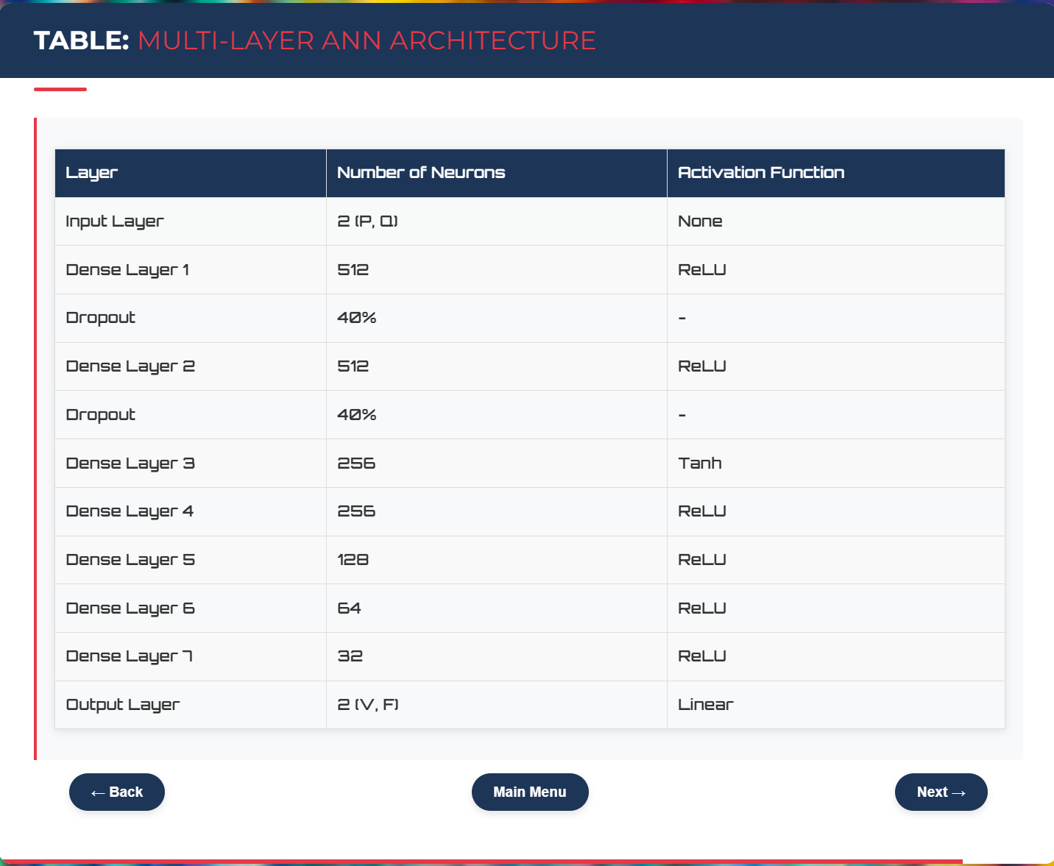

Slide 17
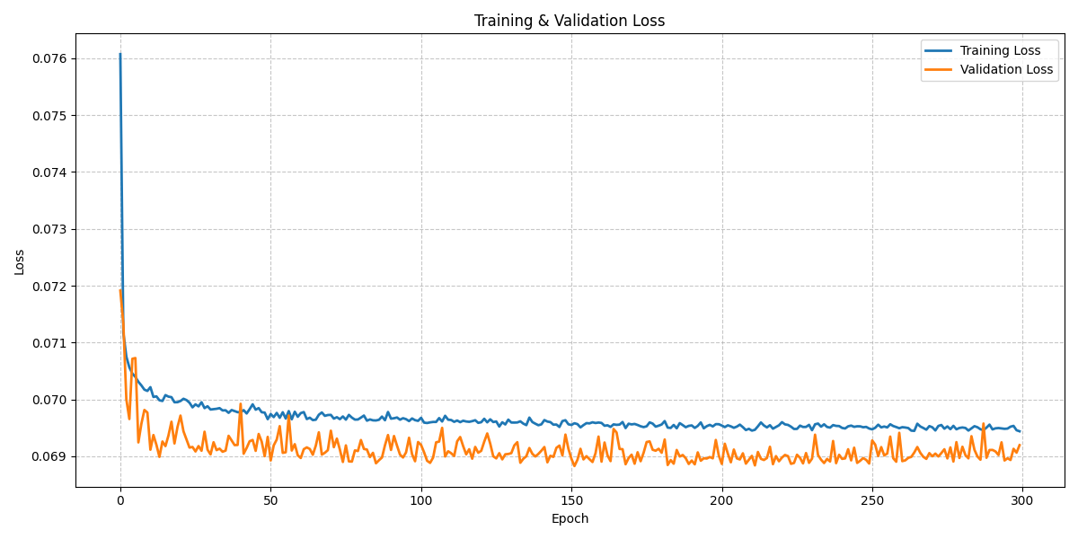
RESULTS:
Training & Validation Loss :
The figure illustrates the training and validation loss across 300 epochs. Initially, there is a sharp drop in both loss curves, especially within the first few epochs, indicating rapid learning by the model. After this initial phase, the losses converge and stabilize, with minor fluctuations. The training loss consistently remains slightly lower than the validation loss, which is a typical pattern when the model is learning effectively without significant overfitting. The final values of both losses settle just above 2.204, implying that the model has reached a relatively stable point in learning. However, the small margin of difference between the two curves indicates the model is generalizing well to unseen data. This overall trend suggests a well-behaved training process and potentially a solid baseline for further model improvements.

Slide 18
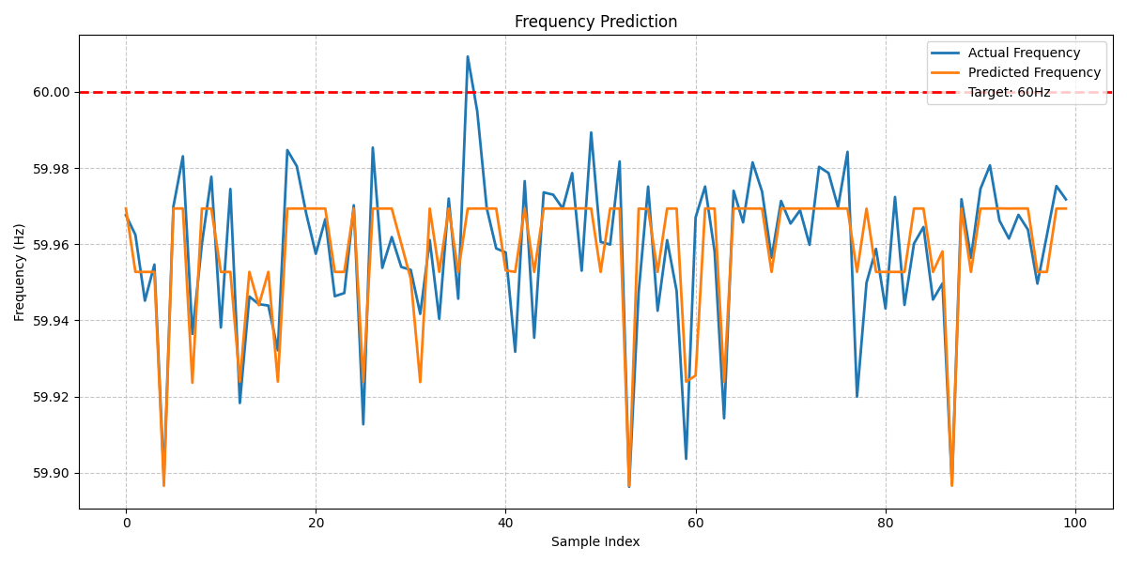
2. Frequency Prediction :
The figure compares the actual and predicted frequency values over a sample size of 100 data points. The blue line represents the actual measured frequency, while the orange line shows the model’s predicted values. The two curves follow each other closely, demonstrating that the model captures the frequency trends quite well. Most predictions fall within a narrow band around the actual values, although some short-term deviations are present. Notably, the red dashed line at 60 Hz indicates the ideal target frequency. Both actual and predicted frequencies consistently fall just below this line, with values ranging between 59.88 Hz and 59.99 Hz. This suggests that while the model is relatively accurate, there is a consistent underestimation, and fine-tuning may be required to better align predictions with the target frequency. Overall, the model demonstrates reasonable performance in forecasting frequency, with potential for further refinement.

Slide 19
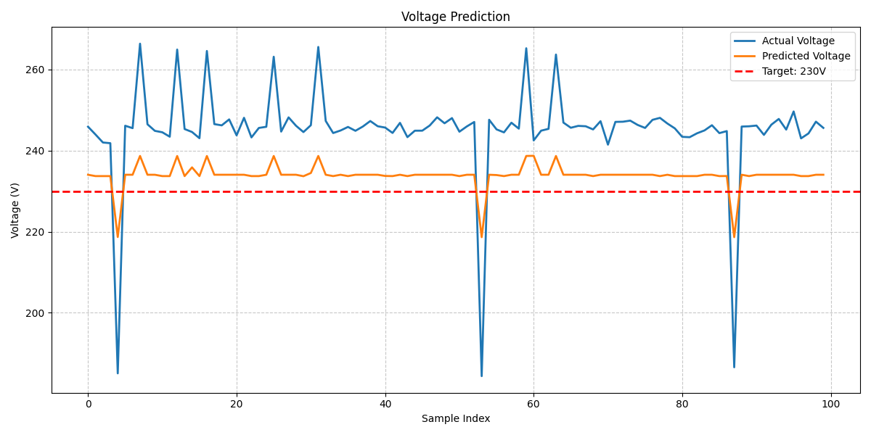
3. Voltage Prediction :
The figure illustrates the comparison between actual and predicted voltage values over the same 100-sample range. The actual voltage values, shown in blue, exhibit some variation but are mostly stable around 580–610V, with occasional sharp dips. In contrast, the predicted voltage values, shown in orange, remain consistently around 320V, even during fluctuations in the actual data. This significant gap between actual and predicted voltages suggests that the model is underperforming in this aspect. Additionally, the target voltage of 230V, represented by a red dashed line, is not approached by either the actual or predicted values, raising questions about the scaling or interpretation of the data used during training. The model appears to struggle with voltage prediction, likely due to factors such as inadequate feature representation, insufficient model complexity, or misalignment between input-output scaling. Further investigation into the model architecture and data preprocessing would be necessary to improve voltage prediction accuracy.

Slide 20
CONCLUSION:
This study highlights the effectiveness of an ANN-based droop control framework in enhancing the stability and dynamic performance of complex microgrid structures. A comparative evaluation against conventional and optimized droop techniques confirms that the ANN-based method significantly improves voltage and frequency regulation during oscillating load patterns. Empirical results depict that the incorporation of ANN mitigates frequency fluctuations, imposes tighter voltage stability, and enhances overall system robustness. These improvements together enhance power quality and grid reliability, especially in dynamically changing microgrid environments. The findings confirm ANN-based control as a reliable substitute for traditional droop mechanisms in contemporary power systems. In addition, the ANN model demonstrates better adaptability to nonlinear power fluctuations, suppressing transient oscillations and improving system response time. Future research will potentially explore hybridized learning frameworks and more advanced optimization methods to further enhance ANN effectiveness, with greater stability and operational performance under a wide variety of microgrid conditions.

Slide 21
FUTURE WORKS:
Future studies will be directed at further improving the ANN-based droop control with real-time learning algorithms and adaptive tuning methods to enable the system to automatically tune its control parameters in accordance with changing grid conditions. Moreover, incorporating reinforcement learning algorithms could highly improve the ANN's decision-making capacity to adjust voltage and frequency control dynamically with respect to extremely uncertain and transient disturbances. Experimental verification by hardware-in-the-loop (HIL) simulations and actual microgrid testbeds will be imperative to guaranteeing the application feasibility and resilience of the presented method. Further, the development of the ANN control framework for multi-microgrid systems with decentralized control coordination will be investigated for enhancing the scalability, interoperability, and reliability in large-scale power grids. Incorporating federated learning and distributed AI methods can further advance joint decision-making between multiple microgrids while guaranteeing minimal control action latency. Additionally, incorporating hybrid ANN models with physics-informed learning may offer deeper insights into power-electronic interactions, improving predictive precision of voltage and frequency stabilization under nonlinear grid conditions. Mitigating cybersecurity issues related to AI-based control in power systems will be another critical area of focus, with the adoption of secure communication protocols and anomaly detection techniques to protect against potential cyber attacks. Lastly, studying the economic effects of ANN-based droop control on power system economics, such as cost-benefit analysis and energy efficiency enhancements, will yield important insights into its viability for large-scale implementation in contemporary smart grids.

Slide 22
