Slide 1
ANOMALY DETECTION
BY – JISHNU TEJA DANDAMUDI
CB.SC.U4AIE24019
AIE-A
GROUP 17

Slide 2
WHAT IS AN ANOMALY?
In a power system, an anomaly refers to a deviation from normal operating conditions or a discrepancy that is not expected.
INTRODUCTION:
Anomaly detection in power systems presents several key challenges. First, PMU data is high-dimensional, requiring efficient techniques to process and extract meaningful features. The dynamic nature of the grid, influenced by fluctuations in demand and renewable energy generation, further complicates the task of distinguishing between normal variations and true anomalies.
Additionally, conventional classifiers often struggle with heavily imbalanced datasets, leading to poor performance in detecting rare events. Another major concern is the increasing vulnerability of smart grids to cyberattacks, making it crucial to develop anomaly detection methods that can differentiate between natural disturbances and malicious activities.

Slide 3
Objectives:
The proposed method leverages Isolation Forest, a decision-tree-based algorithm effective for unsupervised anomaly detection, and Long Short-Term Memory (LSTM) Autoencoders, which are well-suited for learning sequential dependencies in time-series data. By combining these techniques, the framework enhances the identification of anomalies in power system data, ensuring a more adaptive and effective detection process. Unlike conventional rule-based approaches that rely on predefined thresholds, this model learns patterns directly from data, enabling it to generalize across diverse scenarios, including system disturbances, missing data, and potential cyber threats.

Slide 4
DATASET - SGSMA_Competiton_2024_PMU_DATA
Features: The dataset includes 14 features such as 3-phase current and voltage magnitudes, corresponding angles, frequency, and the Rate of Change of Frequency (ROCOF).
Training Data: Contains 90 minutes of data sampled at 30 frames per second, resulting in approximately 160,000 data points.
Testing Data: Two sets, each with 25 minutes of data and containing specific events (e.g., faults, cyberattacks) at various system locations. Approximately 44,000 data points per test set.
Voltage Magnitude (in volts)
Current Magnitude (in amperes)
Phase Angles (in degrees)
Frequency (in hertz)
ROCOF (Rate of Change of Frequency, in hertz/second)

Slide 5
METHODOLOGY:
This study introduces a fusion approach combining Long Short-Term Memory (LSTM) Autoencoder and Isolation Forest (IF) to enhance anomaly detection accuracy. Anomaly detection in power systems requires a robust framework capable of distinguishing between normal operational variations and critical faults.

Slide 6
IMPLEMENTATION 1:
This Python script implements Dynamic Mode Decomposition (DMD) for anomaly detection in time-series data, starting by loading a CSV dataset from a specified directory, handling missing values via forward-filling, and scaling feature values using MinMax normalization (excluding timestamps). It transposes the data so each column represents a time step and applies DMD with a specified rank to reconstruct the signal using low-rank temporal dynamics. Reconstruction errors—calculated as the mean absolute difference between the original and reconstructed signals—are used to identify anomalies, defined as time points where the error exceeds the 95th percentile threshold. Finally, it visualizes the reconstruction error over time, marking detected anomalies and the threshold on the plot using Seaborn and Matplotlib.

Slide 7
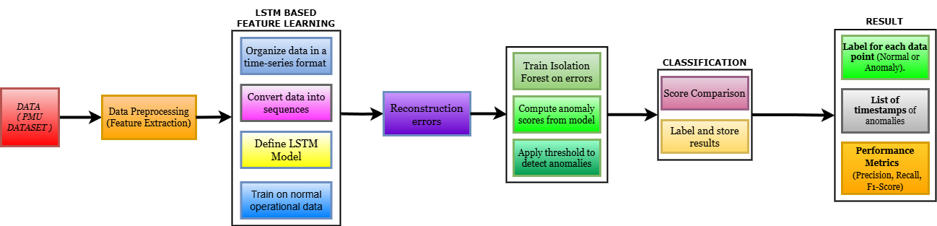
IMPLEMENTATION 2:
This study introduces a fusion approach combining Long Short-Term Memory (LSTM) Autoencoder and Isolation Forest (IF) to enhance anomaly detection accuracy. Anomaly detection in power systems requires a robust framework capable of distinguishing between normal operational variations and critical faults. This study introduces a fusion approach combining Long Short-Term Memory (LSTM) Autoencoder and Isolation Forest (IF) to enhance anomaly detection accuracy.

Slide 8
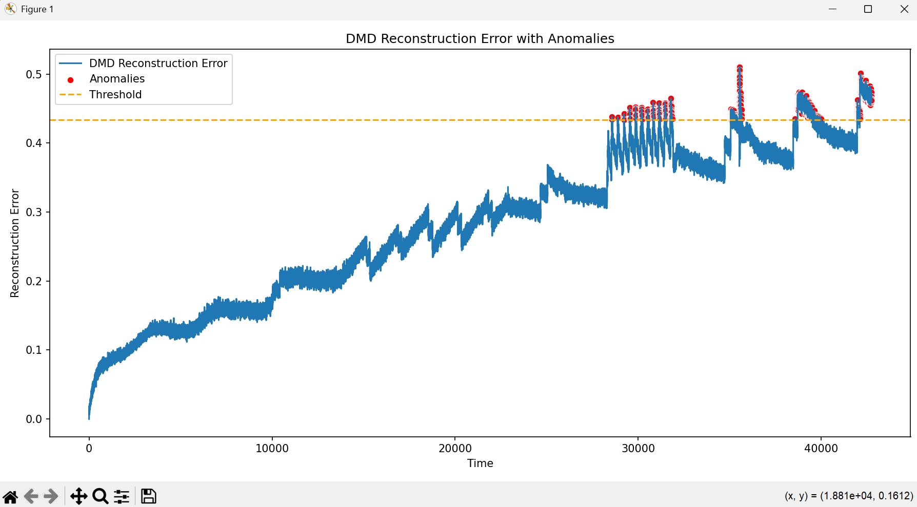
RESULT & ANALYSIS for 1:

Slide 9
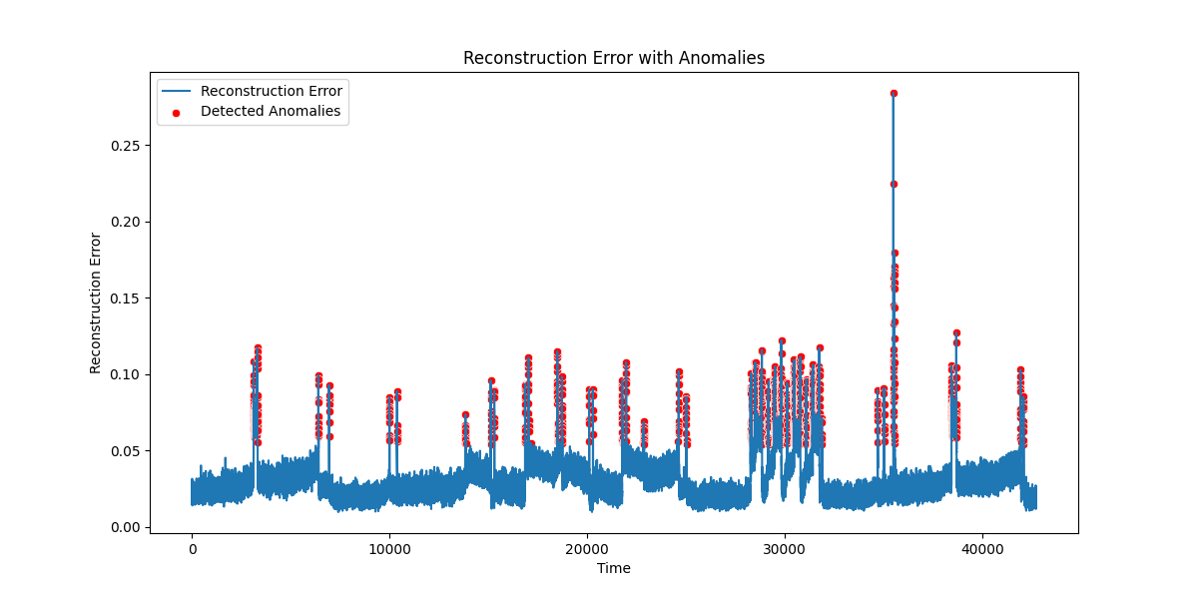
RESULT & ANALYSIS for 2:

Slide 10
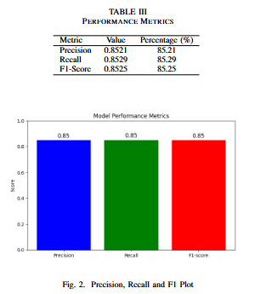

Slide 11
conclusion:
The proposed hybrid anomaly detection framework combines an LSTM autoencoder for feature extraction with an IF for anomaly classification, effectively leveraging DL and ML for power system monitoring. The LSTM autoencoder captures temporal dependencies, while reconstruction errors guide the IF in isolating anomalies efficiently. This dual-stage approach enhances detection accuracy while minimizing false positives and negatives. Performance evaluation using precision, recall, and F1-score confirms its effectiveness for real-time power grid surveillance.

Slide 12
Future work:
Future enhancements in anomaly detection can focus on adaptive thresholding using Bayesian optimization or reinforcement learning to improve classification accuracy. A multi-modal DL approach integrating PMU data, weather conditions, and cybersecurity logs with Graph Neural Networks (GNNs) or Transformers could enhance detection robustness.
*Self-supervised learning* methods like contrastive learning can address the challenge of limited labeled anomalies. Quantum ML techniques, such as Quantum-enhanced LSTMs, may further improve computational efficiency. Explainable AI (XAI) using SHAP or LIME can enhance model interpretability, while federated learning enables decentralized model training for secure data sharing.
Additionally, adversarial robustness* through GAN-based anomaly simulation can strengthen cybersecurity. These advancements will lead to a more intelligent, secure, and scalable anomaly detection framework for real-time grid monitoring.

