Slide 1

John Benditz, Senior Vice President
Kimley-Horn and Associates, Inc.
ITS Tennessee Annual Meeting
Knoxville, TN
October 8, 2009

Slide 2

ITS Partnership Development
Appropriate Time for Consideration
Various ITS Partnership Structures
Potential Partnership Obstacles
Where are Tomorrow’s Opportunities

Slide 3
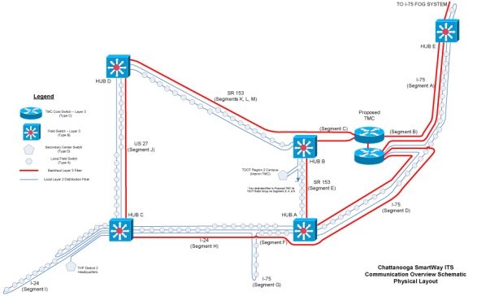
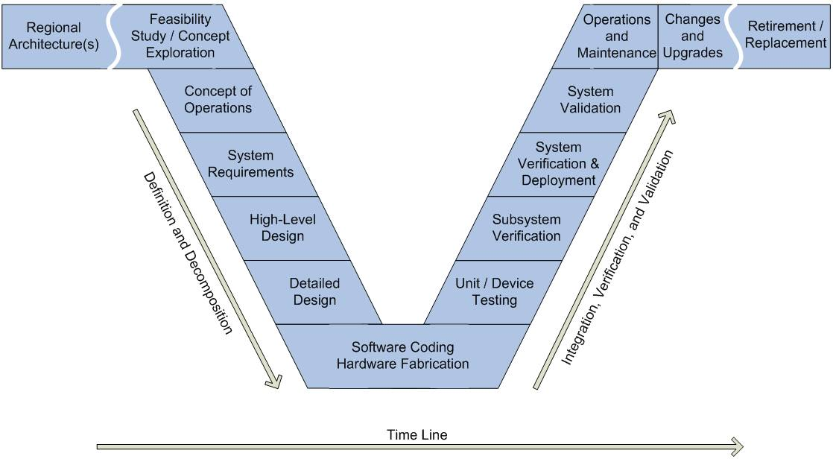
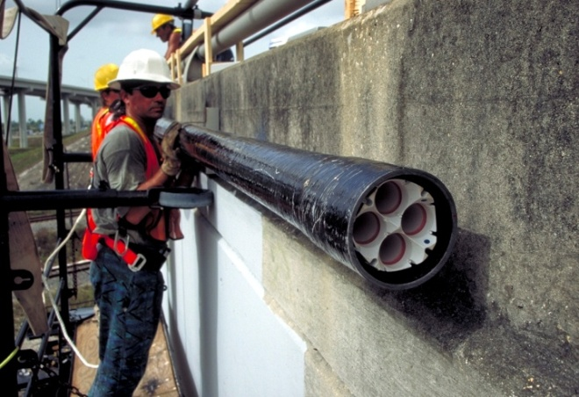
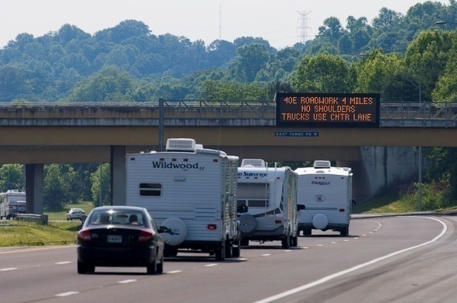
ITS Partnership Development
Appropriate Time for Consideration
  Development of Regional Architecture
  Preparation of plans and special provisions
  Construction of field deployment elements
  After systems become operational

Slide 4

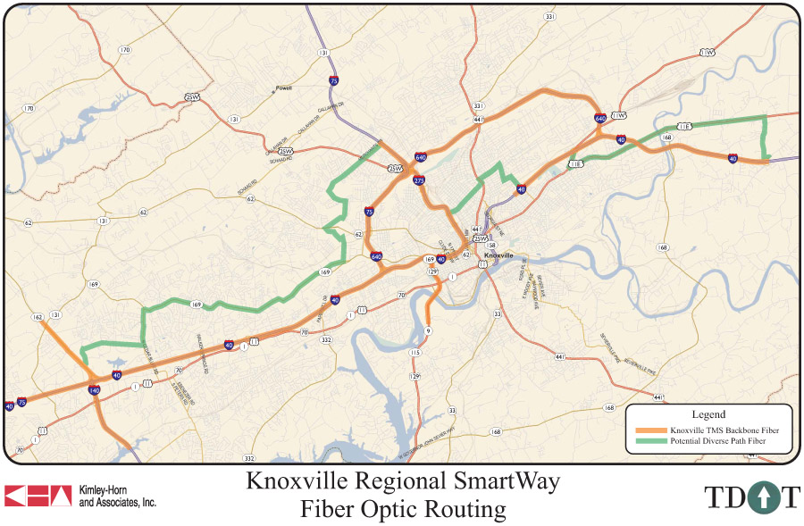
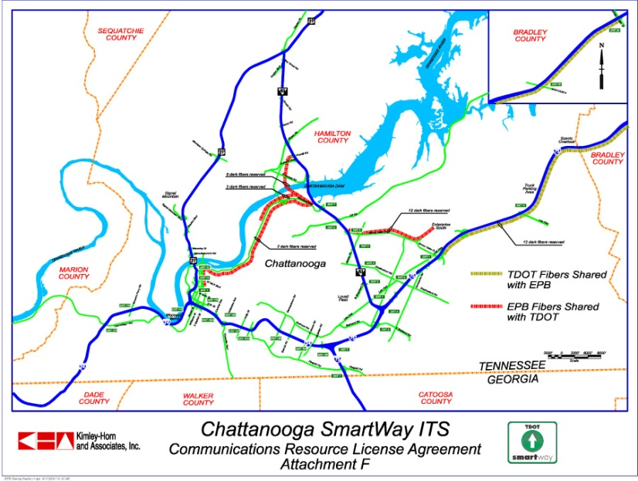
ITS Partnership Development
Various ITS Partnership Structures
  Infrastructure/cost sharing
  Capability expansion
  Mission accomplishment

Slide 5
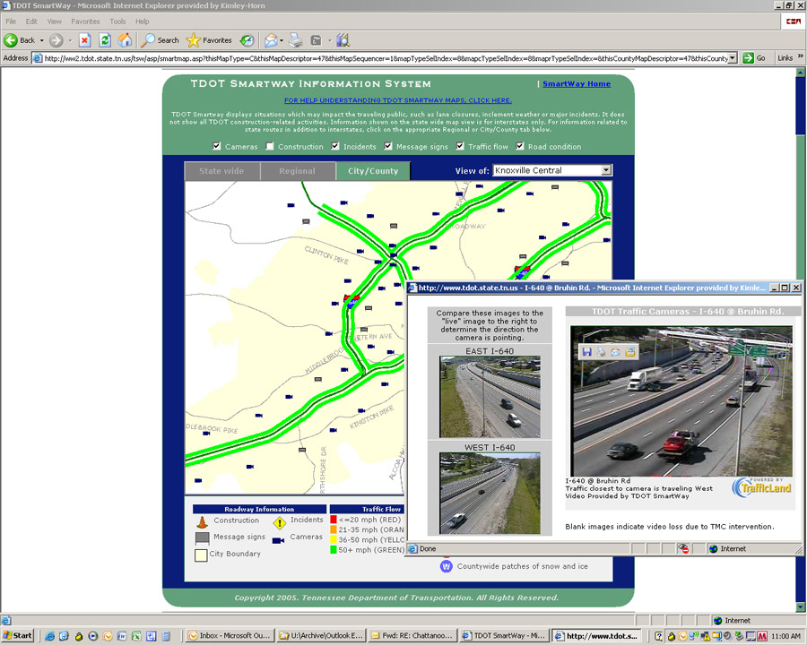
ITS Partnership Development
Various ITS Partnership Structures
  Infrastructure/cost sharing
  Capability expansion
  Mission accomplishment

Slide 6

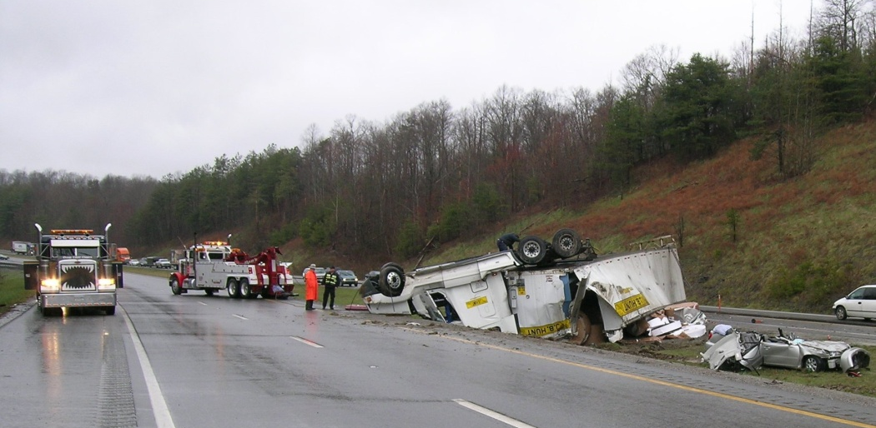
ITS Partnership Development
Various ITS Partnership Structures
  Infrastructure/cost sharing
  Capability expansion
  Mission accomplishment

Slide 7
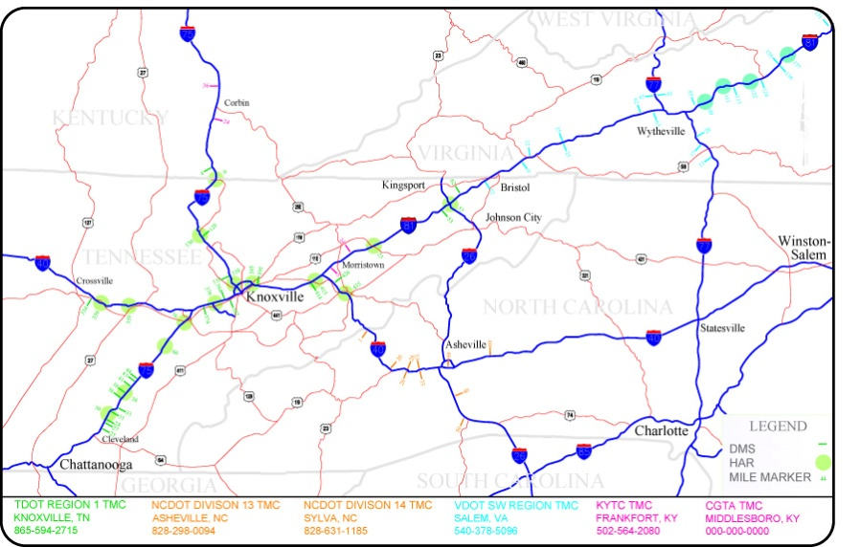
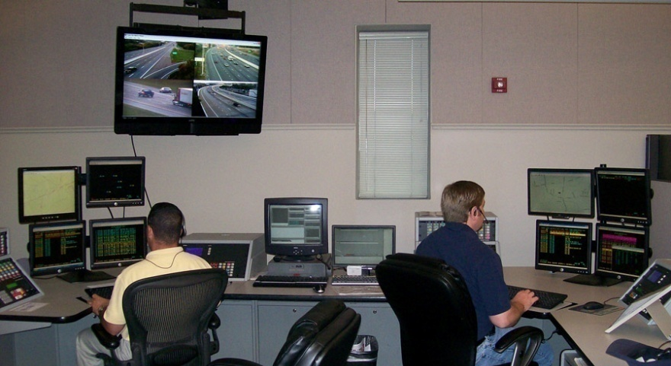
ITS Partnership Development
Potential Partnership Challenges
  Necessity for a champion
  Complexities of dissimilar business models
  Unequally yoked partnerships
  Recognition of diverse missions
  Solutions in search of an application

Slide 8
ITS Partnership Development
Where are Tomorrow’s Opportunities?
  Continued infrastructure deployment/expansion
    Regional
    Urban
  Compatible applications
    Public
    Private
  Emerging technology applications
  Institutional processes

Slide 9
Thank You
Questions ?

