Slide 1
Survey of Emerging Broadband Communications Technologies
Mostofa Howlader
Oak Ridge National Laboratory

Slide 2
Outline
Past, Present and Near-Future Technology
Voice/Data
Advanced Mobile Phone systems (AMPS) (Analog), 2nd Generation(2G) – Personal Comm. Systems (PCS) (Digital), 2.5G, 3G (CDMA), 4G (OFDM)
Data
Paging
Home services
Bluetooth™, WiFi, Zigbee
Broadband “Last Mile”
Mobile WiMAX (IEEE 802.16), WiFi (802.11n)
Near Future Technologies and Standards
Major Technologies
HSPA (High-Speed Packet Access)
HSPDA, HSUPA, HSPA+; Release 7
LTE (Long Term Evolution); Release 8
EV-DO (Evolution-Data Optimized), EV-DO Revision A, EV-DO Revision B
UMB (Ultra Mobile Broadband)
WiMAX (Mainly for Backhaul)
WAVE (Two-way Vehicle Communication)
FemtoCell (Indoor Wireless Connectivity)

Slide 3
Wireless and Cellular Systems
3 kHz to 100 GH Wireless Communication
Lower Spectrum
Below 2.4 GHz
Dominated by Voice Communication/Transmission
AM Radio – 535 kHz to 1.7 MHz
FM Radio – 88 MHz to 108 MHz
Cell Phone – 824 MHz to 849 MHz & 1.9 GHz
Upper Spectrum
Above 2.4 GHz
Dominated by Data Communication
1G
2G
2.5G
3G
3.5G
3.?G
4G
1980s
Early 1990s
Late 1990s
2001+
2005+
Until 2015
2010-2020

Slide 4
Mobile Services
Analog cellular (Obsolete)
824-849 & 869-894 MHz
Initially used analog standards
AMPS (US)
Total Access Communication System (TACS); ETACS (Europe); JTACS (Japan)
Demand for increased capacity forced change to digital standards
IS-136 (Interim standard -136)
IS-95
GSM (Global System for Mobile)
Three classes of services
Voice
Voice/Data
PCS (2G)
Third generation (3G), Fourth generation (4G)
Data
Paging
Broadband

Slide 5
GSM in Detail
GSM has been most popular standard worldwide
Basic GSM
9.6 kbps or 14.4 kbps
High-Speed-Circuit-Switched-Data-Service (HSCSD)
Up to 56 kbps
Software-only solution not requiring hardware upgrades
Packet-based protocol is layered on top of GSM networks
Transfer rates up to 100 kbps
Supports IP (Internet Protocol)
No dialup to ISP needed
Uses channel only when sending/receiving packets
Makes possible data transfer without circuit connection
Uses up to 8 channels simultaneously

Slide 6
EDGE & 2.5G Limitations
Enhanced Data rates for GSM Evolution (EDGE)
Data rate up to 384 kbps
Technology compatible with both GSM and IS-136 standards
2.5G systems are extensions of the 2G infrastructure
Adding features to an existing radio interface
This infrastructure is limited
Narrow channels
Coverage provided by local infrastructure only
How do you provide global connectivity?

Slide 7
Third Generation (3G) Standards
Also called
IMT-2000 (International Mobile Telecomm. 2000)
Previously called UMTS (Universal Mobile Telecomm. System)
Third generation (3G) cell-phone standards are based on code-division multiple-access (CDMA).
Since 2006, the widely used 3G cell-phone technology is wideband code division multiple access (WCDMA), which is built on 2G European GSM technology by the UMTS.
The other parallel technology is CDMA2000, which is based on 2G cdmaOne (IS-95) standard using CDMA technology.
Although 3G systems are capable of delivering 2 Mbps data rate under better channel environments such as LOS (line-of-site) and non-mobile, the typical data rate in multipath environment is about 400 Kbps.

Slide 8
3G partnership project 2 (3GPP2)
3GPP and 3G partnership project 2 (3GPP2) have been defining standards for enhancements to today’s 3G systems. The objective is to add network capacity and features enabling operators to offer new data-oriented services over their existing networks.
CDMA2000 represents a family of technologies that includes CDMA2000 1X and CDMA2000 1xEV. CDMA2000 1X can double the voice capacity of cdmaOne (IS-95) networks and delivers peak packet data speeds of 307 Kbps in mobile environments. CDMA2000 1xEV includes CDMA2000 1xEV-DO is a high-speed data only system for 1.25 MHz FDD (frequency division duplex) channels and delivers peak data speeds of 2.4 Mbps supporting applications such as video conferencing.
CDMA2000 1xEV-DO provides integrated voice and simultaneous high-speed packet data multimedia services at speeds of up to 3.09 Mbps.

Slide 9
3G partnership project (3GPP)
WCDMA uses direct sequence spread spectrum (DSSS) to spread the signal over a 5 MHz spectrum. It is based on 3GPP Release 99 and provides data rates of 384 Kbps for wide area coverage and up to 2 Mbps for hot-spot areas. In addition to the use of orthogonal spreading codes, it uses quadrature phase shift keying (QPSK) for its modulation.
3GPP Release 5 extends the WCDMA specification with high speed downlink packet access (HSDPA).
HSDPA includes advanced features such as adaptive modulation and coding (AMC), hybrid automatic repeat request (HARQ), and de-centralized scheduling architecture.
The 3GPP has also defined WCDMA enhancements for the uplink path. This enhancement is known as high speed uplink packet access (HSUPA); the combination of HSDPA and HSUPA is simply known as HSPA (high speed packet Access).

Slide 10
Long Term Evolution (LTE)
What is LTE?
LTE describes standardization work by 3GPP to define a new high-speed radio access method for mobile communications systems.
LTE is the next step on a clearly-charted roadmap to so-called ‘4G’ mobile systems that starts with today’s 2G and 3G networks. Building on the technical foundations of the 3GPP family of cellular systems that embraces GSM, GPRS and EDGE as well as WCDMA and now HSPA.
LTE offers a smooth evolutionary path to higher speeds and lower latency. Coupled with more efficient use of operators’ finite spectrum assets, LTE enables an even richer, more compelling mobile service environment. LTE provides a smooth evolutionary path for operators deploying all 3GPP and non-3GPP technologies.

Slide 11
Data Rate - Summary
HSPA
DL: 14.4 mbps; UL: 384 kbps; 5 MHz channel
HSDPA/HSUPA
DL: 14.4 mbps; UL: 5.76 mbps
HSPA+
DL: 28.8 mbps; UL: 11.5 mbps 2x2 MIMO; 16 QAM
DL: 42 mbps; UL: 23 mbps 2x2 MIMO; 64 QAM
LTE
DL: 300 mbps; UL: 75 mbps; 20 MHz channel
Latency from 40-50 to 10 ms

Slide 12
Worldwide Interoperability for Microwave Access (WiMAX)
WiMAX is a global effort to bring the benefit of standards to the broadband fixed wireless (BFW) market. In particular, WiMAX is designed to apply technology innovation and scale economics to the BFW market in a bid to transform it from a niche to a mass-market opportunity. One way WiMAX developers plan to do this is by evolving fixed-wireless technology to support mobility, which will bring WiMAX into competition with 3G/3.5G technologies such as WCDMA/HSDPA and EV-DO/EV-DOrA.
There are two key groups developing and promoting WiMAX:
The IEEE 802.16 Working Group on Broadband Wireless Access Standards is responsible for creating 802.16 standards for Wireless Metropolitan Area Networks (WMAN).
The WiMAX Forum is responsible for commercializing WiMAX systems. It develops profiles based on IEEE 802.16 standards and harmonized ETSI HiperMAN standard, and interoperability certification programms for products based on those profiles.

Slide 13
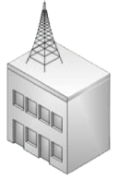
Point-to-Point Architecture
SS- Subscriber Station
LOS
SS
BS
SS
NLOS
BS
Dedicated long-rang, high capacity link.
Used for backhaul
Coverage area is approximately 30 miles.
LOS or NLOS signal propagation is assumed

Slide 14

Point-to-Multipoint Architecture 802.16-2004
SS- Subscriber Station
SS
SS
SS
BS
SS
Central BS supports multiple SSs
Last mile broadband access
Coverage area is approximately 5 miles.
LOS or NLOS signal propagation is assumed

Slide 15


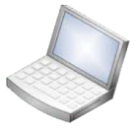
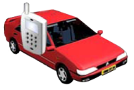
Cellular Architecture using WiMAX (802.16e)
Operator Network
MS
MS
MS
Fixed SS
BS
Fixed SS
MS
MS Handoff between BSs
MS
MS
A mobile topology is similar to a cellular network because multiple BSs
collaborate to offer services to both SSs and MSs.
Each BS coverage area is approximately 5 miles.
NLOS signal propagation on frequencies ranging between 2 and 6 GHz.

Slide 16
Multi-Hop Relay Architecture -802.16j-2009
RS- Relay Station
Operator Network
BS
RS/SS
RS/SS
RS/SS
RS/SS
RS/SS
Each BS coverage area is approximately 5 miles.
Beyond that it uses other BSs as RS
NLOS signal propagation is assumed

Slide 17
FemtoCell
Low power BS for indoor
Improve the signal quality for indoor uses
Relive the macro-cells from pushing more data in the pipe
WLAN type connections to the DSL (digital subscriber line) or cable modem
Operate in the licensed band
3GPP, 3GPP2, WiMAX forum all working on femtocell standards
Challenges
Interference with the macro-cell signals

Slide 18
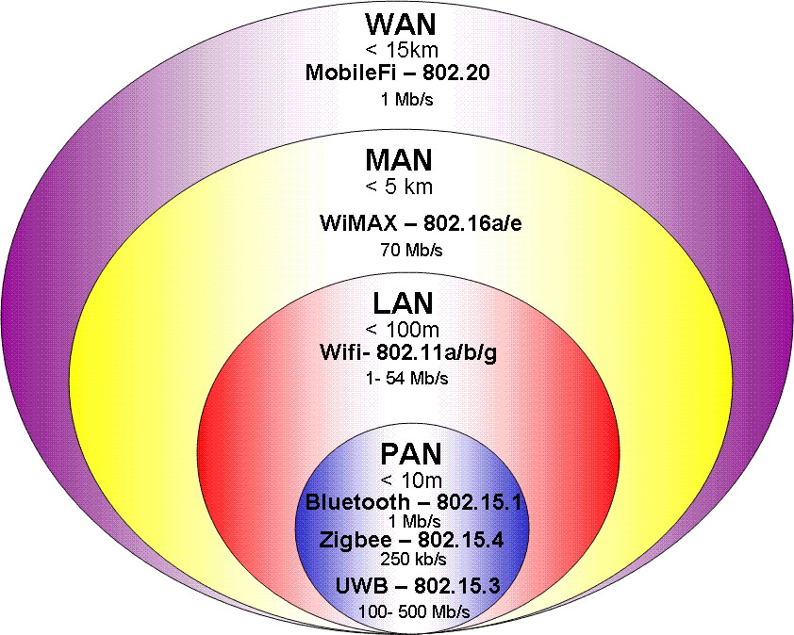
Wireless Data Protocol Coverage
WAN – Wide Area Network
MAN – Metropolitan
LAN – Local
PAN - Personal

Slide 19
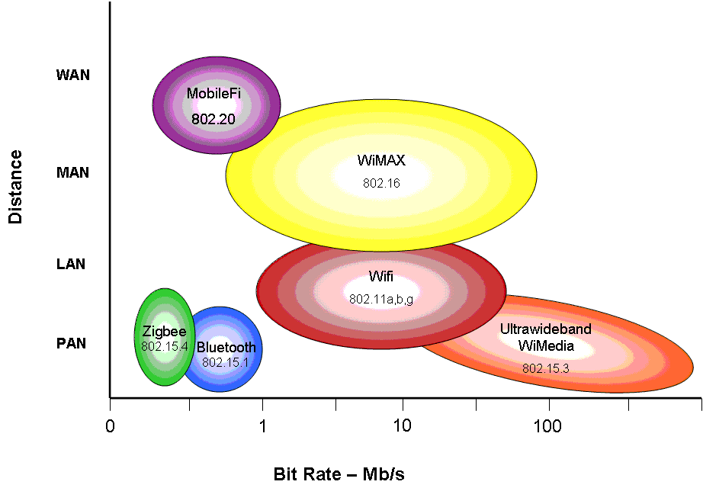
Coverage vs. Bit Rate

Slide 20
Three Standards Being Implemented
Zigbee – Standard 802.15.4
Low Data Rate – 250 kbits/s
Low Power Consumption – Battery life of years
Used for Sensor Networks and Device Control
Wifi – Standard 802.11b
High Data Rate - 11 Mbits/s
High Power Consumption – Wall Outlet
Used for Wireless Internet Access Points
Bluetooth – Standard 802.15.1
Nominal Data Rate – 1 Mbits/s
Nominal Power Consumption – Battery life 1 to 3 days
Used as a Cable Replacement

Slide 21
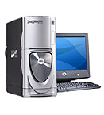


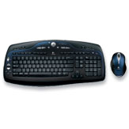

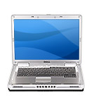
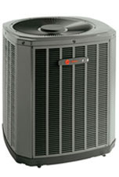

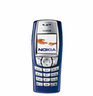
The Need to Stay Connected
Wired Ethernet
Main Server
Bluetooth
802.11b
802.11b
Bluetooth
Zigbee
Zigbee
Bluetooth
HVAC Control
Lighting

Slide 22
Wireless Access in Vehicular Environment (WAVE)
WAVE loosely follows OSI layer concept
Collectively IEEE 802.11p and IEEE 1609.x are called WAVE
WAVE Components
RSU (Roadside Units)
OBU (Onboard Units)
These two can form WBSS (WAVE basic service sets)
802.11p is based on 802.11a.
Oct. of 1999, FCC granted Dedicated short-range communication
(DSRC) frequency band of 75 MHz (5.85-5.925)

Slide 23




System Picture
Driver
End User
Vehicle and
Road Data
OBE
RSE
DSRC Roadside
Road Data
DSRC Vehicle-to-Vehicle
Infrastructure Data System
Vehicle Side
Road Side
Back Side

