Slide 1
Deployment of ITS Nationally in Support of Operations
Stephen R. Gordon
Oak Ridge National Laboratory
ITS Tennessee
October 8, 2009

Slide 2
What is Deployment Tracking?
A database of national ITS deployment information supporting multiple users:
  USDOT in managing the ITS program
    What’s going on? Where is action needed to stimulate deployment or integration?
  State and local planners
    What’s working? What have other areas deployed? Where can I get more information?
  Researchers and vendors
    Where’s the market? What are the market trends? How does deployment match local conditions?

Slide 3
Deployment Tracking Methodology
Scope of tracking effort covers 108 metropolitan areas and each state
Deployment data are gathered through surveys of public sector agencies
  Freeway, Transit, Arterial, Public Safety, and Toll management in metropolitan areas
  State DOTs targeted in statewide survey concerning systems with statewide or regional scope
2300 agencies are involved; response rates are typically 90% or greater

Slide 4
Deployment Tracking Survey Status
2007 Survey is the most recent
  Data from 108 Metropolitan Areas and each state
  New feature: State of the Practice
    Goes beyond the “What” and “Where” of deployment to “How”
    Targeted Arterial and Freeway TMCs, focusing on maintenance and emergency response
Next survey will be 2010

Slide 5
Highlights from the 2007 Deployment Tracking Results (108 metropolitan areas)
Freeway miles with real-time traffic data collection technologies: 41%
Ramps controlled by ramp metering: 20%
Freeway miles covered by surveillance cameras: 36%
Freeway Miles covered by on-call service patrols: 43%
Arterial miles covered by on-call service patrols: 14%
Signalized intersections with emergency vehicle preemption: 24%
Fixed route transit vehicles equipped with AVL: 62%
Paratransit vehicles operating under computer aided dispatch: 62%
Fixed route buses accepting electronic fare payment: 70%

Slide 6
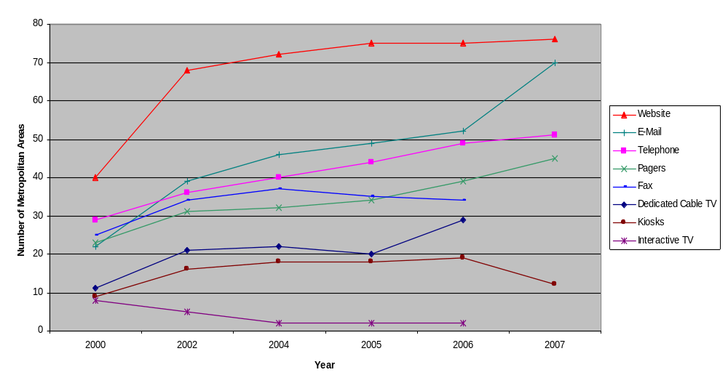
Adoption Trends for Traveler Information Technologies

Slide 7
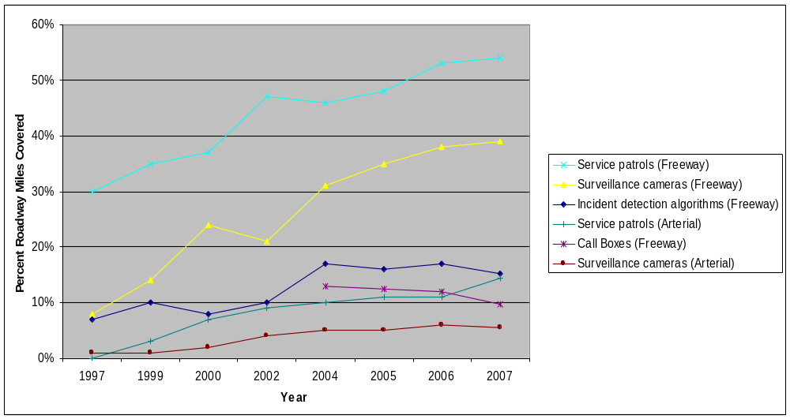
Deployment Trends for Incident Management Technologies

Slide 8
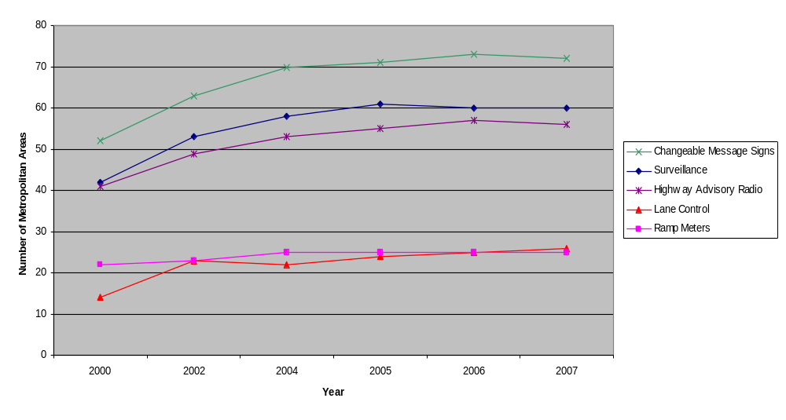
Trends for Adoption of Freeway Traffic Management Technologies

Slide 9
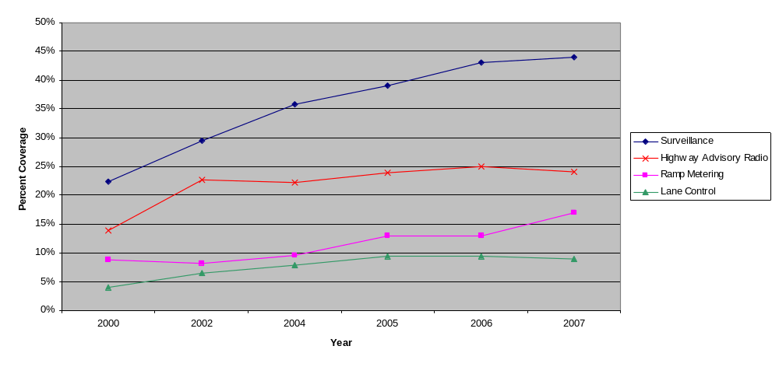
Trends for Deployment of Freeway Traffic Management Technologies

Slide 10
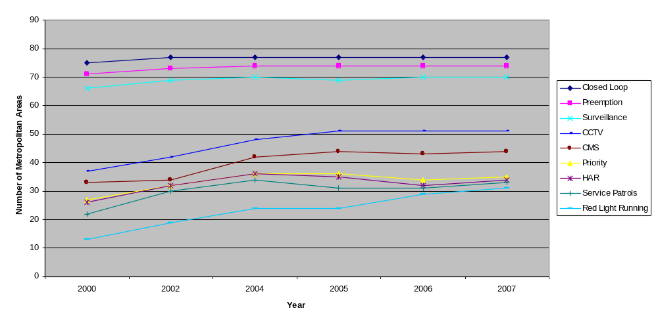
Trends for Adoption of ITS Technologies for Arterial Management

Slide 11
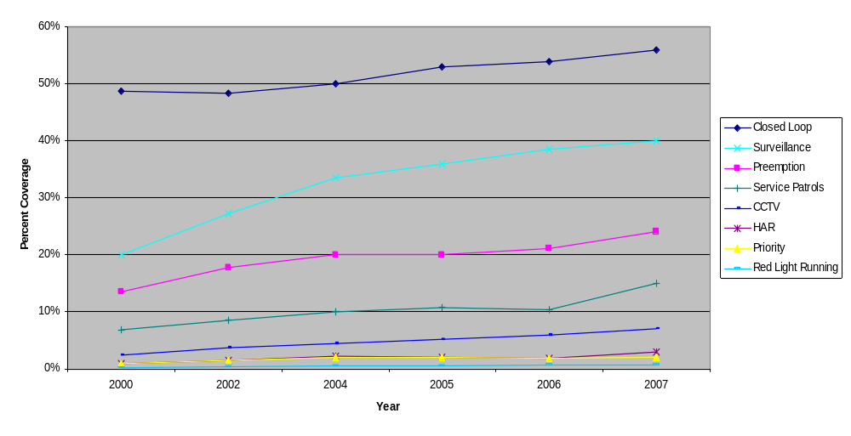
Trends for Coverage of ITS Technologies on Arterials

Slide 12
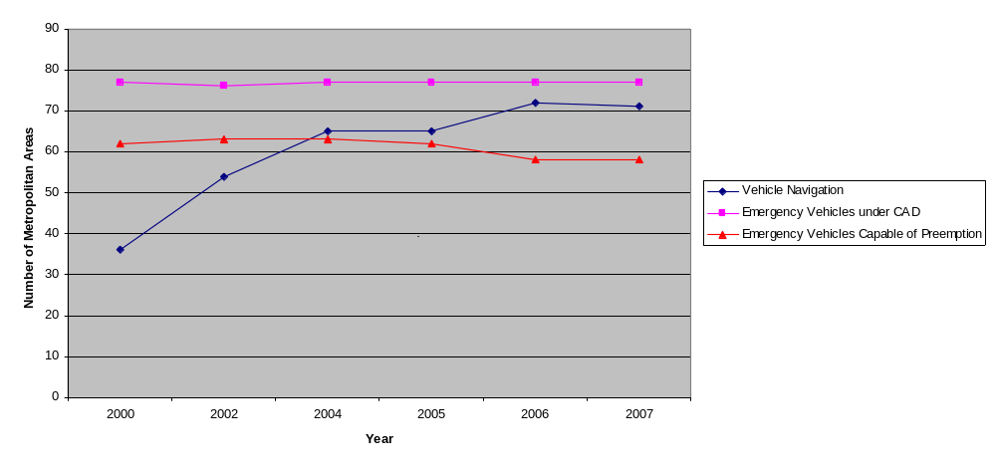
Trends for Adoption of ITS Technologies for Public Safety

Slide 13
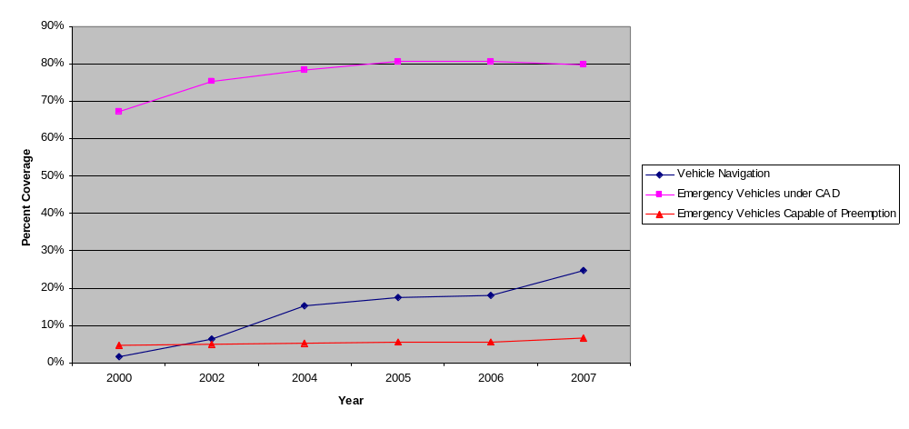
Trends for Deployment of ITS Technologies by Public Safety Agencies

Slide 14
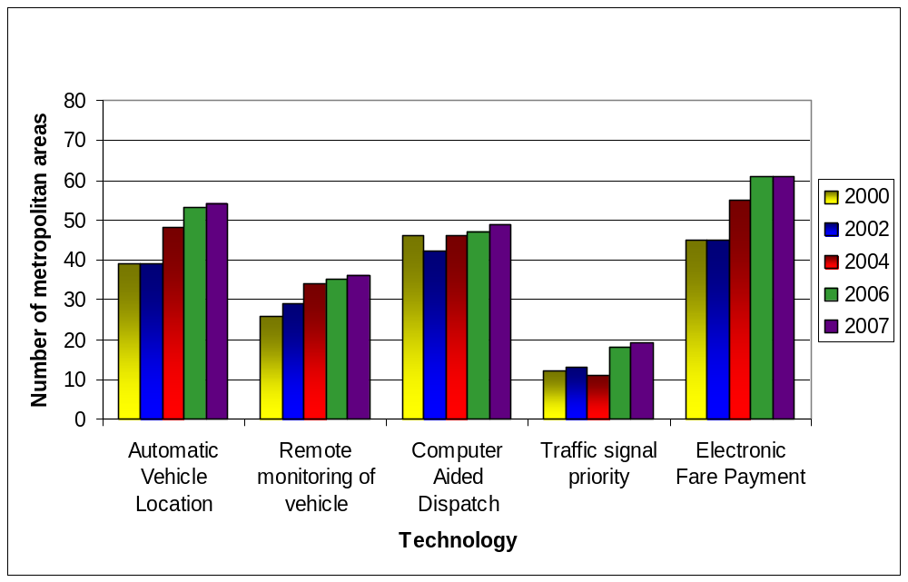
Adoption of Transit Management Systems, 2000 - 2007

Slide 15
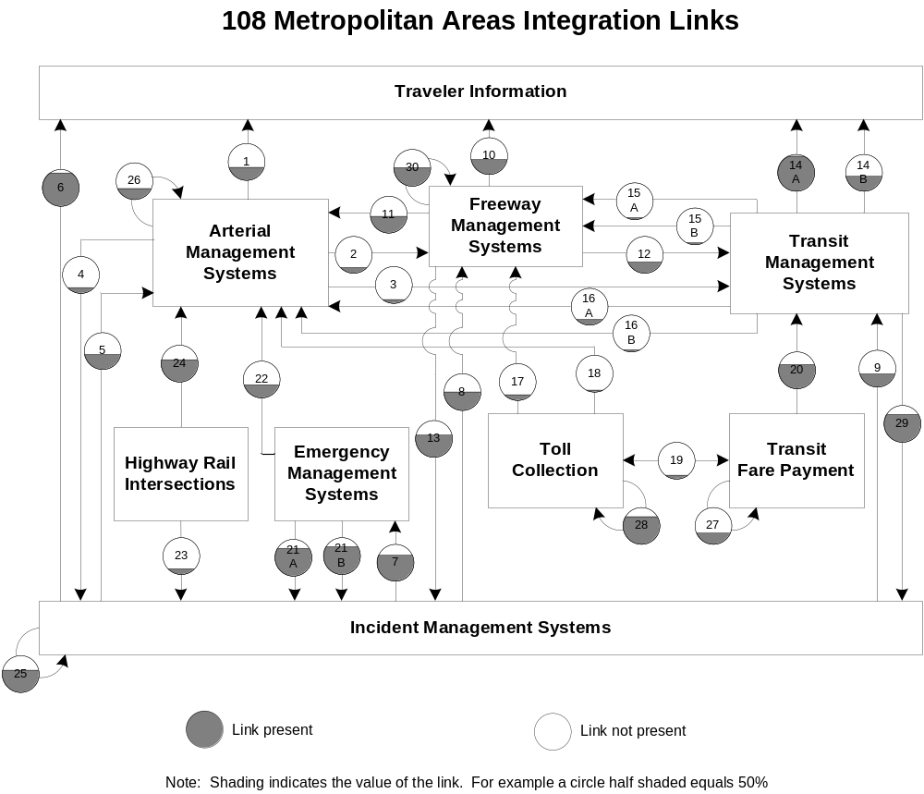
Status of Integrated Systems

Slide 16
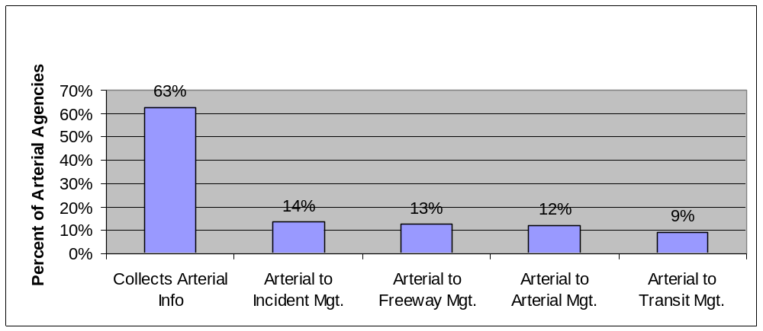
Arterial Integration Gap

Slide 17
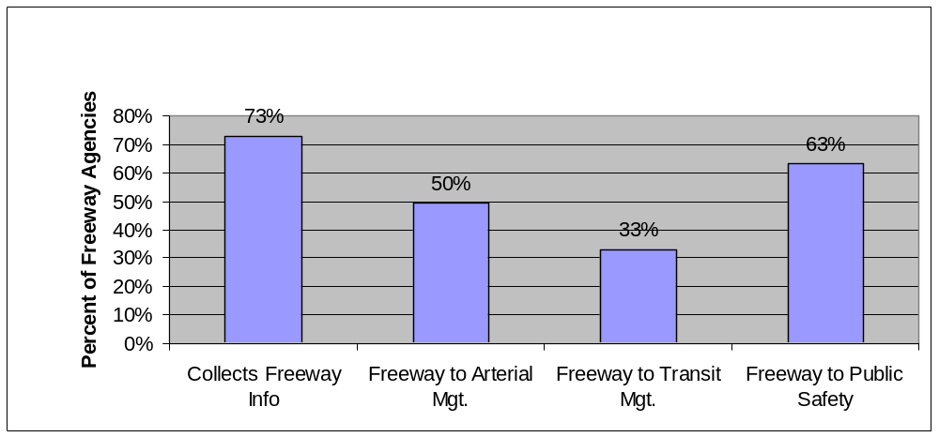
Freeway Integration Gap

Slide 18
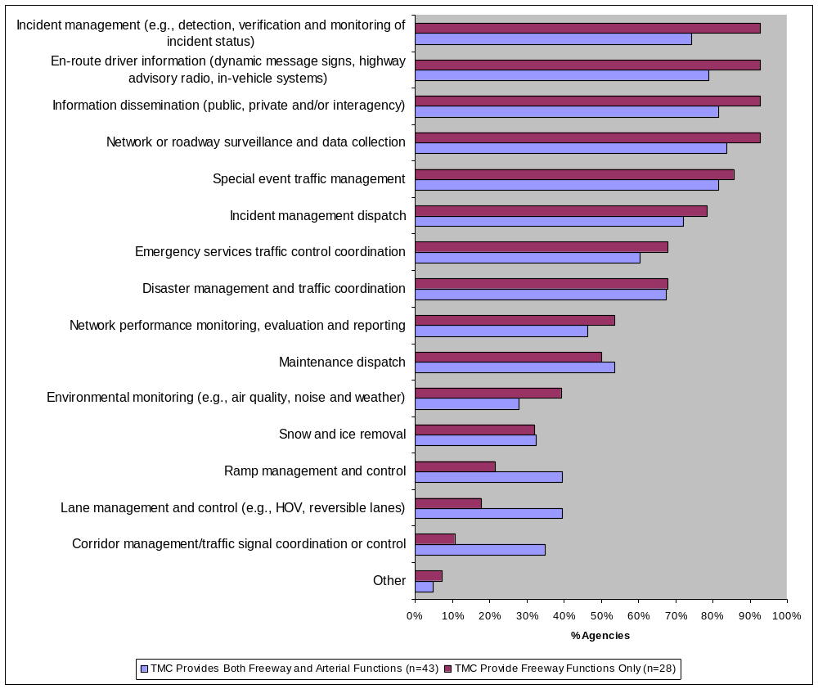
Which of the following best describes the functions performed on freeways?

Slide 19
Highlights from the 2007 Deployment Tracking Results
Overall, the 2007 results show a broad and deep commitment to ITS technologies; however…
  Coverage on freeways is generally less than half the total miles
  Trends show few or no new metropolitan areas adopting key technologies in the last few years and coverage is generally static
  Further, the pattern of deployment shows a greater emphasis on monitoring (surveillance systems) than management (ramp metering, lane control)
Looking ahead, expansion of the national ITS program will likely be linked to an increased emphasis on operating the system and meeting performance goals

Slide 20
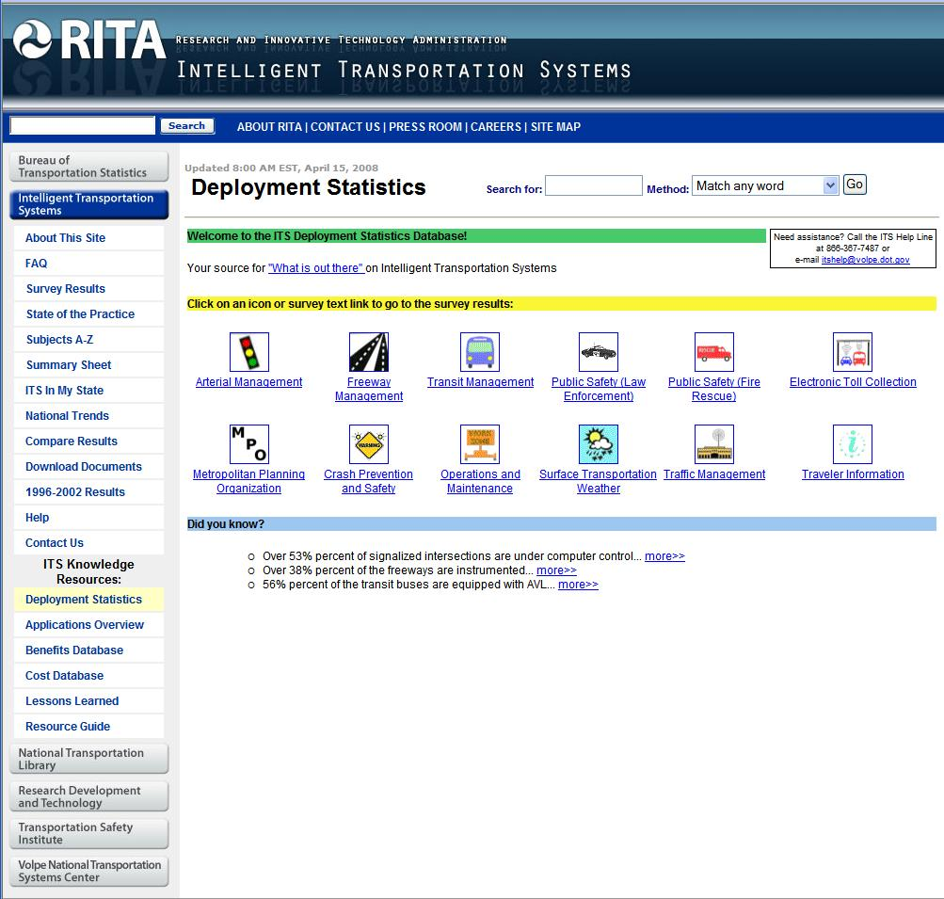
ITS Deployment Statistics Database
How much ITS has been deployed in cities and states across the U.S.
Annual or biennial data since 1997
Covers 108 metropolitan areas
All 50 states
Answers to almost 1000 deployment questions sorted into 12 technology categories
www.itsdeployment.its.dot.gov

Slide 21
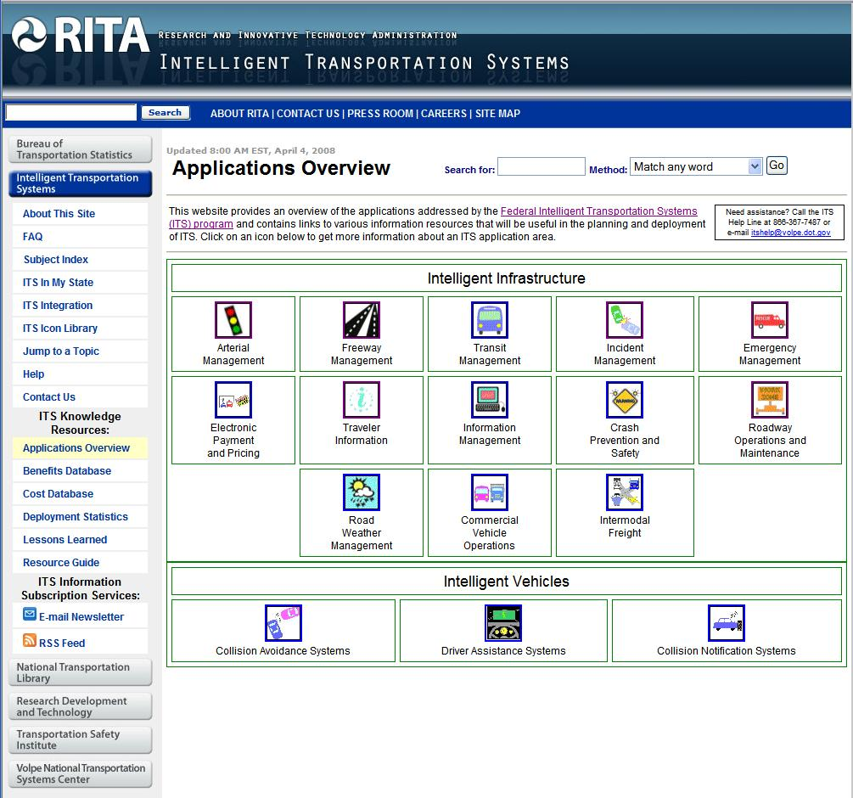
ITS Applications Overview
Brings multiple resources together
Sorts all ITS technologies into 16 major categories
Answers questions about each technology, e.g.:
  What are the benefits?
  What are the costs?
  How much is out there?
  What are the lessons learned?
  What evaluation documents are available?
  What resources are available?
  What are the related initiatives?
  Who are the DOT contacts?
www.itsoverview.its.dot.gov

Slide 22





ITS Decisionmakers’ Resources:
_{AO}
ITS Applications Overview
  www.itsoverview.its.dot.gov
  ITS Benefits Database
    www.itsbenefits.its.dot.gov
  ITS Costs Database
    www.itscosts.its.dot.gov
  ITS Deployment Tracking Database
    www.itsdeployment.its.dot.gov
  ITS Lessons Learned Knowledge Resource
    www.itslessons.its.dot.gov
  ITS Evaluation Documents Database
    www.its.dot.gov/evaluation/docs.asp
  ITS/Operations Resource Guide
    www.resourceguide.its.dot.gov
_{Applications Overview}
_{DS}
_{Deployment Statistics}
Notes:
This concludes our web tour of the ITS Decisionmakers’ Resources.
We hope you come away from this session with a basic understanding of the ITS Decisionmakers’ Resources, how they work, and how you can use them.
(Hopefully) We have also learned a lot from you during this session about what you like about the Resources and how you would like to see them improved.
Thanks for your time and attention.

Slide 23

Backups

Slide 24
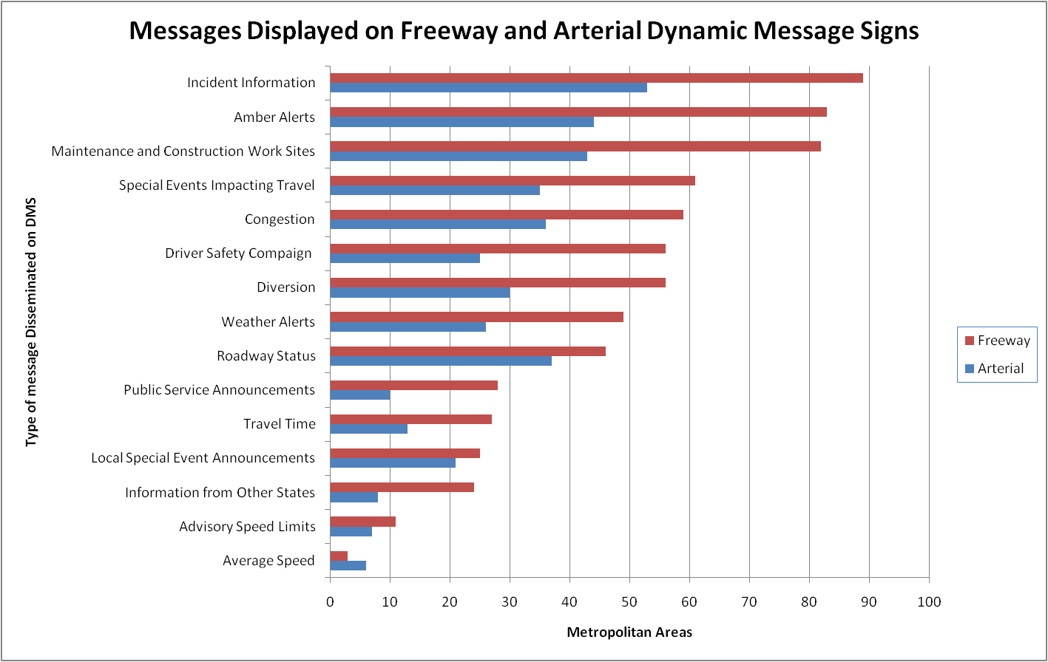

Slide 25
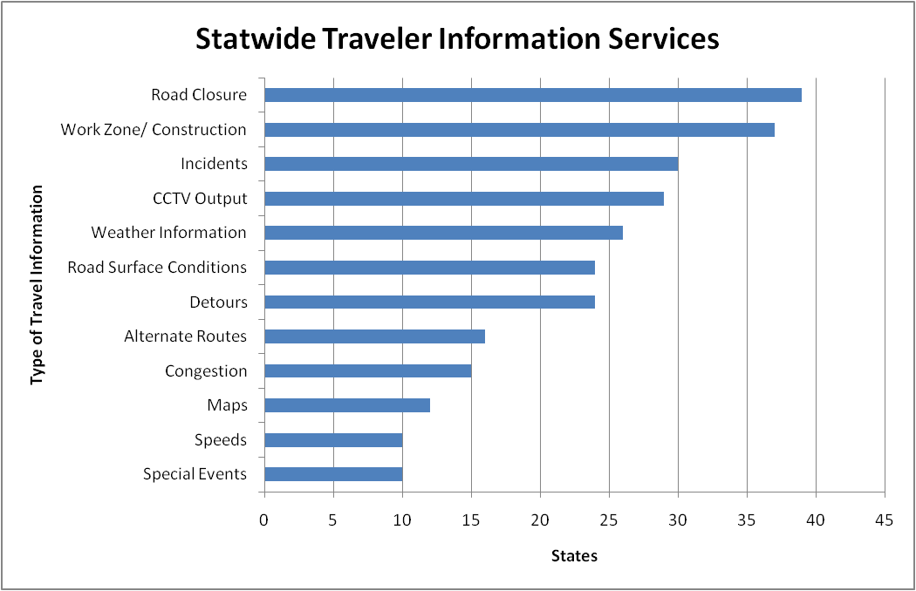
Statewide Traveler Information Websites
(n=39)

