Slide 1
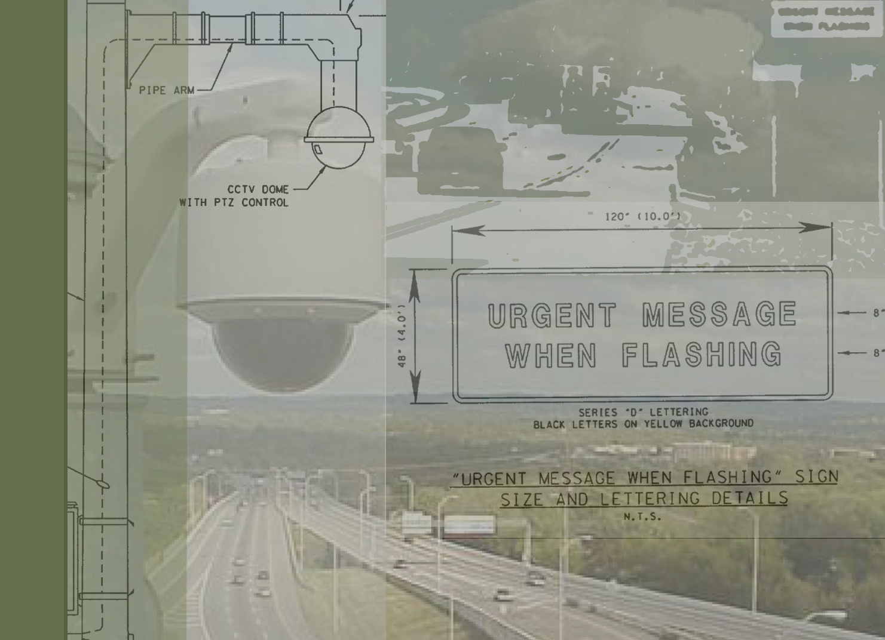

TDOT Statewide ITS
Performance Measures Plan
October 9, 2009

Slide 2
Performance Measures
“Start small but report now – don’t delay until you have the perfect data, the right measurement framework or a sophisticated information technology system. WSDOT’s 100 page Gray Notebook is published every quarter and is not automated. Pick a topic and start now.”
–Washington State Department of Transportation

Slide 3
Project Goals
The primary goals TDOT Statewide ITS Performance Measures Plan were to provide TDOT with:
Clearly defined operations objectives for ITS in the State of Tennessee
Specific performance measures to evaluate the progress made towards achieving the operations objectives
A set of recommended actions that specify what technology, procedural, and process related changes need to be made in order to begin tracking the performance measures

Slide 4
Participants
TDOT Divisions
TDOT Regions and SmartWay TMCs
Community Relations
Design
Incident Management
Information Technology
Long Rang Planning
Maintenance
Project Planning
Traffic Engineering
Region 1 – Knoxville SmartWay TMC
Region 2 – Chattanooga SmartWay TMC
Region 3 – Nashville SmartWay TMC
Region 4 – Memphis SmartWay TMC

Slide 5
Development Process
SmartWay Strategic Priorities
Develop Operations Objectives
Develop Performance Measures
Implement and Collect Baseline Data
Establish Targets for Performance Measures
Develop and Implement Action Plans for Achieving Targets
TDOT Region/ Division Interviews

Slide 6
Development Process
SmartWay Strategic Priorities
Develop Operations Objectives
Develop Performance Measures
Implement and Collect Baseline Data
Establish Targets for Performance Measures
Develop and Implement Action Plans for Achieving Targets
TDOT Region/ Division Interviews
Included as part of TDOT Statewide ITS Performance Measures
project scope.

Slide 7
Guiding Principles
Performance measures should be linked to existing ITS strategic priorities and operations objectives.
Performance measures should focus on results of the programs.
Performance measures should use data that is available, accurate, and reliable.
Performance measures should be simple and easy to understand.
Performance measures should be useful in conveying the benefits of ITS to the public.

Slide 8
Two Types of Performance Measures
Results of Products or Services
Outcomes
Products
or
Services
Products
or
Services
Outputs

Slide 9
Two Types of Performance Measures
Average Incident Clearance Time
Outcomes
TMC Hours of Operations
Number of Functioning CCTV Cameras
Outputs

Slide 10
Operations Objectives
Reduce incident clearance times
Reduce the number of secondary incidents
Reduce traffic flow recovery time
Provide accurate real-time traveler information statewide
Improve travel time reliability

Slide 11
Draft Performance Measures
A set of draft performance measures were selected based on the guiding principals and operations objectives
The TDOT ITS Coordinating Committee hosted a statewide video conference to discuss
  All of the Regions and most of the Division were represented
  Each draft performance measure was discussed, debated, and modified based on input from the entire Committee
Consensus was reached on a set of seven performance measures

Slide 12
Draft Performance Measures
Each performance measure included:
Performance Measure Description
  Purpose
  Calculation Methodology
  Tracking
  Data Required
  Relationship to Existing Activities
  Example
Implementation Plan
  Specific steps required in order to start tracking the performance measure

Slide 13
Performance Measures
Operations Objective: Reduce incident clearance times
Performance Measures:
1. Percent of major highway incidents that are cleared within 90 minutes or less
(Tracked by metro and rural areas in each region)
2. Percent of minor highway incidents that are cleared within 30 minutes or less
(Tracked by metro and rural areas in each Region)

Slide 14
Performance Measures
Operations Objective: Reduce the number of secondary incidents
Performance Measure:
3. Secondary incident occurrence rate
(Tracked by metro and rural areas in each Region)

Slide 15
Performance Measures
Operations Objective: Reduce traffic flow recovery time
Performance Measure:
4. Average time to clear traffic backups post incident
(Tracked in each Region on all roadway segments where deployment of ITS allows TDOT to determine traffic flow recovery time)

Slide 16
Performance Measures
Operations Objective: Proved accurate real-time traveler information statewide
Performance Measures:
5. Perceived accuracy of real-time traveler information
(Tracked in each Region for field devices and tracked statewide for SmartWay website and 511 traveler information number)
6. Average time to post real-time traveler information on field devices
(Tracked in each Region for field devices)

Slide 17
Performance Measures
Operations Objective: Improve travel time reliability
Performance Measure:
7. Travel time variability on instrumented roadway segments
(Tracked in each Region on all roadway segments where travel time data is available)

Slide 18
Next Steps
Select performance measures to implement and track
Collect baseline data for performance measures
Set targets for performance measures
Develop an action plan that identifies the steps needed in order for TDOT to meet their performance measure targets
Implement the action plan, monitor results through performance measures, and modify action plans as necessary

Slide 19
Thank You!
Terry Gladden
TDOT Long Range Planning
615-741-3629
terry.gladden@tn.gov
Tom Fowler
Kimley-Horn and Associates, Inc.
512-418-4504
thomas.fowler@kimley-horn.com

