Slide 1

Leveraging Bandwidth and Media Strategy for the Implementation of Future ITS Backbone Technologies
Tom Bennett, RCDD, WD, OSP, TE,CT

Slide 2

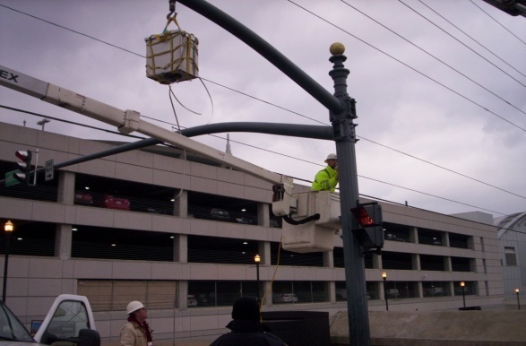

The Strategies we will Discuss Today will Address the Challenges We Face in Designing, Deploying, and Operating
ITS Networks

Slide 3
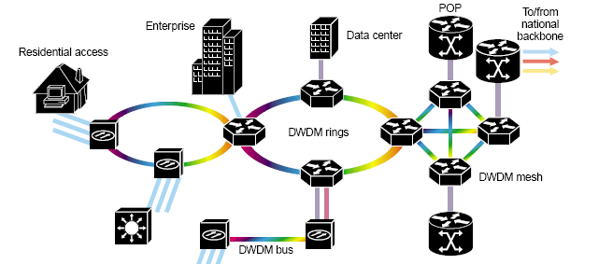
Geographical Coverage Challenges
An ITS Network is essentially classified as a Metro Area Network
Communications Circuit media deployments:
A. Dedicated Fiber Optic Backbone
B. Wireless LAN extension (802.11)
C. Public Network – Leased Line or Broadband

Slide 4
Industry Backbone Standards Which backbones are appropriate for the ITS environment?
Hiearchical Star and Ring Topologies Most Common
Fiber Optic Backbones –Single Mode Deployment
Wireless Mesh Backbone – The 4.9 Ghz public safety band
NLOS and LOS Low Speed P0int to Point and Wireless Technologies

Slide 5
Investments Made in Infrastructure
Right of Way Facility Planning and Design
Street Crossings, Permits, Documentation, Encroachment Agreements
Underground Pathway
Duct banks, Bore Sleeves, Manholes, Junction Boxes
Roadside Infrastructure
Poles, DMS Structures, Cable Media, Towers, Antennas, Signage
Monitoring Center and all Active Network Devices
Core and Remote Switch Fabric, Routers, CCTV, DMS, RDS, HAR, etc.
How Many of these Investments can we leverage Now and in the Future?

Slide 6
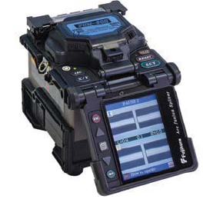
Long Term Value of Investments
How well did Designer, Contractor Perform their Role?
Design Value = Immediate Need + Long Term Planning
Includes Performance Specification + Growth Capacity
Install Value = Craftmanship + Attention to Detail

Slide 7
What is the Intended Life Span of the ITS System?
Most ITS implementations have ILS of 15-20 years.
Includes Cable Media and Roadside Infrastructure
This does not include Network Specific Components
MTBF ratings for these components are lower…

Slide 8
Component Risk Factors
Environmental Extremes (ex: Humidity, Lightning)
Proper Level of Surge Protection Level
Electrical Source + Media level of Protection
Primary Protection
Secondary Protection
Grade of Component (Hardened, Redundancy)
Physical Security (Prevent Theft!!)

Slide 9
Performance Now and Later
Expected Bandwidth and Network Performance
Compatibility and Flexibility of Interfaces
Backbone Performance Headroom properly matched for Capacity and Growth
Use Designs Based Upon Non Proprietary Standards

Slide 10
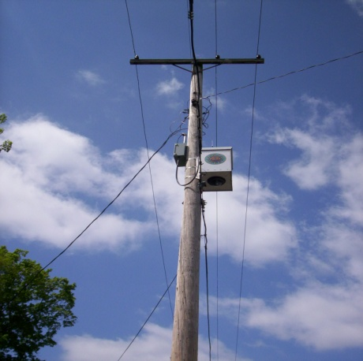

Typical Bandwidth Requirements for ITS Components
CCTV IP Encoded Video Stream
1-6MBPS dependent upon encoding method and fps settings
VDS/RDS System Telemetry
2-5 MBPS Typical (Based on Software)
Traffic System Controller
1 MBPS Worst Case (Based on Polling settings)
DMS signage communication
1 MBPS Worst Case (Based on Software Management)

Slide 11
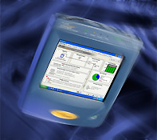
Determining Network Performance
Use of Ethernet Protocol Analyzers to
Verify Predicted vs. Actual Performance
Use of SNMP Network Management Platforms
Benchmark Initial Configuration as Reference
Use as Live Troubleshooting Tool

Slide 12
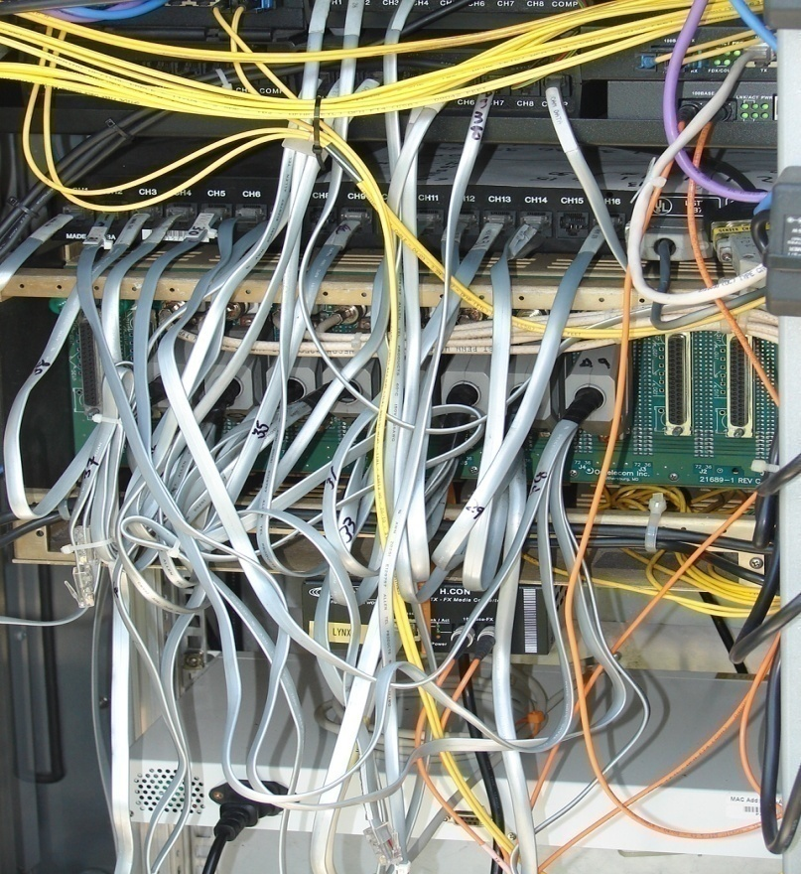
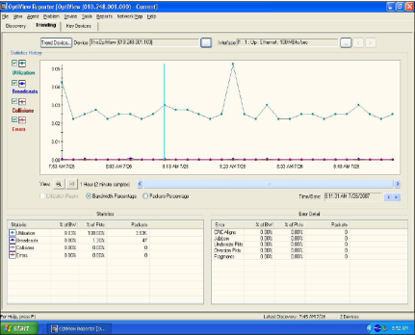
Protocol Analysis Tools
Hardware vs. Software Protocol Analysis
Hardware Analyzer:
Software Analyzer:
Measurement made from the field or from TMC core switch location

Slide 13

The IP Video Multicast Stream
IP Video represents the highest bandwidth usage
TCPIP vs UDP protocol bandwidth usage
Frames Per Second setting requires consideration
Video Compression Methods Utilized are Improving
1. MPEG 2-4 Standard
2. H.264 Standard
Notes:
Take ownership of this critical layout.

Slide 14
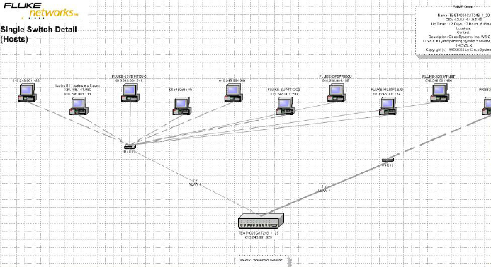
Bandwidth Strategy
Goal: Load Balance the network through planned port optimization. (Analyze prior to Activation)
Goal: Effective use of VLAN assignment to segregate network traffic by type (video, telemetry, etc.).
Notes:
Address wire management and slack loop storage.

Slide 15
Media Strategy BACKBONE MEDIA OPTIONS
ITS Backbone Selection and Design

Slide 16

ITS Equipment Cabinet Layout
Wire Management is a vital investment to maximize future use of an equipment cabinet

Slide 17
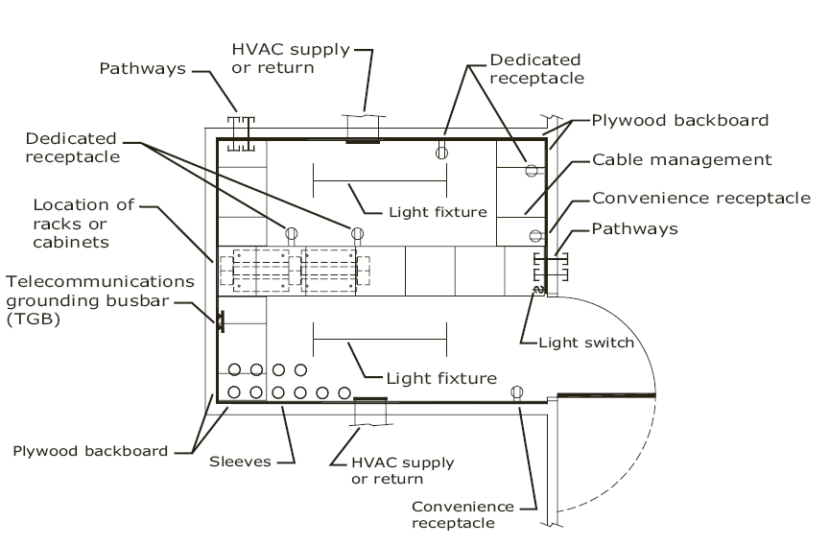
TMC Monitoring Center Entrance/ER Facility

Slide 18

Media Strategy- Proper Entrance Cable Routing
Route cables for maximum benefit
A. Ladder Rack
B. D Rings
C. Bend radius
D. Slack Loop Protection
E. Closed Carrier Protection (Conduit and Innerduct)
Notes:
Each factor is an important closet build out consideration.

Slide 19
Fiber Optic Backbone Strategy
Single Mode Fiber (8.3/125 micron)is the Backbone of Choice
for the ITS Application.
Zero Water Peak Glass should always be specified.
End to end solution should be maintained down to pigtails,patchcords.
Older systems deployed may have non ZWP fiber installed. This will impact their ability to utilize WDM technology in the 1400nm window.
Notes:
Typical floor sleeve exit, note no vertical transition space was planned.

Slide 20
Use of High Performance Optical Connectors and Splicing
Best performing terminations are SFF type, angle polish;
they offer Significantly Better Return Loss Performance.
Field terminated connectors have significantly higher insertion loss and will experience greater variation in insertion loss between strands over time.
Fusion spliced factory pigtails which utilize factory machine polish connector end face will provide superior and consistent performance.

Slide 21
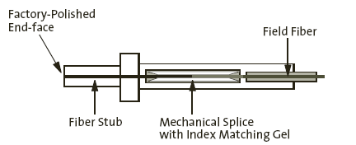
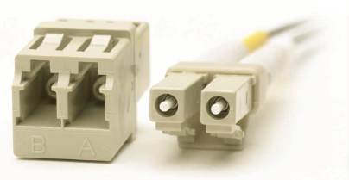
Field vs. Factory Terminated Connectors
Fusion Splice a Factory Pigtail for Optimum Performance
Field Installed
Fiber Connector

Slide 22
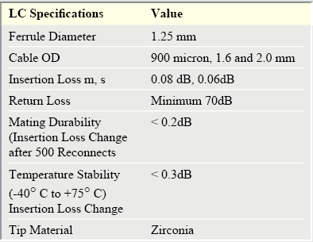
SFF LC Single Mode Connectors
LC SFF
Significant Performance Increase Over SC/ST Connectors

Slide 23
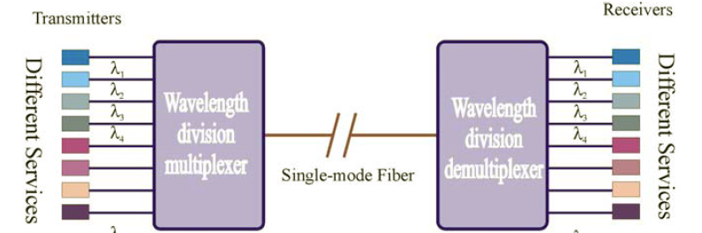
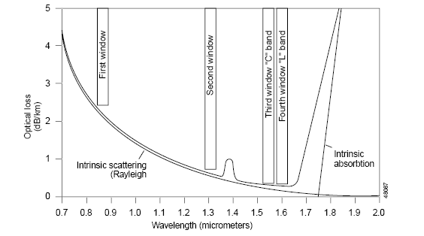
Principles of WDM
How WDM Helps us Increase Bandwidth
WDM or DWDM Process
Loss vs. Wavelength Curve

Slide 24
Maximizing Fiber Performance
Utilize ZWP fiber in all backbone segments
Insure that all backbone pigtails and patch cords
utilize ZWP fiber cable to prevent bottlenecks
Utilize fusion splicing of all single mode pigtails
Test all strands at minimum of 1310 nm
and 1550nm wavelengths

Slide 25
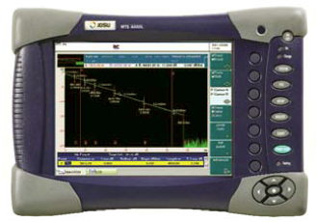
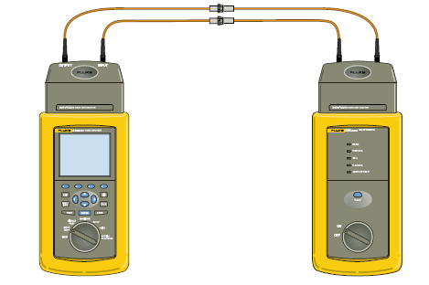
Performance Verification
OTDR performance testing
at 1310nm/1550nm
Optical Power Meter Testing
at 1310/1550 nm
An Optical Spectrum Analyzer is a highly effective tool that may be utilized to confirm full range of optical wavelength performance for the fiber cable plant.

Slide 26
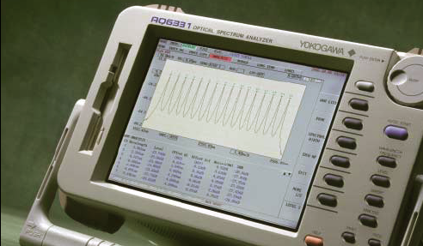
Optical Spectrum Analyzer
Depicting Dense Wavelength Division Multiplexing Measurement

Slide 27
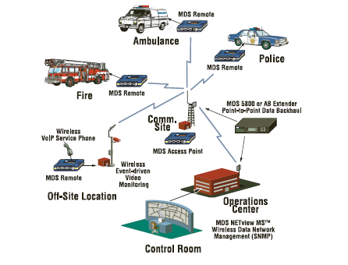

Wireless Network Deployment
Types of Wireless Networks
Point to Point Wireless Technology – Low speed Telemetry or Serial Communications
Point to Multipoint – IEEE 802.11 a,b,g,n WAP
Will support limited IP Video 2.4 Ghz,5.0, 5.8 Ghz

Slide 28
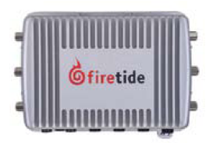
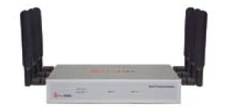
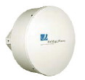
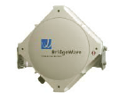
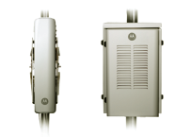
Mesh Node Architecture – Mesh Cell Construction
900 Mhz NLOS , 2.4 Ghz,4.9 Ghz, 5.0,5.8 Ghz
Backbone Gigabit Wireless (MM Wave 60,80 Ghz)
Public Wireless(WIMAX 802.16,WAVE 802.11p, 3G,4G )

Slide 29
Future ITS Backbone Implementations
Single Mode Fiber will continue to dominate ITS
Metro Area Mesh Deployments will be a factor
Suitable for municipal vehicle deployment.
Gigabit wireless links will provide backbone extension.
Public wireless networks such as 3G and 4G will continue to be used to supplement remote bandwidth needs as device bandwidth needs decrease (Video H.264 compatible codecs cameras increase).
Use of DS1 Lease Line Facilities will decrease.

Slide 30
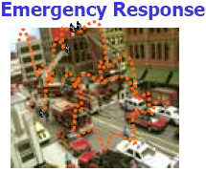
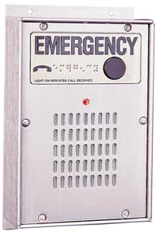
ITS Future Applications
Use of mobile technologies such as Mesh Wireless
Allows improved mobile support for vehicles.
Leverages existing metal poles as antenna structures.
Use of IP Voice technology such as IP
emergency phones located at roadside
along high traffic corridors

Slide 31
ITS Future Applications (continued)
RFID Applications – Including sensors for detection of nuclear radiation, explosive and hazardous materials.
ETC Applications – Electronic Toll and Commerce
Traffic Enforcement Systems
Emergency Vehicle Notification Systems

Slide 32
ITS Future Trends of Certainty
Continued transition of CCTV cameras to IP technology with integrated recording solutions.
If and when the decision to record video is made, IP recording systems are available that have powerful built in analytics
Transition of serial interfaces to Ethernet standards
for all telemetry and polling devices.
Terminal Server serial port scenarios will cease to exist.

Slide 33



Slide 34

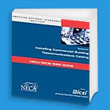


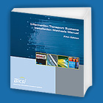
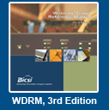
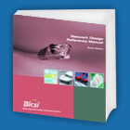
Reference Publications
TDMM
TIA/EIA
TIA 568 Standard
ESSRM
NTS
WDRM
ITSIMM

