Slide 1
Intelligent Transportation Systems in Franklin
Eric Gardner, P.E.
Director of Engineering
(615) 791-3218
ericg@franklintn.gov
1

Slide 2
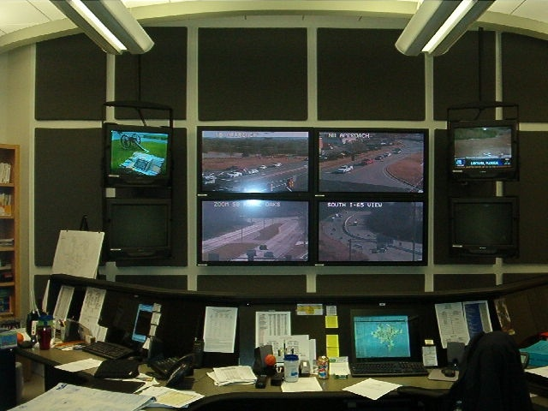
City of Franklin’s ITS History
1996 – Met w/ USDOT in Washington D. C.
1999 to 2002 – Over $3.0 million in Federal Funding secured to build the Traffic Operations Center (TOC) and the SR 96 E System of 4 CCTV cameras and communications with 12 signalized intersections.

Slide 3
City of Franklin’s ITS History
April 2002 – TOC Open
Fiber connection to 12 intersections
Hardwire interconnect with 8 intersections in CBD
April 2002 to 2006 – Pre ITS Master Plan
No New CCTV
Addition of 2 intersections on Fiber
Addition of 1 intersection on Hardwire
Implementation of a Spread-spectrum radio interconnect with 24 intersections.

Slide 4
City of Franklin’s ITS History
2006 - ITS Master Plan
Defined the ITS Network for full system build out
Using Existing Planned Roadway Construction
Provisions for Infrastructure as part of development
Small scale City projects to fill gaps in the network
Proposal for MPO on upcoming Regional Transportation Plan
Amended to the Major Thoroughfare Plan
Identifies ITS Infrastructure as part of Impact Analysis

Slide 5
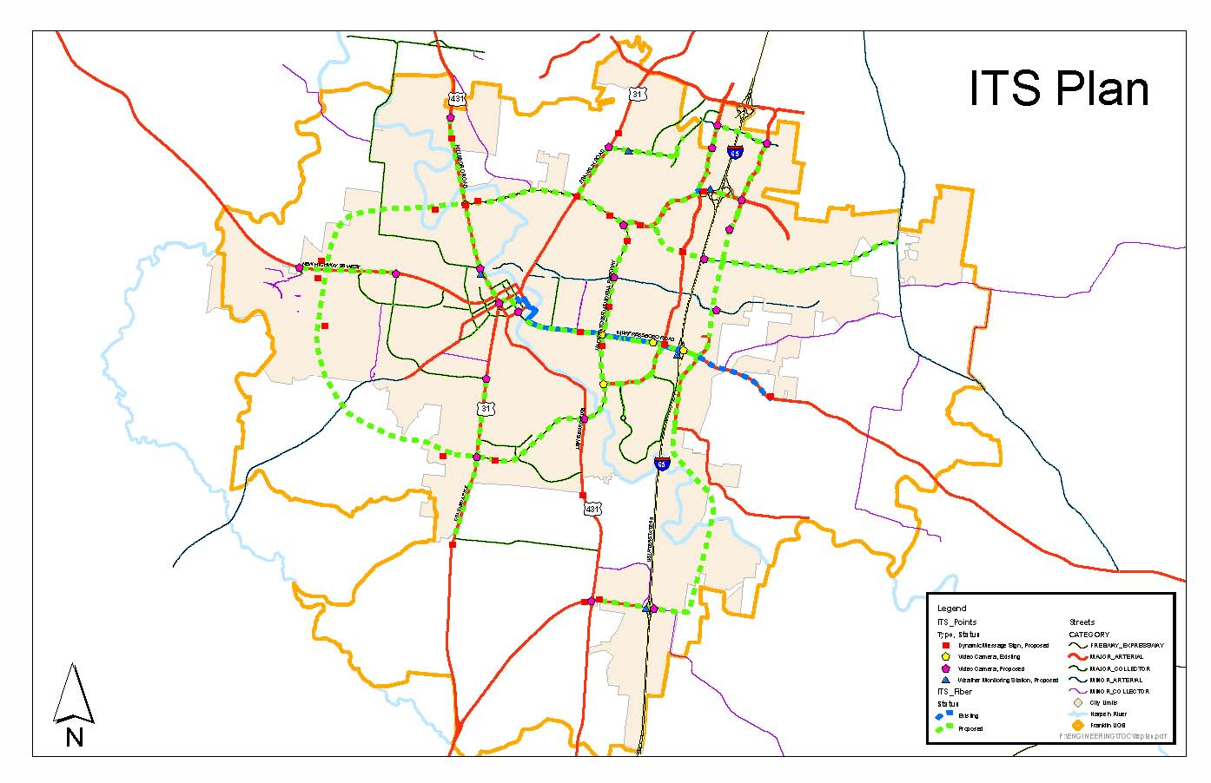
2006 ITS Master Plan

Slide 6
2006 ITS Master Plan
Post 2006 ITS Master Plan
2 CCTV Cameras added through TDOT Projects with 8,000 lf of 3” PVC and Pull boxes
4 CCTV Cameras added through COF Projects with 10,000 lf of 3” PVC, pull boxes, 4,000 lf of 48 ct Fiber.
2 CCTV Cameras added by Development with over 12,000 lf of 3” PVC and pull boxes.

Slide 7
City of Franklin’s ITS History
2007 – Traffic Operations Center Software Upgrade
2008 – Traffic Operations Center Infrastructure and Upgrades
2009 – Franklin ITS Phase 1 (ARRA 2009)

Slide 8
2009 ARRA ITS Project

Slide 9
ITS Funding Sources
Include ITS Infrastructure as part of other Projects.
Federal
STP Funding – Typically 80/20 Local Match
State
Mack Hatcher Memorial Pkwy (SR 397) widening
Mack Hatcher Memorial Pkwy (SR397) extension
Local
Carothers Phase 1, 2 and 3.
Hillsboro Road
Private
Rachel Springs Development.
Highwoods Development.

Slide 10
Regional Significance of the ITS Infrastructure
The Nashville Regional ITS Architecture from 2003.
MPO is currently updating.
TDOT’s Current ITS project is currently installed to Concord Rd. at I-65 in Brentwood.
The City of Brentwood currently has an ITS infrastructure in place throughout the city.
The City of Franklin’s ITS Project is running conduit to the border with Brentwood.
Conduit being added to I-65 Widening Project from SR 96 E to SR 840.

Slide 11
Questions???
Eric Gardner, P.E.
Director of Engineer
City of Franklin
ericg@franklintn.gov
Call: 615.791.3218

