Slide 1


ITS
Applications
for
Work Zones
October 8, 2009

Slide 2
Smart Work Zone Terms
PATMS
Portable Active Traffic Management System
Smart Work Zone
Intelligent Work Zone
Temporary ITS
Real Time Traffic System

Slide 3
PATMS
Portable Active Traffic Management Systems
The ability to dynamically manage recurrent and non-recurrent congestion based on prevailing traffic conditions in real time with portable field devices.
Recurring Congestion
daily commuting
usual pattern for a given location, time, and day
Non-Recurring
Congestion
work zones
incidents
special events
adverse weather
Notes:
Not all work zones require PATMS, but once non-recurring congestion begins to impact recurring congestion then PATMS should be considered and can be cost justified through savings in reduced crashes, delay and fuel/emisions.

Slide 4
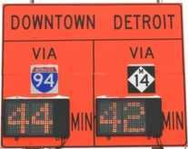
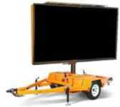




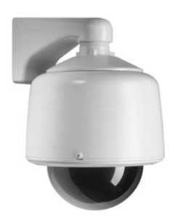



SWZ
System Overview
I-94
Stopped Traffic
Sensor 1832
06/02/09 18:05.00
Notes:
JamLogic combines field sensors and inputs with real time traffic data. Site specific application logic is applied and then output to any field device, PDA or web page to provide work zone system information to public and private partners.

Slide 5
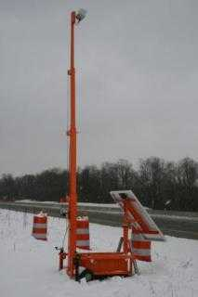
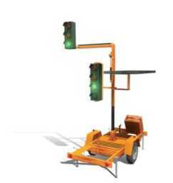

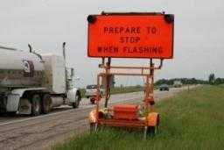
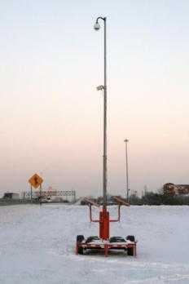
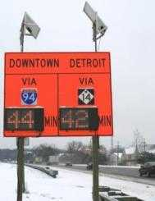
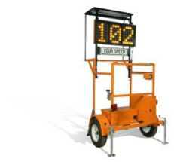
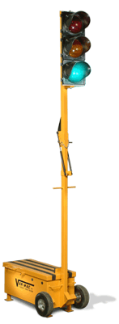
Smart Work Zone
Field Assemblies
PCMS
Flasher Trailer
Temp Signals
Sensor Trolley
Speed
Trailer
Static-Dynamic
Signs
Camera Trailer

Slide 6


Smart Work Zone
GOALS
Worker/Motorist Safety | Primary Crash
Capacity/Throughput | Secondary Crashes
Trip Reliability | Fuel/Time/Emissions
Accurate Info to Drivers | Delay Time
Uniform Behavior | Headway
Public Respect | Road Rage
Awareness | Speed Differentials
Notes:
Properly designed work zones all have the following goals. This table lists the INCREASED benefits and DECREASED liabilities of a good work zone.

Slide 7
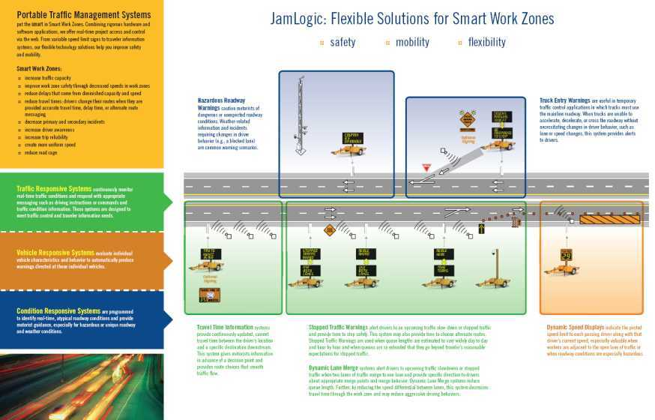
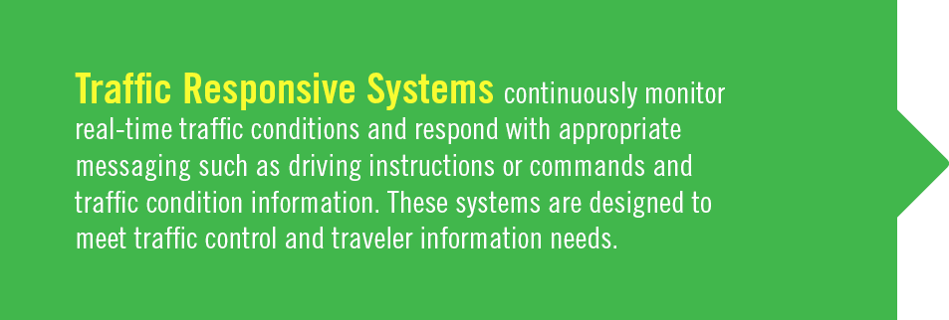
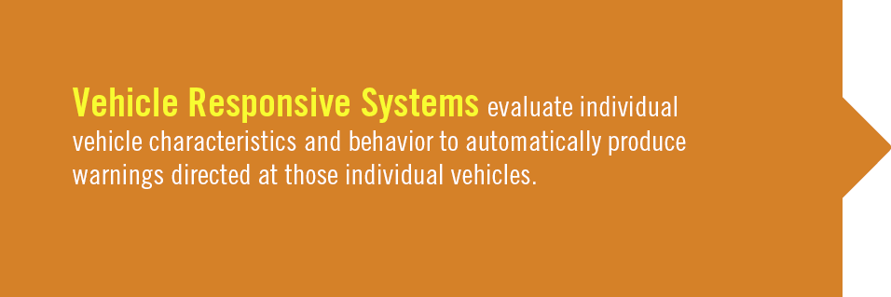
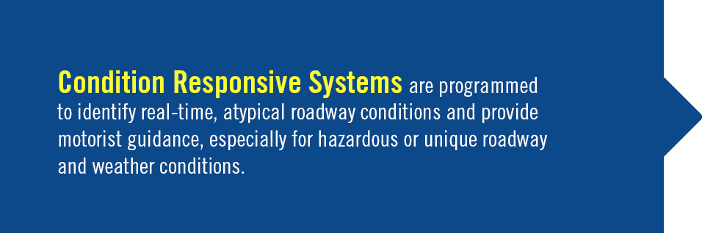

SWZ Applications
Notes:
Applications can be divided into three system categories…
TRAFFIC RESPONSIVE (reacting to general traffic conditions),
VEHICLE RESPONSIVE (responding to a specific vehicle), and
CONDITION RESPONSIVE (responding to site specific conditions).

Slide 8
SWZ
Applications
APPLICATION / CATEGORY | TRAFFIC RESPONSIVE | VEHICLE RESPONSIVE | CONDITION RESPONSIVE
TRAVELER INFORMATION SYSTEMS
Travel Time | X
Delay Time | X
Route Management | X
TRAFFIC CONTROL SYSTEMS
Dynamic Lane Management/Late Merge/Early Merge | X
Dynamic Speed Advisory | X
Changeable Speed Limit |  |  | X
Temporary Signal or Ramp Metering | X
CONFLICT WARNING SYSTEMS
Congestion Advisory Stopped/Slow Traffic - Queue Warning | X
Vehicles Entering/X-ing/Exiting Warning |  | X
Excessive Speed Warning |  | X
Hazardous Roadway Warning |  |  | X
Work Area Intrusion Warning |  | X
Oversized Vehicle Warning |  | X
Notes:
The three application categories can also be subdivided into three types of systems:
TRAVELER INFORMATION (Informing Motorists)
TRAFFIC CONTROL (Managing Motorists)
CONFLICT WARNING (Warning of Potential Danger)

Slide 9
Traffic Responsive
Examples
APPLICATION | EXAMPLES
Travel Time | Time to Downtown - XX Minutes
Delay Time | Hwy 123 to Exit Z - XX Min Delay
Route Management | Major Delays – Seek Alternate Routes
Dynamic Lane Management | Late Merge/Early Merge/Speed Warnings
Dynamic Late Merge | Stopped Traffic Ahead – Use Both Lanes Merge Ahead – Use Both Lanes Merge Here – Take Turns
Dynamic Early Merge | Merge Right (or Left) – Do Not Pass
Dynamic Speed Advisory | Watch for Slow Traffic – 30 MPH Ahead
Congestion Advisory | Stopped Traffic Ahead – Prepare to Stop Be Prepared to Stop – When Flashing
Temp. Ramp Metering | Form 2 Lanes When Metered – 1 Car per Green
Temp. Signals
Notes:
Let’s review some Traffic Responsive examples.

Slide 10
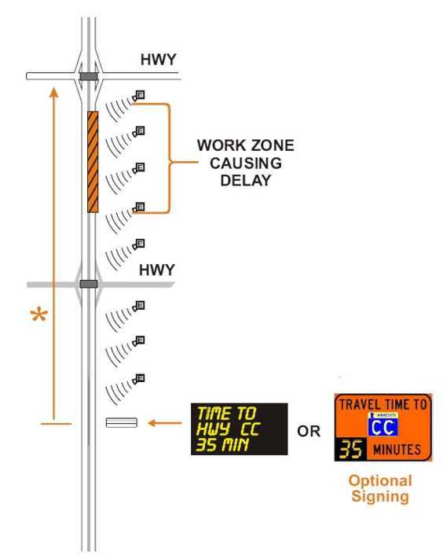
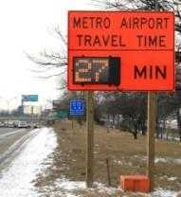
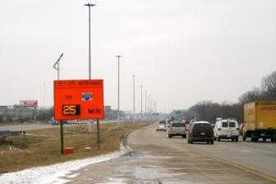
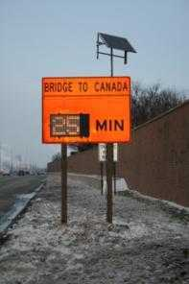
Traffic Responsive – Traveler Info
Travel Time Application
Saving:
Fuel, Time &
Crashes
Notes:
Travel Time is a common application for works zones. By providing accurate info to drivers, road rage and aggressive driving is reduced and so are complaints and calls to the DOT.

Slide 11
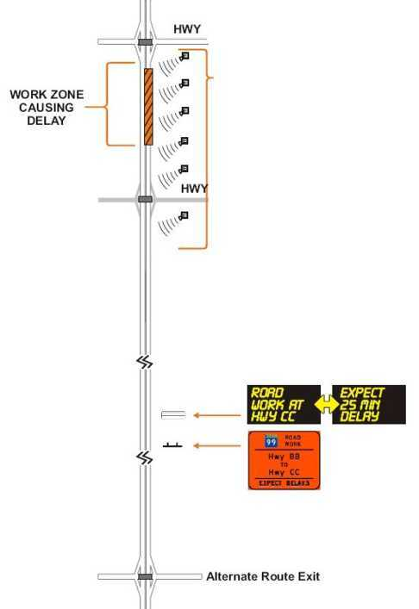
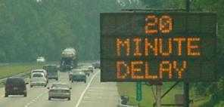
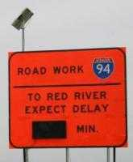
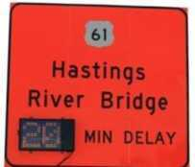
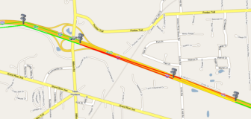
Traffic Responsive – Traveler Info
Delay Time Application
SPEEDS < 30 mph
SPEEDS 30-45 mph
SPEEDS > 45 mph
Notes:
Delay time applications are much like travel time, but assist drivers that are not familiar with the local area and roadways. Delay times should reflect the amount of additional time it takes to travel a segment of road beyond the free flow time (at posted speeds).

Slide 12
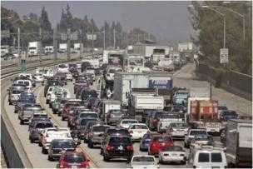
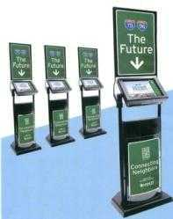

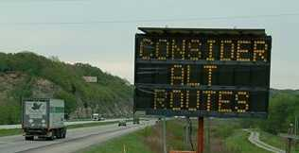
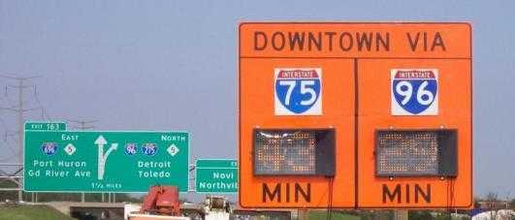
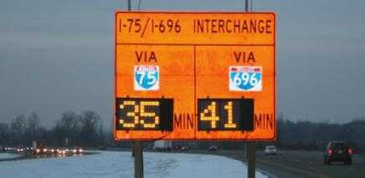
Traffic Responsive – Traveler Info
Route Management Application
Kiosks
Dual Travel Times
Notes:
Route management incorporates travel times or delay times and suggest alternate routes when major congestion occurs, thus allow for better system wide traffic distribution and more trip reliability.
The dual travel times above where used in Detroit and were different by almost 15 minutes when the job started, but commuters quickly adjusted their routes to provide almost balanced times, thus balance the overall system traffic in the entire area.

Slide 13
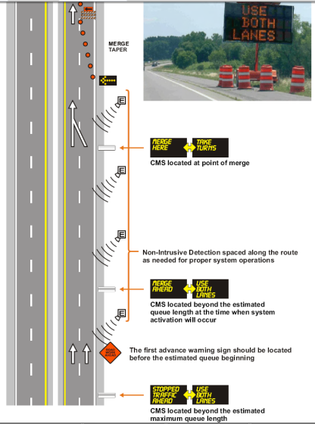
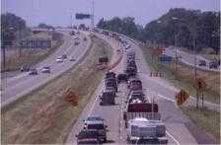
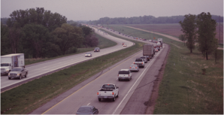

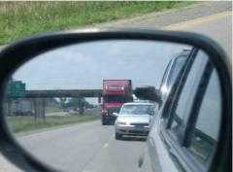

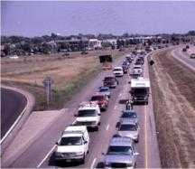
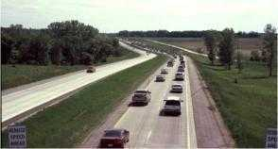
Traffic Responsive – Traffic Control
Dynamic Lane Management Application
AFTER
BEFORE
AFTER
Notes:
When Dynamic Lane Management (a.k.a. Dynamic Late Merge or Dynamic Early Merge) is utilized drivers utilize both lanes during congested periods, thus reducing queue lengths and providing more orderly and uniform behavior. The AFTER photos above are proof of the ability of this application to manage traffic. This same system layout can be utilized for Early Merge during free flow or to warn excessive speed vehicles of their unsafe approach to a work zone. This system can also be used as a Prepare to Stop system or Speed Advisory system.
This system layout provides the most flexible system and can accommodate numerous applications depending on current traffic conditions.

Slide 14
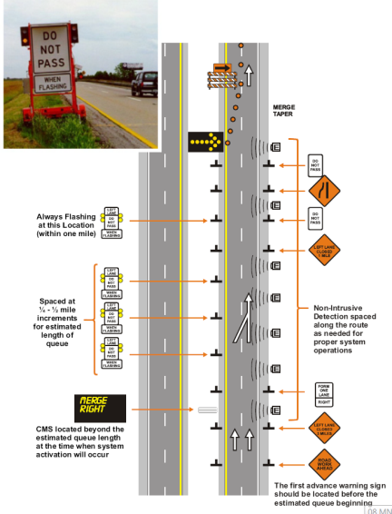
Traffic Responsive – Traffic Control
Dynamic Early Merge Application
Notes:
This is an example of the dynamic early merge system, which can activate static-dynamic (flashing) signs or PCMS’s to encourage early merging and no passing during free flow conditions.

Slide 15
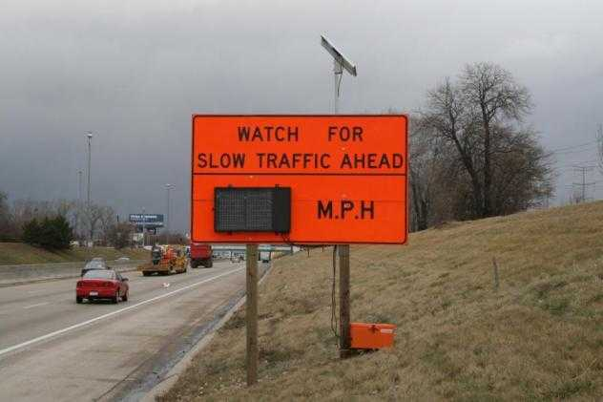

Traffic Responsive – Traffic Control
Dynamic Speed Advisory Application
Notes:
This Traffic Responsive application is useful in warning motorists of the average traffic speeds ahead. This example is a two digit dynamic display on a static sign. This could also be deployed on portable trailers and moved to the proper location to best meet the specific traffic needs. Non-intrusive detection upstream provides this vital information, thus reducing the potential for rear end crashes (the most common type in work zones).

Slide 16
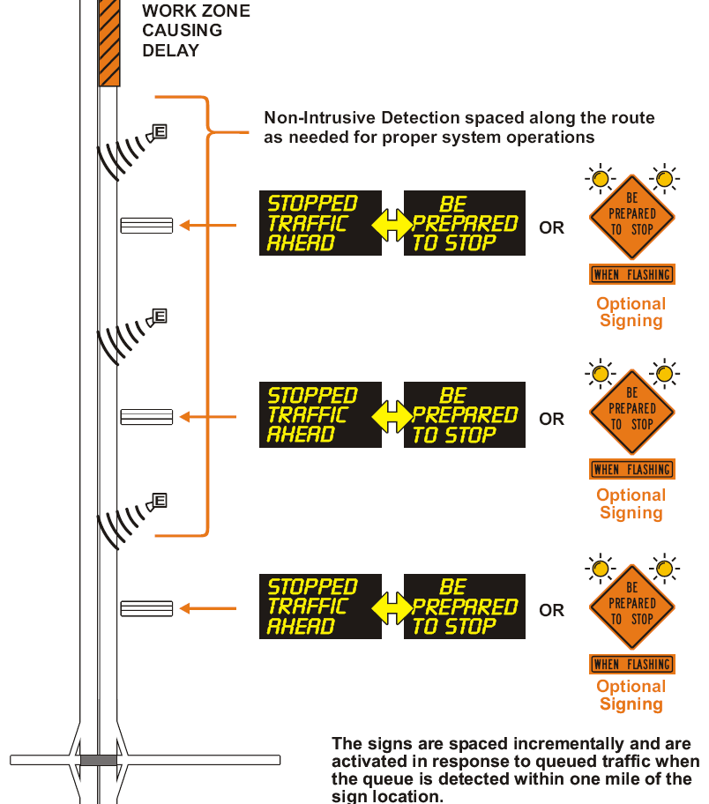
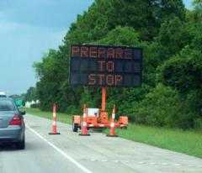
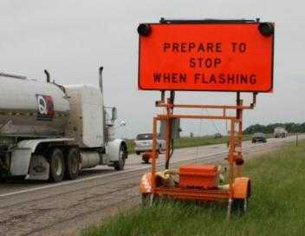
Traffic Responsive – Conflict Warning
Congestion Advisory Application
Notes:
The “Prepare to Stop “ application is extremely useful and helps greatly reduce potential rear end crashes which are common when approaching a work zone traffic queue. Mobile trailer applications (shown above) are great when spaced every ½ mile in the areas where queue typically occur and this system can be easily expanded or relocated.

Slide 17
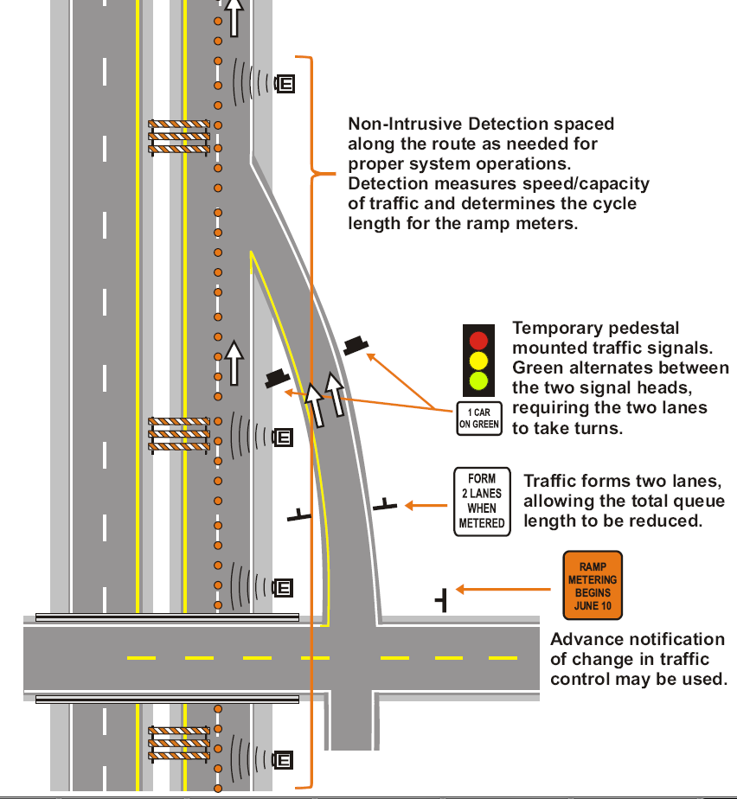
Traffic Responsive – Traffic Control
Temporary Ramp Metering Application
Notes:
A temporary ramp meter application should be considered when a freeway has been reduced by a lane and intermittent large influxes of traffic enter from a on-ramp and would normally cause major disruptions to work zone traffic flow.

Slide 18
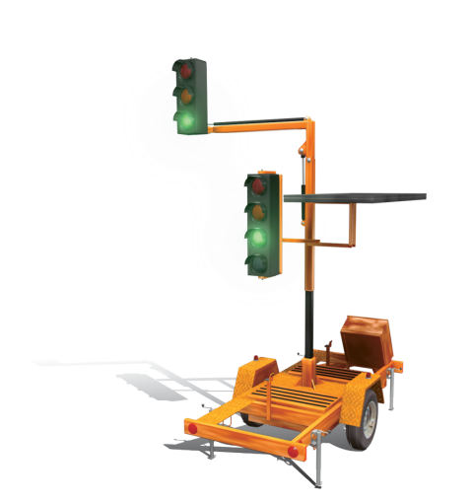
Traffic Responsive – Traffic Control
Temporary Signal Application
All the advantages of permanent traffic lights in a solar powered portable system.
Easy to operate and manouver.
Flexible: pre-programmed and user modes, traffic flow settings, vehicle detector, countdown display.
Notes:
Temporary traffic signal applications have been utilized for decades, for single lane alternating traffic flows for paving projects and bridge reconstruction projects. These applications are still very useful today and have expanded to four legged intersections and can now be easily tied into advance queue warning systems.

Slide 19
Vehicle Responsive
APPLICATION | EXAMPLES
Speed Warnings | Speed Limit Exceeded – Reduce Speed Now Your Speed XX MPH Slow Down – Lane Shift Ahead
Trucks Conflict Warnings Emergency Vehicle Warnings | Trucks Entering – When Flashing Trucks Merging 1000 ft – Prepare to Stop Trucks Crossing Ahead – Prepare to Stop Trucks Exiting Ahead – Do Not Follow Trucks Emergency Vehicle Approaching
Work Zone Intrusion Alert | Siren or Alarm Near Workers Do Not Follow Trucks – Return to Roadway
Oversized Vehicle Warning | Over Height Vehicle – Exit Now Low Bridge Ahead – Exit Now Overheight Vehicle When Flashing – Exit Now
Notes:
The following is a list of Vehicle Responsive application examples.

Slide 20
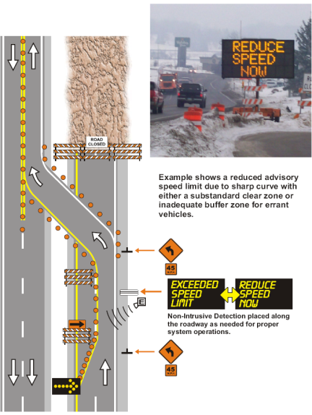
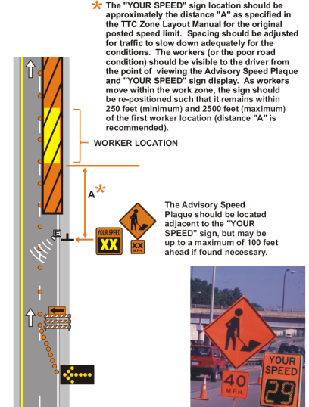
Vehicle Responsive – Conflict Warning
Speed Awareness Application
Notes:
Speed Awareness “Your Speed” or “Reduce Speed Now” or “Speed Limit Exceeded” responding to a specific vehicle entering an area too fast are excellent applications and can help solve site specific issues. These applications can be

Slide 21
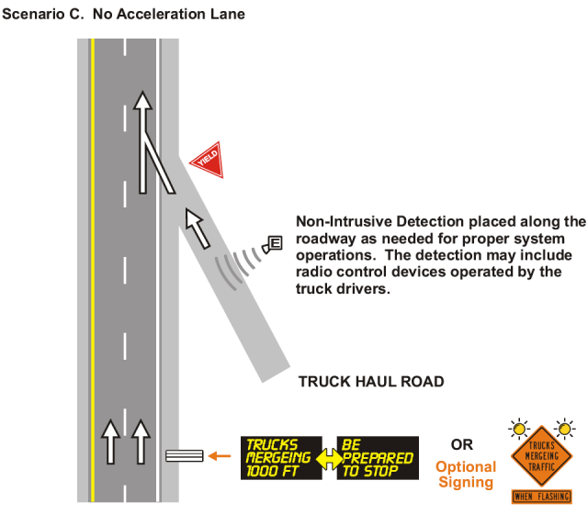
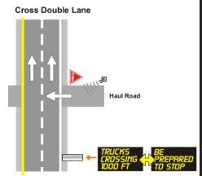
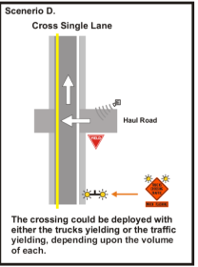
Vehicle Responsive – Conflict Warning
Truck Conflict Application
Notes:
This application can be used for
Trucks Entering / Trucks Exiting / Trucks X-ing
It can also be used to warn of emergency vehicles approaching with siren detection downstream.

Slide 22
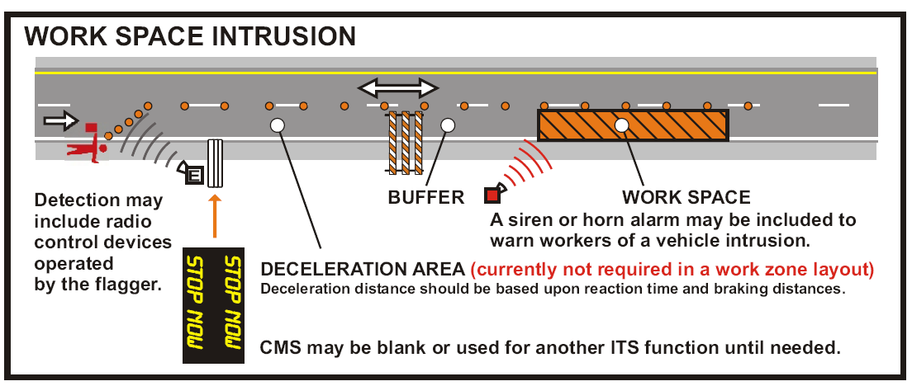
Vehicle Responsive – Conflict Warning
Work Zone Intrusion Application
Notes:
This application is vital for worker safety and warns workers of any vehicle entering a work area.

Slide 23
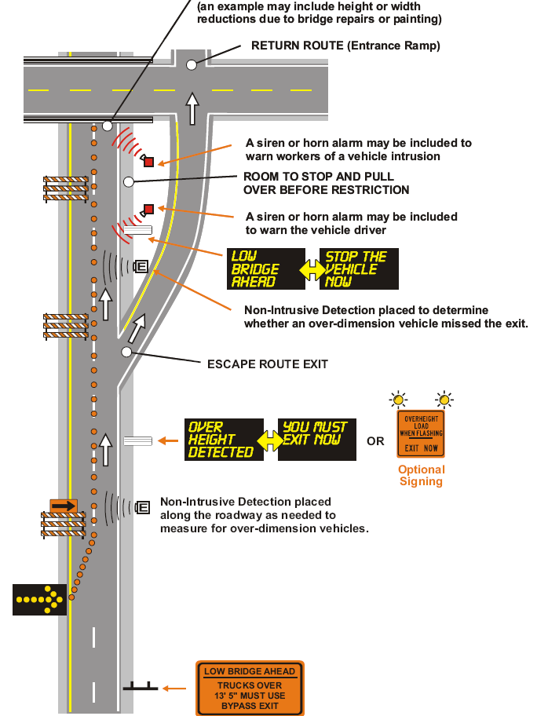


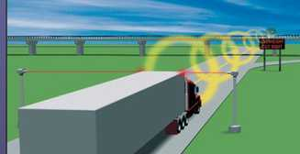
Vehicle Responsive – Conflict Warning
Oversized Vehicle Application
Notes:
This application is great for bridge work projects when clearance is reduced due to bridge repairs or painting.

Slide 24
Condition Responsive
APPLICATION | EXAMPLES
Hazardous Roadway Warnings | Ice on Bridge – Use Caution Water on Road – Reduce Speed High Cross Winds – Use Caution
Visibility Warnings | Fog Ahead – Reduce Speeds Reduced Sight Distance – Use Caution
Conditional Warnings | Changeable Work Zone Speed Limits
Notes:
This slide list several of the unlimited condition responsive applications.
High winds, ice, periodic flooding and Changeable WZ Speed Limits “When Workers are Present” are all common applications.

Slide 25
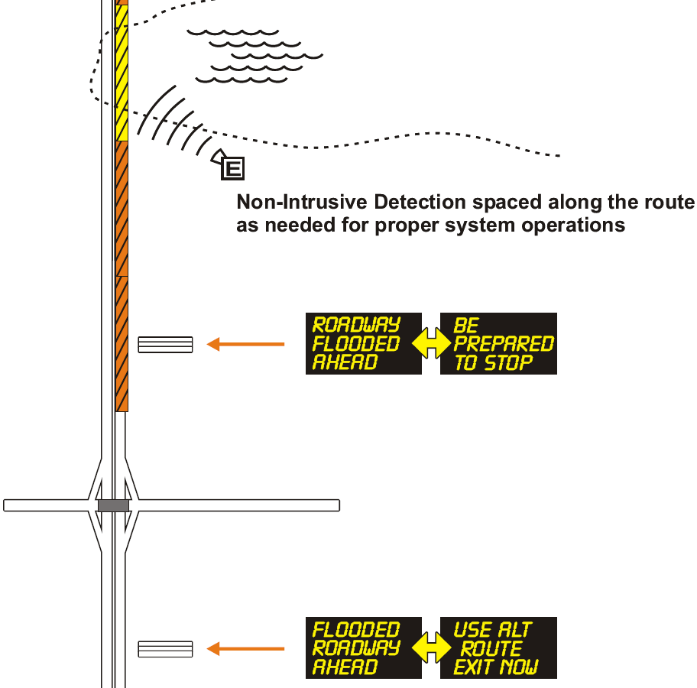
Condition Responsive – Conflict Warning
Flooded Roadway Application
Notes:
Often work zones require lane shifts and drainage cannot always be accommodated. This application can warn or reroute vehicles when periodic flooding occurs.

Slide 26


Condition Responsive – Traffic Control
Changeable Speed Limit Application
Notes:
For work zone speed limits to be respected, they must be realistic for the specific site conditions and may often only be further reduced when workers are actually present, to provide added safety. These applications can manually or by Time of Day change work zone speed limits to predefined speeds, thus gaining more compliance and respect and ideally reducing crashes.

Slide 27
SWZ System Design
Functionality – Unlimited Applications/Inputs/Outputs
Maintainability – Remote Monitoring replaces historical on-site activities. Significant events can be automatically sent to maintenance personnel.
Robustness – Auto reset if comm. is lost. Server has multiple redundancies.
Reliability – All things break. Design for 10 year life. Use proven equipment and always have spares handy.
Usability – Software interfaces should be easy and require no training.
Scalability/Flexibility – Well Designed SWZ’s should easily be able to add additional devices for minor money.
Performance – Every field device should be independent and communicate every 30 seconds to server (RF for Queue Warnings, Truck Entry)
Notes:
Functionality: Refer to the unlimited applications JamLogic can accommodate
Maintainability: We replace typical on-site maintenance with remote power and comm. monitoring, remote auto resets, etc.
Robustness: Loss of Comm = Blanking of signs (15 min) and auto remote reset (30 min)
Server redundancies can be expanded on here or discussed on later slide
Reliability: Everything breaks. We thoroughly test equipment and used field proven devices. MBF (mean time between failures) =10 years.
We have spare equipment available.
Usability: Demo the web interface now if possible or after the presentation. No training necessary, but can provide if needed. 3 clicks to get most info.
Scalability: Use Detroit example with 37 displays, 190 sensors and 30 cameras. Adding equipment after deployment is easy reconfiguration of software logic. Our competition charges heavy $$$ for additions, we charge unit costs with small reconfiguration fee.
Performance: Each device reports to server every 30 seconds. Optional RF comm. is even faster…refer to stand alone applications like Queue Warnings, WZ Intrusion, Truck Entry, Portable Signals…

Slide 28
Smart Work Zone
System Features
Transparent Web-based Access to All Devices & Data
Logging & History of Sensor Data & Signs & Events
Road Segment Congestion Coding
Streaming Video
Unlimited Users with Various Levels of Access & Control
Device Mapping & Listings with Active Status
Communications Diagnostics & Remote Resets

Slide 29

Smart Work Zone
Sensor Data – Anytime, Anywhere

Slide 30



Smart Work Zone
Mapping Example

Slide 31
Questions ?
Todd Foster
Traffic Technologies / JamLogic
toddf@traffic-technologies.com
612-661-4684

Slide 32
Intelligent Work Zone
Resources
Work Zone ITS Safety and Mobility Solutions—Guidance developed by ATSSA ITS Council
http://www.atssa.com/galleries/default-file/2008July21_ITS_Safety_and_Mobility.pdf
The USDOT has numerous resources on work zone planning, technology and operations:
ITS for Work Zones—Deployment benefits and lessons learned from ITS and work zones.
http://www.its.dot.gov/jpodocs/repts_te/14320.htm
Work Zone ITS & Technology—FHWA Office of Operations work zone ITS website.
http://www.ops.fhwa.dot.gov/wz/its/index.htm
Maryland State Highway Administration Lane Closure Analysis Program (LCAP)
http://www.sha.state.md.us/safety/workzone.asp
QuickZone Traffic Impact Analysis Tool—Delay estimation tool for work zones.
http://www.ops.fhwa.dot.gov/wz/traffic_analysis/wzta.htm#tools
Smart Work Zone Deployment Initiative—Information on the use of smart work zone systems.
http://www.ctre.iastate.edu/smartwz/index.cfm
Work Zone Safety and Mobility Rule—Guidance on addressing work zone safety and mobility laws.
http://www.ops.fhwa.dot.gov/wz/resources/final_rule.htm
Work Zone Traffic Analysis Strategies—Guidance on the use of work zone modeling tools.
http://www.ops.fhwa.dot.gov/wz/traffic_analysis/wzta.htm#tools

