Slide 1
Newport News Signal System
Master Plan and Implementation

Slide 2
The Project Overview
Feasibility Study and ITS Master Plan
Design Phase
  Development of a City Standard for central system and controllers
  Utility Make Ready Plans
  Incorporating ITS into the Design
  Resource sharing and redundancy
Construction Management / Operational Support

Slide 3
Feasibility Study and
ITS Master Plan
Established a Vision
Kept Key Stakeholders involved from the beginning
Prioritized functionality and anticipated cost
Schools
Engineering
VDOT
Central
Office
Planning
IT

Slide 4

Systems Engineering Approach
Develop an Operational Concept
Establish the needs of the users and the system
Conduct market research and finalize the functional requirements
Design against those requirements
Test according to the design

Slide 5
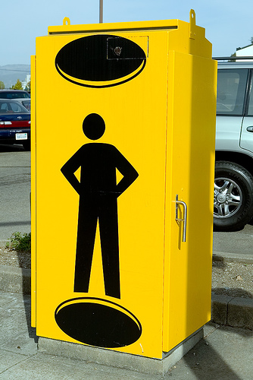
Establishing a City Standard
Historically ---
Software Procurement + Low Bid = Undesired Results
Maintain a competitive process
Working through procurement requirements
Mapping user needs to requirement and capabilities
Providing hands-on evaluations

Slide 6


System Design
~260 signals to be upgraded from TS-1 to TS-2
Two TOCs
Adding ITS Devices
Redundant Communication Network
  Resource Sharing with Schools and
  VDOT

Slide 7
Communication Design
20 Miles of Aerial
20 Miles of Fiber In New Conduit
20 Miles of Fiber in Existing Conduit
Redundant Communication Network
  Resource Sharing with Schools and
  VDOT

Slide 8
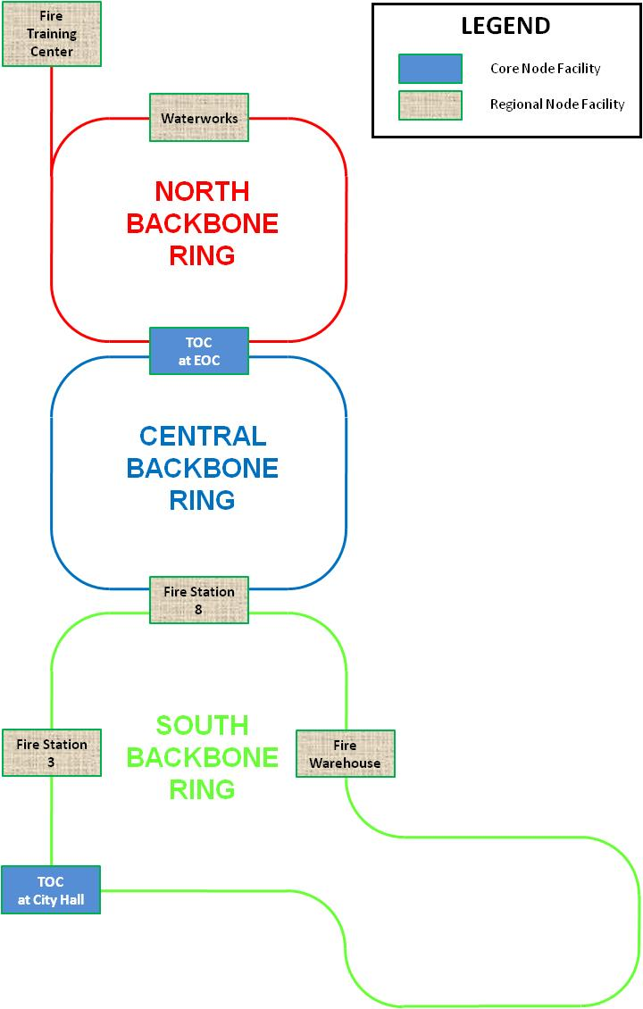
Three Communication Rings
Takes advantage of the natural benefits of parallel routes through the City
Takes advantage of difficult bridge/rail crossings with existing Schools fiber
Core node at both TOCs

Slide 9
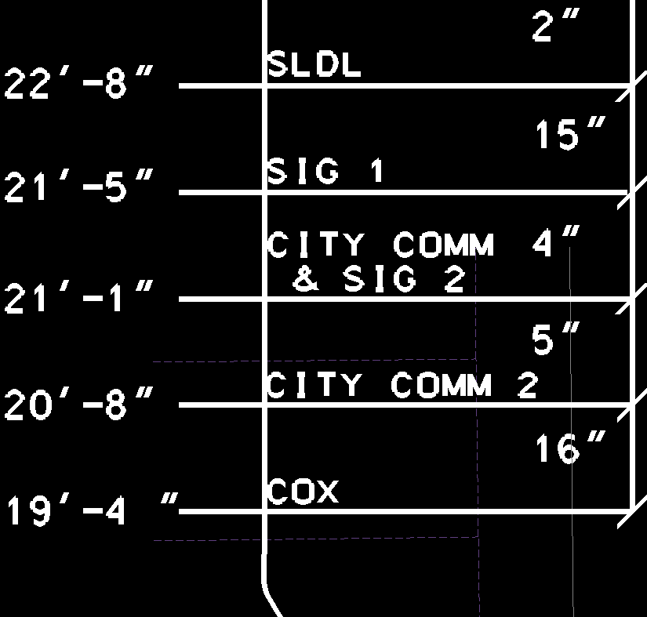
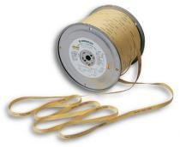
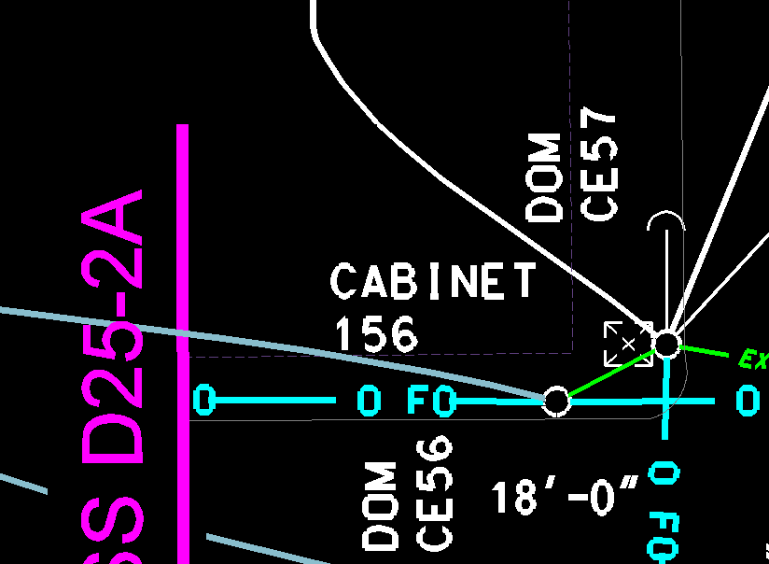
Utility Make Ready Plans
Working hand in hand with Utility Companies
Creating Right Of Way for communications
Installing pull ropes to reduce construction cost

Slide 10
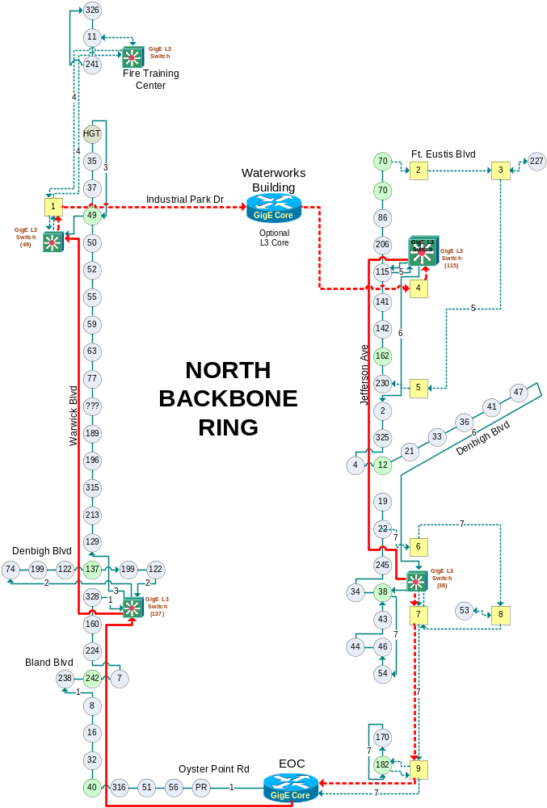
Ethernet changes everything
IP addresses everywhere
Plan like a network engineer
Think like a system administrator
Design against potential hackers
Build redundancies against single points of failure
Balanced use of Layer 2 switching and Layer 3 routing devices

Slide 11
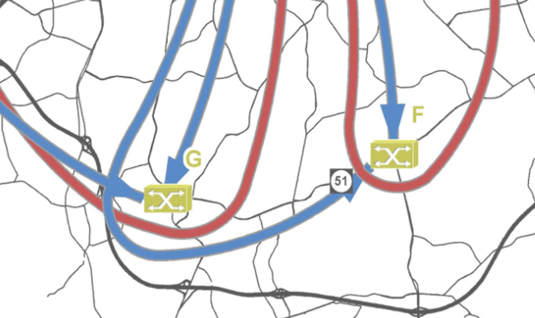


Example of Geographic IP Scheme
Charlotte, NC
A
B
A
B

Slide 12
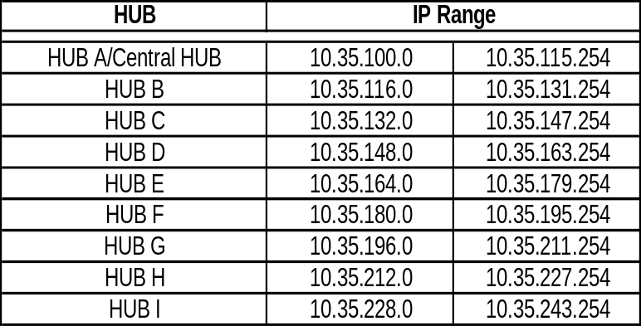
IP addressing and Network Security
Layout a geographic addressing scheme
More detail in Contractor instructions
Establish VLANs for field subsystems and central devices to lower security risks

Slide 13
Redundancy
Connect field switches to two different L3 switches
Use physical rings/routes where possible
Limit number of switches chained together (e.g. <30) to minimize recovery/re-routing times when an L3 router fails
Build in room for expansion

Slide 14
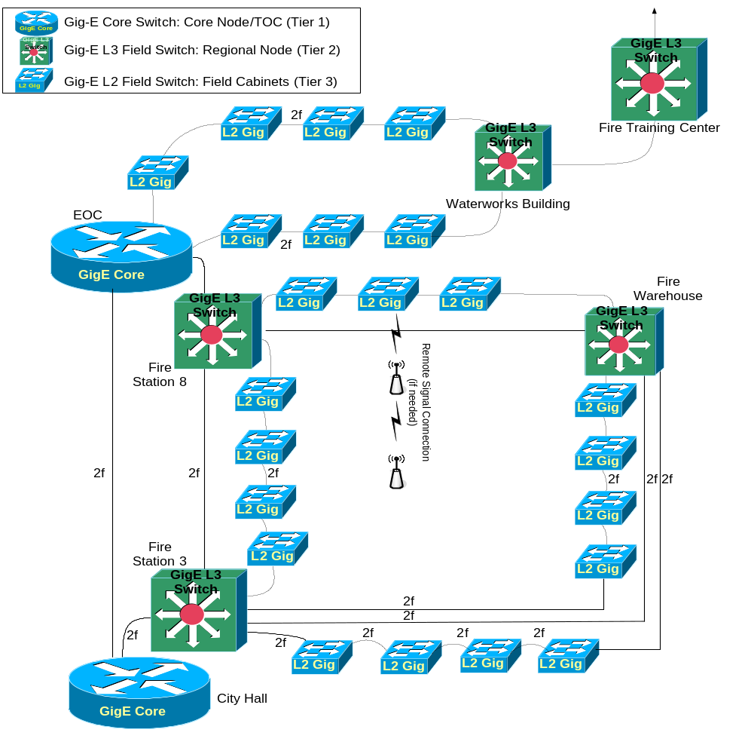
Three tiered-architecture
Least complex in the field cabinet; Most in TOCs
Limit end-to-end “hop” count

Slide 15
Lessons learned thus far?
Resource sharing will save the City nearly $2.5 to $3 Million in communication deployment
Use existing structures to minimize Right-of-Way acquisition delays
Finalize agreements beforehand or early in design

Slide 16
Construction Management Operational Support
Stay tuned - to be determined in 2012

Slide 17

Questions

